Slide 1
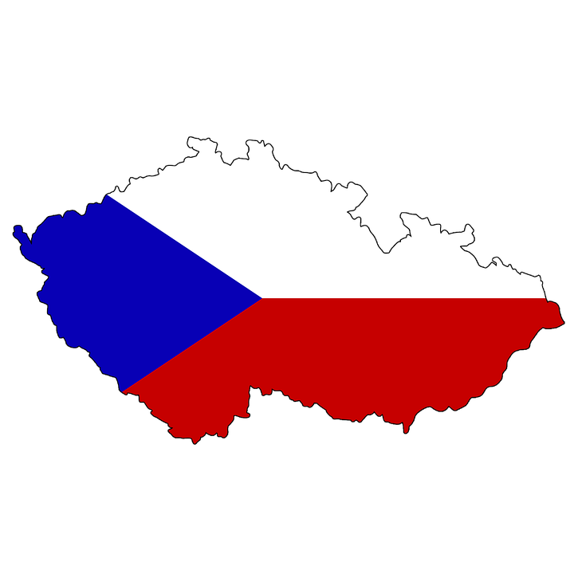
Palacky University in Olomouc
Czech Republic
doc. PhDr. Hana Marešová, Ph.D., MBA
Banska Bystrica, 30. 10. 2019

Slide 2
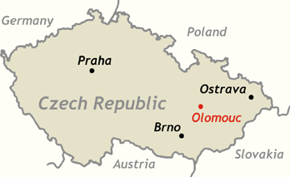
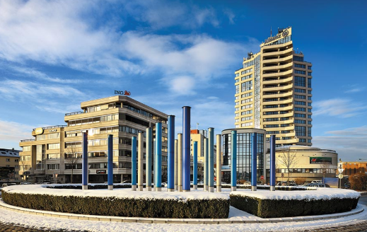
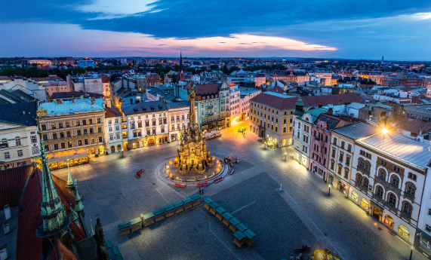
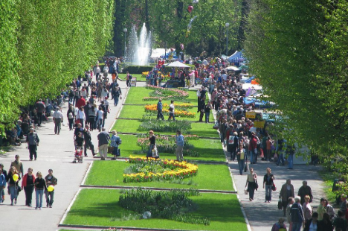
OLOMOUC
archeological evidences from 40 000 – 10 000 B.C. (young paleolith)
100.000 inhabitants

Slide 3
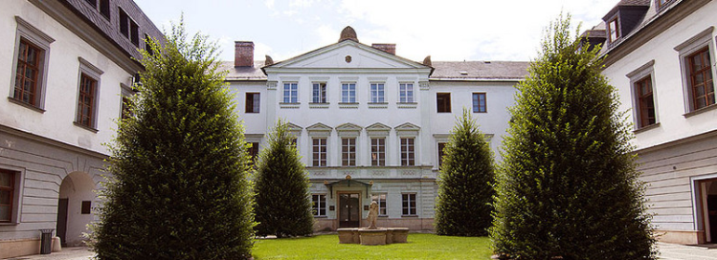
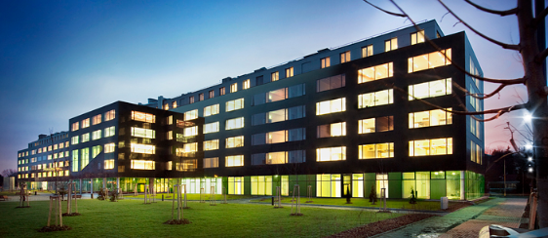
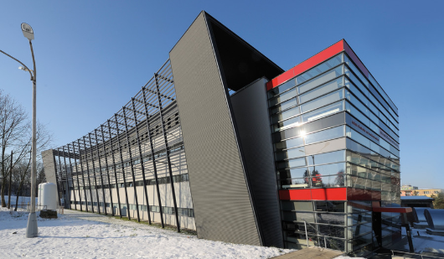
3.000 employees
20.395 students
2. oldest
1573
PALACKY UNIVERSITY
4.187 graduates/year
274 study programmes

Slide 4
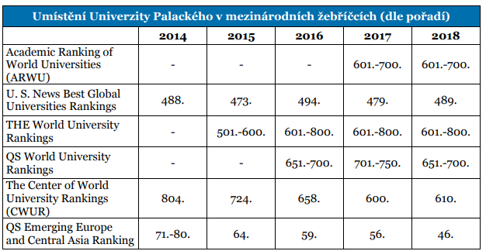
World University Rankings

Slide 5
Education System
8 faculties (Theology, Medicine, Health Sciences, Arts, Science, Education, Law, Physical Culture)
3 cycles following the Bologna principles:
BA (3 years) – MA (2 years) – PhD (3-4 years)
Study programmes in Czech, English, German, Russian
International students: 1.780/year from 52 countries
230 Erasmus+ students in 24 European countries
560 outgoing Erasmus+ students
200 outgoing student within other programmes

Slide 6
Humanities at Palacky University
Faculty of Arts
Department of English and American Studies
Department of Czech Studies
Department of Classical Philology
Department of General Linguistics
Faculty of Education
Department of Civics
Department of Czech Language and Literature
The Institute of Foreign Languages (English Department)

Slide 7
Civics at Palacky University
Faculty of Education
Department of Civics
Study programmes:
a) Civics with focus on education (BA) b) Teaching of Civics at secondary school (MA)
Actual research topics:
national and European Identity
migration, immigration, emigration and Europe
transformations of Czechoslovak and Czech Statehood in the Central European and European Context
Reviewed journal: Civilia

Slide 8
Linguistics at Palacky University
Faculty of Education
Department of Czech Language and Literature
Study programmes:
a) Czech language in education (BA) b) Teaching of Czech language at secondary school (MA) c) Didactic of Literature (PhD)
Actual research topics:
a) reading literacy b) media and communication literacy c) area of children's literature
Reviewed journal: Language-Literature-Communication

Slide 9
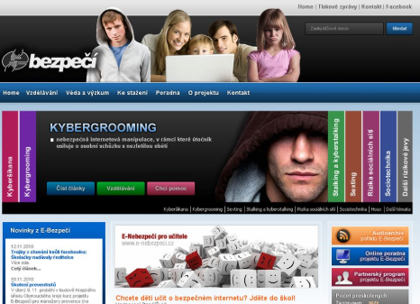
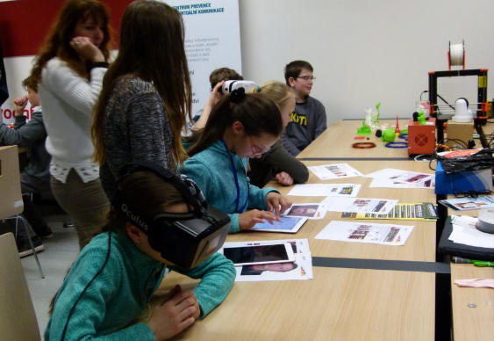
Linguistics at Palacky University
ACTUAL PROJECTS
on DIGITAL CULTURE
IN LANGUAGES
3D virtual enviroments in mother tongue teaching
Cybercommunication risks
Designing and creating of digital materials for language teaching

Slide 10
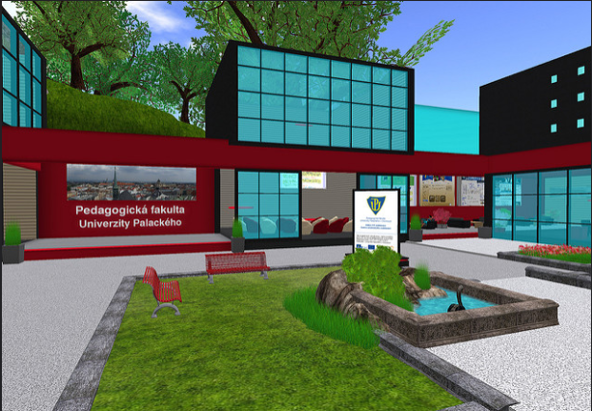
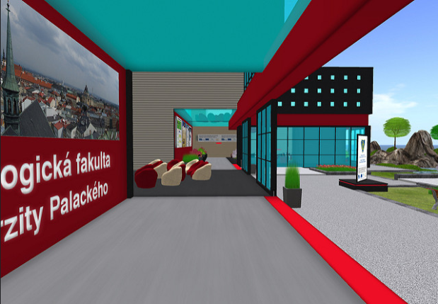
Linguistics at Palacky University
3D virtual building of Faculty of Education

Slide 11
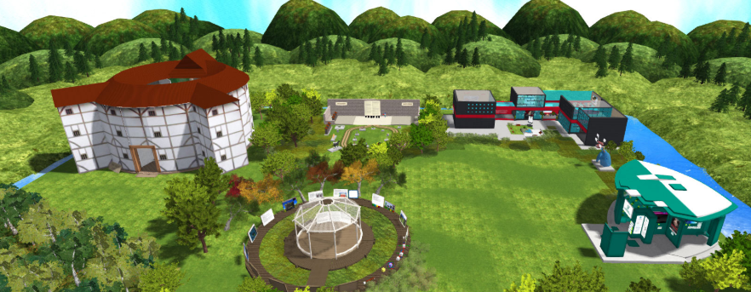
Linguistics at Palacky University
3D virtual enviroment in mother tongue teaching

Slide 12
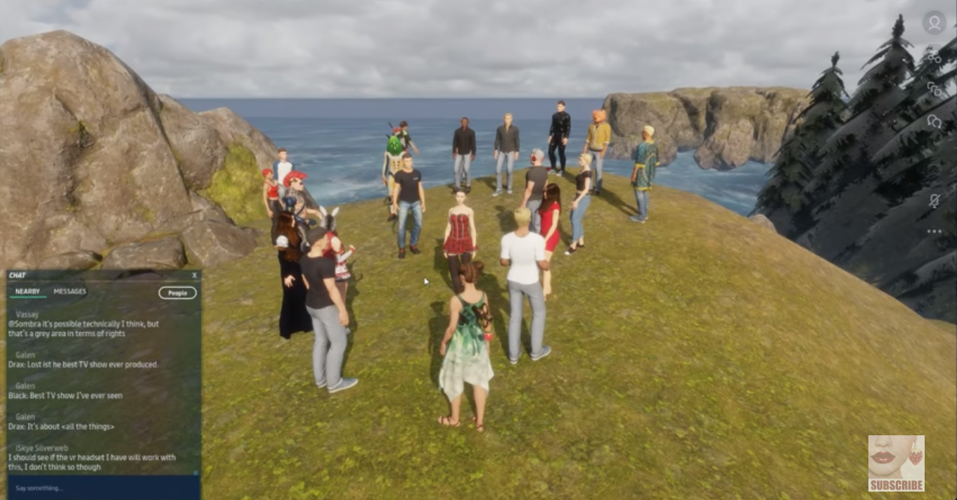
Linguistics at Palacky University
Research the impact of 3D virtual worlds on learning results

Slide 13
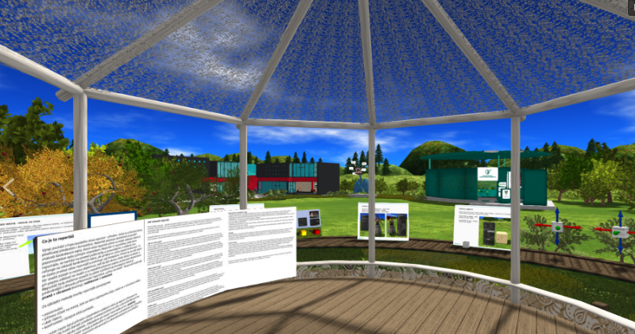
Linguistics at Palacky University
Comparing of traditional language teaching and teaching in 3D virtual worlds

