Slide 1



Reflection of the National and European Identity in the New Millennium (NAETINEM)
Banská Bystrica, Slovakia
Lujza Urbancová

Slide 2
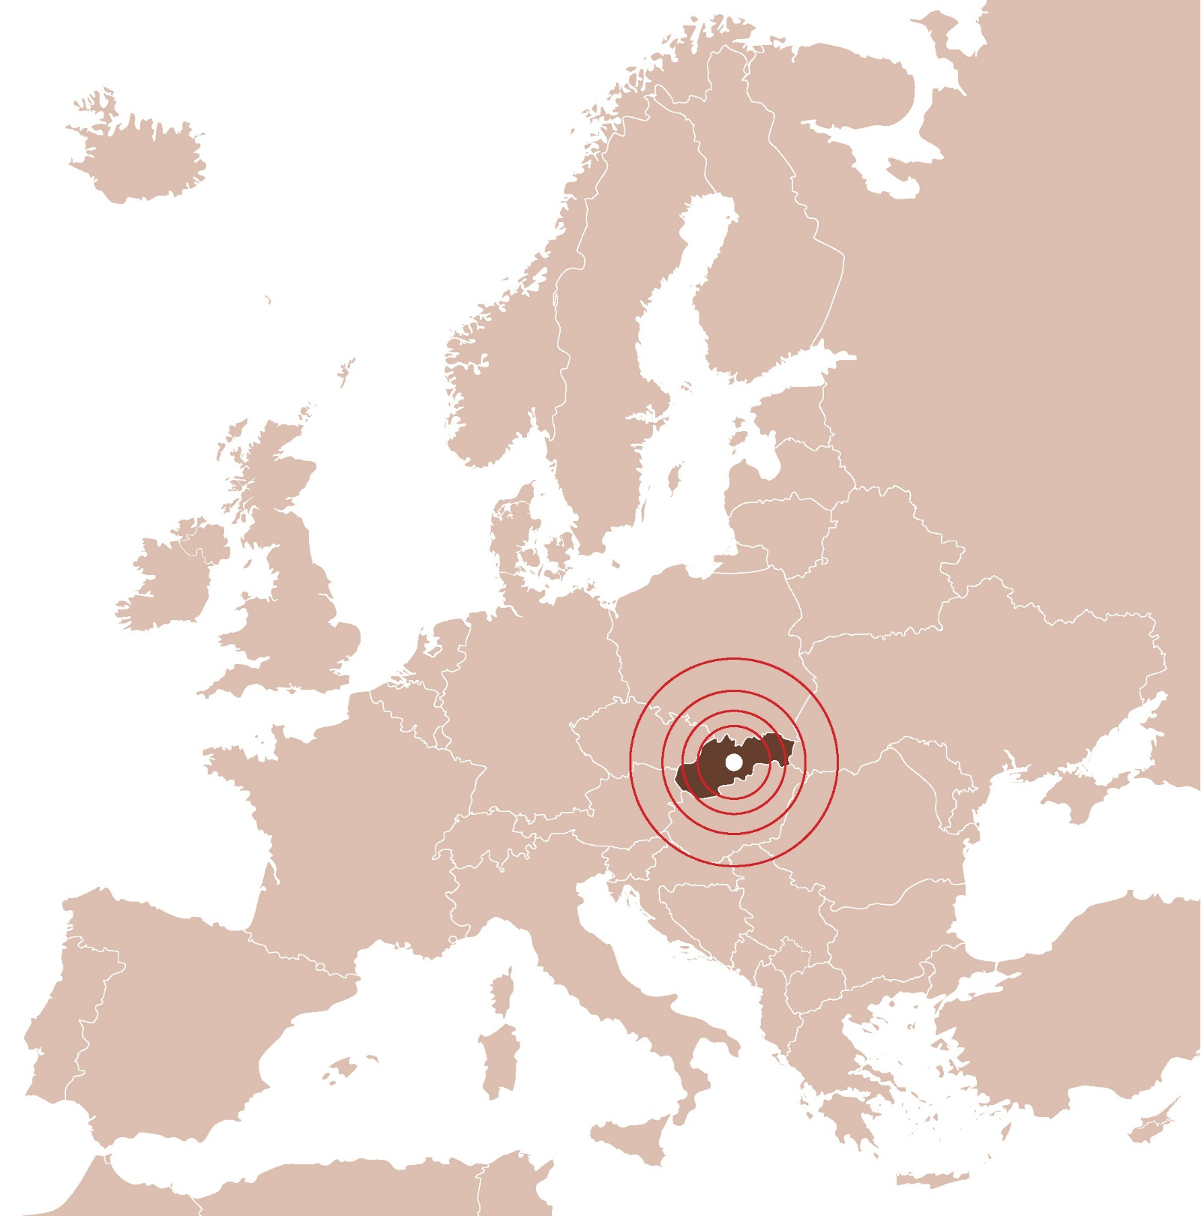

www.umb.sk

Slide 3
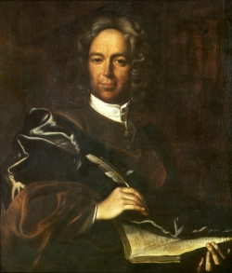


EDUCATION CREATES THE FUTURE - BE THE FUTURE!
MATEJ BEL UNIVERSITY IN BANSKÁ BYSTRICA

Slide 4
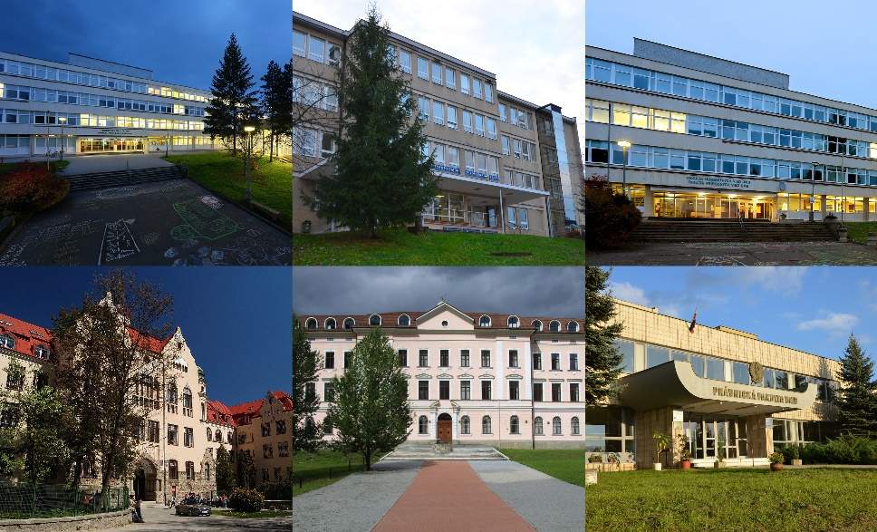






FACULTIES OF MBU
Faculty of Economics
Tajovského 10, 975 90 Banská Bystrica
+421-48-446 21 11
http://www.ef.umb.sk
Faculty of Arts
Tajovského 40, 974 01 Banská Bystrica
tel. +421-48-446 71 11
http://www.ff.umb.sk
Faculty of Political Sciences and International Relations
Kuzmányho 1, 974 01 Banská Bystrica
tel: +421-48-446 12 21
http://www.fpvmv.umb.sk
Faculty of Education
Ružová 13, 974 11 Banská Bystrica
tel: +421-48-446 41 11
http://www.pdf.umb.sk
Faculty of Natural Sciences
Tajovského 40, 974 01 Banská Bystrica
tel: +421-48-446 71 11
http://www.fpv.umb.sk
Faculty of Law
Komenského 20, 974 01 Banská Bystrica
tel: +421-48-446 31 11
http://www.prf.umb.sk

Slide 5






MBU IN NUMBERS
7056
STUDENTS
INTERNATIONAL
STUDENTS FROM OVER 21 COUNTRIES ALL OVER THE WORLD
6
FACULTIES
44
FIELDS
OF STUDY
444
STUDY
PROGRAMMES
3
EXCELLENCE CENTRES

Slide 6

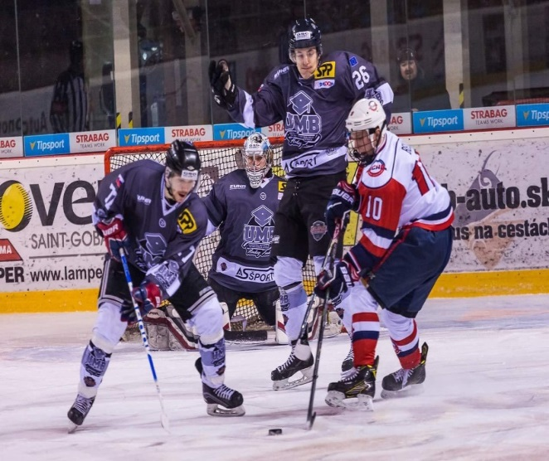
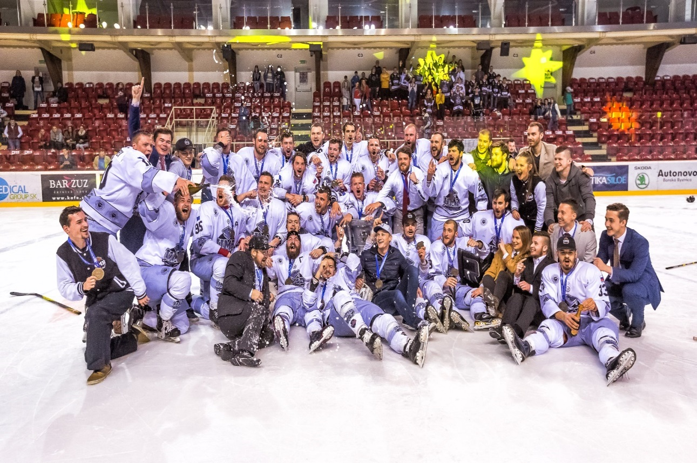
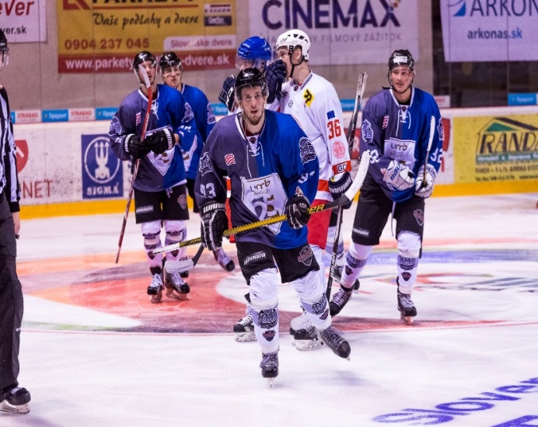
UMB HOCKEY TEAM

Slide 7
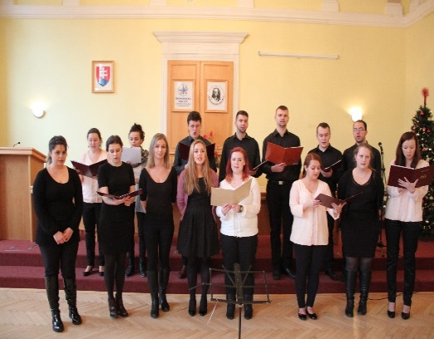
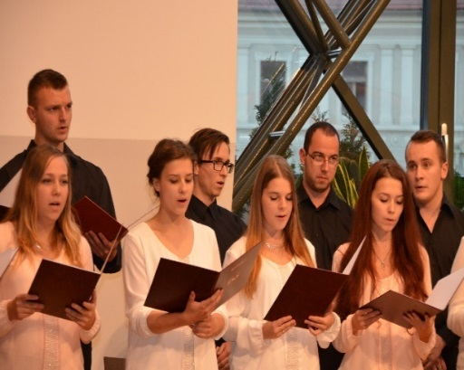
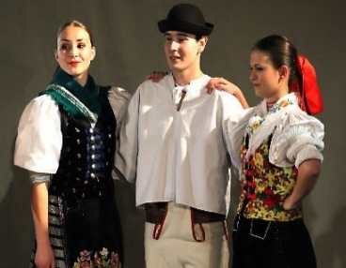
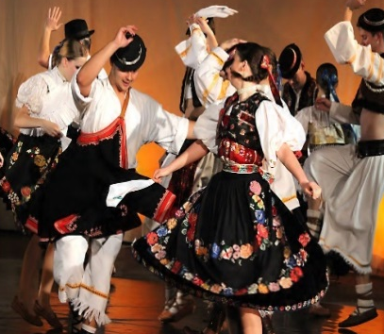
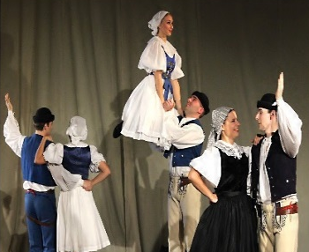
ARTISTIC ENSEMBLES

Slide 8
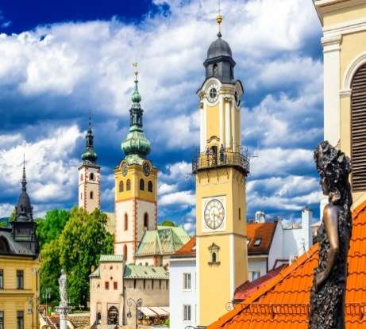
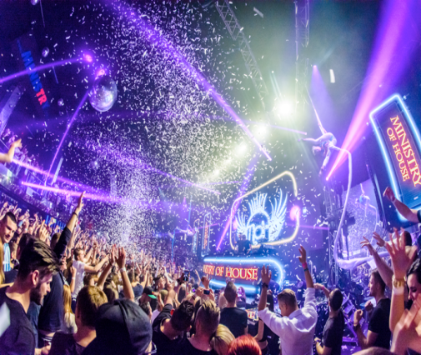
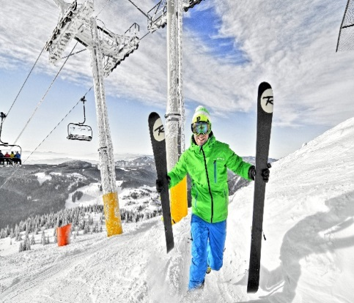
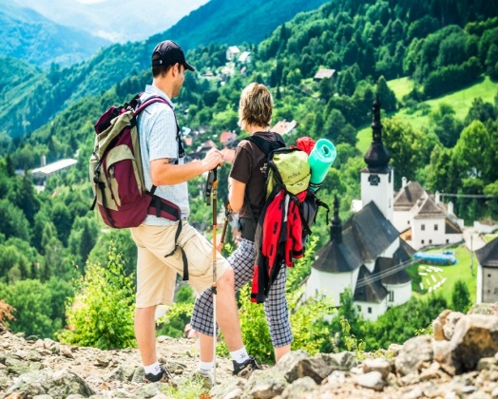
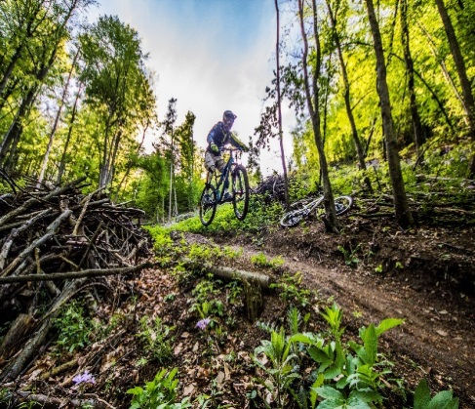

www.umb.sk
EDUCATION CREATES THE FUTURE - BE THE FUTURE!
MATEJ BEL UNIVERSITY IN BANSKA BYSTRICA

Slide 9
National identity ⇨ nation
National identity can be understood as a specific form of human existence. A person becomes a part of it through diverse mechanisms of identification;
e. g. identification with:
a street, town, region, country,
language,
culture,
sport,
history.
National identity is a narrative construction, it can be constructed by historical books, media, content of school education, political parties etc.

Slide 10
National identity ⇨ nation
Contemporary national identity as a conflict between
globalism and localism,
universal and individual,
collective and individual (nation as a collective or a group of individuals),
homogeneous society and heterogeneous society.
Whose perspective is the main in describing the national identity? (Diverse groups in one nation, smaller groups...)
Multi-identity, fluid identity.

Slide 11
Paradox:
ancient nation (seen by nationalists)
vs.
young nation (seen by historians)

Slide 12
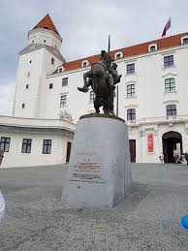
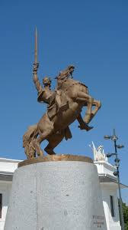
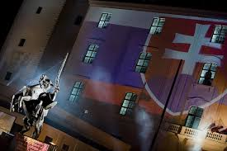
Svätopluk – the king of old Slovaks or Slavs

Slide 13
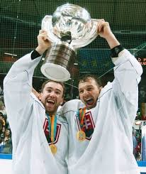
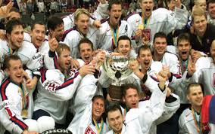
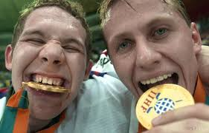
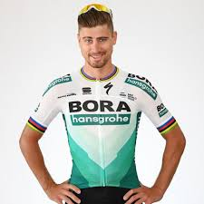
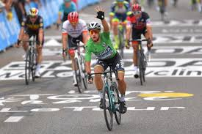
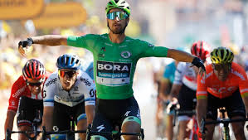
Sport – hockey team, cycling

Slide 14
National stereotypes
Slovaks as
a generous nation,
„My sme národ holubičí, nikto nám nič nedožičí, každý na nás iba kričí, je to o nás známe...“ (Slovak song).
(We are a dove nation, nobody indulges us, everybody shouts at us, it is well known about us...)

Slide 15
Slovak National Anthem
Nad Tatrou sa blýska
Nad Tatrou sa blýska
Hromy divo bijú
Zastavme ich, bratia
Veď sa ony stratia
Slováci ožijú
To Slovensko naše
Posiaľ tvrdo spalo
Ale blesky hromu
Vzbudzujú ho k tomu
Aby sa prebralo
There Is Lightning Over Tatras
There is lightning over the Tatras,
thunder beats wildly.
Let us stop them, brothers
after all, they will disappear,
the Slovaks will revive.
That Slovakia of ours
has been fast asleep so far.
But the thunder's lightning
is rousing Her
to awake.

