Slide 1
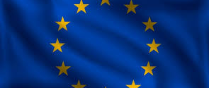
Remembering the First World War – Learning Series Part 4
Project No. 2019-1-CZ01-KA203-061227, Reflection of National and European Identity in the New Millennium (NAETINEM), 05.11.2021

Slide 2
1. Introduction:
In the first part of the learning series you have dealt with different types of memory places.
In the coming units, we will now deal with the forms of memory of different nations. We started with the places of remembrance in Germany. We continued with the current handling of France's memory of the First World War. Finally, we will deal with the current attitude and memory of Great Britain.

Slide 3
1. Introduction:
November 11 is celebrated every year in Great Britain as Remembrance (Sun)Day. It is the day of the armistice at the end of the First World War. A ceremony is held to commemorate and remember the British and Commonwealth dead. During this ceremony wreaths are laid at a monument.
a) Watch the video of the Queen's wreath laying ceremony on Remembrance Day 2014. https://www.youtube.com/watch?v=A56e-IhIW14&t=218s
b) What do you notice? How does the ceremony affect you? Record your results in writing and then share them with your group.

Slide 4
2. Basics:
a) Now look at the photos of M1. What do you see? Then read the text (M2) about it. What do you think of the installation? Discuss it together in your group.
b) How do you think the commemoration of the First World War is being shaped in the UK? To whom is the remembrance addressed? Who is involved (other countries, which groups of people, ...)? Put your thoughts in writing.

Slide 5
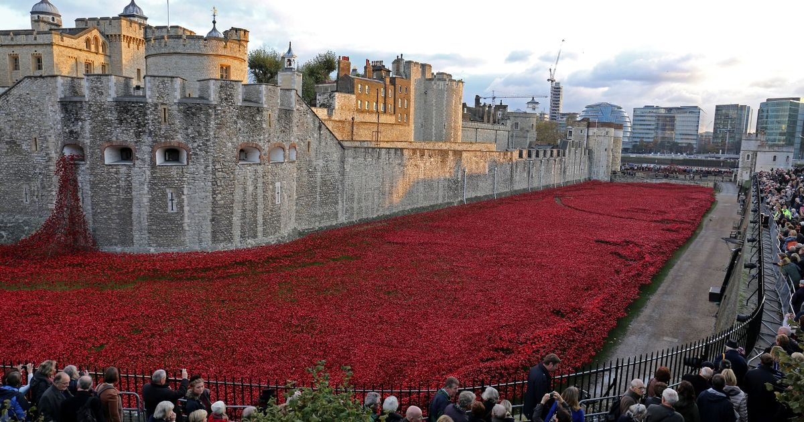
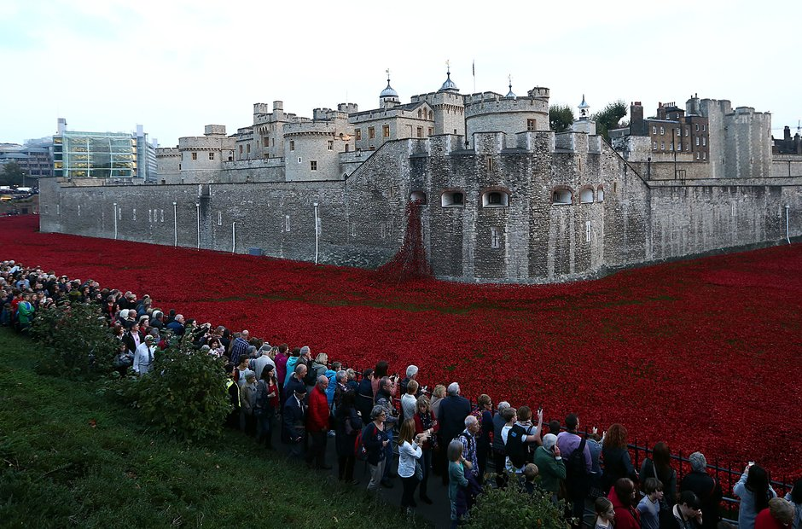
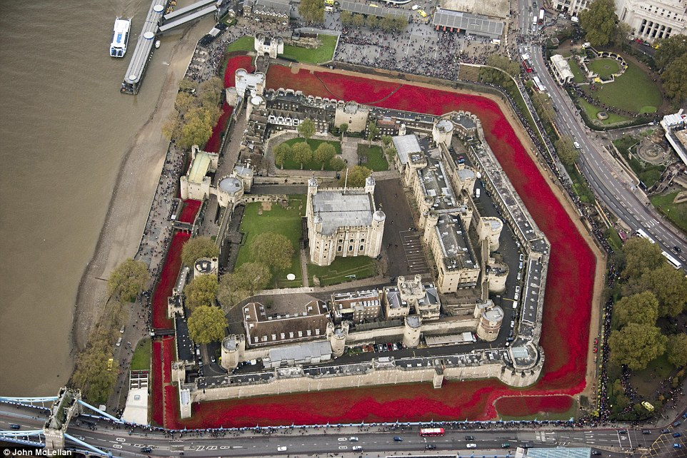
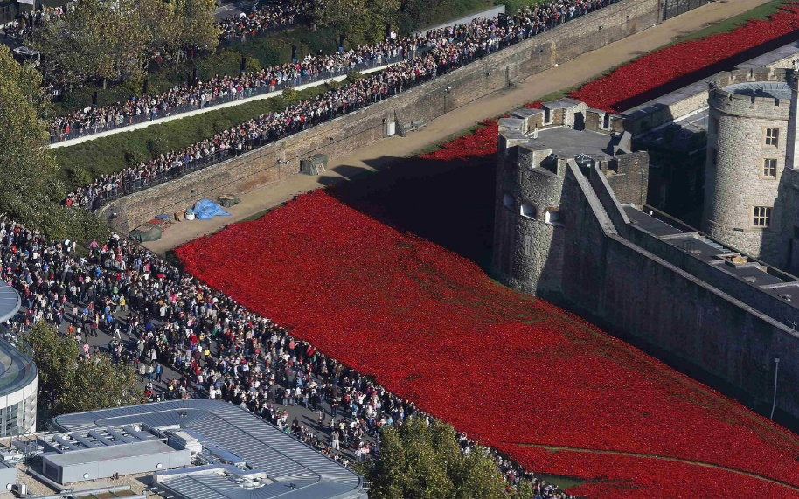
M1

Slide 6
M2
The photos show the "Blood Swept Lands and Seas of Red" installation of over 800,000 ceramic poppies in the moat of the Tower of London.
Each poppy blossom represents a soldier who died in the First World War. The last poppies were added on the eve of Remembrance Day on November 11, by Prime Minister David Cameron. Every citizen could buy a ceramic moonflower for 25 pounds and thus contribute to the creation of the installation.
On Remembrance Day in Great Britain, many citizens wear small paper poppy pins. Politicians and members of the royal family also wear them at official ceremonies on this day.
It is considered a symbol of remembrance of those who died in the First World War. Poppies were very common on the Western Front. They grew in the ground churned up by the fighting and thus sometimes covered vast areas.

Slide 7
3. Elaboration:
Remembrance in the UK of the First World War is very much confined to a national framework. The year 2018, which marks the 100th anniversary of the end of the First World War, is also marked by remembrance. However, the wreath-laying ceremony at the Cenotaph on Remembrance Day was attended by a German guest for the first time this year.
a) First, read the article (M3).
b) London describes Steinmeier's visit and the wreath-laying ceremony as a "historic act of reconciliation". What is the British government's attitude toward Steinmeier's visit? Also consider why the British government might have invited Mr. Steinmeier. Record your thoughts in writing.

Slide 8
Steinmeier performs "historic act of reconciliation" in London
German President Frank-Walter Steinmeier chose something special to commemorate the end of the First World War: He laid a wreath at the memorial service in London - the first German head of state to do so.
London
German President Frank-Walter Steinmeier was the first German head of state to take part in the traditional commemorations in Great Britain to mark the end of the First World War. On the 100th anniversary of November 11, 1918, he laid a wreath in the colors black-red-gold at the memorial in central London on Sunday. The government in London regarded this as a "historic act of reconciliation".
Steinmeier attended the ceremony together with Prince Charles, heir to the British throne. Charles was the first to decorate the memorial with a wreath on behalf of Queen Elizabeth. The 92-year-old followed the proceedings from a nearby balcony. Steinmeier's wife Elke Büdenbender and Duchess Meghan, wife of Prince Harry, watched the ceremony together. The heavy rain in the morning had subsided in time.
Together with the Queen to the church ceremony
Attached to the Federal President's wreath was a short handwritten text that read in English, "Honored to commemorate here side by side, grateful for reconciliation, hopeful for a future of peace and friendship. Frank-Walter Steinmeier." The German president, like the British guests, wore an artificial red poppy on his lapel, the traditional symbol of World War commemoration in Britain.
In the evening, the President planned to attend a church ceremony at Westminster Abbey together with the Queen. Also on the agenda were a meeting with Prince Charles for a cup of tea at his residence Clarence House and a visit to an exhibition at the Tate Modern museum on the art of "Magical Realism" during the Weimar Republic.
M3

Slide 9
3. Elaboration:
c) Imagine you are a member of the British Parliament. You were present at the Remembrance Day ceremony. Write a letter to another member of the British Parliament in which you comment on Steinmeier's participation. Read your letters to each other and discuss them.

