Slide 1
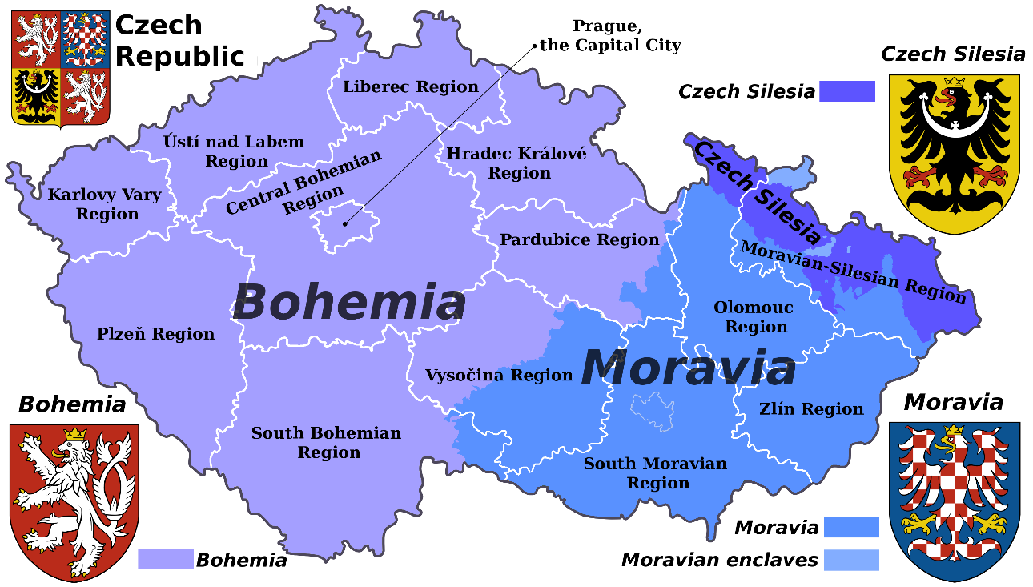
History of Czech Enclaves in the World
Notes:
Links:

Slide 2
Czech Republic history
prehistoric human settlements in the area dating back to the Paleolithic era
In the 3rd century BC – Celtic migrations, Bohemia associated with the Boii
1st century – Germanic tribes of the Marcomanni and Quadi
6st century – Slavs from Black Sea Carpathia region settled in the area – Bohemia, Moravia part
7th century – Frankish merchant Samo who supported the Slavs fighting against nearby settled Avars, became the ruler of the first documented Slavic state in Central Europe – Samo´s Empire
8th century – principality of Great Moravia, controlled by Moymir dynasty
Notes:
Links:

Slide 3
Czech Republic history
9th century – the Duchy of Bohemia emerged when it was unified by the Přemyslid dynasty
Bohemia was from 1002 until 1806 an Imperial State of the Holy Roman Empire
After 1526 Bohemia came increasingly under Habsburg control as the Habsburgs became first the elected and then in 1627 the hereditary rulers of Bohemia
Between 1583 and 1611 Prague was the official seat of the Holy Roman Emperor Rudolf II and his court
The end of the Holy Roman Empire in 1806 led to degradation of the political status of Bohemia which lost its position of an electorate of the Holy Roman Bohemian lands became part of the Austrian Empire.
Notes:
Links:

Slide 4
Czech Republic history
During the 18th and 19th century the Czech National Revival began its rise, with the purpose to revive Czech language, culture, and national identity.
The Revolution of 1848 in Prague, striving for liberal reforms and autonomy of the Bohemian Crown within the Austrian Empire, was suppressed.
In 1918, during the collapse of the Habsburg monarchy at the end of World War I, the independent republic of Czechoslovakia was finally created, with president Tomáš Garrigue Masaryk in the lead.
Notes:
Links:

Slide 5
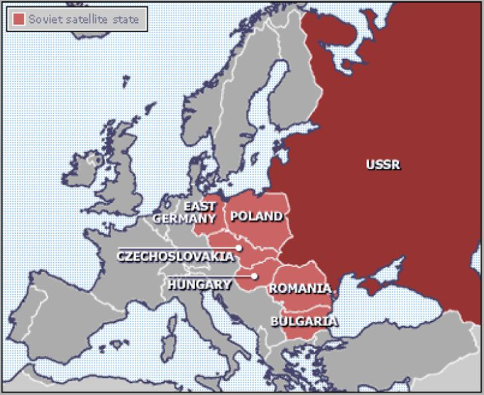
Czech Republic history
Soviet satellites pre 1991
After WW2, between 1945 and 1949, Stalin created a Russian empire influence in Eastern Europe.
This „empire“ included Poland, Hungary, Romania, Bulgaria, Czechoslovakia and East Germany.
Each state had a Communist government.
Notes:
Links:

Slide 6
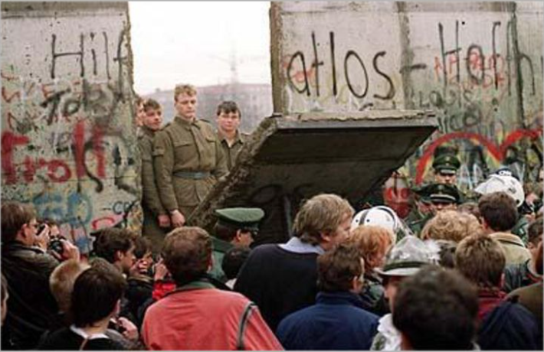
The End of the Cold War
1948 – The Berlin Blockade
1953 – Soviet tanks crushed dissent in East Germany
1956 – Hungarian uprising
1961 – The Berlin Wall
1968 – Czechoslovakia (socialism with a human face)
1980 – Polish dissent crushed by Soviet troops
Soviet troops were still stationed in all these countries by the end of the Cold War as a buffer for the USSR and to maintain friendly governments in power
7) 1985 – Gorbachev leads the USSR. Denies the Brezhnev doctrine of militarily propping up communist leaders in the satellite states no matter what. President Reagan – „Mr Gorbachev tear down this wall.“
8) 1989 – November 9, the Berlin Wall comes downa and the Cold War ends.
9) 17. November 1998 – the Velvet Revolution in the Czechoslovakia
10) By 1990, the former communist leaders were out of power, free elections were held, and Germany was whole again
In Poland, Hugary, East Germany and Czechoslovakia, newly formed centre-right parties took power for the first time since the end of WW2.
Notes:
Links:

Slide 7
Why did the USSR collapse so suddenly?
Stagnation in the 1970s
Declining world power in the 1980s
Grain from the US and loans from Europe
A command economy fails to deliver.
Satisfying consumers was not a priority.
To get an apartment in the 1980s, one had to wait 15-30 years in Poland and up to 20 years in Bulgaria. A quarter of those on the Soviet waiting to it were already pensioners.
Would be car buyers in East Germany had to place their orders 15 years in advance
To save money, to Romanian dictator, Nicolae Ceaucescu, put all citizens on a low calorie diet
Other reasons:
the USSR could not match Reagan´s arms race
Afghanistan – a drain on the economy and morale
The USSR declined to intervene in any of the revolutions of 1989, as it was already committed to unilateral withdrawal from Eastern Europe.
Notes:
Links:

Slide 8
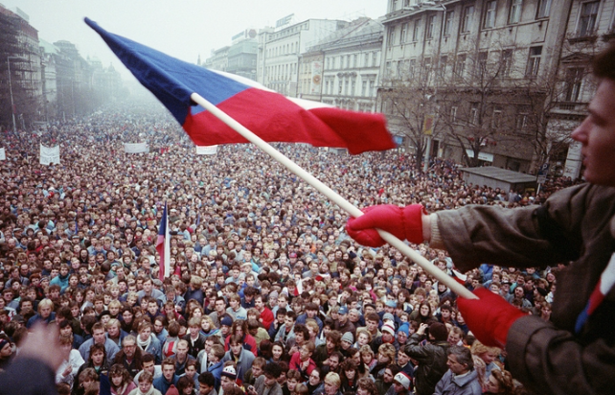
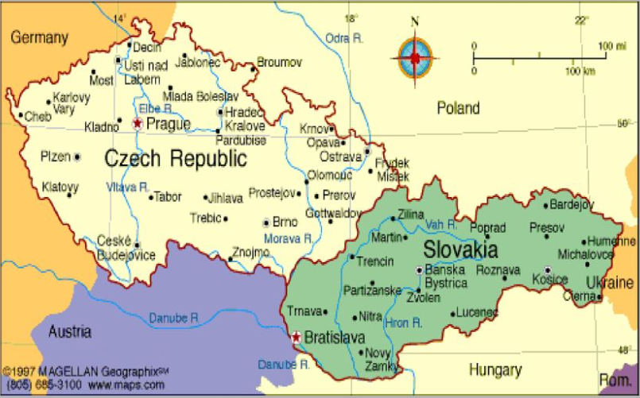
Czechoslovakia after 1989
As the Wall came down and the fears of a Soviet reaction receded, the dominoes started falling at a quickened pace.
In October 1989, riot police arrested hundreds in Prague after an unsanctioned demonstration, only weeks later, hundreds of thousand gathered in Prague to protest against the government.
In 17. November 1989, the Velvet Revolution started.
Alexander Dubcek, the reformist communist who led the Prague Spring in 1968, made his first public appearance in over two decades.
A new, non-communist government took the country´s reins on December 1989 and ond December 29, Vaclav Havel, the famed playwrighter and dissident, was elected President. He resigned in 1992.
1993 – Czechoslovakia splits in the Czech Republic and Slovakia.
Notes:
Links:

Slide 9
Czech Republic history
The Czech Republic and Slovakia, in 1993, both these countries joined the EU in 2004.
NATO also expands – Poland, Hungary and the Czech Republic joind in 1999, Slovakia, Estonia, latvia, Lithuania, Romania and Bulgaria in 2004.
This is despite an unwritten agreement that the West would not „poach“ former members of the USSR.
GDP has increased – five fold in the Czech Republic since 1989.
Life expecgtancy in Eastern Europe up (69-73 years), alcohol consumption down.
Notes:
Links:

Slide 10
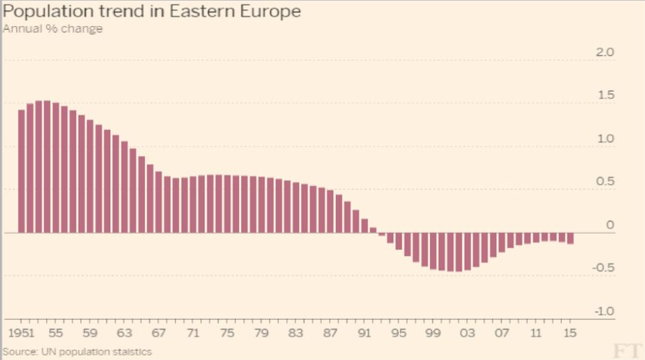
Population trend in Eastern Europe
Overall population down from 310 million in 19990 to 292 million now.
Notes:
Links:

Slide 11
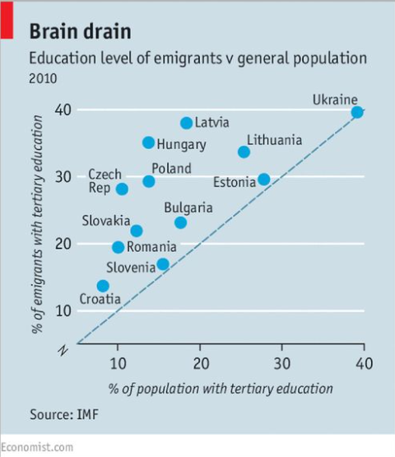
Why is that happening?
Emigration – better welfare and higher earning (in the UK and Ireland, Finland etc.) – workers are leaving
Falling birth rates – Eastern European women had an average of 2.1 children each in the late eighties. Ten years later this had dropped to 1.2. German birth rates the lowest.
As GDP per capita increases in these countries, net emigration should slow down. This is already happening in the Czech Republic and Slovakia where the per capita GDP is 80 % of the EU average.
Notes:
Links:

Slide 12
Some are coming back home…
Jobs are easy to find – unemployment rates run to a remarkable 2,9 % in the Czech Republic.
That drives wages higher – salaries are up 5 % in the Czech Republic compared with a year ago.
Tax levels, compared with western Europa, are rock-bottom: the top income-tax rate is just 25 % in Slovakia and 10 % in Bulgaria.
Cheap housing is another lure – per square metre, a flat in Prague costs about half as much as one in Dublin, and one-seventh as much as in London.
Home sickness and family forces at play.
Notes:
Links:

Slide 13
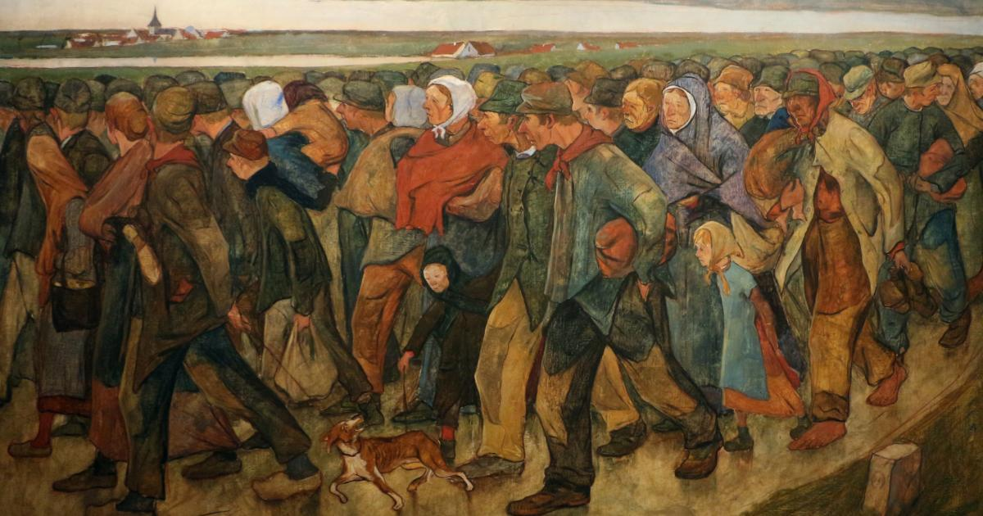
History of the Czech emigration
Notes:
Links:

Slide 14
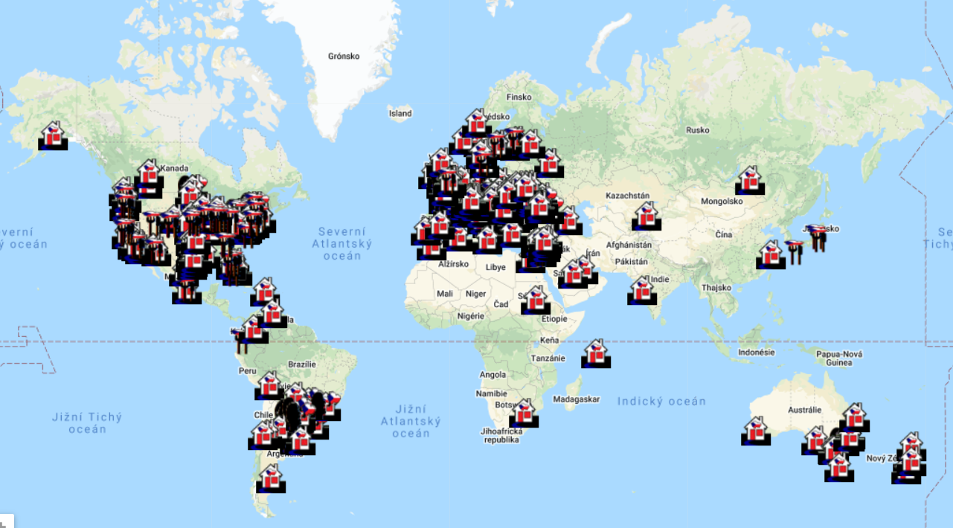
Current Czech communities in the World
Notes:
Links:

Slide 15
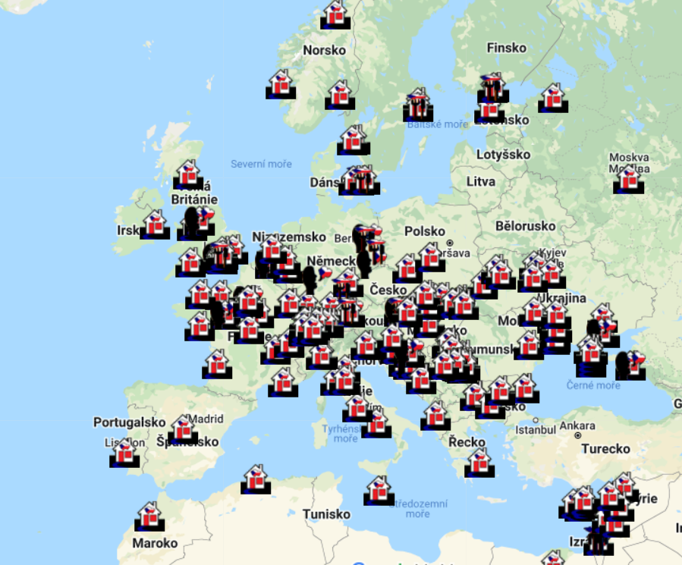
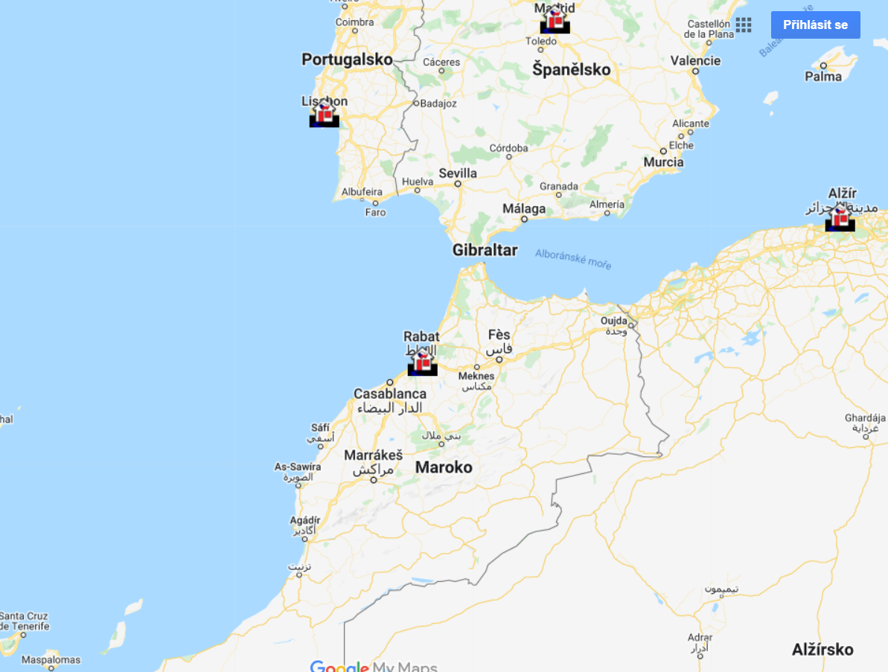
Current Czech communities in Europe (Africa)
Notes:
Links:

Slide 16
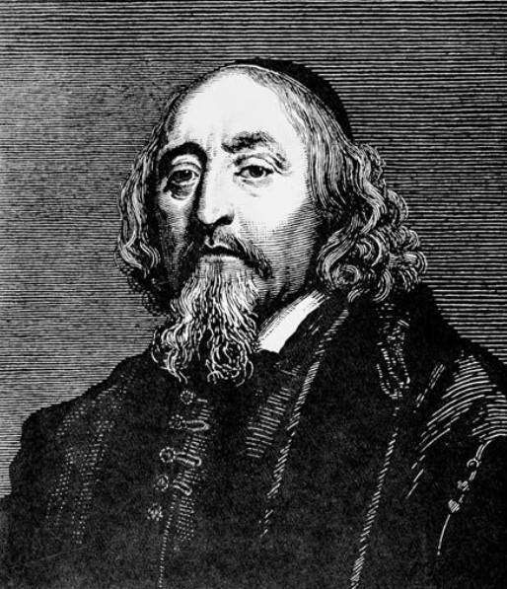
History of the Czech emigration
Religious reasons
The first mass exodus: the Czech Brethren emigration after the defeat of the Estates' Resistance in 1547. Its steps led to Poland and Poznan.
The second mass emigration: the gradual departure of non-Catholics after the Battle of Bila Hora in 1620.
First the noble participants in the resistance left, then the Protestant priests and teachers, followed by the townspeople. Then whole families left their homes.
The Czech nobleman Vilém Slavata of Chlum and Košumberk states in his Memoirs that a total of 36,000 Protestant families emigrated. Among them were Jan Ámos Komenský (Comenius), Pavel Skála, Pavel Stránský, Václav Hollar, Karel the Elder from Žerotín.
Saxony became the main refuge, followed by Silesia, Hungary and Poland. Exiles settled scattered in Transylvania, Russia, Sweden, Denmark, Holland, England, and elsewhere.
Johann Amos Comenius (1592-1670)
Notes:
Links:

Slide 17
History of Czech emigration
Religious reasons
The third wave of religious emigration involved mostly subject non-Catholics in the mid-17th century.
They reached Saxony, Silesia and Prussia.
The subsequent monarchical reaction to the exiles' influence on non-Catholics in Bohemia was the Jesuit counter-reformation terror under Charles VI (1711-1740). The result of this anti-Reformation terror was a fourth stream of emigration to Silesia, Saxony and Prussia.
The fifth stream was stimulated by the call of King Frederick II of Prussia to colonize Prussian territory. The agitation was carried out by the preacher Jan Liberda. After a few years in Münsterberg (today Zembice in Poland), the stream split. Only Lutherans remained, members of the Brethren Church joined with new emigrants from Bohemia for another march to Scythia. Here they founded the Great Camp and later also the Small Camp, Čermín and Veronikapol. In addition to the Sycov region, they also settled in the Střelín region, where they built the settlements of Husinec and Poděbrady.
Another part of this stream reached Opole and built Bedřichův Hradec and Lubín, and the Protestant migration settled other places.
Notes:
Links:

Slide 18
History of Czech emigration
Agricultural colonisation
Czech agricultural colonisation was characteristic of the whole 19th century. At the same time, from the middle of the century onwards, mass emigration to large industrial centres in Europe and overseas was on the increase. The establishment of Czech villages in Romanian Banat dates back to the 1820s. This was at the request of the local military command and was a measure against Turkish expansion in the Balkans. The Czechs built the villages of Svatá Helena, Biger, Rovensko, Eibenthal, Šumica and Nová Ogradina on Romanian territory and Ablián or Češko Selo, Veliký Bečkerek and Velké Srediště on the territory of Vojvodina (Serbia).
In 1861-1865, Czech (but also German) families from the Czech lands moved to Crimea. The new Czech villages of Čechohrad and Bohemka and the Czech-German village of Alexandrovka were established. Several Czech families settled in other villages of the former Tauride province.
In 1867-1868 the Russian government invited Czech settlers to colonise the Black Sea region. They were concentrated especially in the settlements of Metodeyevka, Kyrilovka, Vladimirovka, Glebovka, Aderbiyevka, Tekos, Teshebs, Anastasijevka, Pavlovka and Varvarovka.
Notes:
Links:

Slide 19
History of Czech emigration
Agricultural colonisation
Further emigration took place between 1868 and 1874 to the Volhynia gubernia (todays Ukraine), where it was possible to buy cheap land from Polish landowners. More than 50 Bohemian villages were established: in the Dubno district, for example, Podhájce, Mirohošt', Sedmiduby, Závali, Straklov, Malin; in the Rovno district, for example, Hlinsko, Hrušvice and Kvasilov; in the Luka district, we can mention Teremno, Borjatín, Hubín and others; in the Vlodurovolyn district, Kupičev; in the Ostroh district, Hulč, Bludov, Antonovka, etc. The first Czech settlement in Volhynia was the village of Luthardovka (1863), founded by about seventeen families of descendants of religious exiles who came here from Poland.
The emigration to the territory of the former Yugoslavia created three linguistic islands: in Croatia, Vojvodina and Bosnia-Herzegovina.
Other Czech migrants ended up scattered in Serbia, Slovenia and on the Dalmatian coast. The oldest Czech settlement in Croatia was Ivanovo Selo, settled by Czechs in 1826 (today it is part of the municipality of Grubesno Polje in the Bjelovar region, a town about 150 km northeast of Zagreb). At the same time, Czech families came to the border village of Veliki Zdenci and to other villages. In southeastern Croatia, between Sava and Drava, the strongest concentration of Czech emigration occurred around Daruvar.
Notes:
Links:

Slide 20
History of Czech emigration
Two main emigration streams in the 19th century
One headed to the United States of America. With the discovery of the gold fields in California in 1848, emigration overseas increased. After the economic crisis of the late 1850s and the US Civil War of 1861-1865, the opportunity arose to acquire land in the western part of the USA. The decline in shipping costs with the introduction of steamboats contributed to the escalation of migration in this direction. It peaked in the 1980s.
It was mainly emigration to agricultural areas, where Czech settlements were gradually established: in Texas, for example, Novohrad, Moravia, Prague, Velehrad and Vyšehrad, in Nebraska Prague, Bruno or Kovanda, in Wisconsin Slovan, Mělník, Krok, Pilsen, and similarly in Iowa.
Since the 1980s, Czech emigration has also been directed quite strongly to the industrial centres, mainly to Chicago, New York and Cleveland.
In contrast to the dispersed settlement in the USA, Czech emigration to Austria was concentrated in Vienna. These were especially craftsmen and workers in the blue-collar professions. Vienna became the second Czech cultural centre after Prague.
Notes:
Links:

Slide 21
History of Czech emigration
More industrial migration
From the middle of the 19th century, emigration of Czech craftsmen, tradesmen and especially workers began:
Germany: the most important centers of compatriots were in Dresden, Saxony, Leipzig, Berlin, Hamburg, Bremen and especially in the industrial districts of the Rhineland and Westphalia. From the 1990s onwards, the arrival of miners and mining-related professions predominated.
France (Pas-de-Calais, Nord, Moselle, Meurthe-et-Moselle), Belgium (Haimaut, Liége and Limburg
Switzerlad, Holland, England
Notes:
Links:

Slide 22
History of Czech emigration
Latin America
Between 1872 and 1875, groups of inhabitants from the Broumov region and Police nad Metují in northeastern Bohemia left for southern Chile, where the town of Nueva Braunau was founded.
At the beginning of the 20th century, Czechs left for Argentina, mostly to Buenos Aires and the surrounding area: Berisso, Veronica, Avellaneda. The predominant professions were engineers, merchants and workers in various fields. Within a few decades, the Czech and Slovak emigrants created a strong Czech agricultural colony in the northern Argentine province of Gran Chaco around the town of Presidencia Roque Saenz Pena (in 1937 it had about 5,000 Czechs).
In Brazil, most Czechs have been concentrated in the states of Sao Paulo, Paraná, Santa Catarina and Rio Grande do Sul since the 1990s.
During the WW2 and in the post-war years, Czechs participated in large colonization projects under the leadership of Jan Antonín Bata. The cities of Bataguas, Bataipora, Batatuba were founded.
Notes:
Links:

Slide 23
History of the Czech emigration after 1990
The creation of the modern diaspora after 1990 by young people leaving not out of social need or directly for political reasons, but because of the need for foreign experience (study, work, etc.).
The emergence of a new body of foreign Czechs after the partition of Czechoslovakia in 1993.
 | Country | Number of Czechs
1. | USA | 1.965.035
2. | Canada | 119.670
3. | Germany | 50.000
4. | Austria | 54.627
5. | Slovakia | 46.801
6. | United Kingdom | 40.000
7. | Argentina | 30.000
8. | France | 30.000
9. | Australia | 27.196
10. | Switzerland | 15.000
Spain: 200
Notes:
Links:

Slide 24
History of the Czech emigration after 1990
Czechs in the United States after 1990
1.3 million people now claim Czech origin and over 300,000 people claim Czechoslovak origin. This puts the USA in first place as the country with the largest Czech community abroad. In the USA, the Czech minority ranks 25th in the ranking of minorities by number.
The largest communities are concentrated in large urban agglomerations – Chicago, New York, Los Angeles, Washington, the St. Paul/Minneapolis twin cities, and in the states of Texas, Illinois, California, Wisconsin, Minnesota and Nebraska, where there are also a larger number of (originally purely) Czech farming communities. In Nebraska, persons of Czech origin form the largest ethnic community in relation to the total population of the state (6.2%).
A significant number of compatriots are associated in compatriot associations, many of them are members of several associations at the same time. Because of their disunity, the societies are mostly of local importance, and there are only a few organizations whose chapters are spread over several U.S. states and whose activities extend beyond a narrow membership base.
Notes:
Links:

Slide 25
Story of
Notes:
Links:

Slide 26
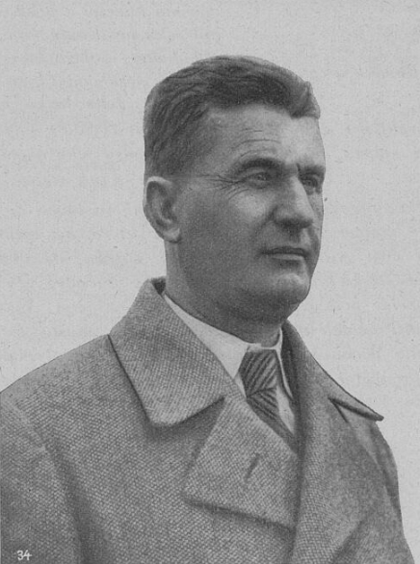
Baťa Towns in the World
Bat'a, also Bat'a's factories, is the name of a large Czech (originally Czechoslovak) shoe company founded by the siblings Anna, Antonín and Tomáš Bat'a in Zlín in September 1894.
From 1932, after the tragic death of Tomáš Bat'a, one of the founders of the company, Jan Antonín Bat'a took over all the company's assets on the basis of the Inheritance Agreement.
In 1939, as a result of the political situation, the Slovak factories were separated under "Bat'a, Slovenská účastinná spoločnosť" with its headquarters in Šimonovany. At the time of its nationalisation, the Czechoslovak Bata concern was involved in forty manufacturing industries. On 1 January 1949, the Bata plants in Zlín were renamed Svit.
Several companies were formed from the Slovak company Bata, and the production of footwear was merged with Zavody 29. augusta (ZDA) in Partizánské.
Notes:
Links:

Slide 27
Baťa Towns in the World
After WW2, Bata's factories in the socialist countries were nationalised without compensation. Branches in capitalist countries remained in family ownership and were managed both from South America – Jan Antonin Bata, and North America – Canada, by the family of Jr. Tomas Bata jr.
The current European headquarters of the company is in Lausanne, Switzerland. The headquarters for the Czech Republic is again in Zlín.
In 2004, the Guinness Book of World Records named Bata the "Largest Shoe Seller and Manufacturer" of all time, as they say the company has sold over 14 billion pairs of shoes in its existence.
Notes:
Links:

Slide 28
Baťa Towns in the World
Aafter the establishment of the Protectorate, Jan Antonín Bata, left the country and from 1941 he began to build new workplaces, production and new cities in South America, in Brazil. In the Czechoslovakia in 1938, he published the book Building a State for 40,000,000 People, in which he presented his extensive economic plans to the public. In 1939, he went into exile in the USA and settled in Brazil, where a new centre for the management of foreign Bata companies was established.
From 1938, his nephew Tomáš Jan Baťa also built a plant in Canada. The management of the company in Zlín was thus made up of Dominik Čipera, Hugo Vavrečka, František Malota and Josef Hlavnička.
After the WW2, the development of the company was divided. Canada became the new center of Bata's company (nephew Tomáš J. Baťa).
Notes:
Links:

Slide 29
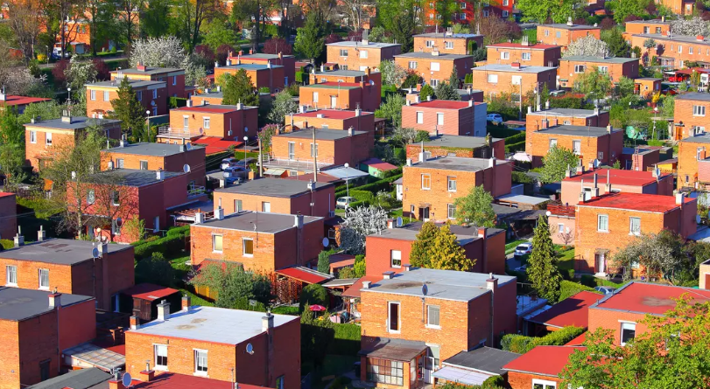
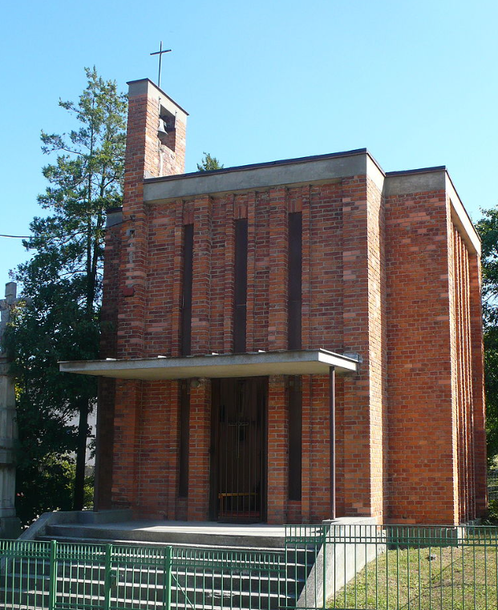
Baťa Towns in the World
Bata built not only the factory, but also all the facilities for it and its employees.
He produced the raw materials himself and sold them without intermediaries, thus saving on costs.
In today's Otrokovice, he built his own tannery, in Zlín he built a company producing machinery and owned fields and forests.
He built Bata houses (luxury housing at the time) and dormitories for his employees, which, together with the high wages at the factory, were the main reason for the influx of labour and the expansion of Zlín.
There were also schools for future employees, kindergartens, and other services.
Notes:
Links:

Slide 30
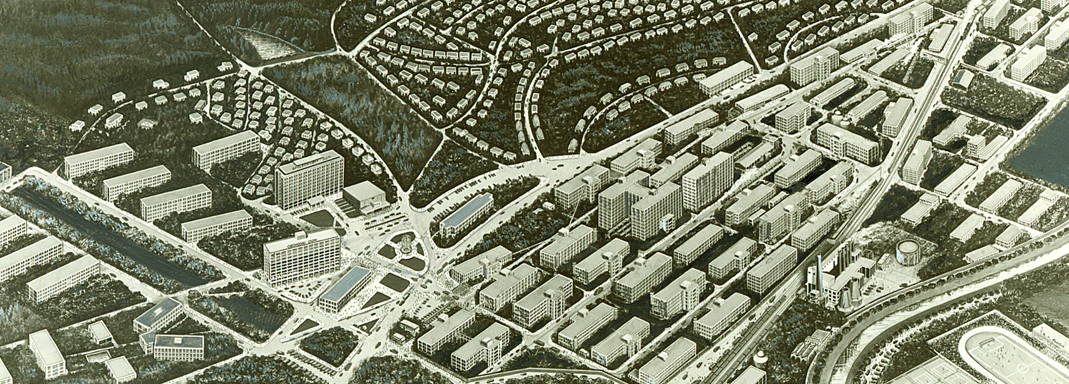
Baťa Towns in the World
The whole of Zlín was built according to a unified functionalist plan by the architect František Lydia Gahura called the Garden City. The development of Zlín continued even after the death of Tomáš Bata. During the time of Jan Antonín Bata, for example, the administrative building No. 21 was built, a department store and a hotel were completed, and the Institutes of Studies were established.
Notes:
Links:

Slide 31
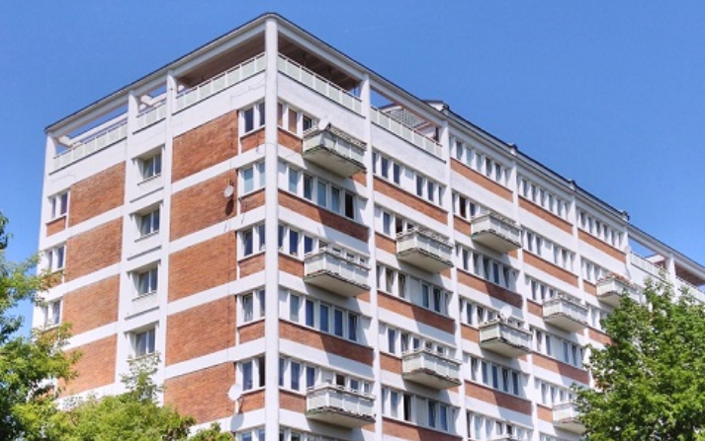
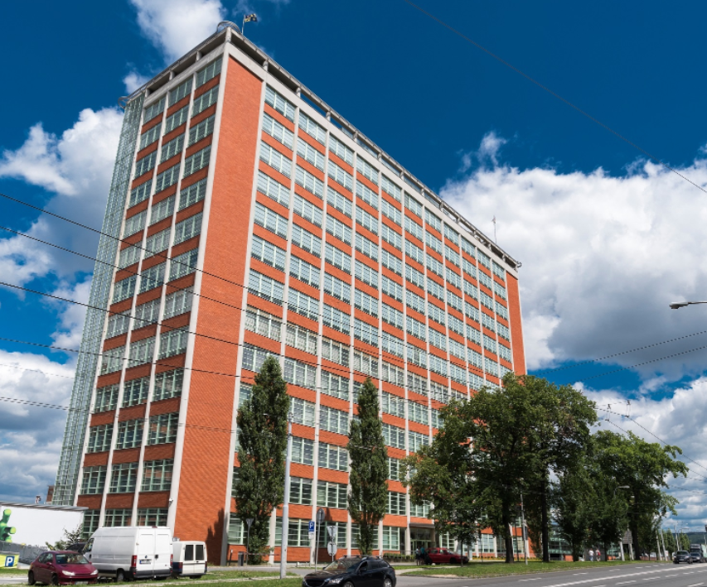
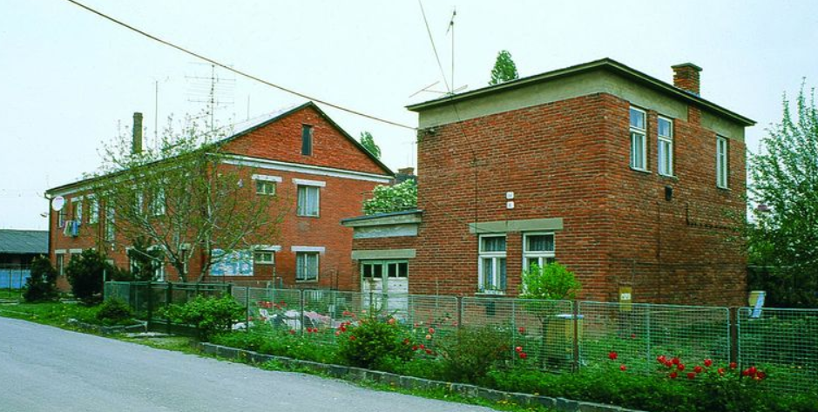
Baťa architecture
Notes:
Links:

Slide 32
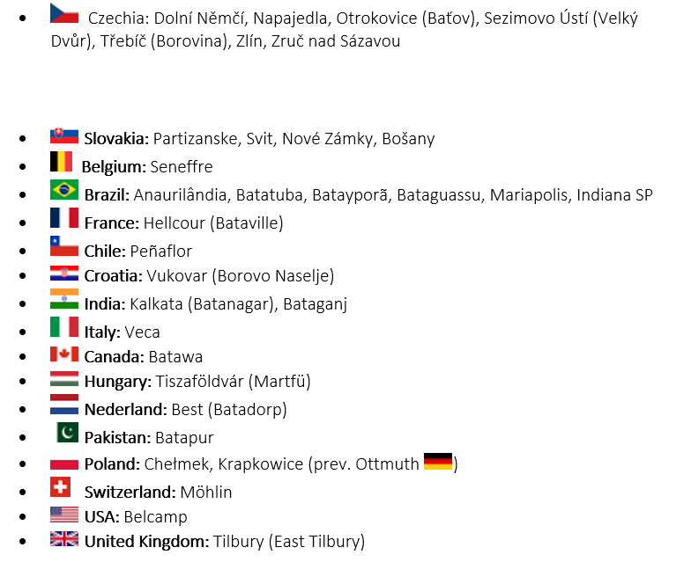
Baťa Towns
in the World
Notes:
Links:

Slide 33
Baťa Towns in Brazil
Jan Antonin Bata did the impossible in Brazil, after creating one of the largest companies in the world in just seven years (by 1939 he had already been expelled by the Nazis) as CEO of Bata in 1932-1942, the years of the deepest world crisis:
120 companies
5810 shops
105 700 employees
Notes:
Links:

Slide 34
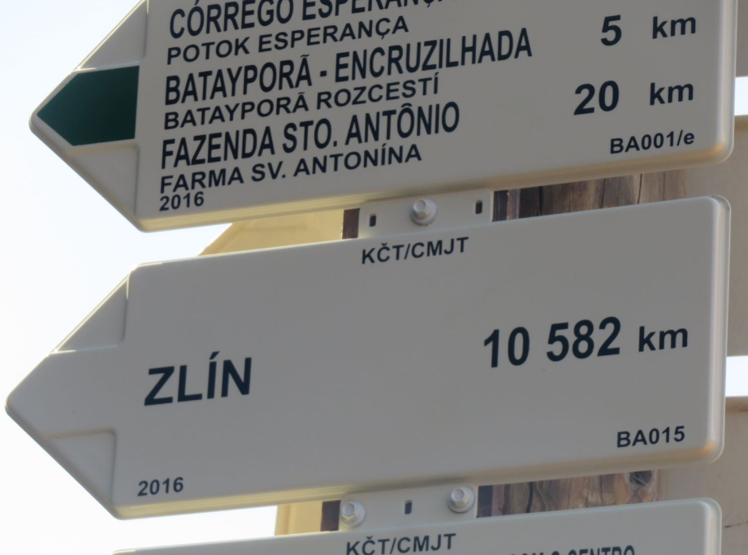
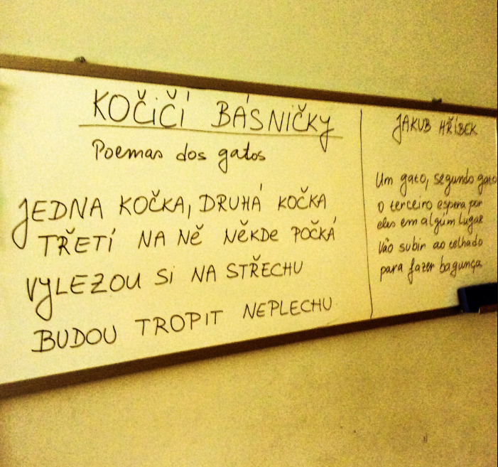
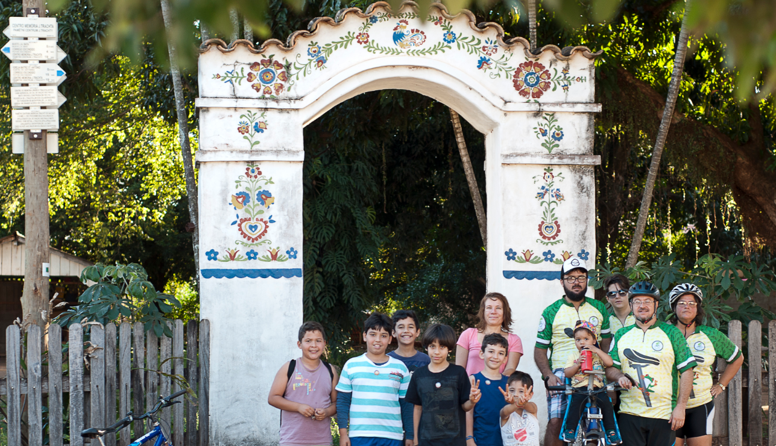
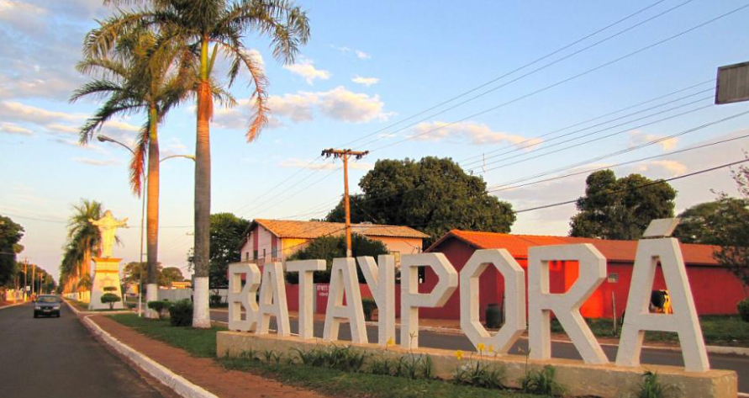
Baťa Towns in Brazil
The city of Batayporã is located in the territory of the state of Mato Grosso do Sul (MS), one of the twenty-seven Brazilian federated states, located in the mid-west of Brazil.
Batayporã (in the Guaraní Indian language, "Bata's Good Water") was founded in the 1950s.
Notes:
Links:

Slide 35
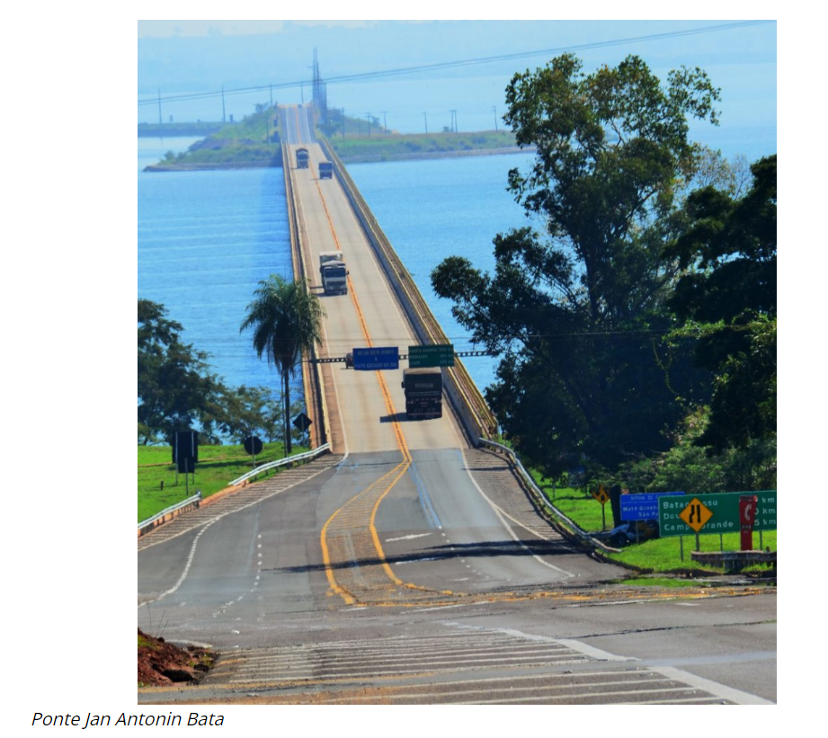
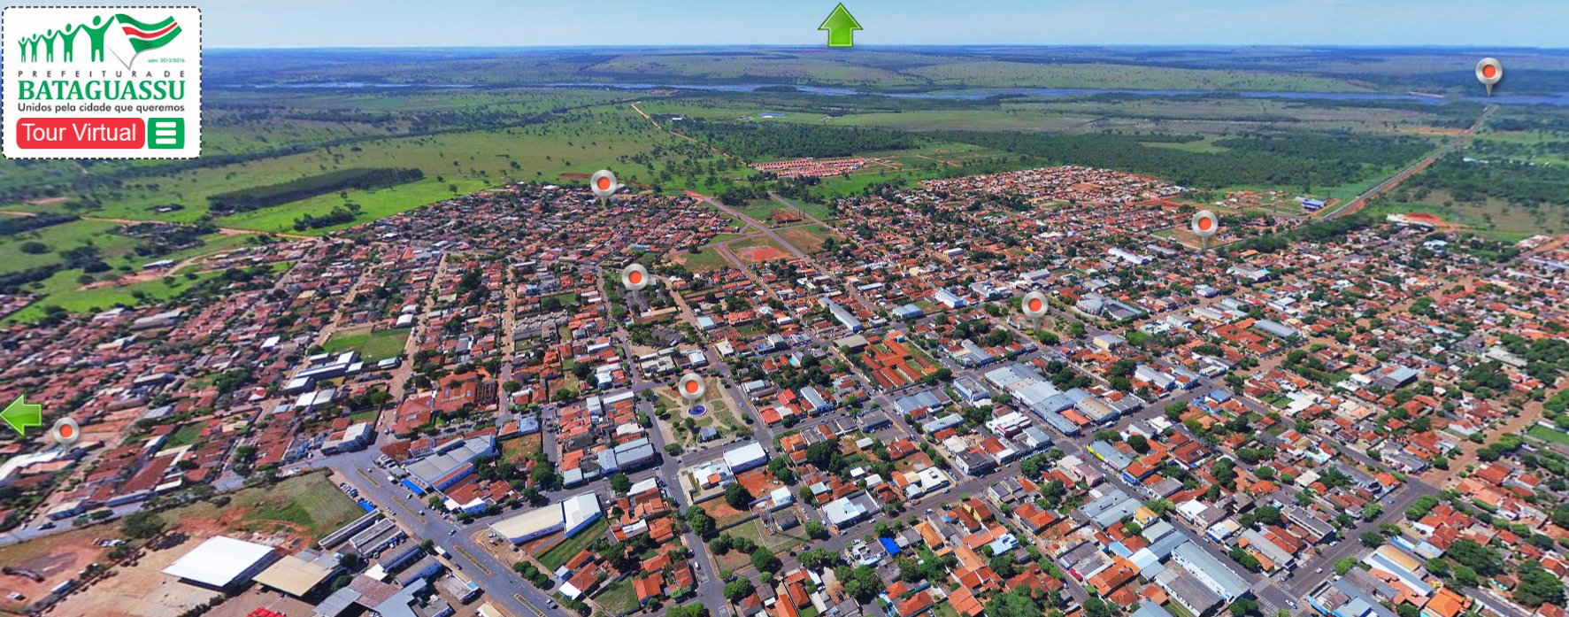
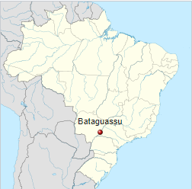
Baťa Towns in Brazil
Notes:
Links:

Slide 36
Melipille - Chile
Notes:
Links:

Slide 37
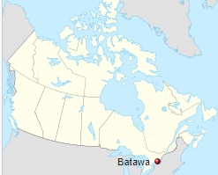
Batawa – Canada
Notes:
Links:

Slide 38
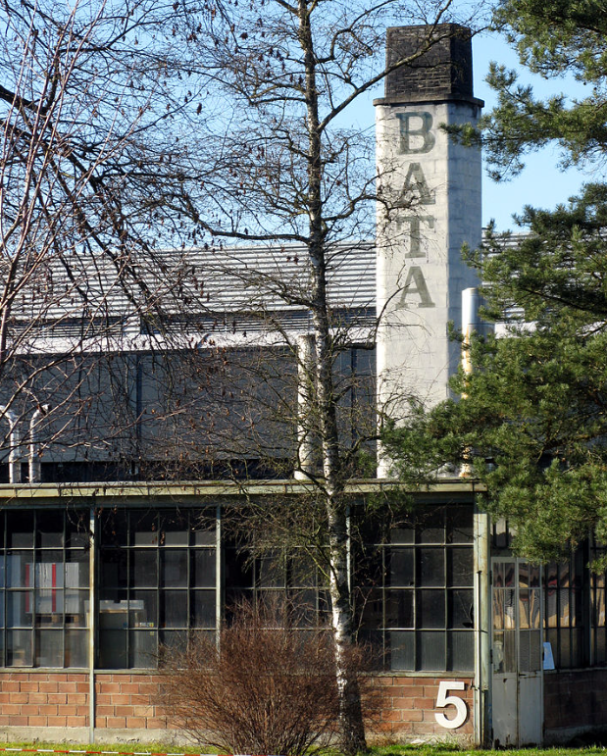
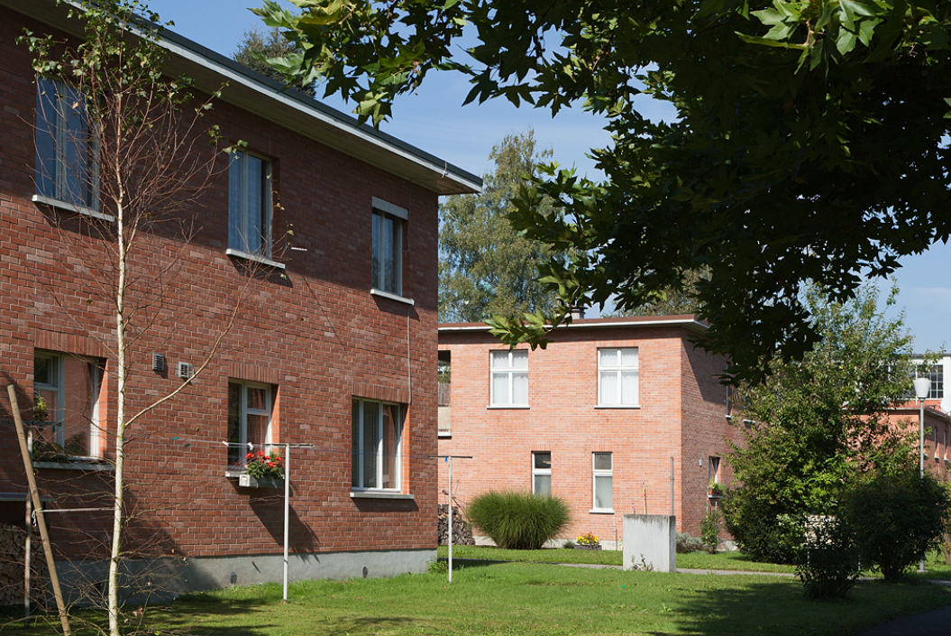
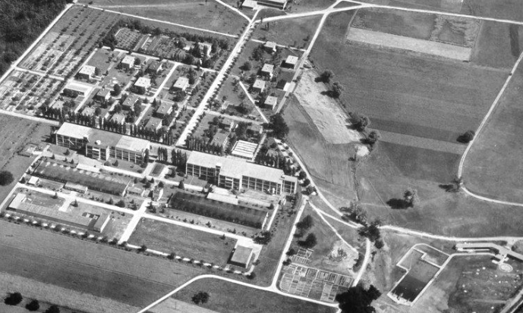
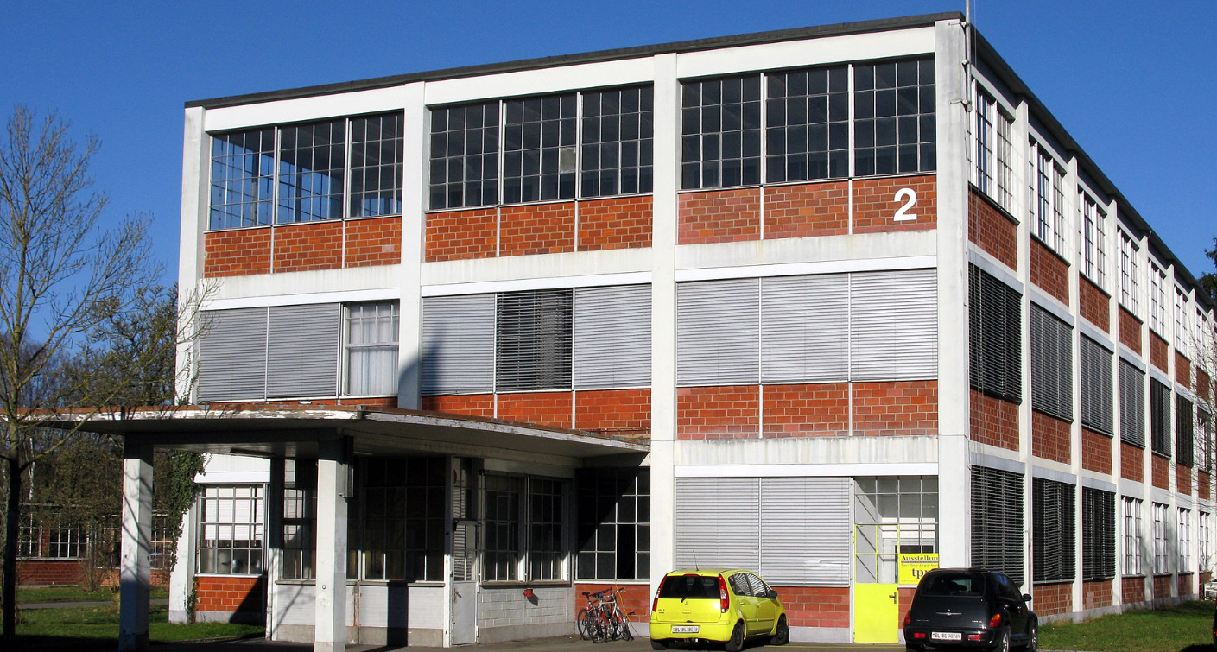
Möhlin – Switzerland
Notes:
Links:

Slide 39
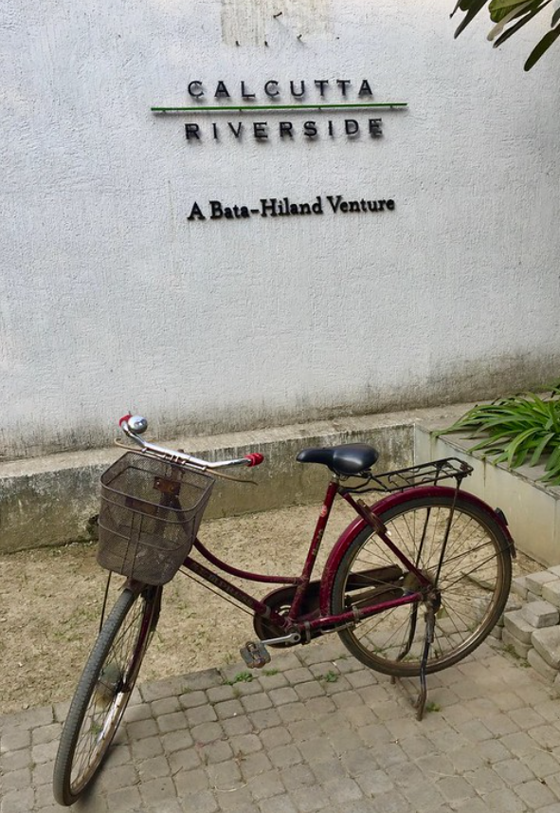
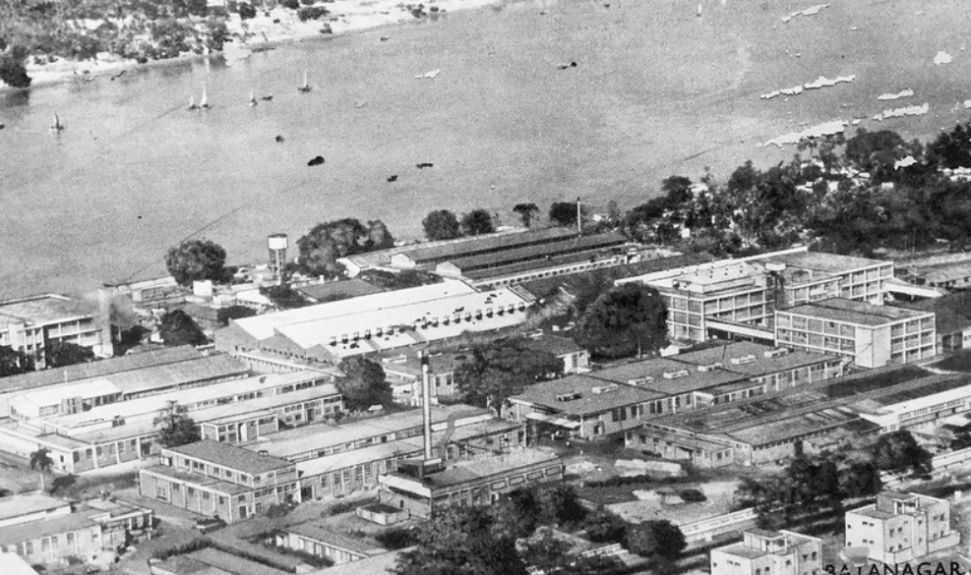
Batanagar – India
Notes:
Links:

Slide 40
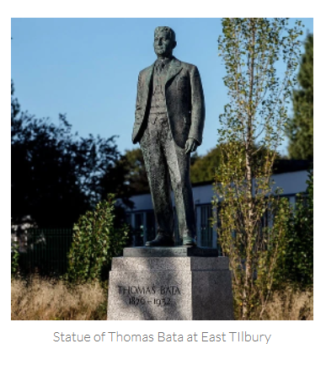
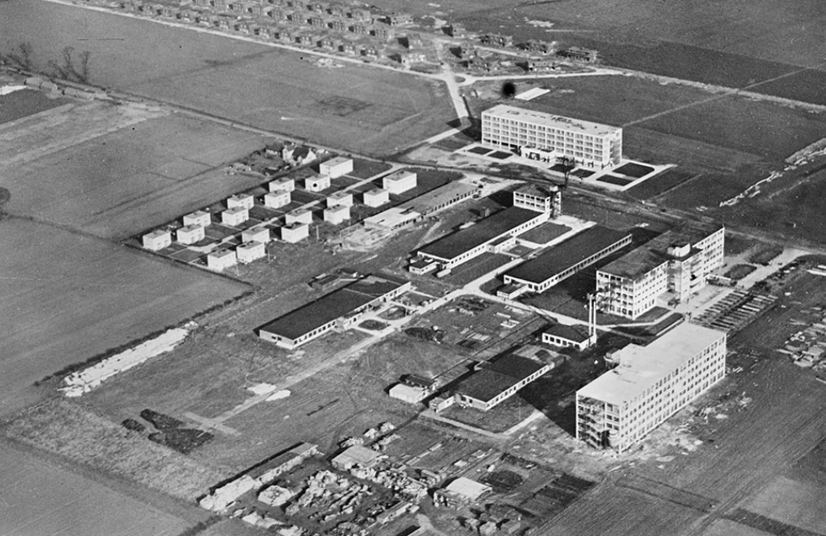
Tilbury – United Kingdom
Notes:
Links:

