Slide 1
History of the Czech Identity 1

Slide 2
The Arrival of Slavs
The original area of the Slavic tribes – the area between the river Bug and the Carpathian arch (today's Belarus and Ukraine)
Beginning in the 5th century – westward movement of Slavic tribes
Creation of the three main branches of the Slavs: southern, eastern and western
Western Slavs in the territory of today's Czech Republic, Poland and north-eastern Germany
Up until the 6th century, Bohemia and Moravia was inhabited by Lombards, who then migrated to the Apennine Peninsula in the 560s.
Slavs were organised into warbands – later shift towards an agricultural way of life

Slide 3
Samo's Empire (623-656)
Ad hoc proto-state established in the early 620s
Mentions of Samo's Empire found in the Frankish chronicles of Fredegar
Samo – a Frankish merchant who managed to unite a number of Slavic tribes to fight against the Avars
His "empire" soon came into conflict with the Franks
In 631, a battle (siege) took place near Wogastisburg, which ended in a loss for the Frankish king Dagobert
The location of Wogastisburg is debated – Mikulčice, the area around Kadaň in north-western Bohemia
From 656 there are no more mentions of Samo's Empire
Outside of the mentions in the Chronicle of Fredegar we are forced to rely primarily on archaeological research

Slide 4
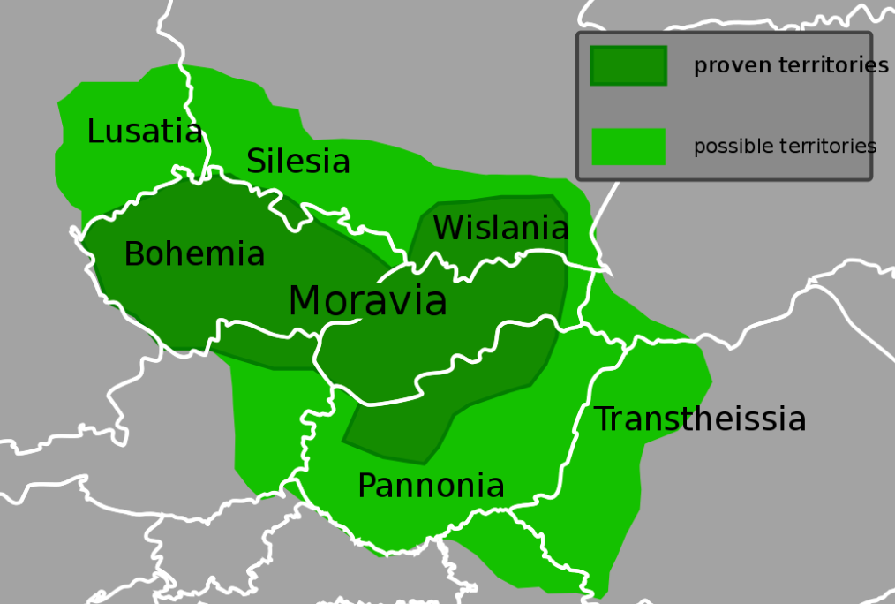
Great Moravia and the Moymirid Dynasty (ca. 830–906)
Following the collapse of Samo's Empire, there are only brief mentions of Slavic settlement and activities in our territory – the so-called Bavarian Geographer, again we rely mainly on archaeological sources and research
Great Moravia – there are several etymologies for the name, such as the work of the Byzantine Emperor Constantine VII Porphyrogenitus "De administratio imperio" (early 10th century) and the designation "Megale Moravia". The first state unit in our territory.
Mojmir I – the first Duke of Great Moravia, dispute with the Prince of Nitra, Pribina
Rostislav (846–870) – originally an ally of the East Frankish Empire of Louis the German, conflict from 855 (tribute dispute and other issues)

Slide 5
Great Moravia and the Moymirid Dynasty (ca. 830–906)
863 – In an effort to strengthen his position, Rostislav allied with Byzantium. Emperor Michael III and the Patriarch of Constantinople, Photios, send a mission headed by Constantine the Philosopher (Cyril) and Methodius. The beginning of wide-scale Christianisation of Great Moravia. Old Church Slavonic – liturgical language. Later the establishment of the short-lived Moravian (Pannonian) archdiocese.
870 – accession of Duke Svatopluk (870–894): nephew of Rostislav, with whom Svatopluk got into conflict. Also the beginning of further clashes with the East Frankish Empire, ended by a compromise peace treaty in Forchheim in 874.
Mojmir II (894–906) – dealing with the invasion of the Avars (Hungarians) and, from 906, there are no further mentions of Great Moravia
Other than the sparse written mentions in period sources and chronicles, we once again rely mainly on archaeological sources

Slide 6
The Czech State in the 10th Century and the Přemyslid Dynasty
The Přemyslids were one of the many Slavic houses in the territory of today's Bohemia, but in the latter half of the 9th century, they managed to establish rulership over the other families – the territory of Bohemia, at the time belonging to Great Moravia. 845 marks the baptism of 14 Bohemian princes in Regensburg. The centre of the Přemyslid holdings was Levý Hradec
Duke Bořivoj (husband of Ludmila) is already closely associated with Levý Hradec (fortified settlement near Prague, downstream of the Vltava)
Vratislaus I (915–921) – son of Bořivoj, husband of Drahomíra
Wenceslas (921–935) – faces attacks from the Roman King Henry the Fowler, eventual peace and submission of Bohemia as a vassal to the Roman King that required the payment of tribute. Wenceslas founds the Church of St. Vitus at Prague Castle
Duke Wenceslas's policy of consensus did not receive broader support, Wenceslas's relatives voice their own ambitions for power
In 935, Duke Wenceslas is assassinated at the fort in Stará Boleslav

Slide 7
The Czech State in the 10th Century and the Přemyslid Dynasty
Boleslaus I (935 – circa 972) – conflict with the German King Otto I, ended in a compromise peace towards the end of the 940s
955 – Battle of Lechfeld with the participation of the troops of Duke Boleslaus I, associated with subsequent territorial gains
Consolidation of the state and attempts at a more systematic Christianisation
Boleslaus II (ca. 972–999) – during his reign, the efforts to establish a diocese in Prague came to fruition. This occurred in 973 (imperial congress in Quedlinburg) – first Prague bishop Thietmar, originally from Saxony
995 – conflict with the Slavnik family (increasing political ambitions challenging Přemyslid dominance) and their massacre at the fort of Libice. Only one of the important family members was spared – Bishop Vojtěch
In 997, Vojtěch was killed during his "mission" in the territory of the Baltic Prussians, his remains subsequently stored in Gniezno, later proclaimed St Adalbert
Boleslaus III (the Red) (999–1002, January – February 1003) – his short reign connected with the first significant internal crisis of the Czech state

Slide 8
Early Medieval Czech State in the 11th Century – Agnatic Seniority and Castle System
Boleslaus III – effort to remove all potential competitors, escape of brothers Jaromír and Oldřich to Bavaria
Boleslaus eventually overthrown with Polish backing (Polish King Bolesław the Brave)
Duke Jaromír (1004) took over with the help of German King Henry II (hostility with Bolesław the Brave)
In 1012 Duke Oldřich seized power (his brother Jaromír was blinded and castrated), in 1019 he conquered Moravia from the Poles and handed over its rule to his son Břetislav.
In 1024, Oldřich accepted the fiefdom of Bohemia from Henry II, further conflicts with Poland and the German king followed; 1033 - Establishment of the Benedictine monastery in Sázava (Procopius)
Břetislav I (1034–1055) – capable ruler, before 1034 as the head of Czech troops advancing into Poland, Gniezno – Decrees of Gniezno (agnatic seniority)
Institution of agnatic seniority and the origin of Moravian districts – Olomouc, Brno and Znojmo, the formation of the castle system, roots of aristocracy and central offices of the duke

Slide 9
Early Medieval Czech State in the 11th Century – Agnatic Seniority and Castle System
Spytihnev II (1055–1061) – short rule, continues the work started by Břetislav I, but "abolishes" Moravian districts
Vratislaus II (1061–1092) – restores Moravian districts (brothers Conrad and Otto), youngest brother Jaromír, Bishop of Prague. Soon, disputes over power emerge between Vratislaus and Jaromír, which, among other things, Vratislaus solves by established the Olomouc diocese in 1063
During the reign of Vratislaus – struggle over investiture (Emperor Henry IV and Pope Gregory VII), Vratislaus sided with the emperor. In 1085, Vratislaus received a (non-hereditary) royal crown for his alliance with Henry IV. A richly illuminated Codex Vyssegradensis was created to represent Vratislaus.
Towards the end of Vratislaus's reign, opposition of his eldest son Břetislav (support from a large part of the emerging aristocracy) and the beginning of the second serious internal crisis of the early medieval Czech state.
Břetislav II (1092–1100) – assassinated at the hunting lodge in Zbečno, murder of a large part of the Vršovci family
Bořivoj II (1100–1107, 1117–1120, his accession violated agnatic seniority), Svatopluk of Olomouc (1107–1109), Vladislaus I (1109–1117) – early 12th century, latent conflict between individual members of the Přemyslid dynasty

Slide 10
The Czech State in the 12th Century – Rise and Renewed Internal Crisis
Vladislaus I (1120–1125) – consolidation of conditions and restoration of the internal integrity of the Czech state, gradual abandonment of agnatic seniority (enforcement of brother Soběslav's succession); Cosmas and the Chronicle of Cosmas – the first work of its kind within the Czech state (written in Latin)
Soběslav I (1125–1140) – conflict with King Lothar III due to internal tensions between the Přemyslids (claims of Otto II of Olomouc) Battle of Chlumec in 1126 – victory of Soběslav and subsequent peace and even an alliance with Lothar III – struggle against the Staufer dynasty. The beginnings of the rise of nobility.
Jindřich Zdík, Bishop of Olomouc (ca. 1083–1150) – promoting church reform, important scholar
Vladislaus II (1140 - 1172) – in 1147 he took part in an unsuccessful crusade; Subsequently an ally to Emperor Frederick I Barbarossa in his dispute with the pope and North Italian cities (Milan). In 1158, Vladislaus II receives the royal crown – King Vladislaus I (again non-hereditary).
Frederick (1172–1173) – the son of Vladislaus, to whom his father de facto handed reign, however, this was met with the disapproval of Frederick I Barbarossa

Slide 11
The Czech State in the 12th Century – Rise and Renewed Internal Crisis
Soběslav II (1173–1178) – son (second-born) of Soběslav I, pushed by Emperor Frederick, who, however, deposed him after the Battle of Legnano
Frederick (1178–1189) – he was given the fiefdom of the Duchy of Bohemia by Frederick I Barbarossa in exchange for a hefty sum of money. Conflict with Soběslav II and Conrad II Otta – the Battles of Loděnice (1185) and Na bojišti (Prague) and the effective secession of Moravia – Conrad II Otto (of Znojmo). In 1182, Conrad was awarded the title of Margrave of Moravia by the emperor at the imperial congress in Regensburg (the beginnings of the Margraviate of Moravia)
Conrad II Otto (1189–1191) – Statutes of Conrad Otto – the oldest Czech law code, often codifying even customary law (laws regarding the inheritance of fiefs), adopted at the assembly of the emerging Czech aristocracy in Sadská in 1189
Wenceslas (1191 - 1192); Ottokar I (1192–1193); Henry Bretislaus (Bishop of Prague, 1193–1197); Vladislaus Henry (1197)
During the 12th century, the so-called internal colonisation continued with greater intensity, establishment of the foundations of aristocratic families and their land holdings (Markvarticové, Hrabišicové, Lords of Ronov, Bavorovici, Vítkovci). Stabilisation of the vassal system, feudal estates, benefices

Slide 12
The Czech State in the First Half of the 13th Century
(Přemysl) Ottokar I (1197–1230) – son of Vladislaus II and Judith of Thuringia, in 1180 he married Adelaide of Meissen, and in 1199 he married Constance of Hungary. He ascended the throne following an agreement with his younger brother Vladislaus Henry. Immediately after his ascension, he got involved in the conflict between the Staufer (Philip of Swabia) and the Welfs (Otto IV of Braunschweig). He switched sides several times and, already in 1198, he received the title of King from Philip of Swabia (and from Otto in 1203 and also in 1204 also from Pope Innocent III)
Golden Bull of Sicily – 1212 (26 September) – issued by the designated German King Frederick II of the Staufer family. It consisted of three interconnected separate documents. Hereditary royal title, indivisibility of the kingdom, the right to invest bishops and other privileges
Conflict with Ondřej, Bishop of Prague, who was advocating for church reform and its independence from secular power (proprietary churches and other issues) – 1222, Prague Concordat and recognition of the independent status of the church, including spiritual exemptions
Wenceslas I (1230–1253) – husband to Kunigunde of the Staufer family (daughter of Philip of Swabia), brother of Agnes (later St Agnes of Bohemia), strengthening the position of the Kingdom of Bohemia, economic expansion, the beginnings of external colonisation as well as urban colonisation
In the years 1231–1237 there was a conflict with the Austrian Duke Frederick II the Quarrelsome
In the years 1241–1242, the Mongols invaded Central Europe and the eastern part of the Kingdom of Bohemia

Slide 13
The Czech State During the Reign of Ottokar II
The eldest son of Wenceslas I, Vladislaus (following another conflict with Frederick II the Quarrelsome), married Gertrude of Babenberg (Frederick's niece) in 1246, however, Vladislaus then died in 1247
The second son of Wenceslas I, Přemysl, Margrabe of Moravia, participated in the resistance of the nobility against the king in the years 1247–1249. Following the suppression of the resistance, he was captured and reconciled with the king.
After the death of Frederick II the Quarrelsome, the Babenberg family is left with no male heirs. Přemysl (with the support of the Kuering family) begins courting Margaret of Babenberg (Frederick's sister) – he married her in 1252 and claimed the Babenberg estate
Conflict with the Hungarian King Béla IV starts brewing. Béla IV also laid claim to the Babenberg inheritance, but in September 1253, king Wenceslas I dies.
(Přemysl) Ottokar II (1253–1278) – ascended the throne during the so-called interregnum after the death of Emperor Frederick II (1212–1250), the centre of power in the Holy Roman Empire shifts to the east
In the years 1254–1255, he went on crusade to Prussia, founding of Königsberg (Kaliningrad)
1260, second war with Béla IV – defeated in the battle of Kressenbrunn (acquisition of Styria). Přemysl divorces Margaret and marries the granddaughter of Béla IV, Kunigunde (son Wenceslas – future King Wenceslas II.)

Slide 14
The Czech State During the Reign of Ottokar II
Ottokar II increases his power and expands the territory of the state, Bishop of Olomouc Bruno of Schauenburg as his advisor
Plentiful founding – royal cities, support for the so-called external (German) colonisation. Emphyteutic (long-term lease) law
Municipal law – North German (Magdeburg) and South German (Nuremberg) legal district (mirroring)
Increase of sovereign’s power is opposed by part of the nobility – especially the Vítkovci in southern Bohemia
1271–1273, another war with the Kingdom of Hungary (Stephen V and Ladislaus IV)
In 1273, Rudolf of Habsburg was elected King of Germany. Ottokar II's response to the election was negative
Diplomatic quarrels and Rudolf's efforts to eliminate Ottokar's position of power led to conflict. Rudolf acts as the protector of the imperial liberties and rights that were being usurped by Ottokar. Imposition of an imperial ban. Moreover, after the invasion of the imperial army into the Austrian lands, Přemysl faced a revolt from some members of the nobility (especially the Vítkovci family)
In 1276, peace between Přemysl and Rudolf was concluded in Vienna. However, it did not last long and on 26 August 1278 the Battle on the Marchfield occured, in which Ottokar II fell.

Slide 15
The Czech State Under the Last Přemyslids
Wenceslas II (1278, 1283–1305), son of Ottokar II, married Judith of Habsburg
After father's death, he was under the guardianship of Otto V of Brandenburg-Salzwedel – "interned" in Bezděz, in Zittau and finally in Spandau; Moravia under the control of Rudolf of Habsburg
1283, he was crowned Wenceslas II in Prague. Nobles acquire important positions in the administration of the country – especially Zavis of Falkenstein (who was a lover Wenceslas's mother, Queen Widow Kunigunde) and the Bishop of Prague, Tobias of Bechyně
After the arrival of Queen Judith to the court, the influence of Zavis decreased – eventually executed in front of the Hluboká Castle
Wenceslas II expands into Poland – in 1289 he acquired Bytom and gradually claimed other principalities. The foundations are laid for the future integration of Silesia into the framework of the Czech state
There is a further strengthening of the influence of the nobility – gradual establishment of the provincial diet as an aristocratic forum, the establishment of a provincial court, land tables and other future estate institutions
The Czech state during the reign of Wenceslas II also underwent another economic boom, best exemplified by the silver mines in Kutná Hora – Bohemian groschen and the mining code of Wenceslas II (Ius Regale Montanorum)
Gothic culture, Cistercian monastery in Zbraslav, Italian Court in Kutná Hora and more

Slide 16
The Czech State Under the Last Přemyslids
In 1300, Wenceslas II received the Polish royal crown – earlier conflict over power with the Piasts (Przemysł II and Władysław Łokietek). Establishment of the Czech-Polish Union. He also married Elizabeth Richeza, daughter of Przemysł II
A year later, after the death of the Hungarian King Andrew III (the last of the Arpads), the son of Wenceslas II (Wenceslas, future Czech King Wenceslas III, grandson of Kunigunde who was related to the Arpads) is crowned Hungarian King Ladislav V after complex negotiations (and bribing). Wenceslas
The rise of the Czech state concerns the German King Albert I of Habsburg, who invaded Bohemia as the head of coalition troops, however, after the unsuccessful siege of Kutná Hora, he was forced to withdraw at the end of 1304.
The position of Wenceslas's son in Hungary also becomes complicated – the efforts of Charles Robert of Anjou to assert his claims to the throne, supported by a number of Hungarian magnates.
Wenceslas III (1305–1306) – takes over as ruler after the untimely death of his father, resigns the Hungarian crown and concludes a peace agreement with Albert I of Habsburg
The situation in Poland becomes complicated – actions of Władysław Łokietek. Wenceslas III, who in the meantime got married to Viola of Teschen, decides on a military campaign to Poland

Slide 17
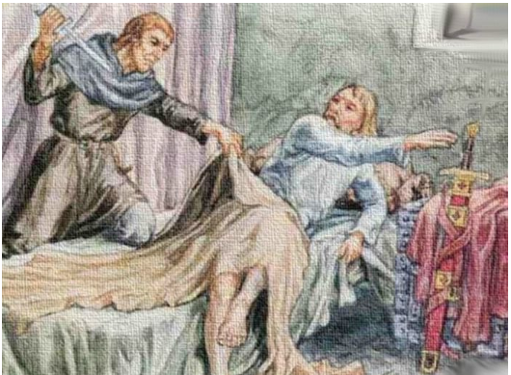
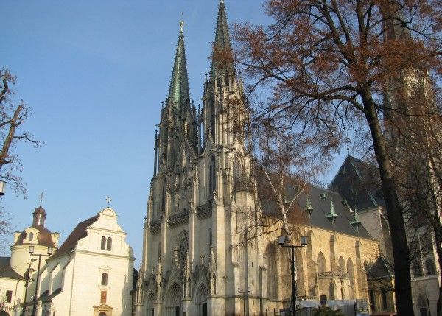
The Czech State Under the Last Přemyslids
However, Wenceslas III is assassinated in Olomouc on 4 September 1306, leading to the fall of the Přemyslid house.

