Slide 1
Development of the Czech School System

Slide 2
The Beginnings of Education and Schooling
Education has been with humanity since the beginning
Primarily collective society – prehistoric, archaeological (or ethnographic) research. Communal way of life.
Children received knowledge from adults, differentiation of work activities – different education of boys and girls
Adherence to the customs of the tribe, numerous initiation rituals, trials of adulthood, animism, magic, natural cycles, celestial phenomena
Military training – tribal defence, security
Agriculture – transfer of basic skills and knowledge
Separation of crafts, later separation of intellectual labour. Gradual transformation of the primitive communal society into a class society – slavery system

Slide 3
Education and Schooling in the Middle Ages
The new feudal system and the associated differentiation of society (monarch, nobility, clergy, burghers, subjects)
Education and upbringing based on the given social class
Christianity – the foundation of all educational activities. Partly adopted elements of ancient culture that weren't in conflict with Christian teachings

Slide 4
Education and Schooling in the Middle Ages
Gradual formation of the four basic types of schools:
Church schools
City schools
Universities
Education system for secular feudal lords (knightly education)

Slide 5
Education and Schooling in the Middle Ages
Church schools are further divided into three types:
Monastic schools
Cathedral schools
Parish schools
City (Latin) schools become divided over time into:
Guild and merchant schools
City secondary schools
Children's schools – city primary schools
Illicit schools (sketchy, unstable)

Slide 6
University education
The oldest universities were established in the Early Middle Ages – Salerno (Schola Medica Salernitana), Bologna (1088), Sorbonne (circa 1160), Oxford (1096), Cambridge (1209), Salamanca (1218)
In the Czech lands – the University of Prague, founded on 7 April 1348 at the behest of Charles IV, the oldest so-called transalpine university
Universities are self-governing and comprised of their academic community
The academic community elects the rector and deans
The University of Prague had what were called university nations: Czech, Saxon, Bavarian and Polish

Slide 7
University education
Universities in the Middle Ages and the Early Modern Period usually consisted of four faculties, which was also the case for the university of Prague:
Deans were the heads of faculties.
Faculty of THEOLOGY
Faculty of MEDICINE
Faculty of LAW
Faculty of ARTS
The university had the right to award academic degrees:
Bachelor
Master
Doctor

Slide 8
John Amos COMENIUS (1592–1670)
One of the most important pioneers of pedagogy and didactics
Goal of education: to know oneself and the world, to master oneself and rise up to God
In accordance with the above goals, Comenius defines three areas of education:
- education in sciences, arts and crafts
- moral education
- religious education
The demand for democracy within the educational process – education accessible to all and critique of encyclopedism (rote memorisation). According to Comenius, education and schooling are endless processes – they are continuous.
J. A. Comenius was the first to delineate the school year and school week – a clearly set number of lessons – and school holidays.
He promoted mass teaching – one teacher works with a class of students who should be of the same age and level. In the case of a larger number of pupils, the teacher should have an assistant. Each class should have its own room.
Progressing from simpler to complex, application of the principle visual aids, fully equipped with aids and textbooks – the teacher should keep notes (methodology) on how to work with the textbook. Each grade should have a set standard of acquired knowledge.

Slide 9
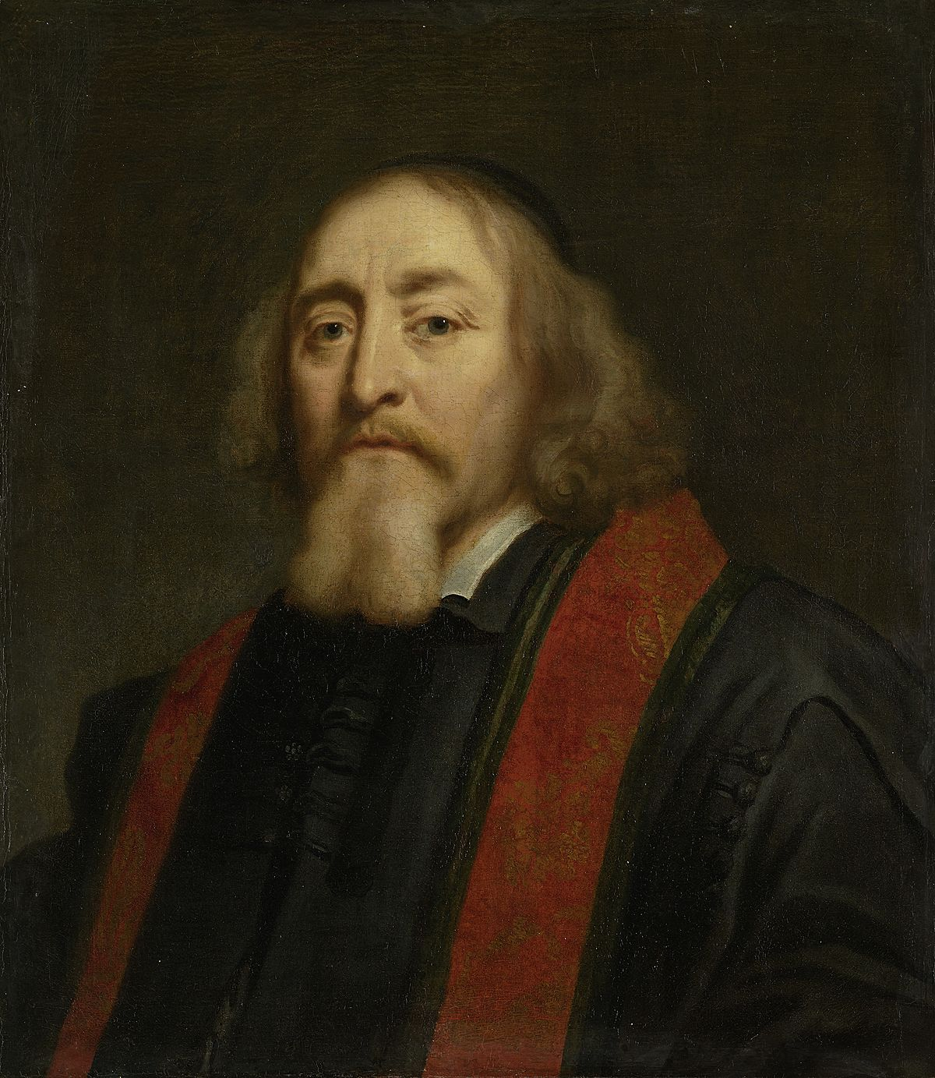
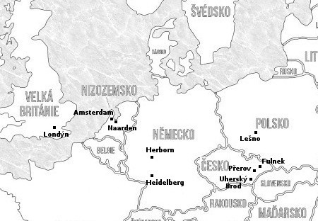
John Amos COMENIUS (1592–1670)

Slide 10
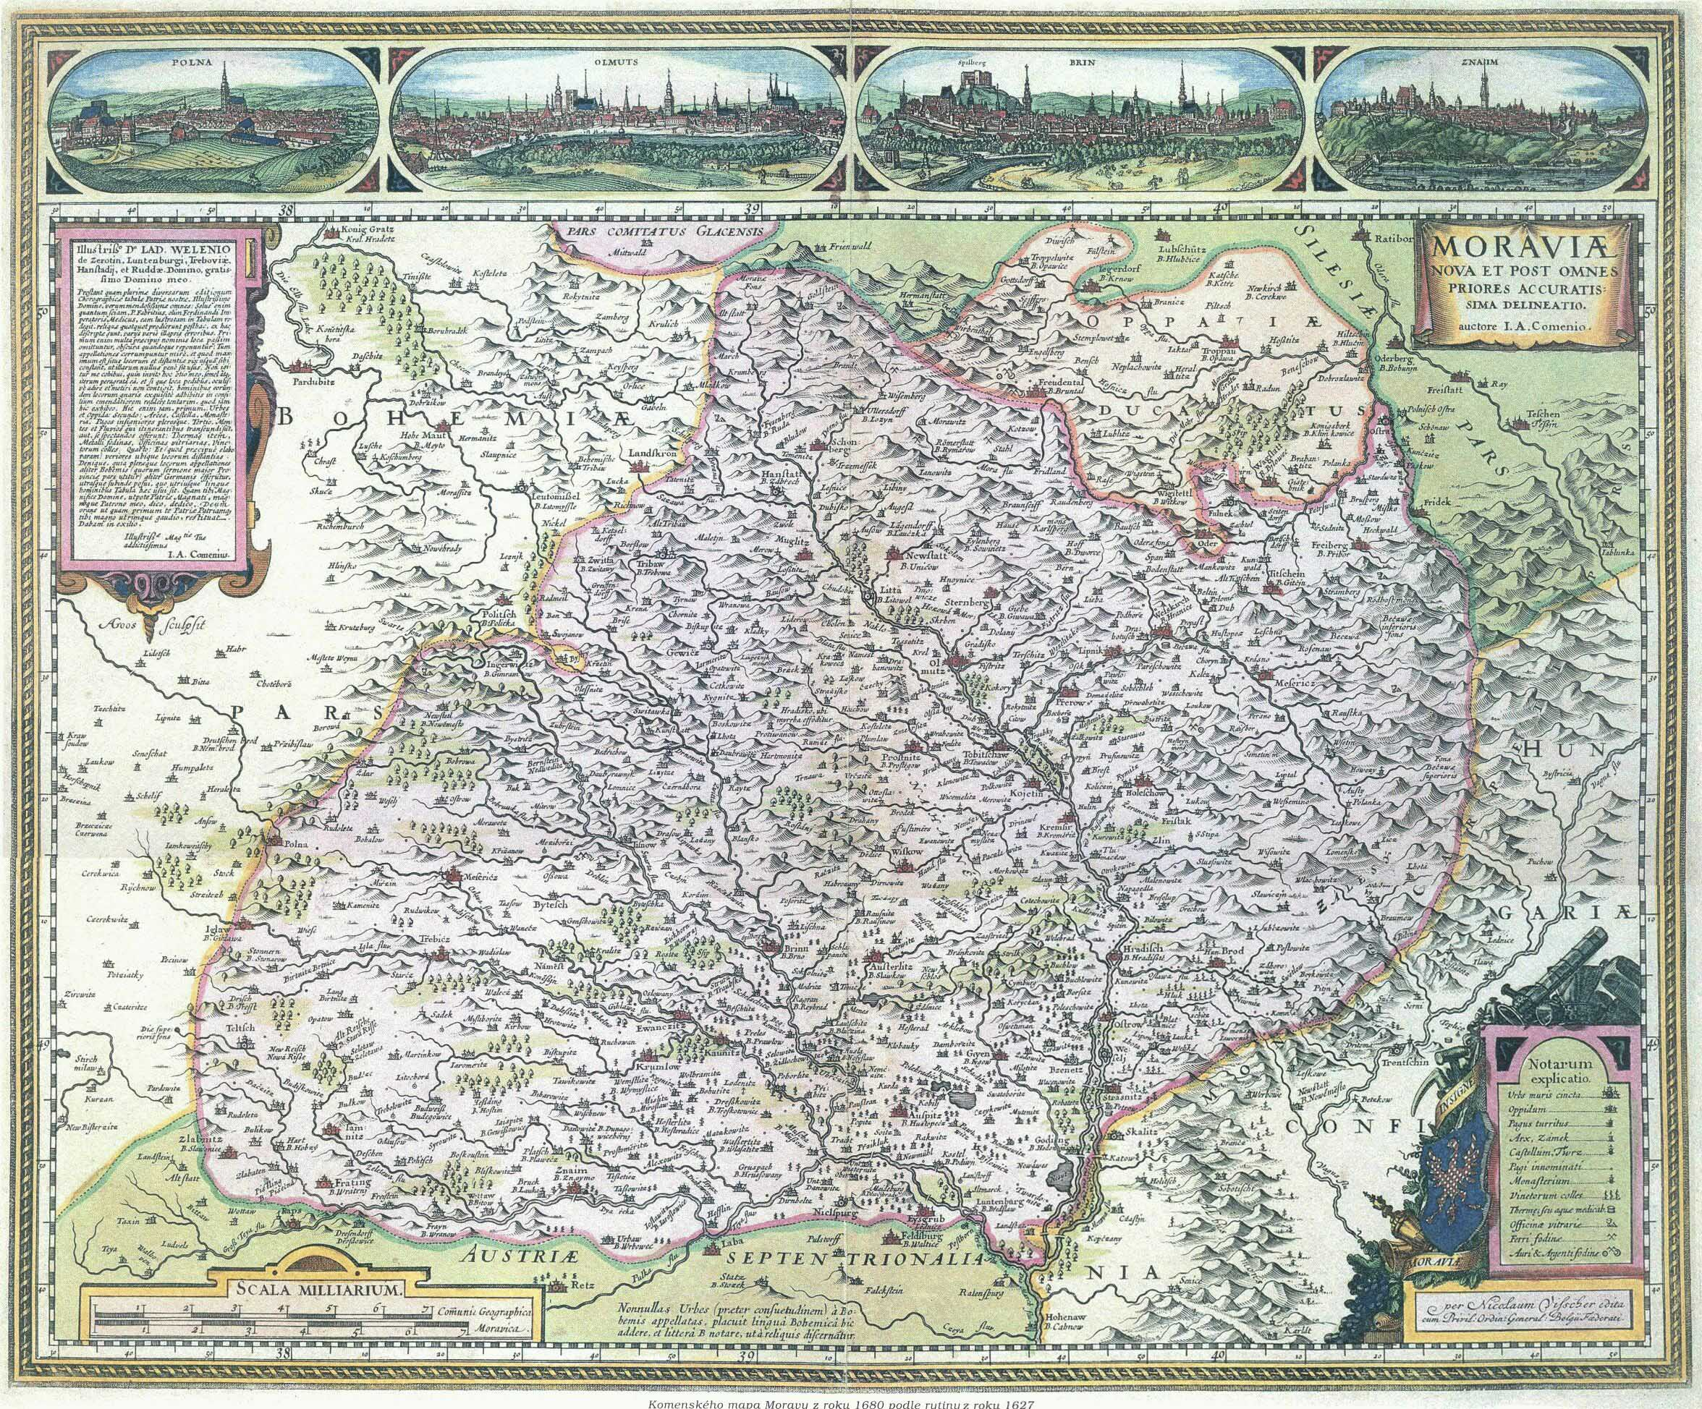
John Amos COMENIUS (1592–1670)

Slide 11
John Amos COMENIUS (1592–1670)
Most important writings in the field of pedagogy and didactics:
Didactica magna
Schola pansophica
Janua linguarum reserata
Informatorium školy mateřské (The Informatorium of Nursery School)
Analytická didaktika (The Analytical Didactic)
Praecepta morum
Orbis Pictus
Škola na jevišti nebo též Škola hrou (School by Play)
Methodus linguarum novissima
Pampaedia
Opera didactica omnia

Slide 12
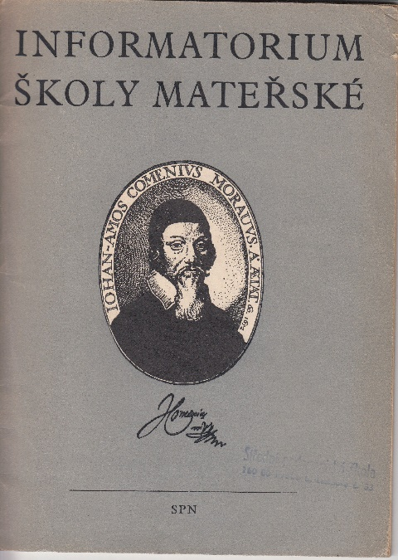
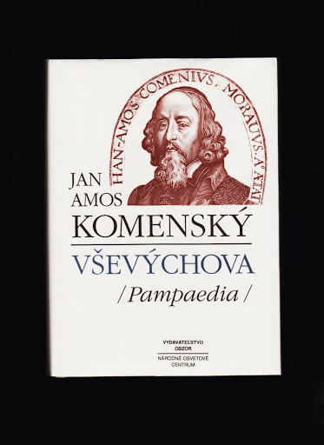
John Amos COMENIUS (1592–1670)

Slide 13
Development of Schooling in the Czech Lands in the Latter Half of the 18th Century
Administrative reforms in the latter half of the 18th century also affected the field of education
Gerhard von Schwieten – establishment of the Court Study Committee (central body of the monarchy in the field of education)
Efforts to promote the nationalisation of schooling
General School Regulations (1774), effective from 1775 for all countries of the Habsburg monarchy – introduction of compulsory school attendance
Johann Ignaz Felbiger – fundamental influence on the formulation and publication of the General School Regulations (author of a syllabary published in both German and Czech)
At the level of the individual countries of the monarchy, he established school committees operating under their respective governorates.

Slide 14
Education in the Context of the Czech Lands, 19th century
1848–1849, foundations laid down for the Ministry of Culture and Education
Throughout the 1850s, the Catholic Church maintained a strong influence on education
(1855 – concordat between the Austrian monarchy and Rome)
1869 – issuance of the liberal Hasner's law (Leopold Hasner), which significantly reduced the influence of the church, determined the extent of compulsory school attendance, regulated the functioning of schools and other aspects (teaching, subjects…)
Gradually, a network of school boards is set up as supervisory and administrative institutes with partial representation of the local government (supervision of schools and compliance with school laws). The lowest level was that of local school boards (municipality), at the district level there were district school boards and at the country level there were provincial school boards directly subordinate to the ministry.
District and land school boards also had the institution of the school inspector
Over time, school boards began to be separated into Czech and German (especially at the district level)

Slide 15
Education in Czechoslovakia, 1918–1938
The highest body for education administration – Ministry of Education and National Culture (divided into a presidium and eight departments): organisation of education, teacher education, didactics, unification of curricula…
Starting from 1920, new organization of local school boards – established in each municipality in which the school was a public institution. Led by a chair along with representatives of the school and municipality
District school committees – established in each political district, ethnically-mixed districts usually had two
Provincial school boards – division into national sections, led by head of the provincial political administration, six-year term of office for board members
Statutory cities – municipal school committees (level of district school committees)
The institution of the district and provincial school inspector – direct supervision of school activities
University education – Charles University in Prague, Masaryk University in Brno was founded in 1919 and Comenius University was founded in Bratislava in the same year

Slide 16
Education in the Czech Lands and Czechoslovakia, National Identity
Starting from the late 18th century, education throughout the Czech lands improves and, in many respects, initiates the process of the formation of a national consciousness
The first half of the 19th century – Matice česká (support for publishing of academic and "educational" publications in Czech), gradual expansion of secondary education, entry of the Czech language into scientific discourse
The period after 1848 – the process of establishing a Czech national consciousness and identity culminates, deeply influenced by education
The rise of Czech secondary education and the establishment of a Czech university in Prague – Charles-Ferdinand University - 1882
The period after 1918 – education becomes a crucial factor in raising awareness of the Czechoslovak nation, support for republicanism

