Slide 1
Ethical Foundations of Human Rights

Slide 2
"The concept of human rights is nothing more than the conviction that states and the entire society place themselves below the sovereignty of morality, that they recognize an unconditional phenomenon above them, something which to them is bindingly sacred (inviolable), and that they are using their powers, with which they create and ensure legal norms, to contribute to this goal."
Jan Patočka

Slide 3
General description of human rights
French: droit de l'homme, German: Menschenrecht
old Czech literature: fundamental or basic rights. After WWII human rights
= rights guaranteed by the constitution to all people of a given country

Slide 4
General description of human rights
HRs are guaranteed in the Czech Republic by the Charter of Fundamental Rights and Freedoms (Constitutional Act No. 2/1993 Coll.)
recognized human rights cannot be restricted by law, only expanded
HRs are protected by the court system, in particular the Constitutional Court of the Czech Republic

Slide 5
General description of human rights
International supervision is carried out by the UN (the International Labor Organization), the Council of Europe (European Court of Human Rights)
Examples of international treaties:
1) International Covenant on Civil and Political Rights,
2) Convention against Torture,
3) Convention on the Rights of the Child
4) Universal Declaration of Human Rights
5) European Convention on Human Rights

Slide 6
Characteristics of human rights
HRs indicate a certain level of civilization
HRs express general morality
the aim is the protection of an individual from abuse (for example by state authorities)
HR basic attributes: 1) vested,
2) inalienable,
3) imprescriptible,
4) non-cancellable.

Slide 7
Theory of development
1) Natural law
law is independent of people
objective law and objective morality exist
values in society are given, timeless, universal, and absolute
2) Positive law
law is a human product
law is that which is codified
there is no relationship between law and morality (moral judgments are unacceptable)
There is no absolute law, justice is conditional

Slide 8
Theory negatives:
1) Natural law
inspiration from "nature" can trigger suggestions for excluding a social group (abused by dictators)
2) Positive law
"anything" that suits those in power may be approved social injustice

Slide 9
The best solution?
combination of both approaches:
legitimacy (1)
protection from injustice (1)
draft solutions for unregulated areas (1)
predictability (2)
security and stability (2)

Slide 10
In practice
the clash of legal positivism and legal nihilism (absolutism and relativism).
What is fair?

Slide 11
Absolute x Relative human rights
1) Absolute human rights – cannot be limited, cannot be questioned even in extraordinary situations; always take precedence
- for example: the right to life
2) Relative human rights – they influence one another, can be limited, one can take precedence over another (the one protecting a higher value has priority); proportionality needs to be observed (one cannot not be denied at the expense of another)
- for example: the right to freedom of expression

Slide 12
Freedom as the highest value of law
based on history
not to be confused with absolute freedom (which leads to anarchy) PARADOX OF FREEDOM = freedom needs to be protected from absolute freedom
freedom = freedom to do what I have the right to do
the freedom of one is limited by the freedom of another

Slide 13
Freedoms guaranteed by the Constitution
Personal freedom
Freedom of movement
Freedom of residence
Freedom of thought
Freedom of conscience
Freedom of religion
Freedom of scientific research
Freedom of the arts
Freedom of expression

Slide 14
Freedoms guaranteed by the Constitution
Freedom of assembly
Freedom of association
Freedom of coalition

Slide 15
Context
cf. the EU Charter of Fundamental Rights; available at: https://eur-lex.europa.eu/LexUriServ/LexUriServ.do?uri=OJ:C:2007:303:0001:0016:CS:PDF

Slide 16
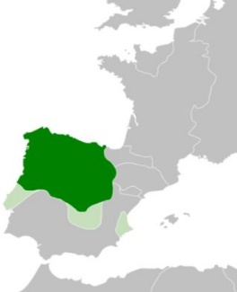
Historical genesis of key documents
Beginnings associated with agreements between the nobility (later also cities) and the monarch. In practice, so-called privileges were concluded.
Codification is documented from the end of the 12th and beginning of the 13th centuries (Kingdom of León, England).

Slide 17
Historical genesis of key documents
Magna Carta (1215)
No free man shall be seized or imprisoned, or stripped of his rights or possessions, or outlawed or exiled, or deprived of his standing in any way, nor will we proceed with force against him, or send others to do so, except by the lawful judgment of his equals or by the law of the land (Art. 38).
Edict of Nantes (1598)
Letter of Majesty (1609)
religious tolerance

Slide 18
Historical genesis of key documents
Petition of Right (1628)
right to a fair trial, no imprisonment without cause
Habeas Corpus Act (1679)
subjects cannot be detained and imprisoned without the consent of the court
Bill of Rights (1689)
limitation of the power of the king, free elections, right of petition, immunity, right to bear arms (defense), prohibition of cruel punishment, etc.

Slide 19
Historical genesis of key documents
The greatest development since the 18th century (the onset of the Enlightenment and the promotion of ideas of equality, religious tolerance) Theory of social contract (Thomas Hobbes, John Locke,, J.J. Rousseau).
Hobbes assumes the existence of an imaginary contract between the people and the sovereign (the latter is supposed to protect the former’s rights); an effort to limit human selfishness

Slide 20
Historical genesis of key documents
Locke criticizes the application of mutual claims and ties (clientelism), promoting the institution of an independent arbiter (= state institutions)
Rousseau sees authority only in the "general will" (the good of society), which entails limiting absolute freedom so that all can have "civil liberty"
Modern concept: Rawls claims that people need to agree to support the weaker members of society, as they themselves may become weak at any time.

Slide 21
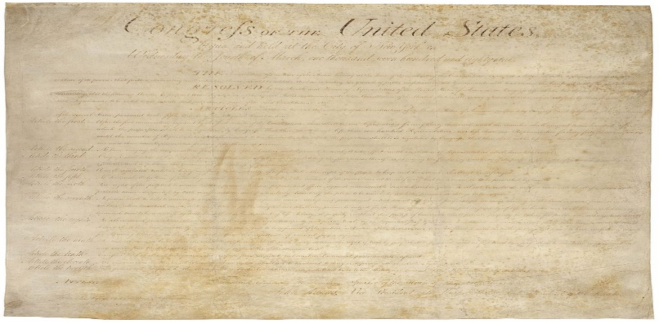
Historical genesis of key documents
Virginia Declaration (1776) – people are free and independent, have equal rights (to life, property, freedom)
United States Declaration of Independence (1776) – "all men are created equal, that they are endowed by their Creator with certain unalienable Rights, that among these are Life, Liberty and the Pursuit of Happiness”

Slide 22
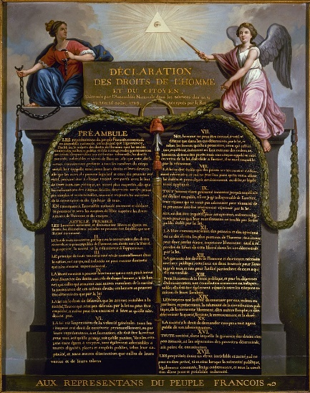
Historical genesis of key documents
"American" Bill of Rights (1791) = the first 10 amendments to the US Constitution; establishing, for example, the right to a fair trial, the right to bear arms, freedom of speech, press, assembly, confession, and petition.
Declaration of the Rights of Man and of the Citizen (1789)
human rights are imprescriptible;
addition of, for example, the right to resistance and security
principle: Everything which is not forbidden is allowed.

Slide 23
Historical genesis of key documents
followed by the qualitative and quantitative development of various legal documents (Europe and North America)
establishment of new democratic states after WWI
the crisis and collapse of the concept of "human rights" during WWII
a new/modern concept of HRs: emphasis on the international protection of human rights (new institutions established as part of various organizations) – a person may sue their own country.

Slide 24
“Modern concept of human rights”
emergence after WWII
promotion of "key" values - “Four Freedoms” (of worship, of speech, from fear, from want)
HR protection is one of the goals of the UN – the UN Charter (1945) is the first example of the internationalization of HRs
Universal Declaration of Human Rights (1948) - adopted on 10 December 1948 = Human Rights Day

Slide 25
“Modern concept of human rights”
International Covenant on Civil and Political Rights,
International Covenant on Economic, Social and Cultural Rights (both 1966)
establishment of the Human Rights Committee (Geneva) and the Optional Protocol

Slide 26
“Modern concept of human rights in Europe”
initiated by the Council of Europe
European Convention on Human Rights (Rome 1950) – the most effective instrument for human rights protection
it established the following institutions: European Commission of Human Rights and European Court of Human Rights
Social Charter (1961) – emphasis on social rights and economic rights; valid in the Czech Republic since 1999

Slide 27
Generational genesis of human rights
1) Civil rights – in particular the right to life, the prohibition of torture and forced labour, the right to private property, freedom of movement and residence, freedom of conscience.
2) Political rights – in particular, freedom of speech, the right to petition, freedom of assembly, association, and universal, direct, equal suffrage by secret ballot.
3) Social rights – in particular the right to work, strike, remuneration, insurance and trade unions, prohibition of child labour.
4) Environmental rights – the right to a healthy environment.

Slide 28
Weak spots in human rights theories

Slide 29
References: https://iuridictum.pecina.cz/w/Lidsk%C3%A9_pr%C3%A1vo https://eur-lex.europa.eu/LexUriServ/LexUriServ.do?uri=OJ:C:2007:303:0001:0016:CS:PDF
Constitutional Act 1/1993 Coll.
Act 2/1993 Coll.
European Convention on the Exercise of Children's Rights (ETS No. 160, 1996)

Slide 30
References:
HANZOVÁ, Marie, KODÝM, Miloslav and KREMLIČKOVÁ, Marta.
Práva a povinnosti našich dětí. 1st ed. Prague: Victoria Publishing, 1995. 107 p. ISBN 80-7187-007-2.
Urofsky, I. M.: Basic Readings in U.S. Democracy. United States Information Agency, Washington D. C.; 1994.
Constitution of the United States
http://www.nuv.cz/uploads/STU/rozhledy/1804/2018_19_R4_1_hotovo.pdf
Declaration of the Rights of Man and of the Citizen:
http://prameny.historie.upol.cz/artkey/dbt_00F_0000_55_Prohlaseni_prav_cloveka_a_obcana_17889.php

