Slide 1
The Influence of Politics on the Formation of a National Identity

Slide 2
Establishment of the United States of America and the U.S. Congress
The Congress first met on 5 September 1774 (representatives from 12 of the 13 British colonies in North America)
The Second Congress met on 4 July 1776 – Declaration of USA's independence.
Two chambers: the Senate and the House of Representatives
The US Congress still operates in this form

Slide 3
The Period of Estate Diets
The predecessors of the modern Czech parliament were the Provincial Diets.
Their tradition dates back to the late 13th century.
The Bohemian Diet, which met in Prague, played the most important role in political life. Meetings of the Moravian Diet took place in Brno and those of the Silesian Diet were in Wroclaw (Breslau) and, later, in Opava. Even after the incorporation of the Czech lands into the Habsburg monarchy, the Bohemian Diet represented one of the symbols of the independent Kingdom of Bohemia.

Slide 4
The Year 1848
8 April 1848 – Cabinet letter of Emperor Ferdinand I announcing the convening of a newly reformed Bohemian Diet. Its body was to be expanded for to include elected representatives for the first time. In practical terms, this transformed the diet into a parliament. A similar process took place in Moravia (the so-called Rural Diet) as well as in Austrian Silesia.
The series of revolutions that took place throughout Europe in 1848 also hit the Czech lands. In connection with this, the form of the representative body was to be significantly altered. The Czech political representation led by the burghers formulated their demands for civil liberties as well as national and political rights. In reaction to the Czech petitions, the emperor's cabinet issued letter of 8 April which presupposed the convening of the diet on a more democratic basis. This was thanks to the fact that its ranks were supposed to be supplemented by elected representatives of the people. However, the overall level of radicalisation that occurred during the so-called Pentecostal Storm prevented the diet from meeting.

Slide 5
The Year 1848
22 July 1848 – Meeting of the Constituent Imperial Diet in Vienna, which was also attended by deputies elected in the Czech lands. The Habsburg monarchy is transformed into a constitutional monarchy.
Czech deputies received their first parliamentary experience in the capital of the Habsburg monarchy. An imperial diet was convened on the basis of the imposed constitution of 25 April 1848 – the so-called Pillersdorf constitution. The original bicameral idea was abandoned. The unicameral assembly consisted of 383 deputies whose primary task was to draft and approve a new constitution. The deliberations were made complicated by a wide range of political views as well as national antagonism. Nevertheless, the representatives put together a final draft of a constitution. However, it failed to get approved.

Slide 6
The Year 1849 and Dissolution
of the Imperial Diet
7 March 1849 – the Imperial Diet assembled since October 1848 in Kroměříž was dissolved. The new constitution – the so-called Stadion constitution – established a bicameral imperial assembly, which, however, never met.
This imposed constitution, issued de facto by Emperor Franz Joseph I, was to reorganize the conditions in the monarchy and stabilise the state after 1848–1849. It presupposed the establishment of a bicameral parliament. While the senate would be filled by the individual provincial diets, the house of the people was to have members directly elected by the citizens of the monarchy. However, the right to vote was limited to wealthy and educated persons. The design of the constitution was highly centralist. However, the provisions of the Stadion constitution never entered into political effect. The constitution was repealed (or suspended) by the so-called Silversterpatent of 31 December 1851 and the monarch retained his absolutist rule. Thus, the first era of constitutional experiments came to an end.

Slide 7
The October Diploma the 1861 Schmerling (February) Constitution
20 October 1860 – Kaiserliches Diplom vom 20. Oktober 1860, zur Regelung der inneren staatsrechtlichen Verhältnisse der Monarchie. The so-called October diploma – Emperor Franz Joseph I renounces absolutism and announces the convening of the Imperial Council and provincial diets
Schmerling's (February) Constitution – 26 February 1861, Prime Minister (state minister) Anton von Schmerling, Imposed. Definitive anchoring of the constitution.
Imperial Council – two chambers
- House of Deputies – total of 343 deputies; Imperial Council enlarged and restricted
(Hungary – 85 deputies and Lombardy – 20 deputies) – Bohemia 54 deputies, Moravia 22 deputies, Silesia 6 deputies
- House of Lords – adult princes of the Habsburg Dynasty, upper nobility and church dignitaries. The emperor also had the right to appoint certain deserving personalities as lifelong members of the House of Lords

Slide 8
December Constitution of 1867
Issued as a set of seven laws on 21 December 1867 – reaction to the Prussian-Austrian War and internal tensions within the Hungarian part of the monarchy
Austro-Hungarian settlement – division of the monarchy into two parts
- Cisleithania
- Transleithania
Shared monarch as well as the ministries of defence, finance and foreign affairs.
Imperial Council – competence only for the Cisleithanian part of the monarchy – Kingdoms and countries represented on the Imperial Council. The number of deputies was set at 203. In Transleithania, the Diet of Hungary was based in Budapest.
Bolstering the role of the Imperial Council – now perceived as a genuine legislative body, the February Constitution of 1861 defined the parliament effectively as the monarch's advisory body.
Preservation of the House of Lords – princes of the imperial family (automatic membership), representatives of leading aristocratic families (hereditary membership), archbishops and bishops. Lifelong members could also be "eminent men" who had contributed the state, the church, science or the arts and were appointed to the House of Lords of the Imperial Council by the emperor.

Slide 9
Provincial Diets
Bohemian Diet – seat in the Thun Palace in Prague, the February Constitution of 1861 designated 241 deputies (of which 6 were ex officio) for the Bohemian Diet, divided into three "Kurien,“ – i.e., curiae or colleges (college of large estates, college of cities and chambers of commerce and trade and the rural college)
Moravian Diet – seat in the so-called Provincial Diet in Brno, which nowadays is the seat of the Constitutional Court of the Czech Republic. As per the constitution of 1861, the number of deputies of the Moravian Diet was set at 100 (of which 2 were ex officio – the Archbishop of Olomouc and the Bishop of Brno) elected in three colleges (college of large estates, college of cities and chambers of commerce and trade and the rural college)
Moravian Pact (Moravian Settlement) of 1905 – introduction of elections of representatives to the Diet within the so-called national cadastres, creation of the fourth, general college. Increase of Moravian Diet deputies to 151.
Silesian Diet – seat in the building of the Diet in Opava, today the seat of the Silesian Provincial Archive. The number of deputies in 1861 was set at 31 (one ex officio – Archbishop of Wrocław) divided into three colleges (college of large estates, college of cities and chambers of commerce and trade and rural college)

Slide 10
Electoral System 1848–1918
Electoral law at this time was governed by the so-called theory of interests – a remnant of the estates era, as seen on the existence of electoral colleges
College – a grouping of voters and deputies into classes by property ownership (originally 4, later 5 colleges)
- Large Estates – owners of large estates registered in the Land Tables
- College of cities – mainly burghers
- Chambers of Commerce and Trade – de facto shared interest associations of entrepreneurs and traders
- College of rural municipalities – rural owners
The Habsburg monarchy had an electoral property census (taxpayer system). In order for a citizen to be able to vote or be elected, they had to pay direct taxes and thus contribute to public affairs, i.e., they had to own some property. This ensured the influence of the bourgeoisie and the large estate owners. The minimum census was first set at 10 gulden, from 1882 it was 5 gulden of direct taxes paid in a given year.

Slide 11
Electoral System 1848–1918
This excluded the less wealthy (numerous rural residents, workers…) from the electoral process.
Voting rights were unequal and had an indirect proportionality – the fewer (wealthier) voters received the most seats and vice versa – the richest had the greatest influence
Women along with members of the armed forces (gendarmerie, army) were denied the right to vote.
Only the women from the large estate owner college had the right to vote – these women could exercise their right to vote either on their own or with the help of a proxy
There was also a census on voters and candidates residing in the location of elections
One voter could be part of multiple colleges

Slide 12
Electoral System 1848–1918
1861 – introduction of the right to elect into the diets, which subsequently sent representatives into the Chamber of Deputies of the Imperial Council (this was therefore an indirect election)
Elections into diets were done in three colleges (example for the Bohemian Diet):
- Large estate college – divided into so-called trust and non-trust large estate (70 seats)
- College of cities, chambers of trade and commerce (87 seats)
- Rural college – indirectly election in this case – electors who then elected deputies (79 seats)
- Ex officio – unelected deputies who held a seat in the parliament in connection with the performance of a function – archbishop, 3 bishops and the rector of the Prague university.
1873 – Introduction of direct suffrage for the Imperial Council. The so-called April Constitution
Efforts to eliminate the passive resistance of Czech deputies. The elections were separated into Imperial Council elections and provincial diet elections.
Increase in the number of members of the Imperial Council from 203 to 353

Slide 13
Electoral System 1848–1918
1882 - Taaffe's electoral reform – reduction of property census from 10 gulden to 5 gulden of direct taxes.
Expansion of the number of eligible voters in connection with the emergence and establishment of new political entities. The election census was also gradually reduced for elections to into diets.
1896 – the so-called Badeni's Electoral Reform concerning the elections into the Imperial Council. Introduction of the fifth general college for which no property census was set. Suffrage for all men over 24 years of age. This college had 72 seats compared to the 353 distributed among the four curia of the Imperial Council – the number of deputies increased to 425. The ever-increasing pressure from social democrats to pass universal suffrage
1907 – Introduction of universal suffrage for the Chamber of Deputies of the Imperial Council .
Abolishing of colleges. Cisleithania was divided into constituencies, in which only one deputy was elected in general elections (only Galicia had two – one Polish, the other Ruthenian)
The number of deputies to the Imperial Council increased to 516 (130 Bohemia, 49 Moravia, 15 Silesia)
Active suffrage – age 24; Passive suffrage – age 30
Again, women and members of armed forces were excluded from the right to vote

Slide 14
Electoral System 1848–1918: Municipalities and Cities
Elections to municipal and city councils developed completely independently, although most of the principles and procedures were identical to the elections to the Imperial Council and provincial diets.
Restrictions – census: property, residence, age
Exclusion of women, the army, members of the police
MUNICIPALITIES AND CITIES
Voters were divided into 3 electoral constituencies, based on the level of taxes paid in the given municipality.
- 1st constituency – the wealthiest people, whose taxes represented 1/3 of the taxes paid to the municipality annually; These were followed by the 2nd and 3rd electoral constituencies – less wealthy, intellectuals (teachers, officials, etc.).
Each constituency then sent the same number of representatives to self-governing bodies – the weight of voters' votes therefore depended on their wealth. It is generally estimated that between 5–20% of male citizens over the age of 24 could participate in local elections between 1861 and 1918.

Slide 15
The Constitutional and Political System of Czechoslovakia, 1918–1938
Until 14 November 1918, the Czechoslovak National Committee (CSNS), headed by its chairman Karel Kramář, exercised transitional legislative and executive power following the establishment of the Republic. It had 39 representatives based on the result of the election of Czech deputies to the Austrian Imperial Council in 1911
Provisional Constitution of 13 November 1918 – adopted by the CSNC
On14 November 1918, a unicameral Revolutionary National Assembly was established on the basis of this new constitution. It was created by expanding the Czechoslovak National Committee to 256 deputies
On the same day, the Revolutionary National Assembly elected the country's president, Tomáš Garrigue Masaryk (1850–1937)

Slide 16
The Constitutional and Political System of Czechoslovakia, 1918–1938
On 29 February 1920, the Czechoslovak National Assembly approved the Constitutional Charter of the Czechoslovak Republic
Progressive Constitution - Inspired by the constitutional charters of the USA and France
Preamble: "WE, the Czechoslovak nation, desiring to consolidate the perfect unity of our people, to establish the reign of Justice in the Republic, to assure the peaceful development of our native Czechoslovak land, to contribute to the common welfare of all citizens of this State and to secure the blessings of freedom to coming generations, have in our National Assembly this 29"' day of February 1920 adopted the following Constitution for the Czechoslovak Republic; and in doing so we declare that it will be our endeavour to see that this Constitution together with all the laws of our land be carried out in the spirit of our history as well as in the spirit of those modern principles embodied in the idea of Self-determination, for we desire to take our place in the Family of Nations as a member at once cultured, peace-loving, democratic and progressive."

Slide 17
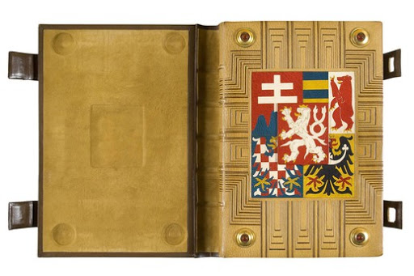
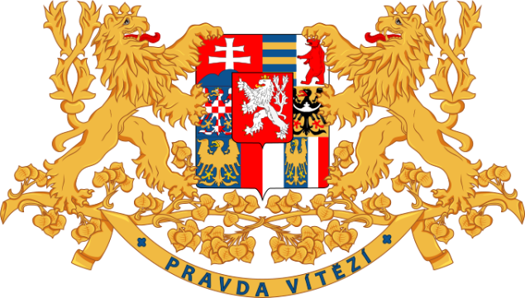
The Constitutional and Political System of Czechoslovakia, 1918–1938
Apart from the Preamble, the Constitutional Charter of the Czechoslovak Republic of 29 February 1920 contained six chapters:
1. General Provisions: The people are the sole source of all State power...
2. Legislative Powers
3. Governmental and Executive Powers
4. Judicial Powers
5. Rights, Liberties and Duties of the Citizen
6. Protection of Minorities

Slide 18
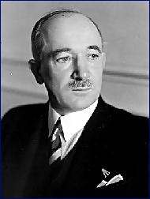
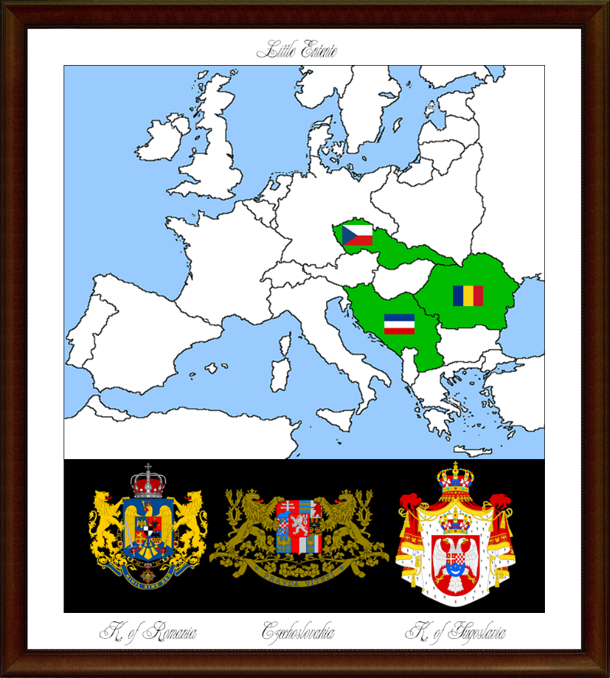
Little Entente – from 1921 (Czechoslovakia, Romania and Yugoslavia) Locarno 1925 and its impact on the future relationship with Germany Bilateral agreements between Czechoslovakia, France and the Soviet Union League of Nations and the role of Czechoslovakia Deterioration of relationship between Czechoslovakia and Nazi Germany after 1933
Czechoslovakia 1918–1938: Foreign Policy and Main Points
Edvard Beneš (1884–1948)

Slide 19
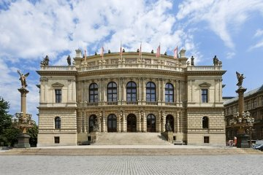
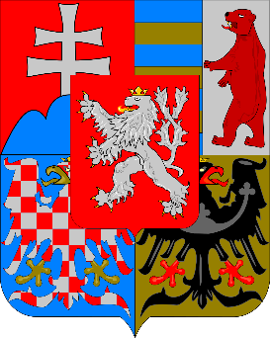
Legislation National Assembly: - Chamber of Deputies (300 deputies) - Senate (150 senators) Executive power - President of the Republic - Government - Provincial governments (from 1928) Chamber of Deputies (today's Rudolfinum) Universal suffrage including women – first elections (communal) on the basis of this newly reformed electoral law were held in 1919
The Political System of Czechoslovakia in the Years 1918–1938

Slide 20
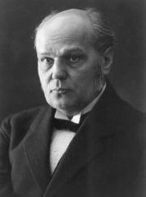
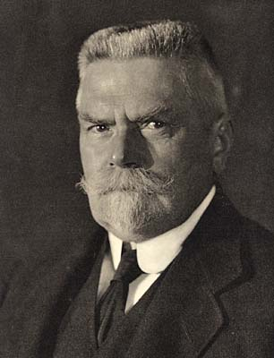
The most important Czech (Czechoslovak) political parties in the years 1918–1938: 1) Republican Party of Farmers and Peasants 2) Czechoslovak Social Democratic Workers' Party 3) Czechoslovak National Socialist Party 4) Czechoslovak People's Party 5) Czechoslovak National Democracy Antonín ŠVEHLA Karel KRAMÁŘ
The First Czechoslovak Republic and Its Party System

Slide 21
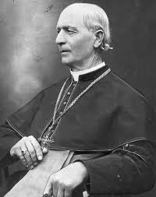
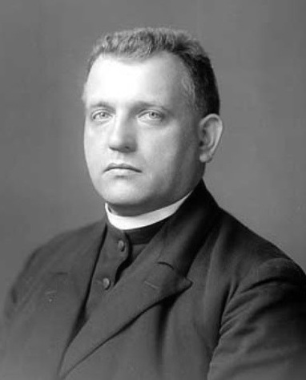
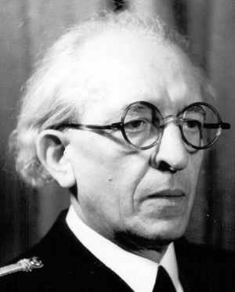
Slovak People's Party - Hlinka's Slovak People's Party Main representatives: - Andrej HLINKA - Josef TISO - Vojtech TUKA
The First Czechoslovak Republic and Its Party System
Andrej HLINKA (1864–1938) Jozef TISO (1887–1947) Vojtech TUKA (1880–1946)

Slide 22
German political parties: Activist political parties (German activism) - German Social Democratic Workers' Party in the Czechoslovak Republic (Deutsche sozialdemokratische Arbeiterpartei in der Tschechoslowakischen Republik – DSDAP); Ludwig Czech, Josef Seliger - German Christian Social People's Party (Deutsche Christlich-Soziale Volkspartei – DCVP); Robert Mayr-Harting, Erwin Zajicek - Farmers' League (Bund der Landwirte – BdL); Franz Spina Negativist political parties (German negativism) - German National Party (Deutsche Nationalpartei – DNP); Rudolf Lodgman von Auen -German National Socialist Workers' Party (DeutscheNationalsozialistischeArbeiterpartei – DNSAP); Rudolf Jung, Hans Krebs
The First Czechoslovak Republic and Its Party System

Slide 23
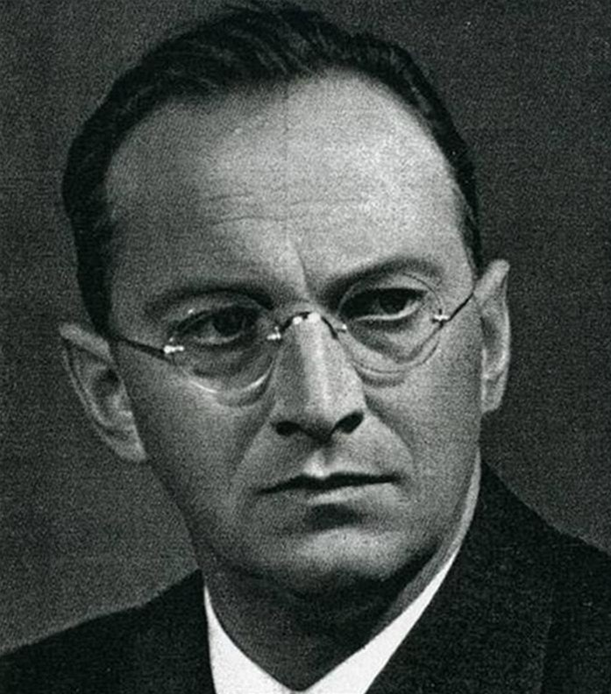
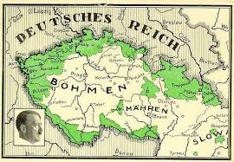
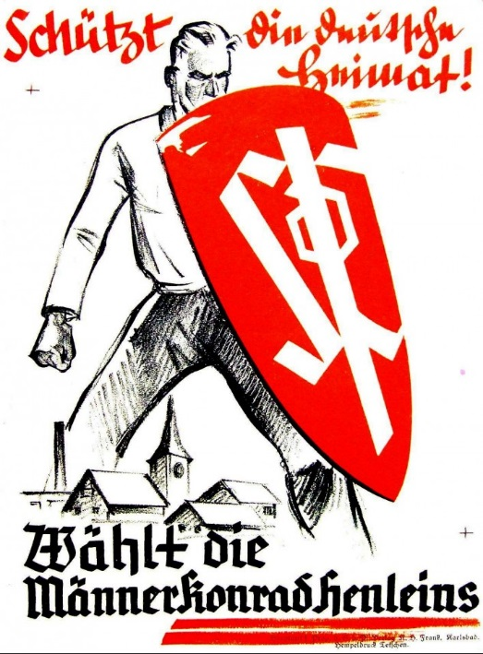
German political parties: - Sudeten German Party (Sudetendeutsche Partei – SdP) Sudeten German
The First Czechoslovak Republic and Its Party System
Konrad HENLEIN (1898–1945)

Slide 24
The Constitutional and Political System of Czechoslovakia, 1945–1948
National Front of Czechs and Slovaks – officially created on the basis of the Košice government programme from 5 April 1945. Association of political parties and organizations. There were no political entities that were allowed to operate outside of the NF platform
Provisional National Assembly of the Czechoslovak Republic – from 28 October 1945 to June 1946. The Czechoslovak Parliament became unicameral – 300 deputies. NF parties represented in the PNA – KSČ, ČSL, ČSS, ČSDSD for Czechia, KSS and DSS for Slovakia
Constituent National Assembly of the Czechoslovak Republic – from June 1946 to 30 May 1948. Formed after the elections in May 1946 – main goal: adoption of a new constitution of the Czechoslovak Republic. 300 deputies.
National Assembly of the Czechoslovak Republic – competence from 30 May 1948 to 1960. Created on the basis of the new constitution of 9 May 1948. Revived NF – KSČ, ČSS, ČSL, KSS, Party of Slovak Revival and Freedom Party
SLOVAKIA: Slovak National Council (SNC) – est. 1944, during Slovak National Uprising
Board of Commissioners – est. 1945, de facto autonomous Slovak government

Slide 25
The Constitutional and Political System of Czechoslovakia, 1945–1989
The Constitution of the Czechoslovak Republic – the so-called Ninth-of-May Constitution – adopted by the CNA on 9 May 1948. It repealed the constitutional charter of 1948. Formally maintaining a pluralistic system. It was largely inspired by the USSR Constitution of 1936.
Structure of the constitution:
- Declaration
- Fundamental Articles - Czechoslovak Republic, a democratic people's state of two equal nations, Czechs and Slovaks
- Detailed Provisions
- Rights and Duties of Citizens – guarantee of all fundamental rights and liberties of the individual
- National Assembly
- President of the Republic
- Government
- Slovak National Organs
- National Committees
- Economic System

Slide 26
The Constitutional and Political System of Czechoslovakia, 1945–1989
The Constitution of the Czechoslovak Socialist Republic – approved over 5-7 July 1960 by the Central Committee of the Communist Party, subsequently adopted on 11 July 1960 by the National Assembly. Introduction of the leading role of the Communist Party in state and society.
Proclamation: "Socialism has triumphed in our country!". Change of state name: Czechoslovak Socialist Republic – CSSR. Change of coat of arms. Parliament – National Assembly of the CSSR.
Strengthening of centralisation elements - the Board of Commissioners was abolished and the competencies of the SNC were curtailed
The 1960 Constitution underwent several modifications: in January 1969 (federalisation) and subsequently after November 1989 – for example, the dropping of the article about the leading role of the Communist Party, change of state name, the abolition of National Committees and more.

Slide 27
The Constitutional and Political System of Czechoslovakia, 1945–1989
Constitutional Act on the Czechoslovak Federation (143/1968 Coll.) – adopted by the National Council of the CSSR on 27 October 1968, effective from 1 January 1969.
The unitary Czechoslovak Socialist Republic was transformed into a federal state.
Establishment of two republics:
- Czech Socialist Republic (CSR) –Czech National Council and Government of CSR
- Slovak Socialist Republic (SSR) –Slovak National Council and Government of SSR
Federal level:
- Federal Assembly of the CSSR – bicameral: House of the People (200 deputies) and House of Nations (150 deputies – 75 Czechia and 75 Slovakia – the so-called prohibition of majorisation)
- Federal Government of the Czechoslovak Socialist Republic

Slide 28
The Constitutional and Political System of the Czech Republic since 1993
The Constitution of the Czech Republic – adopted by the Czech National Council on 16 October 1992, effective from 1 January 1993.
The Constitution of the Czech Republic consists of a preamble and 8 chapters:
- Preamble
- Chapter One: Fundamental Provisions (Charter of Fundamental Rights and Basic Freedoms, political system and political decisions – anchoring of political parties, territorial self-government, state symbols and others)
- Chapter Two: Legislative Power
- Chapter Three: Executive Power
- Chapter Four: Judicial Power (Constitutional Court and Structure of the Courts)
- Chapter Five: The Supreme Audit Office
- Chapter Six: The Czech National Bank, the state central bank, primary purpose to maintain price stability
- Chapter Seven: Territorial Self-Government
- Chapter Eight: Transitional and Final Provisions

Slide 29
The Constitutional and Political System of the Czech Republic since 1993
Parliament of the Czech Republic – defined and laid out in the second chapter of the Constitution of the Czech Republic.
Bicameral Parliament:
- Chamber of Deputies of the Parliament of the Czech Republic - 200 deputies elected on the basis of universal, equal, direct and secret suffrage for a period of 4 years. Active suffrage from 18 years, passive from 21 years. Seat in Thun Palace
- Senate of the Parliament of the Czech Republic – 80 senators elected for a period of six years replacement of 1/3 of senators every 2 years. Passive suffrage from the age of 40. Seat in Wallenstein palace
Regional Councils – 13 regions and the Capital City of Prague
City and Municipal Councils

