Slide 1




Reflection of National and European Identity in the New Millennium (NAETINEM)
Hana Maresova

Slide 2




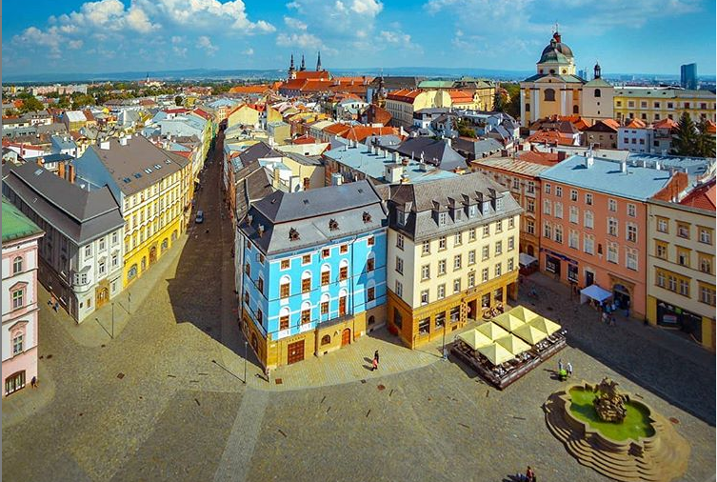
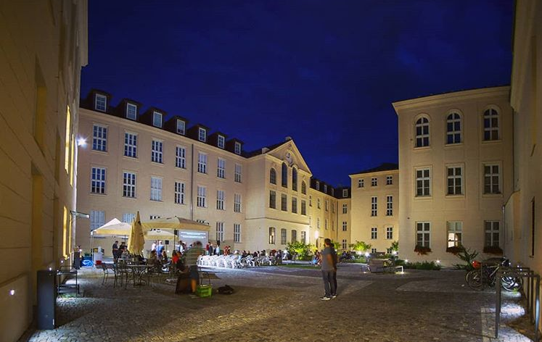
Welcome! Willkommen! Vitajte! Vítejte!
Palacky University
Olomouc

Slide 3
Project description
Reflection of National and European Identity in the New Millennium
Project No. 2019-1-CZ01-KA203-061227
Project duration: 36 months (01.09.2019 – 31.08.2021)
Maximum grant amount: 240 414,00 EUR
Website: http://odborict.upol.cz/NAETINEM/
Social network: https://www.linkedin.com/groups/12311843/ (NAETINEM)
Lead partner: Palacky University in Olomouc, Czech Republic
Partners:
Paedagogische Hochschule in Heidelberg, Germany
Northumbria University in Newcastle, United Kingdom
Matej Bel University in Banska Bystrica, Slovak Republic

Slide 4
Project main aims
Current view on EU citizenship and national identity and their reflexion in the partner countries
Innovation of university and secondary schools curricula (Civics, History, Language, Literature)
Innovation of university teaching by using new digital technology (3D virtual reality)
Relates to these Erasmus+ topics:
EU Citizenship, EU awareness and Democracy
ICT – new technologies – digital competences
New innovative curricula/educational methods/development of training courses

Slide 5
Project outputs
1 Project website + LinkedIN (coordination: Olomouc)
1 virtual room for mobility in 3D (coordination: Olomouc)
26 Toolkit teaching objects (coordination: Olomouc)
4 Factsheets (in 4 languages) (coordination: Heidelberg)
30 Articles (coordination: Newcastle)
1 Questionnaire for students (coordination: Banska Bystrica)
28 Workshops for students during mobility (all partners)
12 Workshops for teachers during mobility (all partners)
36 Presentations at multiplier events (all partners)

Slide 6
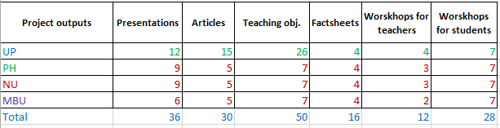
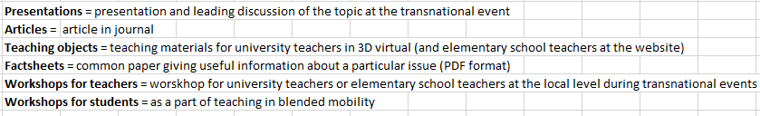
Project outputs
UP = Palacky University Olomouc, PH = Paedagogische Hochschule Heidelberg,
NU = Northumbria University Newcastle, MBU = Matej Bel University Banska Bystrica

Slide 7

What are we going to do?

Slide 8
Project activities
Mapping of existing view on topics of EU citizenship and national identity
1 Baseline survey – university students
4 Transnational events (meeting of partners in project management issues)
4 Multiplier events (meeting on topic with regional stakeholders)
1 Virtual and real mobility of teachers and students
Testing, piloting and training events
Producing intellectual outputs (Toolkit, Articles, Factsheets)
6 On-line planning meetings (via CisCo WebEx)

Slide 9

Project management

Slide 10
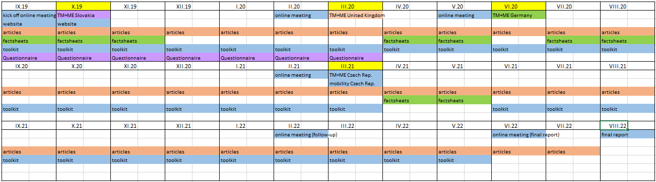


Time Schedule

Slide 11
Project governance
A project steering group:
  H. Maresova, P. Flajsarova, P. Krakora (Olomouc),
  B. Degner (Heidelberg),
  J. Robinson (Newcastle),
  E. Vallova (Banska Bystrica)
  A project steering group will be set and will bring together representatives from each project partner.
  The role of this group will be to ensure effective implementation and delivery of the project.
  The group will meet face to face during transnational events.
  There will also be regular on-line meetings to update on progress, share challenges and issues in terms of delivery, plan the transnational activities.

Slide 12
Partners responsibilites
  Deliver all project activities as agreed and outlined in application
  Respect programme budget rules
  Participate actively in transnational events
  Participate in local steering group
  Participate in project steering group if required
  Ensure adequate project management
  Disseminate project results
  Coordination of Toolkit production, blended mobility realization, website and social media (Olomouc)
  Coordination of Factsheets production (Heidelberg)
  Coordination of Articles production (Newcastle)
  Coordination of Questiannaire evaluation (Banska Bystrica)

Slide 13
Multiplier events (+ Transnational meetings)
Event 1 – October 2019, Banska Bystrica, Slovakia
Theme: Concept of EU citizenship and national identity (Civics and History topics)
Event 2 – March 2020, Newcastle, UK
Theme: Symbols of EU and (inter)national identity in Literature and Language
(History, Literature, Language)
Event 3 – June 2020, Heidelberg, Germany
Theme: Challenges for EU citizenship and (inter)national identity
Event 4 - March, 2021, Olomouc, Czech Republic (MOBILITY)
Theme: Reflection the symbols of EU citizenship and (inter)national identity

Slide 14
Local dissemination of results (Multiplier events)
Multiplier events
Factsheets / Toolkit
Teaching students at universities and local stakeholderes (secondary school teachers)
Each partner will need to set up a local steering group whose role will be to ensure effective
implementation of the project at local and to shape the delivery at transnational level.
This group should include the local relevant stakeholders. These could be secondary school teachers, young people, education authority, politician, employer, etc.
Number of participants at the multiplier events: total 80.

Slide 15
Communication tools and publicity
Branding
Project logo
Project images
Project templates
Tools
Project website: http://odborict.upol.cz/NAETINEM (preparing)
Social media: https://www.linkedin.com/groups/12311843/
Channels
Local media – press releases, press conference
Specialised media – factsheets, articles
Local events
Multiplier events

Slide 16
Administrative management
Group of administrators:
  Each country needs administrator for its own administrative and financial management!
  Main project managers and administrators of the project (available for partners questions):
  Mgr. Pavla Tresterova (pavla.tresterova@upol.cz) – financial issues
  Ing. Veronika Knichalova (Veronika.knichalova@upol.cz) – financial issues
  Mgr. Iveta Ruskova (iveta.ruskova@upol.cz) – administrative issues
  Mgr. Michaela Janakova (michaela.janakova@upol.cz) – blended mobility issues

Slide 17

Thank you for cooperation!

