Slide 1
Reflection of National and European Identity in the New Millennium (NAETINEM)
Hana Maresova

Slide 2
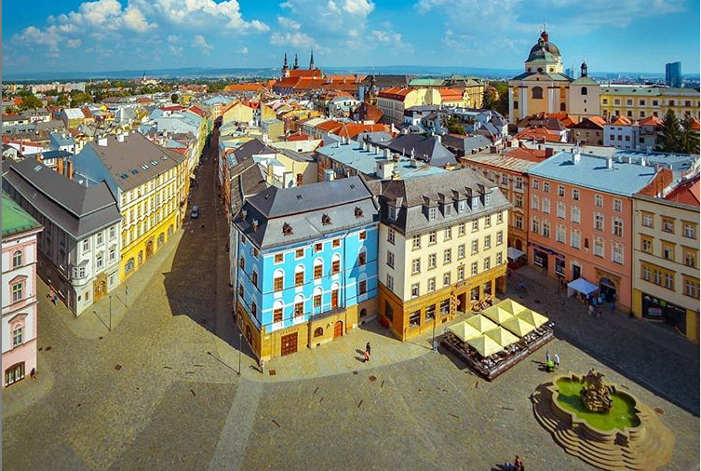
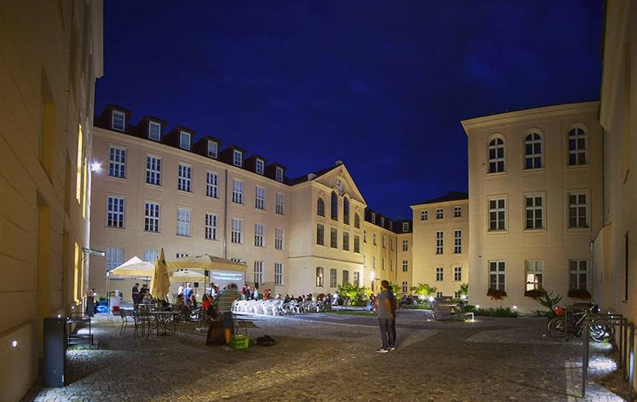
Welcome! Willkommen! Vitajte! Vítejte!
Palacky University
Olomouc

Slide 3
Project description
Reflection of National and European Identity in the New Millennium (NAETINEM)
Project No. 2019-1-CZ01-KA203-061227
Project duration: 36 months (01.09.2019 – 31.08.2021)
Maximum grant amount: 240 414,00 EUR
Lead partner: Palacky University in Olomouc, Czech Republic
Partners:
Paedagogische Hochschule in Heidelberg, Germany
Northumbria University in Newcastle, United Kingdom
Matej Bel University in Banska Bystrica, Slovak Republic

Slide 4
Project main aims
Current view on EU citizenship and national identity and their reflexion in the partner countries
Innovation of university and secondary schools curricula (Civics, History, Language, Literature)
Innovation of university teaching by using new digital technology (3D virtual reality)
Relates to these Erasmus+ topics:
EU Citizenship, EU awareness and Democracy
ICT – new technologies – digital competences
New innovative curricula/educational methods/development of training courses

Slide 5
Project outputs
1 Project website + Facebook (coordination: Olomouc)
1 virtual room for mobility in 3D (coordination: Olomouc)
26 Toolkit teaching objects (coordination: Olomouc)
4 Factsheets (in 4 languages) (coordination: Heidelberg)
30 Articles (coordination: Newcastle)
1 Questionnaire for students (coordination: Banska Bystrica)
28 Workshops for students during mobility (all partners)
12 Workshops for teachers during mobility (all partners)
36 Presentations at multiplier events (all partners)

Slide 6
Project outputs
UP = Palacky University Olomouc, PH = Paedagogische Hochschule Heidelberg,
NU = Northumbria University Newcastle, MBU = Matej Bel University Banska Bystrica

Slide 7
What are we going to do?

Slide 8
Project activities
Mapping of existing view on topics of EU citizenship and national identity
1 Baseline survey – university students
4 Transnational events (meeting of partners in project management issues)
4 Multiplier events (meeting on topic with regional stakeholders)
6 On-line planning meetings (via CisCo WebEx)
1 Virtual and real mobility of teachers and students
Testing, piloting and training events
Producing intellectual outputs (Toolkit, Articles, Factsheets)

Slide 9
Project management

Slide 10
Time Schedule

Slide 11
Project governance
A project steering group:
H. Maresova, P. Flajsarova, P. Krakora (Olomouc), B. Degner (Heidelberg), J. Robinson (Newcastle), E. Vallova (Banska Bystrica)
A project steering group will be set and will bring together representatives from each project partner.
The role of this group will be to ensure effective implementation and delivery of the project.
The group will meet face to face during transnational events.
There will also be regular on-line meetings to update on progress, share challenges and issues in terms of delivery, plan the transnational activities.

Slide 12
Partners responsibilites
Deliver all project activities as agreed and outlined in application
Respect programme budget rules
Participate actively in transnational events
Participate in local steering group
Participate in project steering group if required
Ensure adequate project management
Disseminate project results
Coordination of Toolkit production, blended mobility realization, website and social media (Olomouc)
Coordination of Factsheets production (Heidelberg)
Coordination of Articles production (Newcastle)
Coordination of Questiannaire evaluation (Banska Bystrica)

Slide 13
Administrative management
Group of administrators:
P. Tresterova, V. Knichalova, I. Komarkova, M. Janakova (Olomouc),
? (Heidelberg), ? (Newcastle), ? (Banska Bystrica)
Each country needs administrator for its own administrative and financial management!
Main project managers and administrators of the project (available for partners questions):
Mgr. Pavla Tresterova (pavla.tresterova@upol.cz) – financial issues
Ing. Veronika Knichalova (Veronika.knichalova@upol.cz) – financial issues
Mgr. Iveta Komarkova (iveta.komarkova@upol.cz) – administrative issues
Mgr. Michaela Janakova (michaela.janakova@upol.cz) – blended mobility issues

Slide 14
Team members
Olomouc
Heidelberg, Newcastle, Banska Bystrica – task: to complete the team

Slide 15
Administrative management
Recording of activities – Mobility Tool +
Information on mobilities
Information on time spent on intellectual outputs
Information on multiplier events
Information on learning activities
Information on exceptional costs (outputs)
Recording time
Timesheets
Audit trail – document and receipts archiving
Keep everything!

Slide 16
Financial management
Budget
Each country will receive a budget only after signing the partnership agreement!

Slide 17
Project management and implementation
Time spent on general project co-ordination
Organisation, hosting and participation in transnational events including expertise
Organisation of local events (consultation, training, piloting)
Communication activities
Translation of project documents (except factsheets and toolkit)
Development and production of factsheets

Slide 18
Teaching activities (blended mobilty)
Travel costs to participate in mobility in Olomouc
Accommodation
Based on flat rate and number of mobilities
Intellectual outputs
Time spent on developing and producting Articles, Factsheets and Toolkit – flat rate per day based on cost of living
Multiplier events
Organisation costs for multiplier events – venue, catering, expertise

Slide 19
Transnational project meetings
Travel costs to participate in all transnational events
Accommodation
Based on flat rate and number of mobilities
Special needs support
All travel costs and support tools for students with special needs (multiplier events, mobility)
This budget cannot be used in any other way
Exeptional costs (translation)
Translation to English and from English of Articles, Factsheets and Toolkit – 75% of actual costs
Not for Newcastle

Slide 20
Financial rules
Exchange rate
Conversion into € - exchange rate set by Commission on date of receipt of pre-financing
Budget flexibility
20% flexibility rule between budget categories
Up to 20% can be converted from:
• Project management and organization
• Transnational project meetings
• Intellectual outputs
• Multiplier events
• Exceptional costs
To:
• Transnational project meetings
• Intellectual outputs
• Multiplier events
Project management and implementation and exceptional costs cannot be increased!!!

Slide 21
Communication tools and publicity
Branding
Project logo
Project images
Project templates
Tools
Project website: http://odborict.upol.cz/NAETINEM (preparing)
Social media: Facebook (preparing)
Channels
Local media – press releases, press conference
Specialised media – factsheets, articles
Local events
Multiplier events

Slide 22
Multiplier events (+ Transnational meetings)
Event 1 – October 2019, Banska Bystrica, Slovakia
Theme: Concept of EU citizenship and national identity (Civics and History topics)
Event 2 – March 2020, Newcastle, UK
Theme: Symbols of EU and (inter)national identity in Literature and Language
(History, Literature, Language)
Event 3 – June 2020, Heidelberg, Germany
Theme: Challenges for EU citizenship and (inter)national identity
Event 4 - March, 2021, Olomouc, Czech Republic
Theme: Reflection the symbols of EU citizenship and (inter)national identity

Slide 23
Local dissemination of results
Multiplier events
Factsheets / Toolkit
Teaching students at universities and local stakeholderes (secondary school teachers)
Each partner will need to set up a local steering group whose role will be to ensure effective
implementation of the project at local and to shape the delivery at transnational level.
This group should include the local relevant stakeholders. These could be secondary school teachers, young people, education authority, politician, employer, etc.
Number of participants at the multiplier events: total 80.

Slide 24
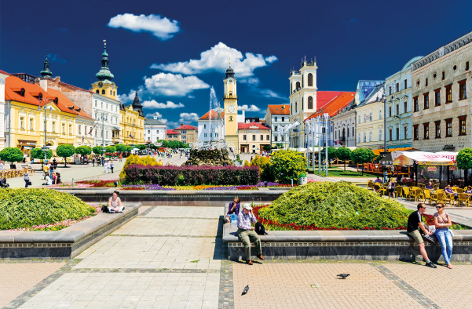
Meeting in Banska Bystrica

Slide 25
Banska Bystrica Meeting Programme
DAY 0 – Tuesday 29 October 2019, 7.00 PM – 9.00 PM
Place: Banska Bystrica, Restaurant (TBC…)
Main focus: introductory evening
Getting to know the partner contexts
Optional meeting
(depends on the arrival time)

Slide 26
Banska Bystrica Meeting Programme
DAY 1 – Wednesday 30 October 2019, 10.00 AM – 12.00 AM
Place: Banska Bystrica, Matej Bel University (Room: TBC…)
Main topic: Concept of EU citizenship and national identity
(Civics and History topic)
Definition of the core terms and issues (Olomouc)
Introducing of each country and university and their view on the core terms and issues (Heidelberg, Newcastle, Banska Bystrica)

Slide 27
Banska Bystrica Meeting Programme
DAY 1 – Wednesday 30 October 2019, 1.00 PM – 5.00 PM
Place: Banska Bystrica, Matej Bel University (Room: TBC…)
Main topic: Concept of EU citizenship and national identity
(Civics and History topic)
Workshop for teachers – 3D virtual mobility training (Olomouc)
Workshop for students – EU citizenship and its challenges (Banska Bystrica)
Introducing a questionnaire on EU citizenship and national identity among university students (Banska Bystrica)

Slide 28
Banska Bystrica Meeting Programme
DAY 2 – Thursday 31 October 2019, 10.00 AM – 12.00 AM
Place: Banska Bystrica, Matej Bel University (Room: TBC…)
Only members of project team:
Project management, Roles and responsibilities
Budget and financial management
Finalising project aims and objectives
Reviewing the project work plan and outputs
Linking transnational and local levels
Communicating and dissemination the project results
Workshop for students – 3D virtual mobility training (Olomouc)

Slide 29
Next nearest steps
Task | Need to be sent
To sign the Partnership agreement by institution | Signed agreement in print version with stamp and scanned version on e-mail: pavla.tresterova@upol.cz (as soon as possible)
To identify group of work team and 2 students with special needs for meeting in Banska Bystrica | Completed excel document with list of members on e-mail: iveta.komarkova@upol.cz (as soon as possible)
To manage the trip to Banska Bystrica (fly ticket, bus ticket, the list of participants for hotel booking) | List of participants for hotel booking on e-mail: elena.vallova@umb.sk (as soon as possible)
To prepare the presentation for 1 multiplier event in BB (we´ll send you a presentation template with topics during September) | Final presentation on e-mail: iveta.komarkova@upol.cz (before 30. 10. 2019)

Slide 30
That´s all ! (For now ☺)
Looking forward seeing you
in Banska Bystrica (30. – 31. 10. 2019)!

