Slide 1
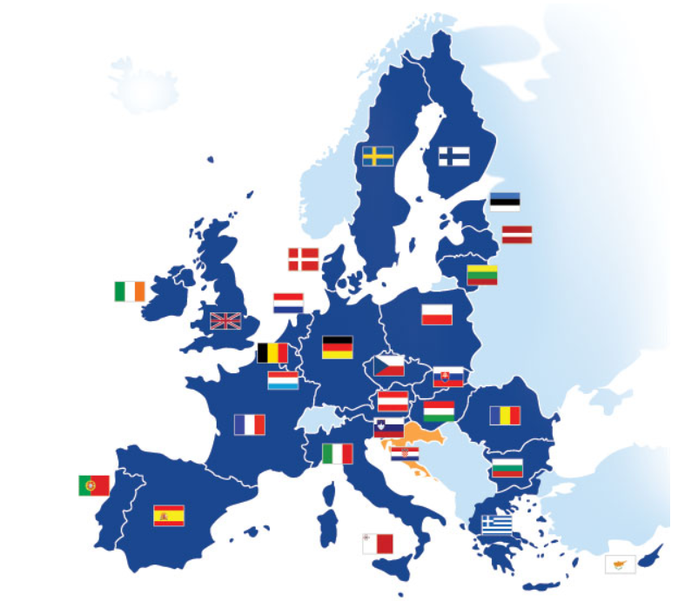
SYMBOLS OF THE EUROPEAN UNION

Slide 2
What are state symbols?
State symbols are (usually) statutory signs by which the state denotes its sovereignty and which are one of the formal manifestations of its statehood.
State symbols also present the state in relation to other states, expressing its history, territorial development, constitutional nature, or even national identity.
The form of state symbols has its historical justification.

Slide 3
What are symbols of the European Union?
The European Union’s symbol is the flag of Europe which displays a circle of twelve golden starts on a blue background.
The Union anthem is taken from Ludwig van Beethoven’s 9th symphony: Ode to Joy.
The motto of the Union is: ‘Unity in diversity’.
The currency of the Union is the Euro.
Europe celebrates the Europe Day on 9 May in honour of the Robert Schuman Declaration. The process of European integration started with this declaration given on 9 May 1950.

Slide 4
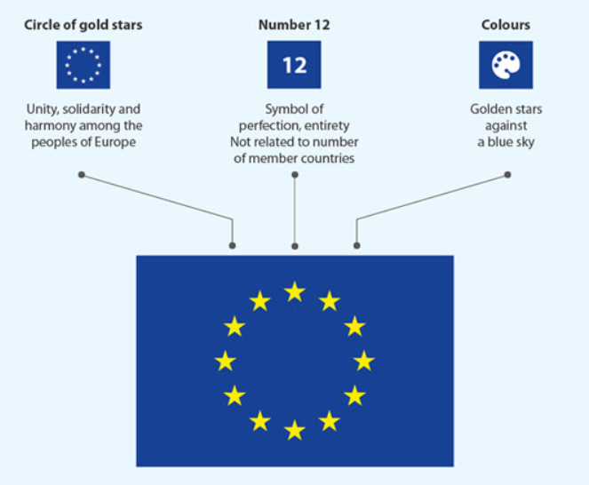
The flag of the European Union
The European flag symbolizes both the European Union and the identity and unity of Europe.
It features a circle of 12 gold stars on a blue background. They stand for the ideals of unity, solidarity and harmony among the peoples of Europe.
The number of stars has nothing to do with the number of member countries, though the circle is a symbol of unity.
The Council of Europe chose the present design for its own use in 1955.

Slide 5
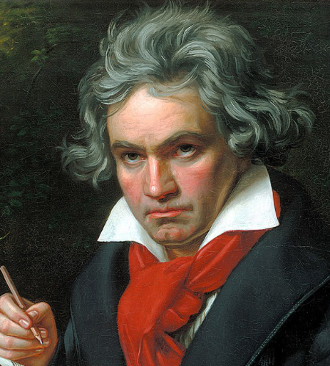
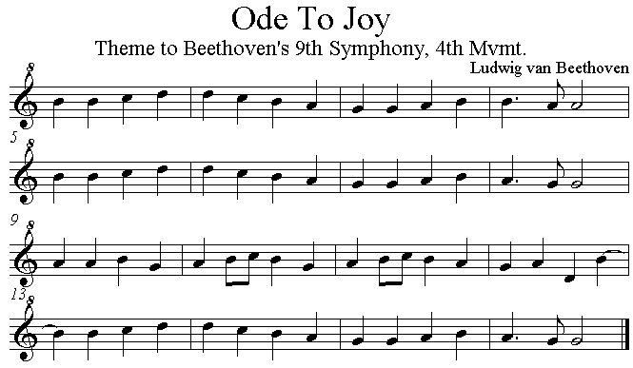
The anthem of the European Union
"Ode to Joy" is the anthem of the European Union, promoted as a symbol for the whole of Europe as are the other European symbols.
In 1971: decision to propose adopting the prelude to the "Ode to Joy" from Ludwig van Beethoven's 9th Symphony as the anthem.
It is used on occasions such as Europe Day and formal events such as the signing of treaties.
German version

Slide 6
The motto of the European Union
Adopted in 2000
IN VARIETATE CONCORDIA, Latin-language version by the Italian Nobel prize winner Ernesto Teodoro Moneta
This motto is also used as a compromise.
European Commission: “The motto means that, via the EU, Europeans are united in working together for peace and prosperity, and that the many different cultures, traditions and languages in Europe are a positive asset for the continent.“

Slide 7
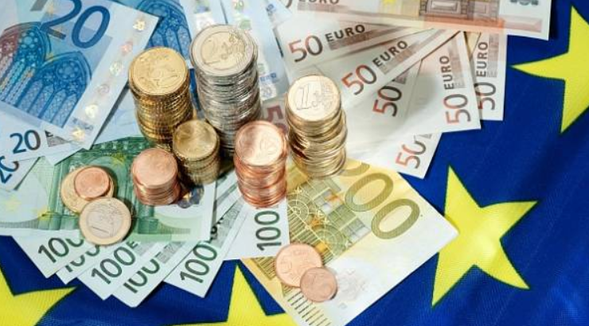
The currency of the European Union
The euro (symbol: €; code: EUR) is the official currency of 19 of the 27 member states of the European Union.
This group of states is known as the EUROZONE or EURO AREA and includes about 343 million citizens as of 2019.
Euro is divided into 100 cents.

Slide 8
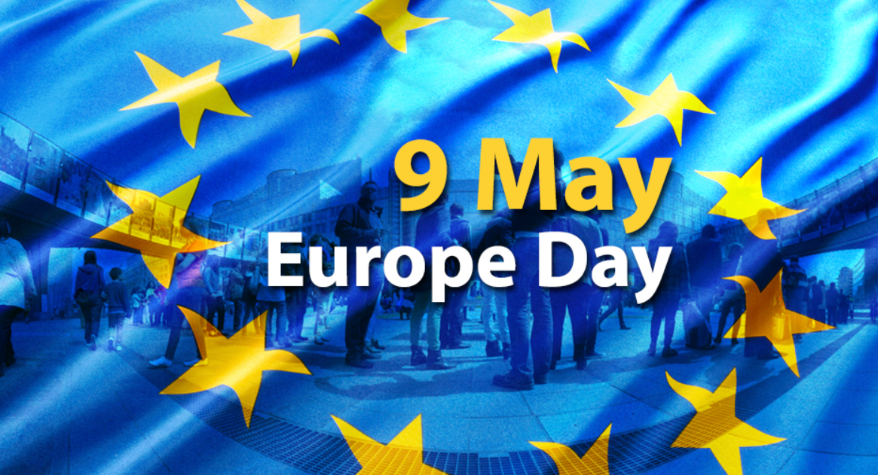
The Europe Day
Europe celebrates the Europe Day on 9 May in honour of the Robert Schuman Declaration.
The process of European integration started with this declaration given on 9 May 1950.
To celebrate Europe Day, the EU institutions open their doors to the public in early May in Brussels and Strasbourg. Local EU offices in Europe and all over the world organize a variety of activities and events for all ages.

Slide 9
Official languages of the European Union
The EU has 24 official languages.
English, French and German have the higher status of "procedural" languages of the European Commission.
European Parliament accepts all official languages as working languages.
The EU encourages all its citizens to be multilingual; specifically, it encourages them to be able to speak two languages in addition to their native language.
The five most spoken languages in the EU are English (44%), German (36%), French (29%), Italian (18%) and Spanish (17%).

Slide 10
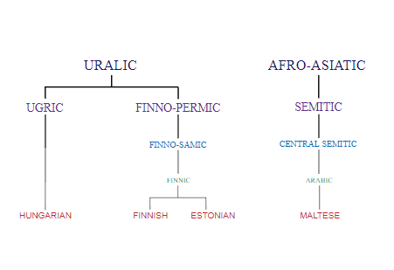
Origin of languages of the European Union

Slide 11
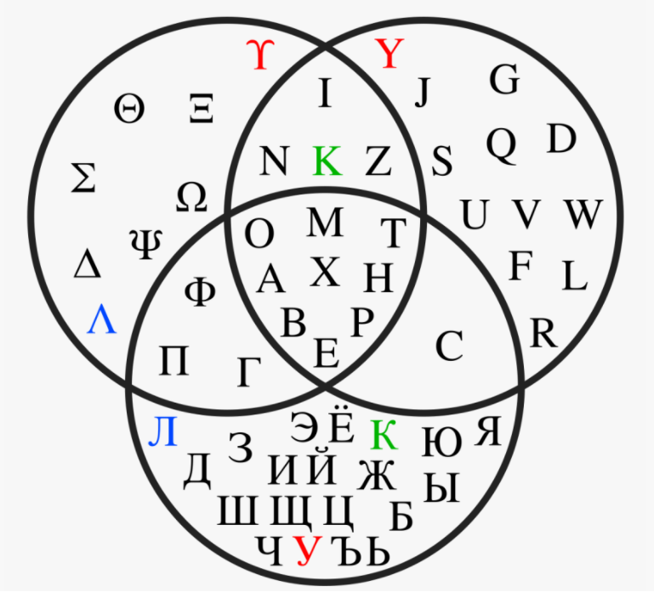
Writing systems of the European Union
Most official EU languages are written in the Latin script.
The two exceptions: Greek script (Greek), Cyrillic script (Bulgarian).
With the accession of Bulgaria to the European Union on 1 January 2007, Cyrillic became the third official script of the European Union.
The current design of euro banknotes has the word euro written in both the Latin and Greek (Ευρώ) alphabets; the Cyrillic spelling (Eвро) was added to the new Europa series of banknotes started in 2013.
Greek
Latin
Cyrillic

Slide 12
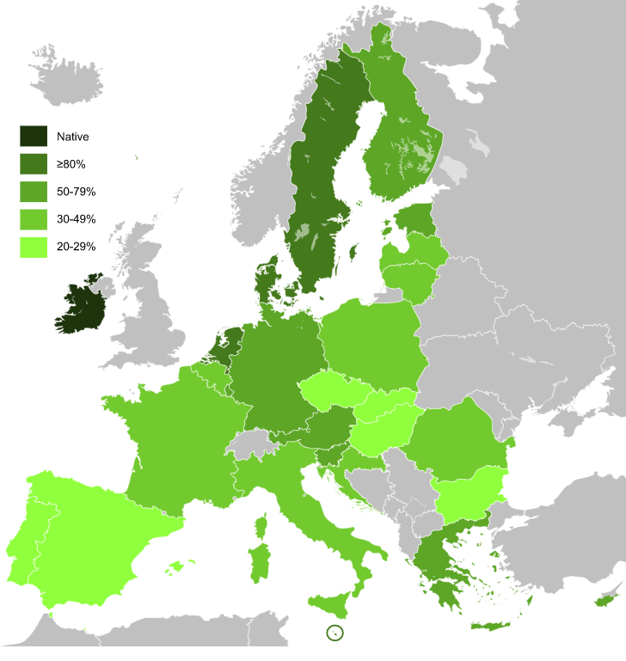
Knowledge of English in the European Union
English language in Europe:
as a native language (UK, Ireland),
official language (Malta and Crown dependencies – Isle of Man, Jersey and Guernsey, Sovereign Base Areas of Akrotiri and Dhekelia) + Netherlands – at isles of Saba and Sint Eustatium (in the Caribbean).
In the other EU countries as a second language.

Slide 13
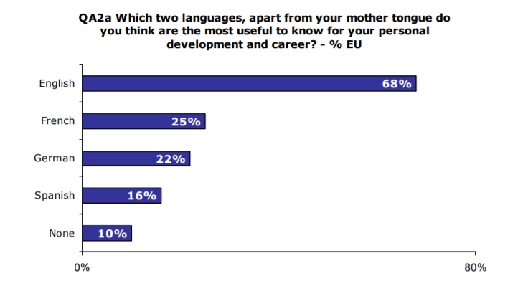
Research on the most useful languages in the European Union
Research of European Commission, Europeans and their Languages Fieldwork: November – December 2005 Publication: February 2006.

Slide 14
Sources for text and pictures:
https://europa.eu/european-union/about-eu/symbols/flag_en
https://europarlamentti.info/en/European-union/symbols/
https://en.wikipedia.org/wiki/Ludwig_van_Beethoven#/media/File:Beethoven.jpg
https://europa.eu/european-union/about-eu/symbols/motto_en
https://en.wikipedia.org/wiki/Anthem_of_Europe
https://europeword.com/european-national-anthem/
https://ec.europa.eu/info/business-economy-euro/euro-area_en
https://europa.eu/european-union/about-eu/symbols/europe-day_en
https://europa.eu/european-union/sites/europaeu/files/eu_in_slides_en.pptx
https://en.wikipedia.org/wiki/Languages_of_the_European_Union#/media/File:Eu-official-languages-tree.svg
https://en.wikipedia.org/wiki/English_language_in_Europe#/media/File:Knowledge_of_English_EU_map.svg
https://ec.europa.eu/commfrontoffice/publicopinion/archives/ebs/ebs_243_en.pdf

