Slide 1




First step to a united Europe?
Part 1
Project No. 2019-1-CZ01-KA203-061227, Reflection of National and European Identity in the New Millennium (NAETINEM), 18.01.2021

Slide 2
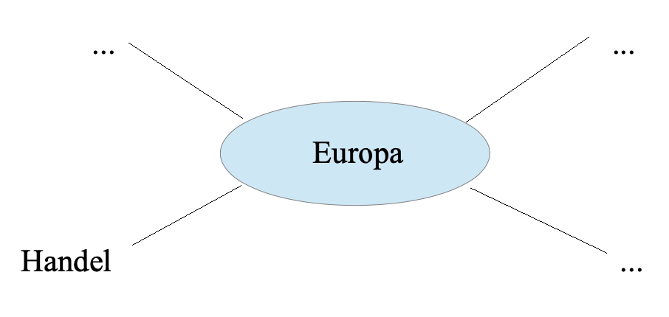

1. Brainstorming:
What do you associate with today´s Europe?
  Create a mind map with terms that are central to you on the topic of "Europe".
Europe
Trade
Is the Congress of Vienna part of your mind map?

Slide 3

Quick info: Congress of Vienna
Napoleon Bonaparte's expansionist policies threw almost the entire European continent into chaos and confusion. In the Battle of the Nations at Leipzig from October 16 to 19, 1813, the European powers were able to achieve victory over Napoleon, who was forced to retreat behind the Rhine after his defeat. This ended French hegemony in Europe and at the same time created the conditions for a new beginning for the whole of Europe. The Congress of Vienna, which met from September 18, 1814 to June 9, 1815, was therefore convened for the purpose of reorganizing Europe.

Slide 4
2. Basics: Who participated in the Congress of Vienna and what was decided?
  Using Jean Baptiste Isabey‘s representation of the Congress of Vienna (Q1) and the excerpt from the Congress of Vienna Acts (Q2), work out who (including which social class) was involved in this conference.
  What do you think can be concluded from this for the legitimacy of the Congress of Vienna and its decisions?

Slide 5
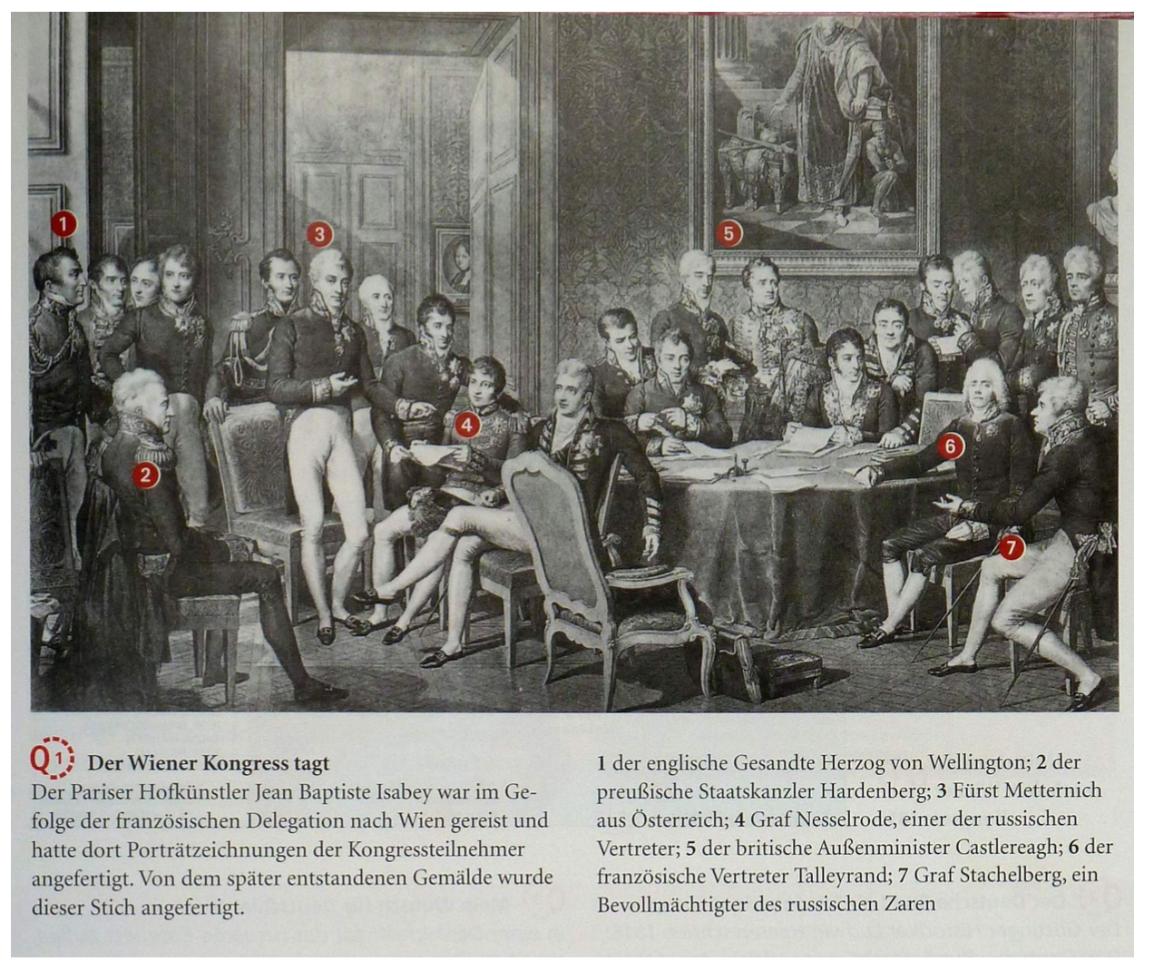
Q1
The Congress of Vienna meets
1 the English envoy Duke of Wellington; 2 the Prussian Chancellor of State Hardenberg; 3 Prince Metternich from Austria; 4 Count Nesselrode, one of the Russian representatives; 5 the British Foreign Secretary Castlereagh; 6 the French representative Talleyrand; 7 Count Stachelberg, a representative of the Russian Tsar
The Parisian court artist Jean Baptiste Isabey had traveled to Vienna in the wake of the French delegation and had made portrait drawings of the congress participants there. This engraving was made from the painting created later.

Slide 6
Q2
Excerpt from the Congress of Vienna Acts
In the name of the Most Holy and Undivided Trinity.
The Powers who signed the Treaty concluded at Paris on the 30th of May 1814, having assembled at Vienna, in pursuance of the 32 d Article of that Act, with the princes and states their Allies, to complete the provisions of the said Treaty, and to add to them the arrangements rendered necessary by the state in which Europe was left at the termination of the last war, being now desirous to embrace, in one common transaction, the various results of their negociations, for the purpose of confirming them by their reciprocal ratifications, have authorized their Plenipotentiaries to unite, in a general instrument, the regulations of superior and permanent interest, and to join to that act, as integral parts of the arrangements of Congress, the Treaties, Conventions, Declarations, Regulations, and other particular acts, as cited in the present Treaty. And the above-mentioned powers having appointed Plenipotentiaries to the Congress, that is to say:

Slide 7
Q2
ART. XV. His Majesty the King of Saxony renounces in perpetuity for himself and all his descendants and successors, in favour of his Majesty the King of Prussia, all his right and title to the provinces, districts, and territories, or parts of territories, of the kingdom of Saxony, hereafter named; and his Majesty the King of Prussia shall possess those countries in complete sovereignty and property, and shall unite them to his monarchy. The districts and territories thus ceded, shall be separated from the rest of the kingdom of Saxony by a line, which henceforth shall form the frontier between the Prussian and Saxon territories, so that all that is comprised in the limit formed by this line, shall be restored to his Majesty the King of Saxony; but his Majesty renounces all those districts and territories that are situated beyond that line, and which belonged to him before the war.
ART. I. The duchy of Warsaw, with the exception of the provinces and districts which are otherwise disposed of by the following Articles, is united to the Russian empire, to which it shall be irrevocably attached by its constitution, and be possessed by his majesty the Emperor of all the Russias, his heirs and successors in perpetuity. His Imperial Majesty reserves to himself to give to this State, enjoying a distinct Administration, the interior improvement which he shall judge proper. He shall assume with his other titles that of Czar, King of Poland, agreeably to the form established for the titles attached to his other possessions.
ART. LIII. The Sovereign Princes and Free-towns of Germany, under which denomination, for the present purpose, are comprehended their Majesties the Emperor of Austria, the Kings of Prussia, of Denmark, and of the Netherlands; that is to say,
the Emperor of Austria and the King of Prussia for all their possessions which anciently belonged to the German Empire,
the King of Denmark for the Duchy of Holstein,
and the King of the Netherlands for the Grand Duchy of Luxembourg, establish among themselves a perpetual Confederation, which shall be called the "Germanic Confederation."
ART. LIV. The object of this Confederation is the maintenance of the external and internal safety of Germany, and of the independance and inviolability of the confederated States.

Slide 8
ART. XCIV. His Imperial and Royal Apostolic Majesty shall unite to his monarchy, to be possessed by him and his successors, in full property and sovereignty;
1. Besides the portions of the Terra-Firma in the Venetian states mentioned in the preceding Article, the other parts of those states, as well as all other territory situated between the Tessin, the Po, and the Adriatic sea.
2. The vallies of the Valtcline, of Bormio, and of Chiavenna.
3. The territories which formerly composed the republic of Ragusa.
Q2
ART. LXVI. The line comprising the territories which compose the kingdom of the Netherlands, is determined in the following manner:
ART. LXVIII. The Grand Duchy of Luxembourg shall consist of all the territory situated between the kingdom, of the Netherlands
ART. XCVI. The general principles, adopted by the Congress at Vienna, for the navigation of rivers, shall be applicable to that of the Po.
ART. LXXIV. The integrity of the nineteen Cantons, as they existed in a political body, from the signature of the Convention of the 29th December 1813, is recognised as the basis of the Helvetic system.
ART. CIX. The navigation of the rivers, along their whole course, refered to in the preceding Article, from the point where each of them becomes navigable, to its mouth, shall be entirely free, and shall not, in respect to commerce, be prohibited to any one; it being understood that the regulations established with regard to the police of this navigation, shall be respected; as they will be framed alike for all, and as favourable as possible to the commerce of all nations.
ART. LXXXV. The frontiers of the states of his Majesty the King of Sardinia shall be
ART. CXV. The custom-houses belonging to the states bordering on rivers shall not interfere in the duties of navigation. Regulations shall be established to prevent officers of the customs, in the exercise of their functions, throwing obstacles in the way of the navigation; but care shall be taken, by means of a strict police on the bank, to preclude every attempt of the inhabitants to smuggle goods, through the medium of boatmen.

Slide 9
Done at Vienna the 9th of June, in the year of our Lord 1815.
Q2
Austria, | The Prince de Metternich.
 | The Baron de Wessenberg.
Spain,
France, | The Prince de Talleyrand,
 | The Duke de Dalberg.
 | The Count Alexis de Noailles
Great Britain, | Clancarty.
 | Cathcart.
 | Stewart, L. G.
Portugal, | The Comte de Palmella.
 | Antonio de Saldanha da Gania.
 | D.Joaquim Leboda Siltxira.
Prussia, | The Prince de Hardenberg.
 | The Baron de Humboldt.
Russia, | The Prince de Rasoumoffsky
 | The Count de Stackelberg.
 | The Count de Nesselrode.
Sweden, | The Count Charles-Axel de Lowenhielm.
ART. CXIX. All the Powers assembled in Congress, as well as the Princes and free towns, who have concurred in the arrangements specified, and in the Acts confirmed, in this General Treaty, are invited to accede to it.
ART. CXXI. The present Treaty shall be ratified, and the ratifications exchanged in six months, and by the Court of Portugal in a year, or sooner if possible. A copy of this General Treaty shall be deposited, in the Archives of the Court and State of his .Imperial and Royal Apostolic Majesty, at Vienna, in case any of the Courts of Europe shall think proper to consult the original text of this instrument. In faith of which the respective Plenipotentiaries have signed this Act, and have affixed thereunto the seals of their arms.

Slide 10
2. Basics: Who participated in the Congress of Vienna and what was decided?
  Summarize shortly what was decided at the Congress of Vienna based on the extract from the Congress of Vienna Act (Q2).
  To what extent do the territorial provisions made at the Congress of Vienna still hold true today?
  Also use the two maps of Europe after the Congress of Vienna (Q3) and of Europe today (Q4).

Slide 11
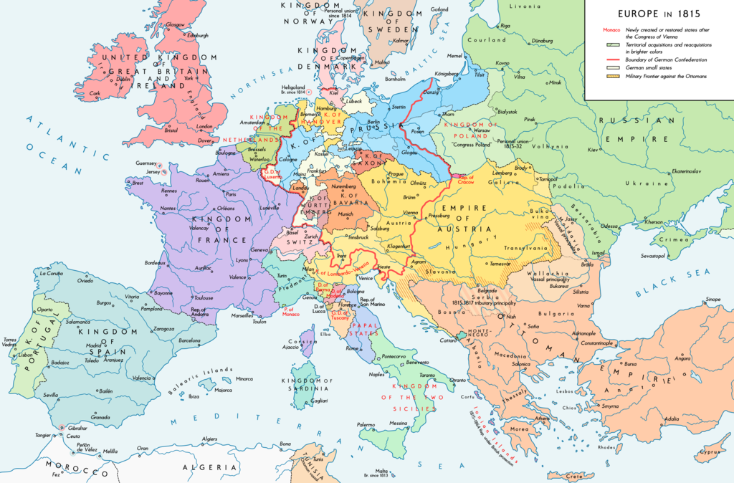

Q3
Founding States of the Holy Alliance

Slide 12
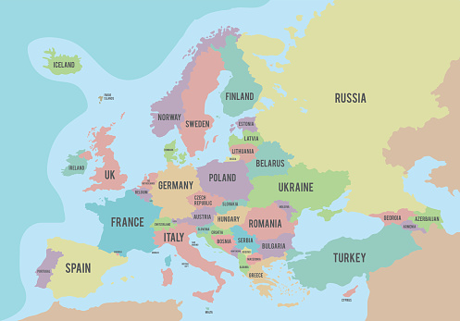
Q4

Slide 13
3. Elaboration: Was the Congress of Vienna a first step to a united Europe?
  What role does the Congress of Vienna play for you? Is it part of your mind map or not and why? Should it be part of your mind map? Give reasons.
  Also, assess whether the Europe as created at the Congress of Vienna has anything to do with our Europe today, and if so, how.

