Slide 1



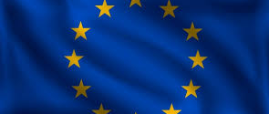
First step to a united Europe?
Part 2
Project No. 2019-1-CZ01-KA203-061227, Reflection of National and European Identity in the New Millennium (NAETINEM), 18.01.2021

Slide 2
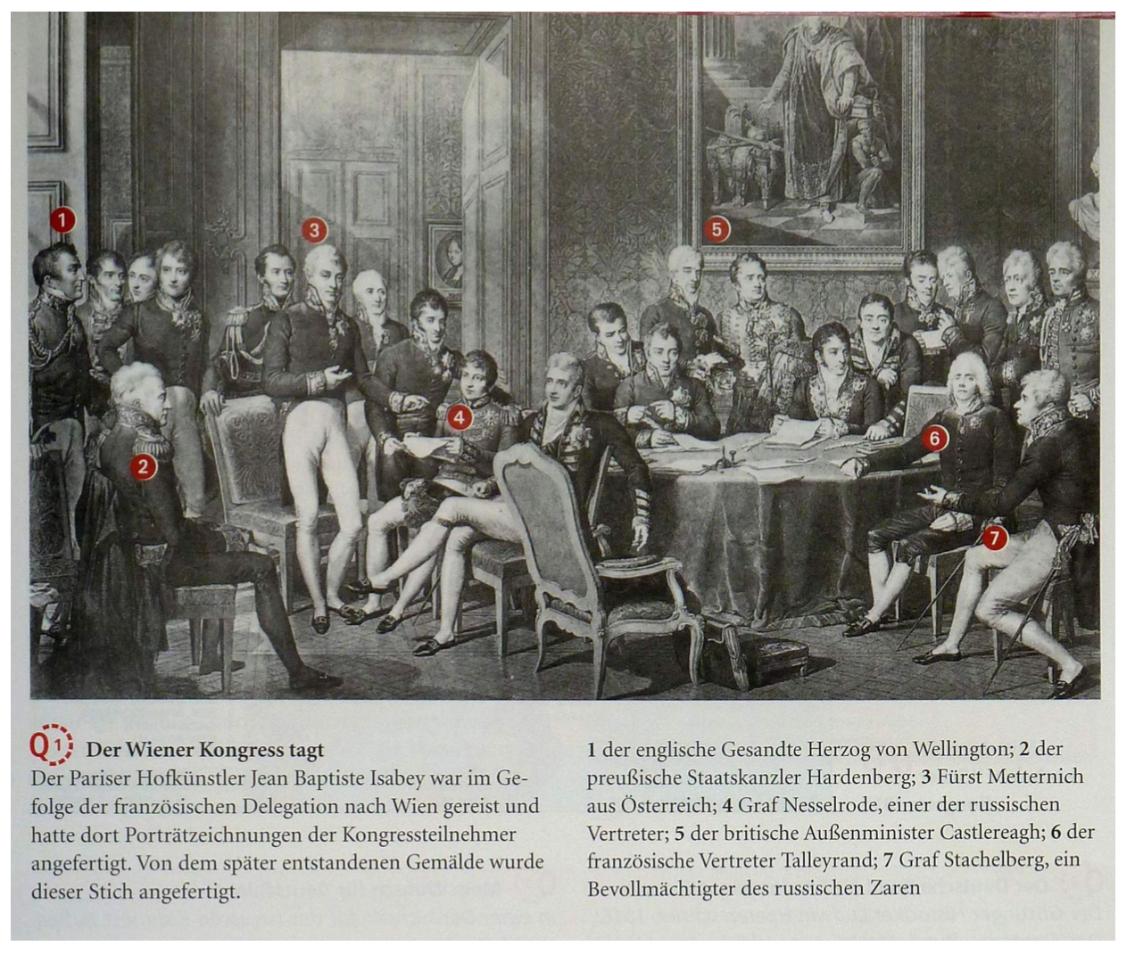


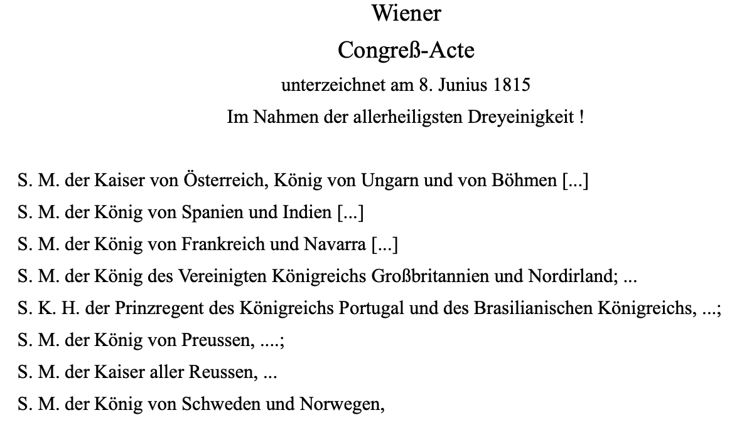

Introduction
  Recall again your assessment of the legitimacy of the Congress of Vienna from the last unit.
    Tip: Use the sources for orientation.
  Write down your thoughts in the form of notes.
The Congress of Vienna meets
1 the English envoy Duke of Wellington; 2 the Prussian Chancellor of State Hardenberg; 3 Prince Metternich from Austria; 4 Count Nesselrode, one of the Russian representatives; 5 the British Foreign Secretary Castlereagh; 6 the French representative Talleyrand; 7 Count Stachelberg, a representative of the Russian Tsar
The Parisian court artist Jean Baptiste Isabey had traveled to Vienna in the wake of the French delegation and had made portrait drawings of the congress participants there. This engraving was made from the painting created later.

Slide 3

2. Elaboration: Contemporary assessments
  How did participants view the Congress and its provisions? Compare the short contributions of the participants. (Q1 and Q2)
"You come at the right time to see great things. Europe is in Vienna. The fabric of politics is all spun with festivities. At your age you love the merry meetings, the balls, the amusements, and I stand for you that you will not have much leisure; for Congress does not advance, it dances. It is a royal confusion. From all sides one cries: peace, justice, equilibrium, indemnity, legitimacy - a word by which your Prince of Benevent [i.e. Talleyrand] has enriched the dictionary of diplomacy. Who will sift this chaos and put a dam against the stream of claims? ... Concord has at last united peoples so long hostile; its most illustrious representatives gave the first example of it. A strange thing seen here for the first time: pleasure wins peace."
"Prussia brought to the Congress merely the one irrepressible desire to extend her possessions at the expense of everyone without regard to right and propriety.... This system, founded a hundred years ago and pursued ever since, found a new support in the enthusiasm of the nation, in the energy of the army, and especially in some excellent military men.... Unable or unwilling to rival the Russians, they are concentrating entirely on Germany; the conquest of Saxony, immense as it was, meant for them merely the beginning of a series of operations by which they hope sooner or later to seize the greater part of northern Germany, to put Austria out of action, and to come to the head of all Germany. Counting on the help of Russia in the execution of this far-sighted plan, they wanted the Congress at least to lay the foundation stone of their edifice to
Q1
Q2
1814 in Vienna Prince de Ligne, Austrian field marshal, greeted his guest, the French Count de la Garde, on his arrival in Vienna
Friedrich von Gentz on Prussia's attitude in 1815 Von Gentz was Metternich's advisor at the Congress of Vienna

Slide 4
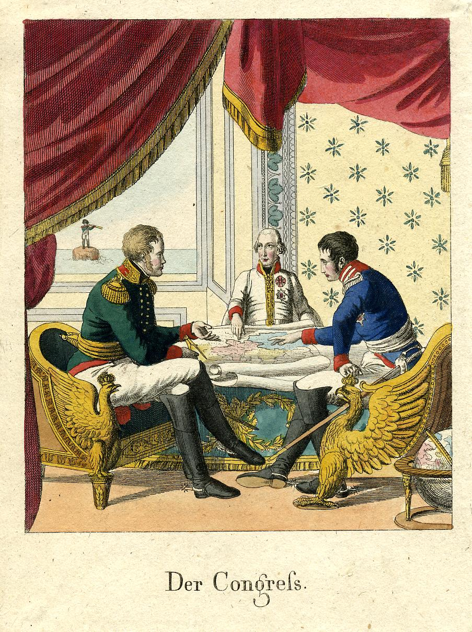
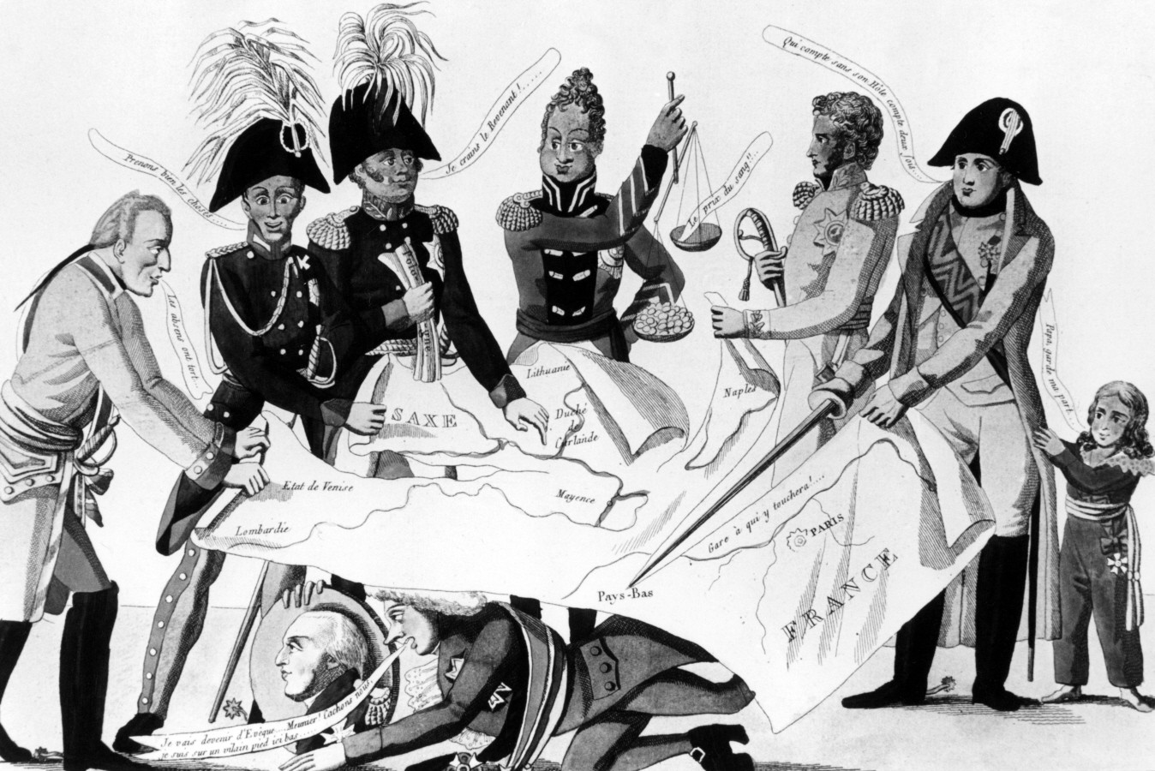
2. Elaboration: Contemporary assessments of the public
How did the public view Congress and its provisions? Compare the cartoons. How do the caricatures differ, what do they have in common? What was criticized by contemporaries at the Congress of Vienna? (Q3 and Q4)
Q3
Q4

Slide 5

2. Elaboration: Today's assessments
  Now that we have looked at how the Congress of Vienna was perceived by contemporaries we now want to take a look at different perspectives today - because unlike the contemporaries, we today have the opportunity to evaluate the event and its impact on the development of Europe in retrospect.
  Read the following texts by two historians (M1 and M2).

Slide 6
M1
How freedom was betrayed at the Congress of Vienna (by Joachim Käppner)
200 years ago, in 1815, the wars of liberation ended in Waterloo with an epochal victory and a no less epochal defeat. Napoleon's foreign rule over large parts of Germany and Europe was defeated, and at the Congress of Vienna the European princes decided to reorganize the continent. They placed a second loser at the side of imperial France: that was freedom. It was what the men who had enthusiastically taken up arms in 1813 and the women who "gave gold for iron" to finance the new armies had hoped for. A patriotic popular movement was growing up, and it wanted more than to be rid of the horrors of an often brutal and exploitative occupation. It wanted unity, and it wanted freedom, at least more freedom than before Napoleon. But when the war was over in 1815, the rule of the princely houses pressed harder than in the century before. And whoever still called for freedom was imprisoned as a "demagogue" [i.e., a seducer of the people]. [...] The Congress of Vienna secured the rule of the great powers, the external order, in international law to such an extent that their internal order was henceforth also considered sacrosanct [i.e. highly sacred, inviolable]. Germany remained a patchwork of diverse dominions, loosely joined together in the German Confederation, under the growing shadow of Prussia. [...] The defeat of freedom in 1815 is associated with the name of Klemens Wenzel Lothar von Metternich. The Austrian statesman was the gray eminence [i.e., outwardly barely visible but influential (political) personality] of the Restoration's [i.e., Restoration's] power system, which was hostile to change and which, while securing peace for a long time, fought any national and liberal liberation. Even the thought of German unity bordered on treason in this epoch, because it would have overturned the existing order. Without this order, Germany might have gone the way of the West and modernity. [...] The great Munich historian Thomas Nipperdey aptly summarized the tragedy of the wars of liberation from 1813 to 1815: "It is the essence of great historical phenomena that what we like and what we dislike are at the same time inherent in them, that they defy our desire to find the positive on the same side: Freedom and peace, precisely do not submit - this constitutes their greatness and their misfortune."

Slide 7
M2
The Congress of Vienna was a huge step forward (article from 18.09.2014)
200 years ago [i.e. 1814] the Congress of Vienna began. It was the first step toward a united Europe, says historian Thierry Lentz. A conversation about peace through diplomacy, Viennese balls and kisses of welcome. 200 years ago, the Congress of Vienna began. How important are the issues that were discussed then today? The Europe of today is - if you will - a grandchild of the Congress of Vienna. 1814/15 is an extraordinarily important moment for the reorganization and foundation of Europe after the Revolutionary and Napoleonic Wars. The Congress of Vienna is an important element of that chain that eventually led to a United Europe - and therefore still deserves attention today. Twenty-five years after the French Revolution, the monarchs suddenly had their say again. Doesn't this mean that the Congress was more a step backward than a step forward? If you look at the Congress of Vienna with today's eyes, there are, of course, an extremely large number of points that can be criticized. There is no question about that. But at that time, the powerful in Europe were trying to find common ground, because that is what negotiations are all about, and that was that a great many monarchs had remained on their thrones. We tend to think today that they tried to undo everything that the French Revolution had achieved, but this is not quite true. After all, they had to give their states a constitution because of the decisions of Vienna. This may seem normal to us today, but at that time there was hardly any state in Europe that had a serious constitution. There are two great achievements of the Congress: the reorganization of Europe and - this is often forgotten - the creation of an international law through what was called the European Concert. This meant the unification of the great European powers to deal with the problems of the continent. In some ways, this was a precursor to the United Nations Security Council, because it was here that decisions were made that affected all those states that had not even signed the Final Acts of Vienna. This was the case, for example, with the outlawing of the slave trade. So it was far from being just a matter of undoing the French Revolution. [...] At the beginning of our conversation, you called the Congress of Vienna a first step toward a united Europe. What parallels are there to today's EU? What was then called the "European Concert" was actually the first time ever in the history of Europe that individual powers said: we have to stop waging war against each other and talk to each other instead. Because they understood that Europe was destroying itself by doing so. At the beginning, there were only four countries: Russia, England, Austria and Prussia. Then France and Italy joined in. And this worked - even though there were wars afterwards, for example between France and Germany - but they did not inflame all of Europe. In this respect: Yes, the Congress of Vienna is the first step towards a Europe that talks to each other, discusses and tries to solve its problems other than by war. Today, we can no longer imagine how wars can be waged against each other in Europe, although this was not so long ago. It is only since the 50's that we have been giving kisses to each other as a greeting instead of fighting each other. Until then, war was waged for hundreds of years to solve problems. This is, of course, a huge step forward. And the first step towards that was the Congress of Vienna.

Slide 8
3. Conclusion
Now it's your turn to give your opinion: Was the Congress of Vienna a step forward towards today's Europe or a missed opportunity?
Imagine you are part of a discussion group dealing with the Congress of Vienna and its significance for Europe. Before you, two speakers have already expressed their opinions (M1 and M2). Now it is your turn. Take a well-founded position on the question of whether and to what extent the Congress of Vienna can be regarded as progress.
Tip: You can respond to the statements of your "predecessors", agree with them (in part) or contradict them and introduce new arguments. Also use your notes from the unit.

