Slide 1
Remembering the First World War – Learning Series Part 2
Project No. 2019-1-CZ01-KA203-061227, Reflection of National and European Identity in the New Millennium (NAETINEM), 05.11.2021

Slide 2
1. Introduction:
In the first part of the learning series you have dealt with different types of memory places.
In the coming units, we will now deal with the forms of remembrance of different nations. We will start with places of remembrance of the First World War with Germany.
In the following units you will also learn how France and Great Britain remember the First World War. ☺

Slide 3
Introduction:
Find out about German places of remembrance of the First World War on the Internet. Share this information with your group.
Tip: Think especially about the definition of places of remembrance from the learning series Part 1.

Slide 4
2. Basics:
a) In task 1, you must have noticed that it is very difficult to find German examples of World War I places of remembrance. What could be the reason for this? Make at least 3 hypotheses and explain them in a continuous text.
Tip: Inform yourself on the Internet about aspects such as the Treaty of Versailles, the war guilt question, etc.

Slide 5
2. Basics:
You tell your dad that you are learning about the First World War at school. He says the following:
As a group, think about a role play in which you try to explain to your father why the First World War is still important for Germany today.
"Oh, the First World War isn't even important today. The Second World War was much worse. You don't even need monuments or celebrations for the First World War anymore."

Slide 6
3. Elaboration:
A special memorial site is the memorial site "Hartmannswillerkopf" in Alsace (M1). Using the newspaper article, try to find out how the memorial site deals with the commemoration of the First World War and what is special about it.

Slide 7
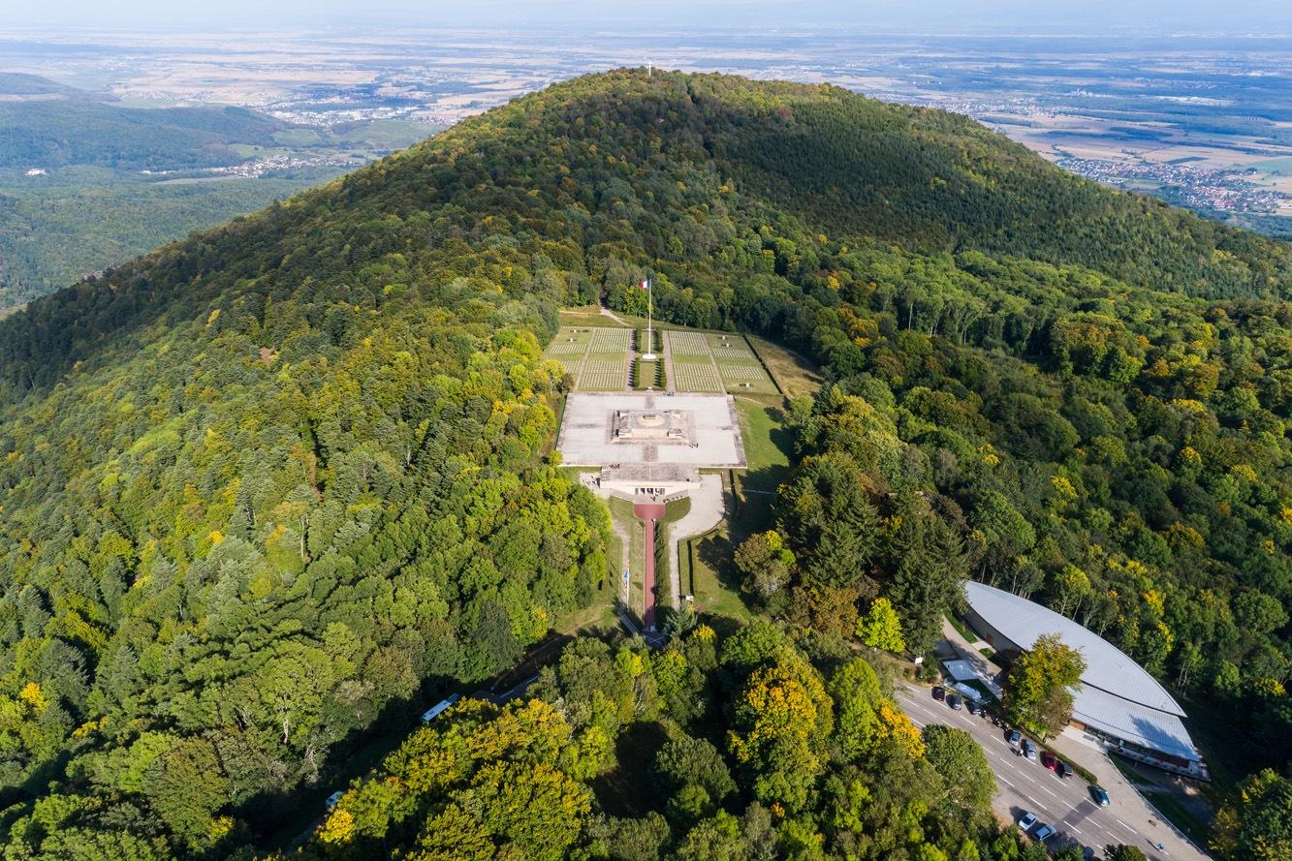
M1
From the Battlefield to the German-French Historial
Joint commemoration at the Hartmannswillerkopf in southern Alsace
Jochen Marmit 08.06.2019 | 15:12 Uhr
https://www.sr.de/sr/sr3/sr_3_aktionen/tour_de_kultur/tour_de_kultur_2019/tdk_tour_de_kultur_2019_09_schlachtfeld_hartmannswillerskopf100.html

Slide 8
3. Elaboration:
The memorial site "Hartmannswillerkopf" is an example of a transnational culture of remembrance between Germany and France. Do you like this concept of a memorial site? Should there be more such memorial sites?
Write a letter to the editor explaining your own opinion to the newspaper.

