Slide 1



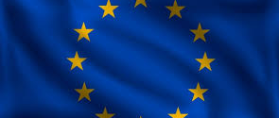
Remembering the First World War – Learning Series Part 3
Project No. 2019-1-CZ01-KA203-061227, Reflection of National and European Identity in the New Millennium (NAETINEM), 05.11.2021

Slide 2

1. Introduction:
In the first part of the learning series you have dealt with different types of memory places.
In the coming units we will now deal with the forms of remembrance of different nations. We have started with the places of remembrance in Germany and will continue with the current handling of France's memory of the First World War.

Slide 3
1. Introduction:
2018 marks the 100th anniversary of the end of the First World War. To mark the occasion, France's President Emmanuel Macron has taken the initiative and made his country the focus of international celebrations. The highlight of 2018 will be a major commemoration in Paris. Macron has invited over 80 heads of state and government from countries directly or indirectly involved in the war to a ceremony at the Arc de Triomphe.
a) Find information about the French President's speech commemorating the Armistice 100 years ago.

Slide 4


2. Basics:
a) Macron repeatedly emphasizes in his speech that it is important to remember and not to forget. Why is this so important? First take notes and then share them with your group.
b) Imagine that you were a secret spectator at the memorial service and Macron's speech. Write a diary entry about this. You can bring in your reflections from the previous tasks. Present this diary entry to your group and give each other feedback.

Slide 5
3. Elaboration:
First look at the following cartoon (M1) from France, published on the decision of the Treaty of Versailles.
a) Describe what you see in the cartoon.
b) Also interprets the content of the cartoon.

Slide 6
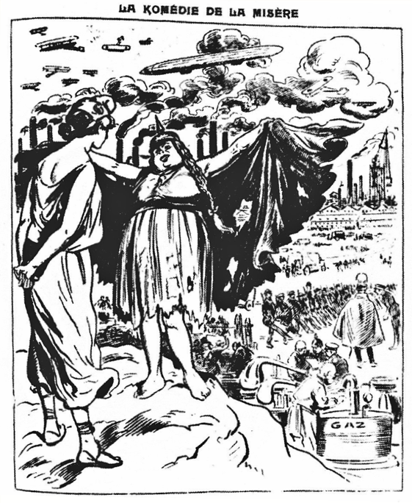
M1
The Treaty of Versailles: French cartoon.
"The comedy of misery. Be careful, Marianne, be careful, day and night she is preparing.",
"Le Ruy Blas," May 15, 1921.

Slide 7
3. Elaboration:
c) Now look at the current pictures of Macron together with Merkel and Steinmeier (M2). How do you feel about the relationship between them? Discuss this in your group.
d) Write a diary entry by Macron in which you reflect on the importance of French-German friendship. Present this diary entry to your group.

Slide 8
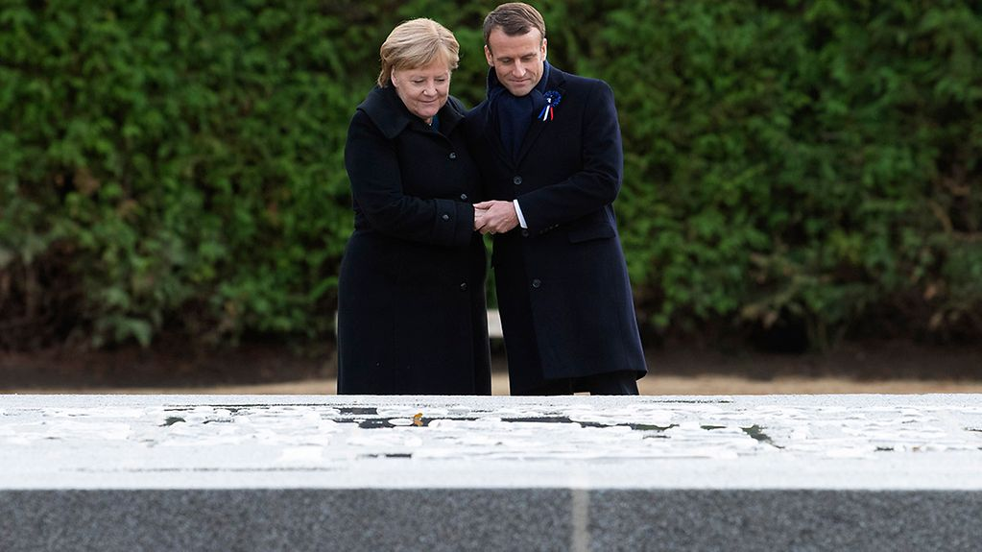
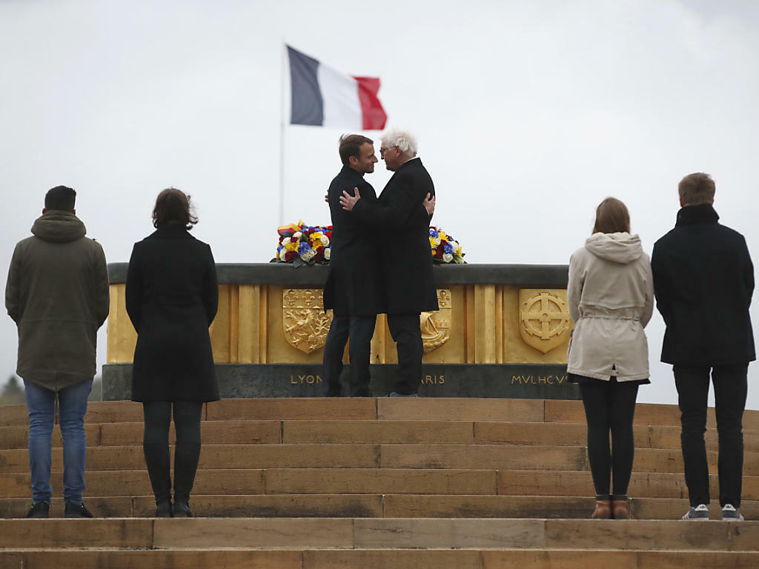
M2

