Slide 1
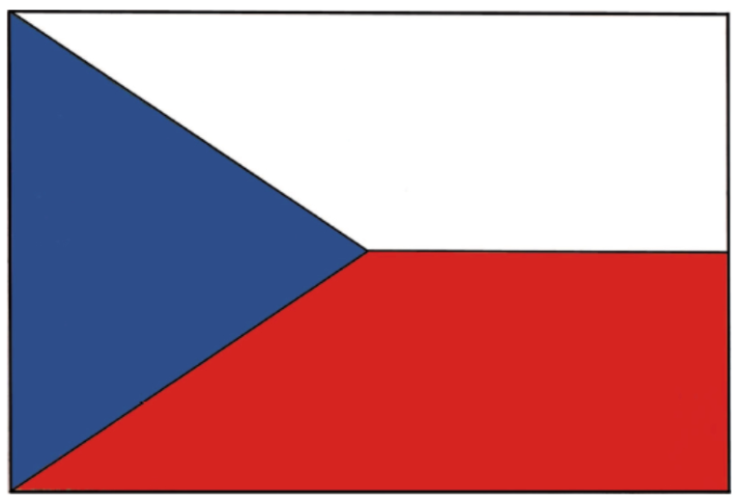
STATE SYMBOLS
OF THE CZECH REPUBLIC

Slide 2
What are state symbols?
State symbols are (usually) statutory signs by which the state denotes its sovereignty and which are one of the formal manifestations of its statehood.
State symbols also present the state in relation to other states, expressing its history, territorial development, constitutional nature, or even national identity.
The form of state symbols has its historical justification.

Slide 3
The state symbols in the Czech Republic
large national emblem
small coat of arms
state colours
National flag
flag of the president of the republic (so-called presidential standard)
state seal
National anthem

Slide 4
Legislation of state symbols
Article 14 of the Constitution of the Czech Republic (lists state symbols)
Act No. 3/1993 Coll., on the state symbols of the Czech Republic, as amended by Act No. 154/1998 Coll. (“Law on State Symbols”)
Act No. 352/2001 Coll., on the Use of State Symbols of the Czech Republic and on the Amendment of Certain Acts, as amended (“Act on the Use of State Symbols”)
Article 6ter of the Paris Convention for the Protection of Industrial Property of March 20, 1883, published by Decree of the Minister of Foreign Affairs under No. 64/1975 Coll.
+ a number of other laws and by-laws, eg in the area of ​​elections, education, etc., regulating specific ways of using state symbols of the Czech Republic, especially state emblems
+ international conventions regulating the use of Czech state symbolism abroad - especially the marking of diplomatic and consular workplaces and vehicles, etc.

Slide 5
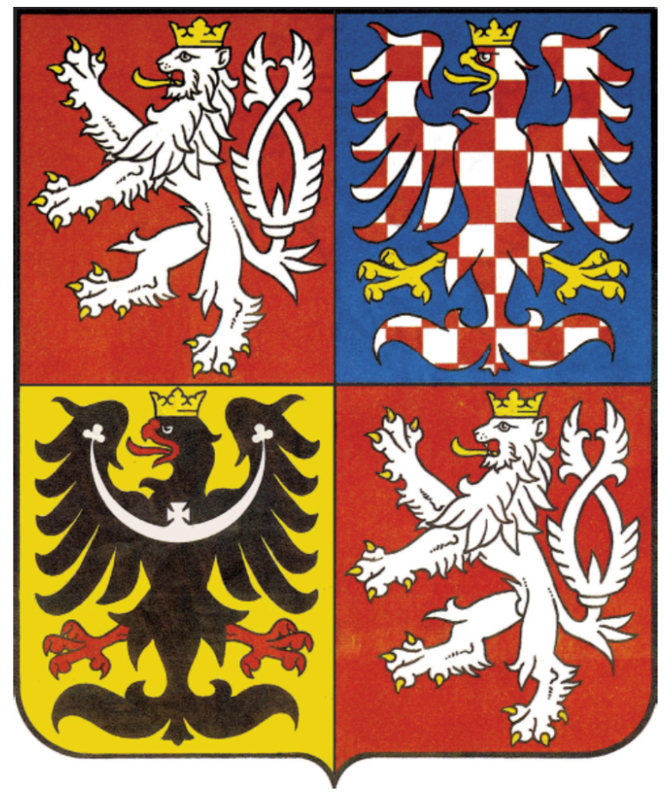
State emblem
the Czech Republic has 2 state emblems, namely large and small.
is used to represent the state and to mark buildings with state administration bodies
The large coat of arms consists of a square shield, in the first and fourth red field of which is a silver two-tailed lion in a jump with a gold crown and gold armour. In the second blue field is a silver-red checkered eagle with a gold crown and gold armour. In the third golden field is a black eagle with a silver crescent ending in clover trefoils and in the middle with a cross, with a golden crown and red armour.

Slide 6
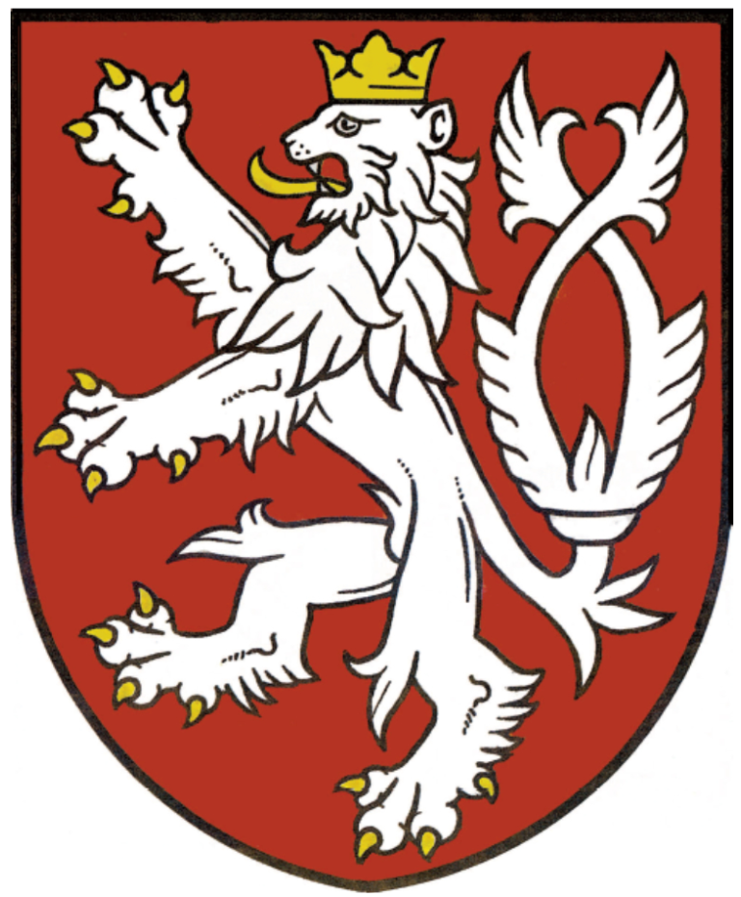
State emblem
The small coat of arms consists of a red shield, in which there is a silver two-tailed lion in a jump with a gold crown and gold armour.
The coat of arms may be used only under the conditions laid down by law. The coat of arms may not be used in any other way than expressly stipulated by law or by-law.
Only the so-called authorized persons can use the state emblem.

Slide 7
National flag
The national flag consists of an upper stripe of white and a lower stripe of red, between which a pole blue wedge is inserted to half the length of the flag.
The ratio of the width of the flag to its length is 2:3.

Slide 8
National flag
The historical flag was the bicolour (white-red), at the time of the national revival began to appear blue (the influence of Russia) and was similar to the Dutch flag, to differentiate in 1920 it was decided on the shape of a blue wedge.

Slide 9
National colors
They are called tricolours
Unofficially, it is claimed that: white = the colour of purity and truth, red = blood shed by patriots in the fight for freedom, blue = friendship, cloudless sky
White is always on top or left from the observer's point of view
The national colours are the same as the colours of the national flags
They are used as a tricolour on festive occasions, on ribbons for medals etc.

Slide 10
Flag of the president
The flag of the President of the Republic (or the standard of the President of the Czech Republic or the presidential standard) is white, with a border consisting of flames alternately white, red and blue. In the middle of the white field is a large coat of arms. Below it is a white (silver) inscription TRUTH WINNERS on a red ribbon lined with yellow (gold) linden branches.
The flag of the President of the Republic may be used to indicate the seat of the President of the Republic during his presence in the Czech Republic and to indicate the means of transport used by the President of the Republic.

Slide 11
Development of the appearance
the presidential flag has changed its appearance several times since 1918
1993
1918–1939, 1939–1945 1960–1990 1990-1992
1945–1960 Protectorate ČSSR ČSFR
of Bohemia and Moravia

Slide 12
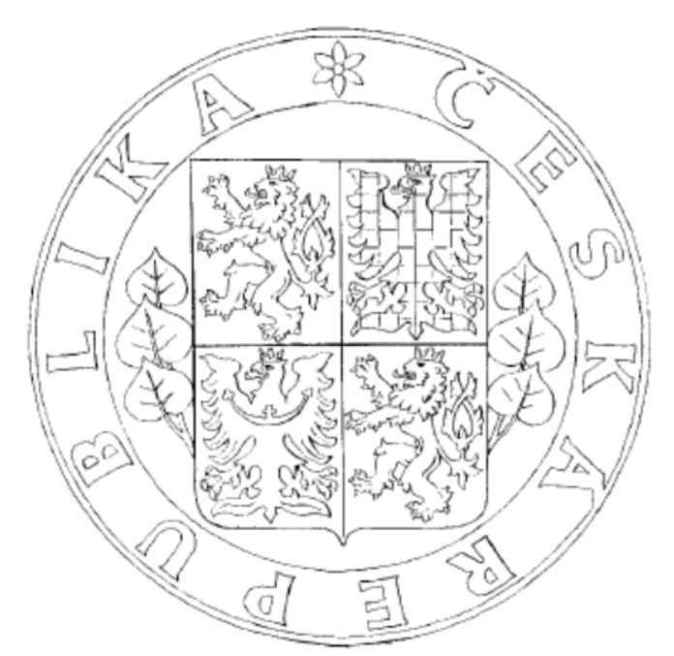
State seal
Consists of a large national emblem supported by linden branches on the sides, around which is a copy of "CZECH REPUBLIC". The seal of the state seal is kept by the President of the Republic.
The state seal can be used to seal international agreements, to the credentials of diplomatic representatives and in other cases, if so provided by a special legal regulation, an international agreement by which the Czech Republic is bound and which has been promulgated, or if it is usual.
It originated from the seal of the Czech Kingdom from 1429–1432, when each monarch had his own seal.

Slide 13
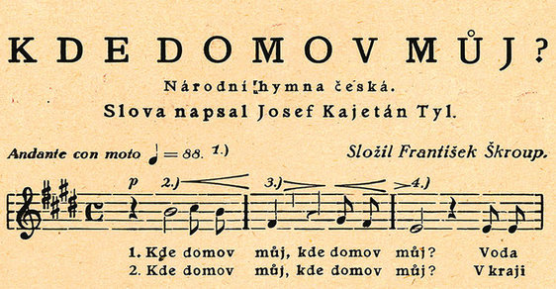
National anthem
The national anthem consists of the first verse of the song by František Škroup (music) and Josef Kajetán Tyl (lyrics) "Where is my home".
The song comes from J. K. Tyl's play "Fidlovačka or no anger and no fight" in 1834;
The national anthem can be played and sung on public holidays and other occasions, if usual.
National anthem since 1918
https://www.youtube.com/watch?v=cPTwOZWnm6E&ab_channel=VocalNationalAnthems

Slide 14
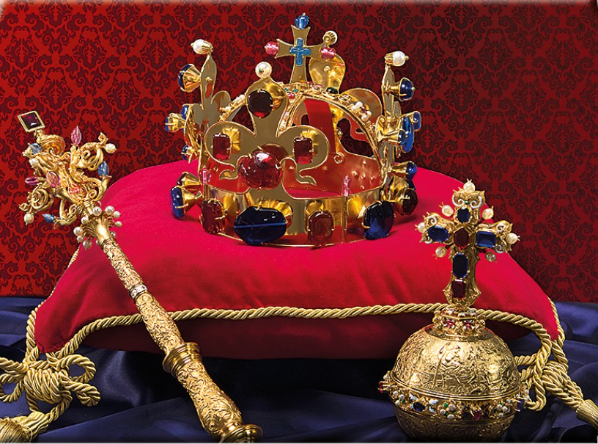
Crown Jewels
Unofficial state symbols
Used in the coronation of Czech kings.
They contain: Saint Wenceslas crown (made for the coronation of Charles IV. by the Czech king in 1346), sceptre, royal apple, coronation cloak (camembert)
They are stored in the crown chamber above the southern entrance to the Church of St. Welcome to Prague Castle.
The entrance door is equipped with 7 locks, the individual keys have: the president, the prime minister, the archbishop of Prague, the mayor of the capital. of the City of Prague, Chairman of the Senate, Chairman of the Chamber of Deputies, Dean of the Metropolitan Chapter at St. Welcome.
Video

Slide 15
Sources
https://www.mvcr.cz/clanek/statni-symboly-ceske-republiky.aspx
https://www.dumy.cz/stahnout/89764
https://www.reflex.cz/clanek/zajimavosti/86121/ceskou-hymnu-pitvame-uz-sto-padesat-let-a-uplne-zbytecne-narodni-pisnicku-neznale-kritizoval-i-peroutka.html
https://www.youtube.com/watch?v=cPTwOZWnm6E&ab_channel=VocalNationalAnthems
https://www.youtube.com/watch?v=XDMy0iKpwuc&ab_channel=JanVelebil

