Slide 1



History of the
Czech Identity
2

Slide 2
The Czech State in the Time of the Luxembourgs – John of Luxembourg (1310–1346)
Rudolf of Habsburg (1306–1307) – married Queen Widow Elizabeth Richeza, "King Gruel", dies prematurely in 1307 of dysentery during the siege of Horžďovice
Henry of Gorizia (1307–1310), already briefly reigned in 1306, married to Anne of Bohemia; 1309 – coup in Prague (patricians), growth of Anne's influence
Former Bohemian chancellor and Archbishop of Mainz, Peter of Aspelt – negotiations with King of Germany Henry VII of Luxembourg with the support of part of the Czech nobility
Accession of John of Luxembourg to the Bohemian throne – marriage to Elizabeth of Bohemia
Inaugural Diploma – 1310, guarantee of rights and liberties for Bohemian nobility, clear starting points for estate power
Two segments of the nobility: Henry of Lipá, who opposed the king and supported the Ronov family together with the Markvartic family, maintained a relationship with the queen widow Elizabeth Richeza. On the other side were the lords concentrated around Vilém Zajíc of Valdek
The internal conflict, in which the Prague Bishop Jan of Dražice was also involved, ended in 1318 with the Domažlice Treaties – further strengthening of the influence of the nobility at the expense of the monarch

Slide 3
The Czech State in the Time of the Luxembourgs – John of Luxembourg (1310–1346)
Territorial expansion of the Czech state – 1322 annexation of the Cheb region, an of Upper Lusatia between 1319 and 1329, Wroclaw in 1335
1335 – meeting between John of Luxembourg, Polish king Casimir III the Great and the Hungarian king Charles Robert in Trenčín. John of Luxembourg renounced his claims to the Polish crown, and the Polish king withdrew from his ambitions in regards to Silesia.
In the 1330s, John of Luxembourg received several Italian cities as pledge (Bergamo, Brescia, Bobbio, Cremona, Milan, Pavia, Novara and Lucca) from the emperor of the HRE
At the same time, he conducts an ambitious foreign policy and is practically absent from the Kingdom of Bohemia.
King John of Luxembourg fell on 26 August 1346 at the Battle of Crécy

Slide 4
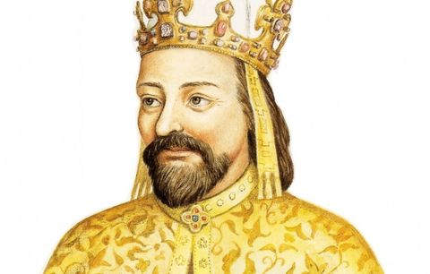
The Czech State in the Time of the Luxembourgs – Charles IV (1346–1378)
He was born in 1316 to Elizabeth of Bohemia and was baptised as Wenceslas
Later, as a result of marital disputes between John and Elizabeth, he was taken away from his mother and subsequently sent to France for upbringing – King Charles IV the Fair, who kept young Wenceslas in his favour, soon confirmed as Charles. He was educated at the French court and met Pierre Roger (future Pope Clement VI).
He proved his talent as a ruler in the administration of the city of Lucca and, afterwards, from 1333, in the administration of Moravia as the Moravian Margrave. After returning to the kingdom, he faced adversity from some sections of the nobility, but he did his best to consolidate sovereign power.

Slide 5
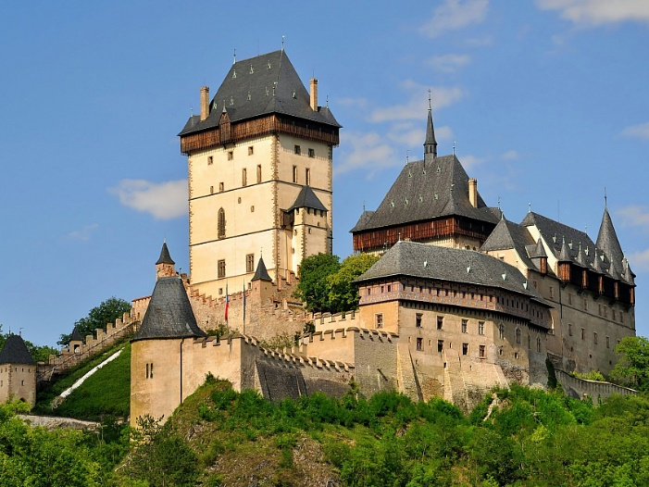
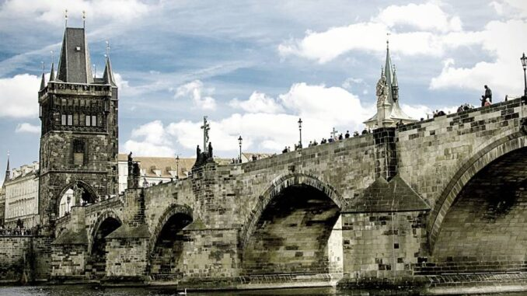
The Czech State in the Time of the Luxembourgs – Charles IV (1346–1378)
Husband to Blanche of Valois; As part of the consolidation of the country, Charles also strived for its further development – 1344 – elevation of the Prague diocese to an archdiocese (papal bull Romanus Pontifex): Arnošt of Pardubice, the foundations of the St Vitus cathedral were laid in the same year; shortly afterwards (30 April 1344) the founding of the diocese in Litomyšl
In 1346, he took the throne as King Charles and sought to gain the throne of the HRE – rival Louis the Bavarian, marriage to Anna of Bavaria (1349)
April 7, 1348 – foundation of the Prague University, the same year the construction of the Karlštejn Castle began and the foundations of the New Town of Prague were laid

Slide 6
University education –
Prague university 1348
Universities in the Middle Ages and the Early Modern Period usually consisted of four faculties, which was also the case for the University of Prague:
Deans were the heads of faculties.
Faculty of THEOLOGY
Faculty of MEDICINE
Faculty of LAW
Faculty of ARTS
The university had the right to award academic degrees:
Bachelor
Master
Doctor

Slide 7
The Czech State in the Time of the Luxembourgs – Charles IV (1346–1378)
In 1355, completed journey to Rome and received imperial coronation – Emperor Charles IV
Maiestas Carolina – Code strengthening royal power. However, it encountered strong opposition from the nobility and never came into force
Marriage to Anna von Schweidnitz in 1353 – final incorporation of Upper and Lower Lusatia
Golden Bull – year 1356, establishing the election of the German King – 7 electors
After the death of his wife Anna von Schweidnitz (1362), inheritance in the form of Schweidnitz and the Duchy of Jawor – Silesia as a whole becomes part of the Czech lands
Lands of the Czech Crown – Kingdom of Bohemia, Moravia, Silesia, Upper Lusatia, Lower Lusatia, Feuda extra curtem (foreign fiefdom, New Bohemia), Brandenburg
1363, marriage to Elizabeth of Pomerania in Krakow
In 1373, Charles IV acquired Brandenburg
Shortly before his death, he made a trip to France – attempted, among other things, to settle the papal schism
Charles IV died 29 November 1378; autobiography Vita Caroli

Slide 8
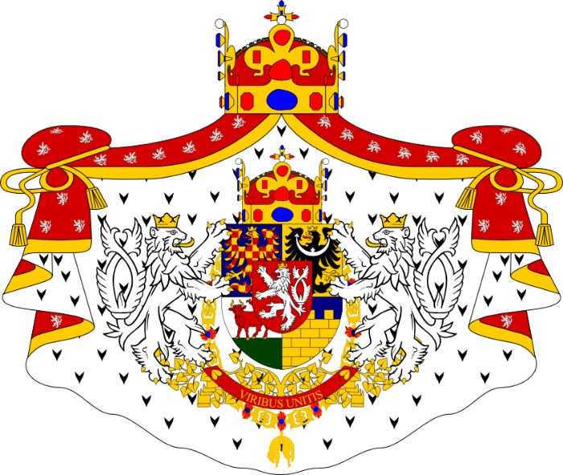
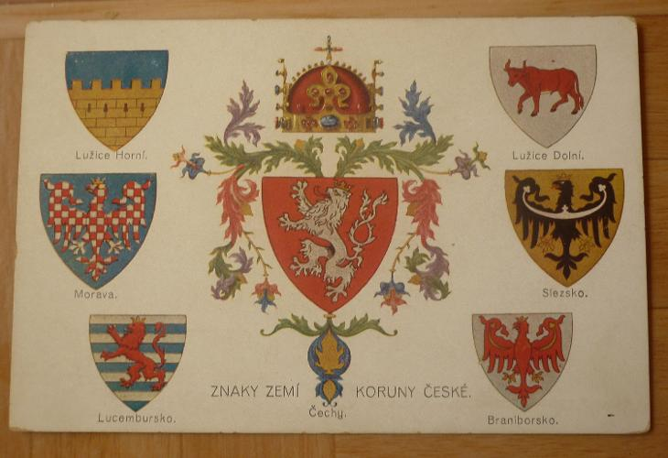
Lands of the Czech Crown
Term for the collection of states, which was adopted during Charles IV's reign
Bohemia: Prague (Caput regni)
Moravia: Brno and Olomouc
Silesia: Wroclaw
Upper Lusatia: (Bautzen, Görlitz, Zittau)
Lower Lusatia: Chotěbuz (Cottbus)
(Luxembourg, Brandenburg, Feuda extra curtem)

Slide 9
The Czech State in the Time of the Luxembourgs – Wenceslas IV (1378–1419)
Born in 1361 in Nuremberg to Anna von Schweidnitz; in 1363 he was crowned by Archbishop Arnošt of Pardubice as King of Bohemia, in 1376 he was elected King of Germany in Aachen
He began ruling in 1378, at a time when the Czech state was gradually falling into an internal crisis exacerbated by the plague epidemic of 1380.
He appointed lower nobility (favourites) into the royal offices, which subsequently provoked disputes with the upper nobility and Archbishop Jan of Jenštejn – arrest of vicar general Jan of Pomuk (1393)
League of Lords – in 1394 Wenceslas IV was captured (with the knowledge of the Moravian Margrave Jobst) in Králův Dvůr and transferred to Wildberg Castle, subsequently freed by his brother John of Görlitz
Complications in the HRE – in 1400 Wenceslas IV deposed from the German throne (replaced by Ruprecht III of the Palatinate)
1402–1403, Wenceslas IV interned again (Vienna), at the behest of his brother Sigismund among others. After his release, he was forced to accept the demands of the high nobility. Growing social unrest
From the 1380s, signs of a reformation movement are beginning to appear in the Czech lands – they are generally related to the worsening situation of the country, bands of thieves, internal instability, the absence of law (Jan Žižka)
Predecessors and Contemporaries of Hus – Konrad von Waldhausen, Jan Milíč of Kroměříž, Matthias of Janov, Tomáš Štítný of Štítný, Jacob of Mies, Master Christian of Prachatice, Jerome of Prague, Master Jan of Jičín. Inspired by the English scholar John Wycliffe

Slide 10
The Czech State in the Time of the Luxembourgs – Wenceslas IV (1378–1419)
In January 1409, Wenceslas IV puts out the Decree of Kutná Hora – regulates the ratio of votes at the Prague university in favour of the Czech university nation. Hus's reformist group gains control of the university.
In 1410, Wenceslas's brother Sigismund of Luxembourg is elected as King of Germany.
Increasing tension between Wenceslas IV, who (together with his wife Sophia of Bavaria) sympathises with the reformists, and Archbishop Zbyněk Zajíc of Hazmburk; Bethlehem Chapel as the main pulpit of the reformists
John Hus (ca. 1370–1415) comes the forefront of the reform movement – critique of the sale of indulgences and the deviation of the Church from fundamental principles – the demand for its rectification, respect for God's law, following Christ's example and principles. The highest authority for a believing Christian is the Holy Scriptures – the New Testament and the word of God contained within. Belief in the salvation of true believers. Followers of John Hus come to be called HUSSITES.
Tensions between the reformists and the king soon escalated. An interdict is made against Hus – leaves Prague.
1414 – general ecclesiastical council convened in Constance, John Hus is also invited – unsuccessful attempt to defend his reform ideas, which eventually led to his condemnation as a heretic – burnt at the stake on 6 July 1415 (Jerome of Prague then burnt in May 1416)
Hus's burning caused considerable uproar in Bohemia – a letter of complaint from the Czech nobility, social tensions escalated and the dividing line between Hussite followers and Catholics further widens.
30 July 1419 – First Defenestration of Prague, Jan Želivský, shortly after – 16 August 1419 – Wenceslas IV dies

Slide 11
The Hussite Revolution (1419–1436)
Following the death of Wenceslas IV, Sigismund of Luxembourg becomes the heir to the Czech throne
At the same time, the internal situation within the kingdom and especially in Prague worsened
The Hussites begin to separate into two factions – radicals and moderates
Establishment of Tábor – millennialist visions, radicalism (called Taborites)
Sigismund tries to enforce his claims to the throne – the situation eventually results in a crusade and the Battle of Vítkov in July 1420. Jan Žižka of Trocnov as a leading Hussite military commander and strategist.
Following his failure, Sigismund withdraws
1421 (June), Čáslav Assebly – approval of the Four Articles of Prague as the central law of the land (1.Free proclamation of the Word of God; 2. Communion under both kinds; 3. Prohibition of secular rule of priests; 4. Punishment of "deadly" sins). Twenty-member council of the Kingdom of Bohemia – provisional government of the land (upper and lower nobility with representatives of cities)
Communion under both kinds – sub utraque specie – Utraquists, Chalicers
Finding a suitable candidate for the vacant royal throne – Sigismund Korybut
The Hussites, led by Jan Žižka, repel another invasion by Sigismund – Battle of Německý Brod in January 1422

Slide 12
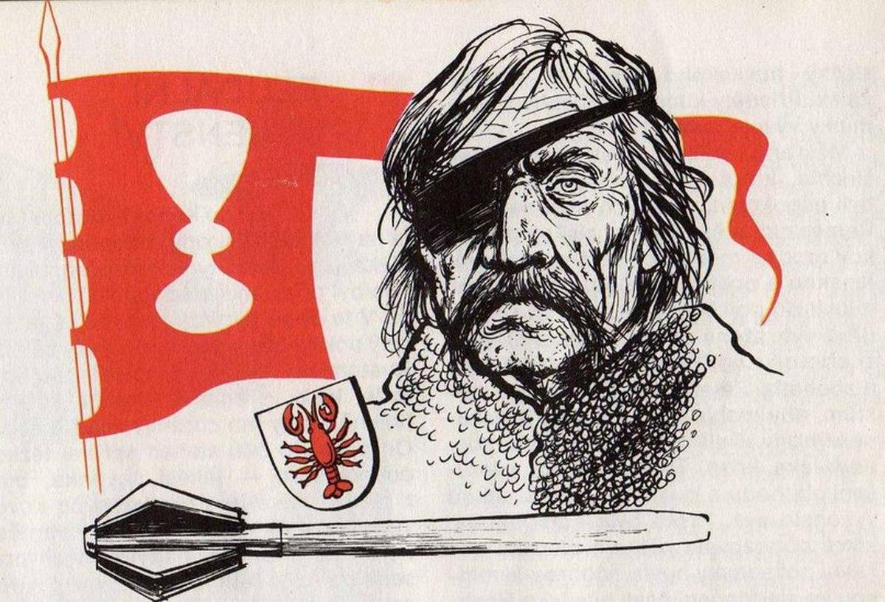
The Hussite Revolution (1419–1436)
Gradually, four main Hussite unions are formed (strengthening the role of cities)
Prague Municipal Union
Tábor Municipal Union
East Bohemian (Sirotčí/Orphan) Municipal Union
Union of Jakoubek of Vřesovice
In 1423, Jan Žižka put together a new Hussite union in Eastern Bohemia – Žižka's Military Law. Disputes with moderate Hussites (Prague after the execution of Jan Želivský) and the Catholic nobility. Role of Čeněk of Wartenberg. June 1424 – Battle of Malešov
Jan Žižka died on 11 October 1424
during the siege of Přibyslav,
legacy continued by Jan Roháč of Dubá

Slide 13
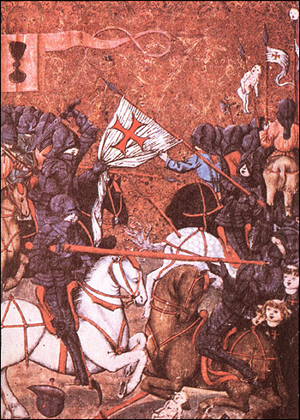
The Hussite Revolution (1419–1436)
New Hussite military commander Prokop Holý
Disagreements and tensions between the individual Hussite factions continued (the coup in the Old Town of Prague in 1427 and the removal of radical Hussite council members)
Battle of Ústí nad Labem (1426), Battle of Tachov , Battle of Domažlice
Hussite glorious rides – raids
Efforts to find compromise – 1432 iudex Egrensis (Judge of Cheb). Subsequent negotiations with the Hussites at Council of Basel

Slide 14
The Hussite Revolution (1419–1436)
Reignited disputes between radical and moderate Hussites
Taborites and Orphans versus the Prague Union (Jan Rokycana), moderate Hussites and the Catholic nobility
30 May 1434 – Battle of Lipany – Taborite-Orphan group led by Prokop the Bald defeated
This opens the way to a compromise
Compacts of Basel (promulgated in Jihlava) in 1436 – adopted an article permitting communion from the chalice, as well as other articles in a truncated form – First country in Europe where communion under both kinds was officially recognised.
Sigismund of Luxembourg ascended the Bohemian royal throne – but died in 1437
Archbishop of Prague Jan Rokycana
Upper Consistory (Catholics), Lower Consistory (Chalicers)
Strengthening the influence of cities on the administration of the country – especially in Bohemia
Albert of Habsburg (1437–1439)
Ladislaus the Posthumous – 1440, election of the "administrative" committee – 18 lords, 14 members of the lower nobility and 14 burghers

Slide 15
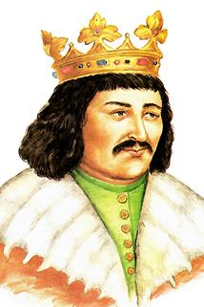
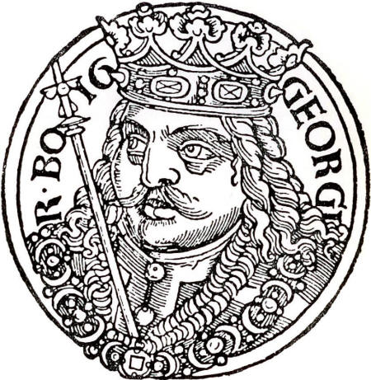
Reign of George of Podebrady (1458–1471)
Landfrieden – regional military-political groups – ensuring order and legal conduct
East Bohemian Landfried – led by the noble George of Kunštát and Poděbrady, a supporter of the chalice and the Compacts
In 1448, he took control of Prague
From 1452, George of Poděbrady was the provincial steward, in 1453 King Ladislaus began reign, but then died in November 1457.
On 2 March 1458, George of Poděbrady was elected King of Bohemia – the first elected King of Bohemia

Slide 16
Reign of George of Podebrady (1458–1471)
George of Poděbrady ensured the observance of the Compacts, opposed the newly established Unity of the Brethren
However, much of Europe perceives the Czech state and Utraquists as heretics (see Francois Villon and his poems). Pope Pius II also speaks openly against Poděbrady. The Czech king counters these tendencies through a diplomatic offensive – project for a union of European monarchs – delegation led by Leo of Rožmitál (1464)
Internal resistance of the Catholic nobility – Green Mountain Union, 1467, suppressed
Pope Paul II imposed an interdict on George of Poděbrady in 1466, in 1467 the Hungarian king Matthias Corvinus spoke out against him (crusade against the "Czech heretics")
Both sides of the conflict experienced victories and losses (capture of Matthias Corvinus near Vilémov), in 1469 Corvinus was crowned King of Bohemia in Olomouc by the Catholic estates.
However, George of Poděbrady effectively remained in power in Bohemia – prior to his death (March 1471) he concluded an agreement with King Casimir IV of Poland about the succession of the Jagiellonians

Slide 17
Jagiellonians on the Czech Throne
Vladislaus Jagiellon (1471–1516)
After the death of George of Poděbrady, the Polish prince Vladislaus Jagiellon was elected on the basis of agreement among segments of the nobility. However, in practice he again rules only in the Kingdom of Bohemia (Moravia, Silesia and both Lusatia remained under the control of Matthias Corvinus)
Peace of Olomouc – 1479: agreement with Matthias Corvinus on succession, Corvinus retained his reign in the neighbouring countries
Effort from Catholics to gain control of the kingdom – resulted in an anti-Catholic uprising in Prague in 1483 and the Second Defenestration of Prague.
Vladislaus Jagiellon forced to accept the demands of Utraquists. This was affirmed at the Kutná Hora Assembly in 1485 – Catholics recognised the Compacts as a fundamental law of the land – the so-called Religious Peace of Kutná Hora.
Strengthening the estates' position in the state – this continuous process since the end of the Hussite wars culminates during the reign of Vladislaus Jagiellon.

Slide 18
Jagiellonians on the Czech Throne
Louis Jagiellon (1516–1526)
After the death of Matthias Corvinus in 1490, Vladislaus Jagiellon received the Hungarian royal crown and moved to Buda.
He did not spend much time in the Czech lands, which only further strengthened the power of the estates
After the death of Vladislaus Jagiellon, his son Louis Jagiellon was elected to the Bohemian royal throne and he, like his father, stayed mainly in Hungary.
1517 – the so-called St Wenceslas Agreement: acknowledgement of certain privileges for cities while also allowing the nobility to conduct business (limiting the economic profits of cities)
Early 16th century marked by the Turkish threat in the Balkans. The Ottoman Empire expands further north-west and threatens the Kingdom of Hungary
King Louis tried to confront the threat – assembled an army of of the estates from Hungary and the Bohemian lands, and the decisive Battle of Mohács takes place on 29 August 1526
The troops of Louis Jagiellon succumbed to the overwhelming superiority of the Ottomans under the command of Sultan Süleyman I and King Louis himself perished while retreating from the battlefield

Slide 19
Estates Monarchy and Its Administration
The estates monarchy quickly develops after the Hussite Wars (see previous slide) and this process is further accelerated by the religious peace of Kutná Hora.
1500 – Vladislaus Land Order strengthened estate institutions (diet) while side-lining cities, which gained important positions in the estate administration after the Hussite period.
Diets
Bohemian Diet – Prague (colleges of upper nobility, lower nobility and representatives of the cities) – headed by the supreme burgrave
Moravian Diet – Brno (Olomouc), retention of clergy positions – headed by a governor
Silesian Diet – Wroclaw; in Silesia there were also local (princely) assemblies in individual principalities – headed by a supreme governor
Upper Lusatian Diet – headed by the Upper Lusatian advocatus
Lower Lusatian Diet – headed by the Lower Lusatian advocatus
General Assembly of the Lands of the Bohemian Crown – representatives of all crown provinces
Important role of individual provincial courts. Resolutions of assemblies recorded in the so-called land tablets (they differed based on the agenda – market, citational…)

Slide 20
Estates Monarchy and Its Administration
In addition to the provincial diets – i.e., estate administration – there was also the administration of the monarch (king) represented since the last Přemyslids by the court authorities
With the arrival of the Habsburgs in 1526 (Ferdinand I) comes an effort to centralise the royal (state) administration in Vienna as much as possible.
Central Offices
Court Chamber (Hofkammer) – superior financial administration office
Secret Council (Geheimer Rath) – foreign and domestic policy, the most important central body
Court Chancellery (Hofkanzlei) – conceived as the supreme superior body of court chancelleries in individual crown provinces
Court War Council (Hofkriegsrath) – defence of states, upkeep of troops and other aspects related to the military

