Slide 1
History of the Czech Identity 4

Slide 2
National Revival and Formation of Czech National Identity and National Consciousness
Begins in the last third of the 18th century, lasts until about mid-19th century, three stages
1. Defensive phase (1770s – first decade of 1800s) – direct reaction to the incursion of German and efforts to preserve the Czech language – Josef Dobrovský, Gelasius Dobner, František Martin Pelcl, Václav Matěj Kramerius
2. Offensive phase (first decade of 1800s – 1830) – gradual expansion of the Czech language, literature, establishment of Czech science and culture (Patriotic Museum in Prague, Society of the National Museum) – Josef Jungmann, František Palacký, Pavel Josef Šafařík and others
3. High (Late) National Revival (1830–1848) – Matice česká (1830); Formation and promotion of a Czech national identity and Czech national consciousness. The unifying elements are the Czech language, shared history and traditions, common territory. Subsequently, there is a gradual establishment of Czech politics and a Czech intelligentsia, Czech education and culture.
The year 1848 brings significant impetus, which is subsequently reflected in the gradual expansion of civil society and parliamentarism

Slide 3
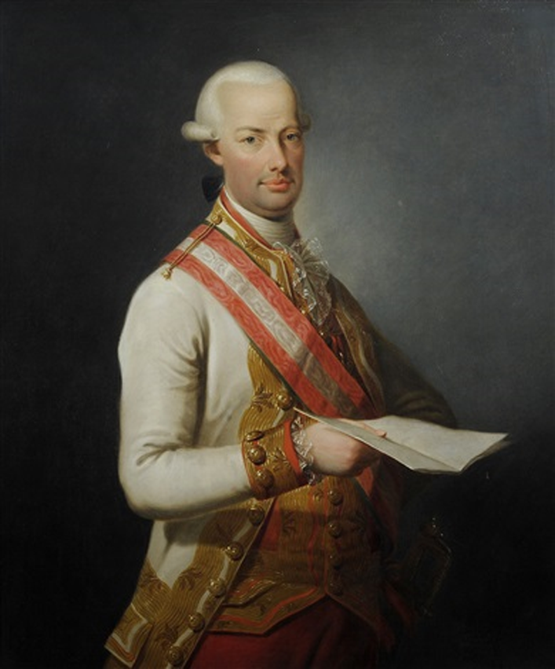
Czech Lands at the Turn of the 18th Century and First Half of 19th Century
Leopold II (1790–1792) – effort to revise the reforms of his predecessor, partial re-establishment of the role of the provincial diets (Prague, Brno, Opava), coronation in Prague in 1791 and an industrial exhibition
Francis II (I) (1792–1835) – period of the Napoleonic Wars, which affected the Czech lands in 1805 – Battle of Austerlitz.

Slide 4
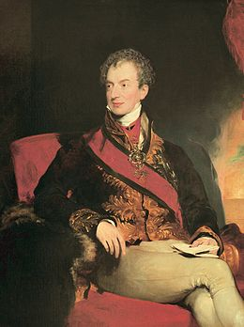
Czech Lands at the Turn of the 18th Century and First Half of 19th Century
Klemens Wenzel von Metternich – skilled diplomat and crucial figure in Austrian foreign policy, Congress of Vienna (1814–1815), involved in the establishment of the Holy Alliance
1811 – General Civil Code (Allgemeines bürgerliches Gesetzbuch für die gesammten Deutschen Erbländer der Österreichischen Monarchie) – modelled on the French Civil Code of 1804 – represents the foundations of civil law in the Czech lands

Slide 5
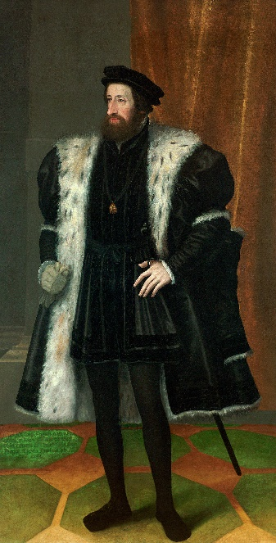
Czech Lands at the Turn of the 18th Century and First Half of 19th Century
Ferdinand I (V) (1835–1848) – suffered from epilepsy and other health issues related to the marriage policy within the Habsburg-Lorraine dynasty. Monarchy de facto ruled by the so-called state council – Matternich, František Antonín Kolovrat and Archduke Louis
The beginnings of the industrial revolution in the Czech lands – 1828 Rudolf's Glassworks in Vítkovice, 1832 horse-drawn railway between České Budějovice and Linz (1827–1836; F. A. Gerstner), beginnings of railway network construction – Northern Railway of Emperor Ferdinand (from 1837)

Slide 6
The Revolutionary Year of 1848
The revolutionary events made their way to Vienna from Germany in March 1848. The State Council resigned, K. W. von Matternich left the country.
Emperor Ferdinand I promised a constitution and, soon, the first constitution in the history of the monarchy and the Czech lands was produced (April 1848) – called the Pillersdorf Constitution (after its creator)
On the basis of this constitution, a parliament (Imperial Council) was established and numerous liberal and social reforms were implemented (e.g., abolition of servitude, establishment of self-government and others)

Slide 7
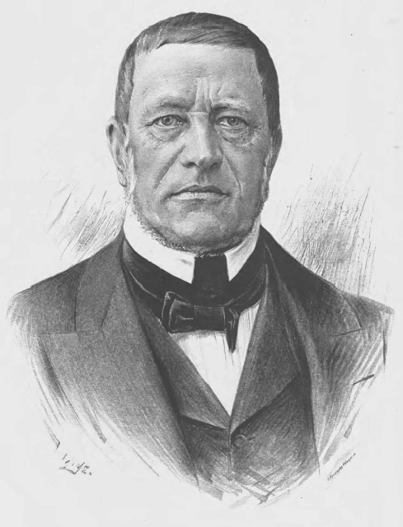
The Revolutionary Year of 1848
Cabinet Letter – 8 April 1848, promise of autonomy for the Czech lands
Palacký's Letter to Frankfurt – framework of the Czech political programme – Austroslavism
June 1848 and the Prague Slavic Congress; the so-called Pentecostal Storm – General Alfred Windisgrätz

Slide 8
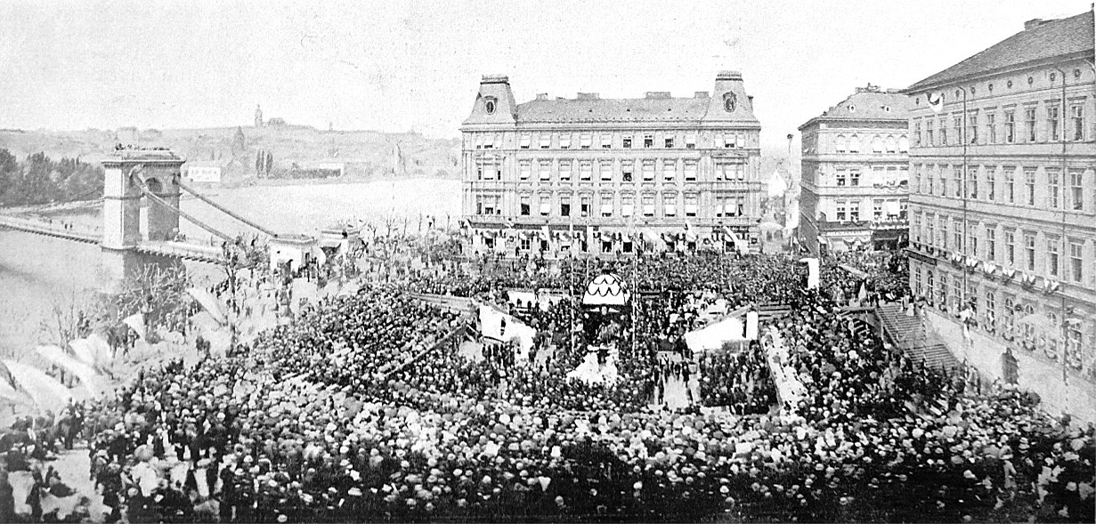
The Revolutionary Year of 1848
A major complication was the national issue – the Habsburg monarchy contained many national entities within its borders and, at this time, the process of their national awakening was starting to strongly manifest itself.

Slide 9
The Revolutionary Year of 1848
September 1848 – on the initiative of deputy Hans Kudlich from Úvalno, Silesia, on September 7, the Imperial Council abolished servitude
As a result of the unrest from people seeking national autonomy in Hungary, a second revolutionary wave broke out in Vienna in October 1848. The parliament moved its session to Kroměříž in Moravia and the emperor and the court took refuge in Olomouc, also in Moravia, where Ferdinand I eventually abdicated and, on 2 December 1848, the young Franz Joseph I ascended the Austrian throne.
The situation in the monarchy gradually stabilised over the spring of 1849. In March, the parliament was dissolved, and the government, with the emperor's approval, published the Stadion Constitution. This act symbolically ended the revolutionary period. However, as a result of the revolutionary years 1848/1849, the Habsburg monarchy was transformed into a constitutional monarchy, in which parliamentary life and the foundations of civil society developed over the following decades.

Slide 10
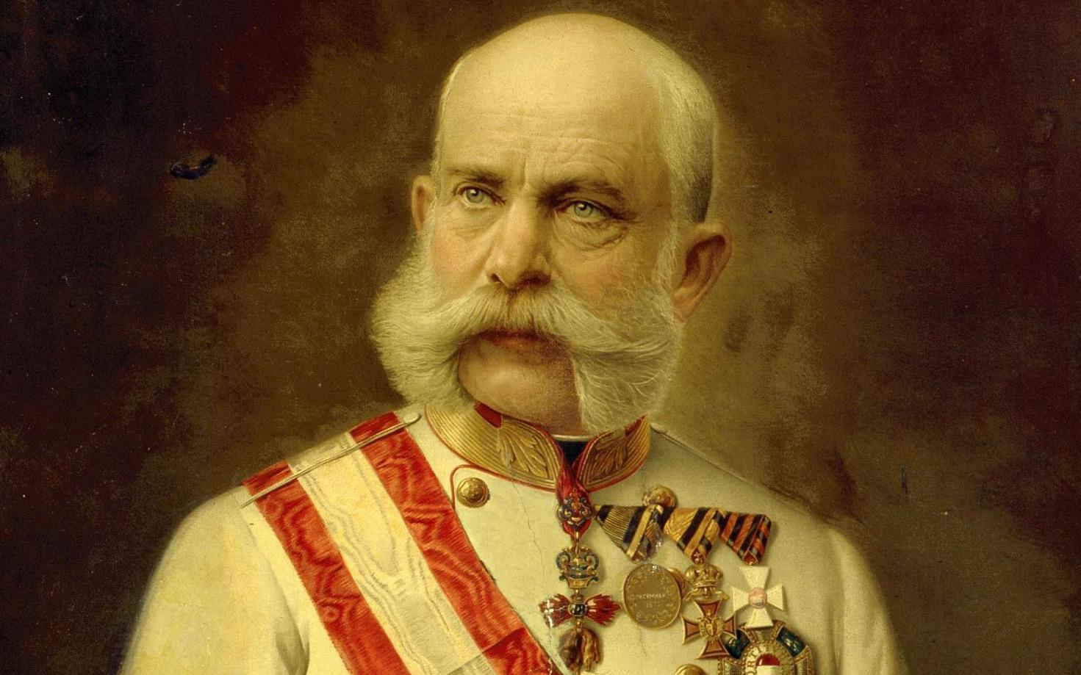
The Revolutionary Year of 1848
September 1848 – on the initiative of deputy Hans Kudlich from Úvalno, Silesia, on September 7, the Imperial Council abolished servitude
As a result of the unrest from people seeking national autonomy in Hungary, a second revolutionary wave broke out in Vienna in October 1848. The parliament moved its session to Kroměříž in Moravia and the emperor and the court took refuge in Olomouc, also in Moravia, where Ferdinand I eventually abdicated and, on 2 December 1848, the young Franz Joseph I ascended the Austrian throne.

Slide 11
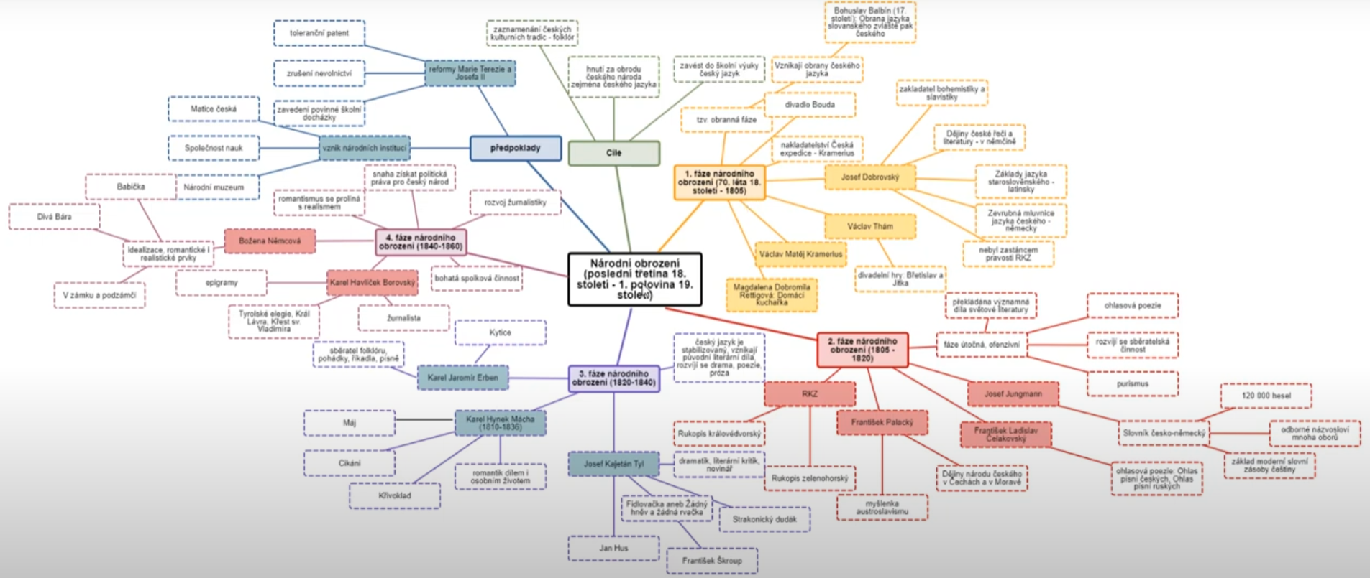

Slide 12
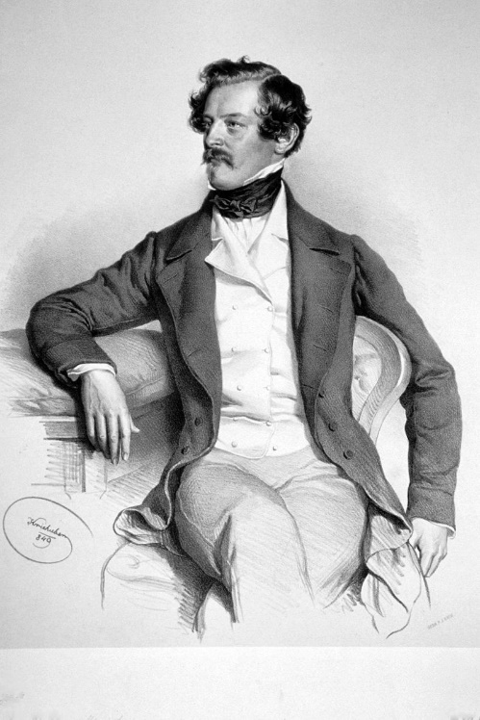
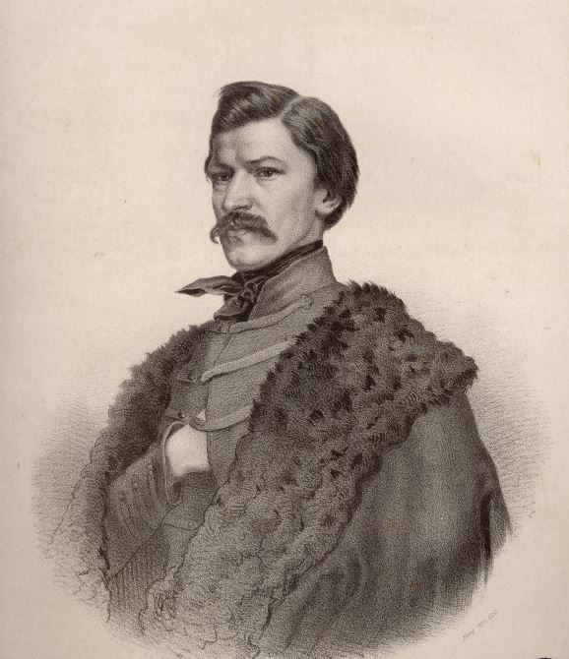
The Czech Lands in the Latter Half of the 19th Century
Silvesterpatent – 31 December 1851, principles of the so-called organic lawmaking and the effective suspension of the imposed Stadion Constitution. Period of the so-called Bach's neo-absolutism (Minister of the Interior Alexander Bach) – 1850s. Economic development of the Czech lands, preserved functional self-government; figure of Karel Havlíček Borovský

Slide 13
The Czech Lands in the Latter Half of the 19th Century
October Diploma – 20 October 1860, in response to events in northern Italy and the weakening of the monarchy. Restoration of constitutionality announced.
Schmerling's (February) Constitution – 26 February 1861, restored the Imperial Council. Civil liberties – forming organisations, establishment of political parties (Old Czechs, later Young Czechs)
František Palacký(1798–1876) – leading figure in Czech politics; František L. Rieger, Karel Sladkovský, Alois Pražák, Eduard and Julius Grégr and others.
December Constitution of 1867 – Dualism: Austria-Hungary – Cisleithania and Transleithania
Fundamental Articles – 1871: attempt to amend the constitutional order, the so-called Czech-Austrian Settlement, which applied only to Bohemia. Faced opposition from German liberals and did not come into effect

Slide 14
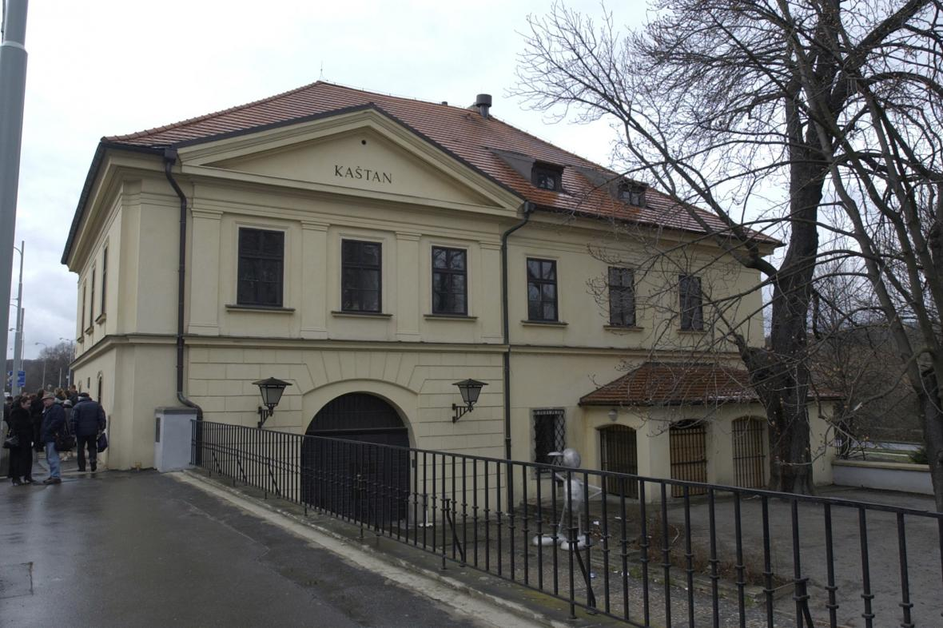
Czech Lands at the Turn of the 19th and 20th Centuries
After the rejection of the Fundamental Articles, passive resistance of Czech deputies to the Imperial Council and the diets (Bohemia) continues, 1873 – direct elections to the Imperial Council
1874 – establishment of the National Liberal Party (Young Czechs) – Karel Sladkovský, critique of the politics of the Old Czechs and their cooperation with the conservative estates (nobility)
1878 – government of Count Eduard Taaffe – the so-called right-wing iron circle, including deputies from the Czech lands – Czech group of deputies at the Imperial Council. Crumb Politics – F. L. Rieger: politics of demanding small concessions in exchange for loyalty to the government
1878 – Congress U Kaštanu – establishment of the Czech Social Democracy – the oldest political entity

Slide 15
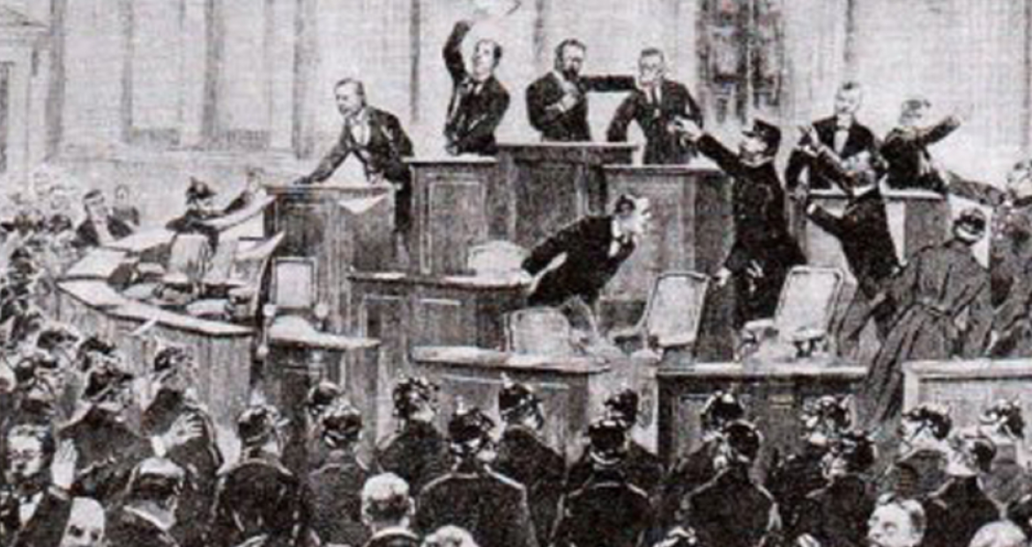
Czech Lands at the Turn of the 19th and 20th Centuries
1880 - Stremayr's language legislation: in addition to German, Czech can be used in dealings with the authorities, but German remains the exklusive internal language
1882 – division of the Charles-Ferdinand University in Prague into Czech and German sections
1890 – so-called point-making, an attempt by the Czech National Party (Old Czechs) to reach an agreement with German liberals on the ethnic division of Bohemia – purely Czech and purely German language areas. Opposition from Young Czechs. The situation resulted in the crushing defeat of the Old Czechs in the elections to the Imperial Council and the Diet in 1891 and their gradual withdrawal from politics.

Slide 16
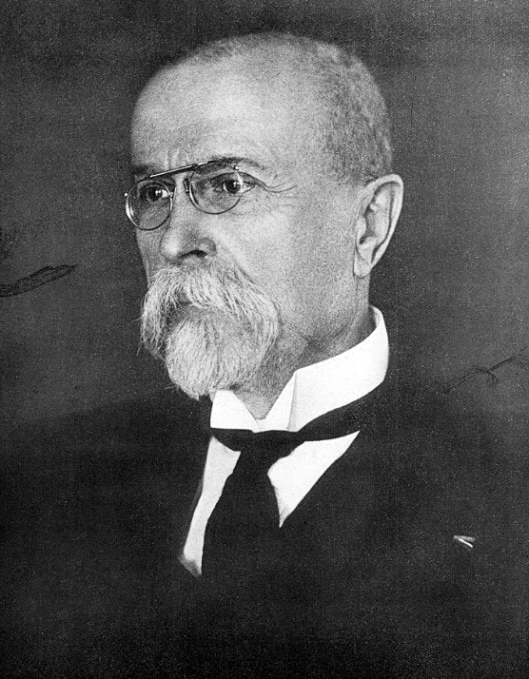
Czech Lands at the Turn of the 19th and 20th Centuries
1897 – Badeni's language legislation (Kasimir Badeni) – Czech also established as an internal official language, resistance of Austrian Germans, suspended – reaction in the so-called Badeni's language riots
Struggle for universal, equal and direct suffrage – 1897 established the so-called general college (curia) for elections to the Imperial Council
T. G. Masaryk – political realism, conflict over the meaning of Czech history, ideals of humanity, social issues

Slide 17
Czech Lands at the Turn of the 19th and 20th Centuries
Division of voters into colleges (curiae) from 1861 – initially three colleges: large estate, municipalities and chamber of commerce and trade, rural. Subsequent establishment of a general college. Applied to elections to the Imperial Council and to the provincial diets – Bohemia, Moravia and Silesia.
Pressure of social democracy – 1905, strikes and protests aimed at passing universal suffrage
1907 – Laws 15–17 RGBl. introduce universal, equal and direct suffrage to the Imperial Council – all men over age of 24. Number of deputies of the Imperial Council increased to 516.
1905 – Moravian Settlement (pact) – equality between Czechs and Germans in Moravia (constituencies, use of language, education – the Laws of Perek and of Parma), the establishment of a general college

Slide 18
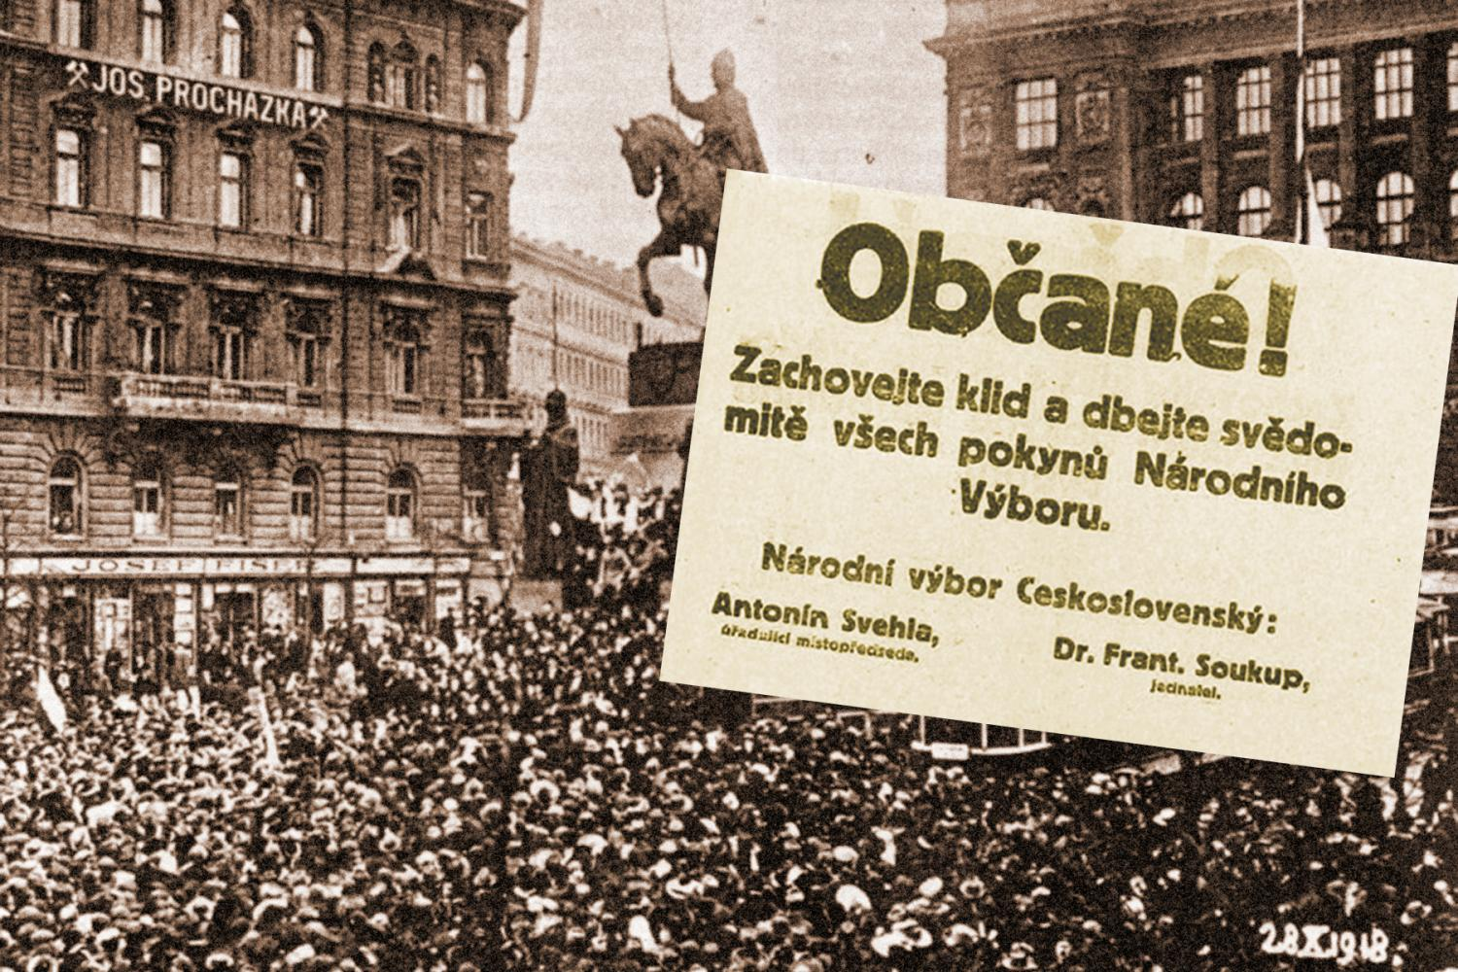
Czech Lands at the Turn of the 19th and 20th Centuries
1918 – establishment of the Czechoslovak Republic

Slide 19
Czech Lands at the Turn of the 19th and 20th Centuries
28. 10. 1918 – establishment of the Czechoslovak Republic

Slide 20
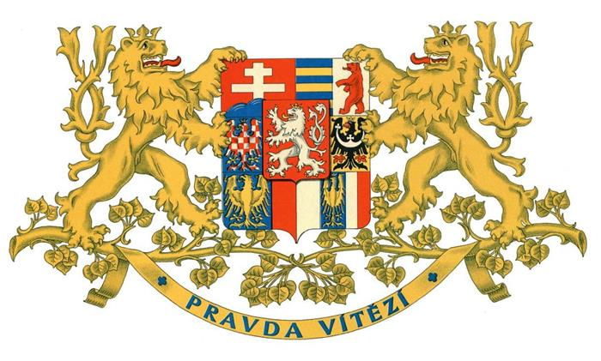
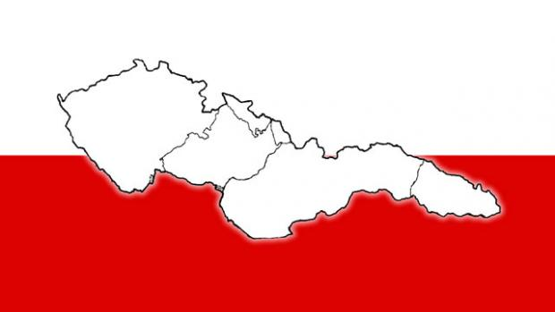
Czech Lands at the Turn of the 19th and 20th Centuries
28. 10. 1918 – establishment of the Czechoslovak Republic

