Slide 1
History of Europe – forming a European identity 1

Slide 2
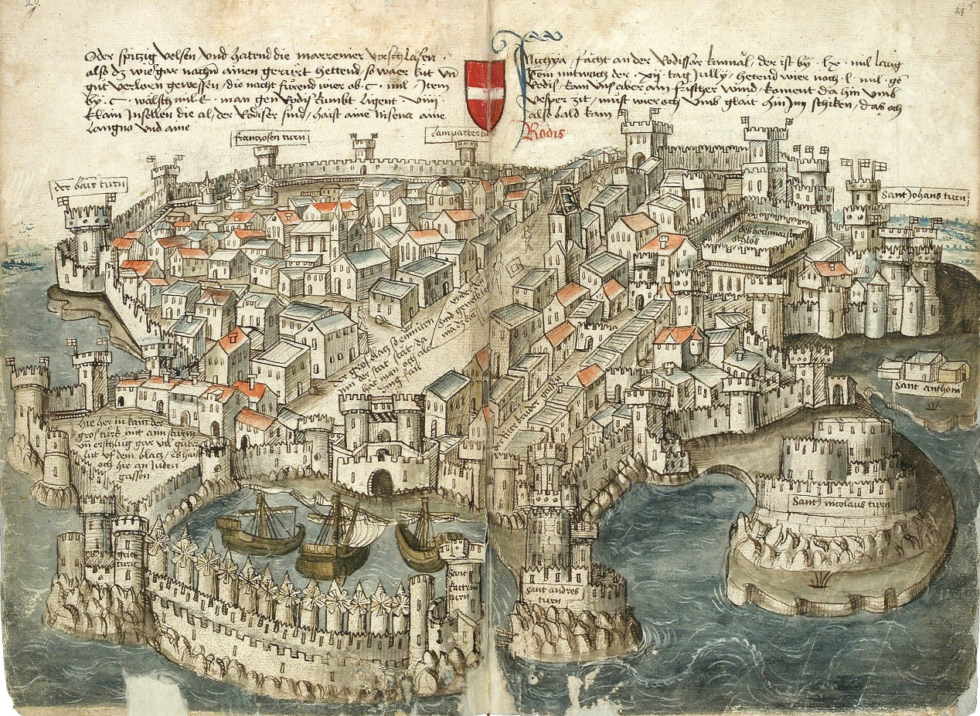
Medieval Cities and Their Formation
Established on the sites of older settlements, merchant settlements (especially on the Italian and Iberian Peninsulas and France)

Slide 3
Medieval Cities and Their Formation
Most are greenfield cities – newly established cities constructed according to specific rules
The town hall, the square and the walls of the city act as its symbols
Cities are governed by municipal law and acquire elements of self-government: Burgomaster, council members
They become economic centres with the development of artisanal production – creation of guilds
They also become centres of trade – holding of markets, rise of merchant class, Jewish people and the emergence of Jewish ghettos

Slide 4
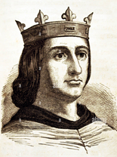
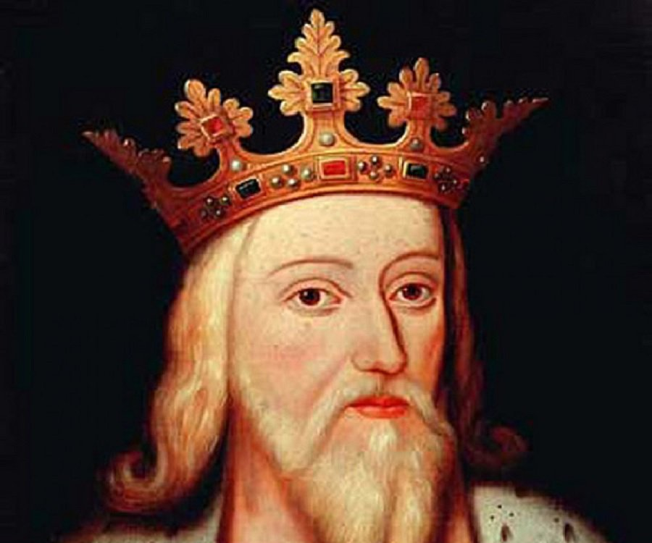
The Hundred Years' War – Rivalry between England and France (1337–1453)
The conflict had deeper causes tracing back to the 12th century and the reign of King Henry II of England, who inherited large territories in France
The conflict erupted shortly after the French Capetian dynasty's senior line ended in 1328 with the death of king Charles IV
The French throne is taken by the House of Valois – King Philip VI, the French throne is also claimed by King Edward III of England (a Capetian on his mother’s side)

Slide 5
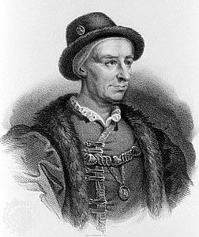
The Hundred Years' War – Rivalry between England and France (1337–1453)
In 1337, the English army invaded France and a conflict erupted for more than 100 years, in which the English initially had the upper hand (Battle of Crécy – 1346), France was allied with Scotland; French King John the Good
The war intensified in 1415 after another attack by England; the story of Joan of Arc as a symbol of the fight against the English
Towards the end of the war, France (King Louis XI) gained the upper hand, with Duke Philip I of Burgundy taking its side; 1453 Battle of Castiglione and final defeat of England

Slide 6
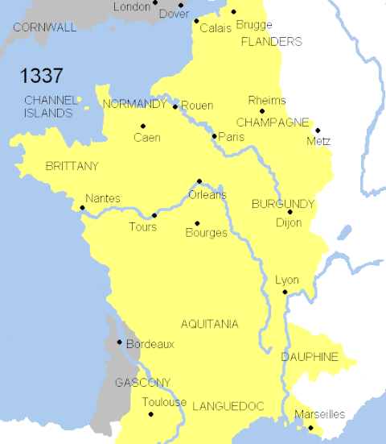
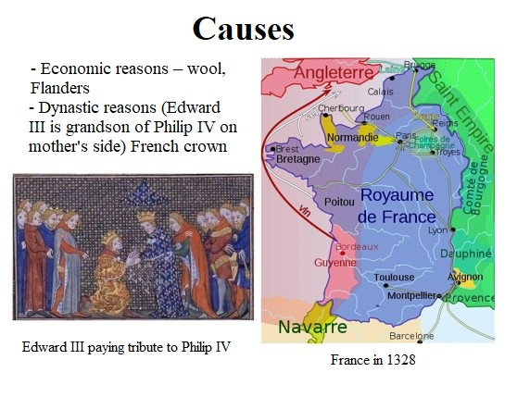
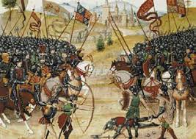
The Hundred Years' War – Rivalry between England and France (1337–1453)

Slide 7
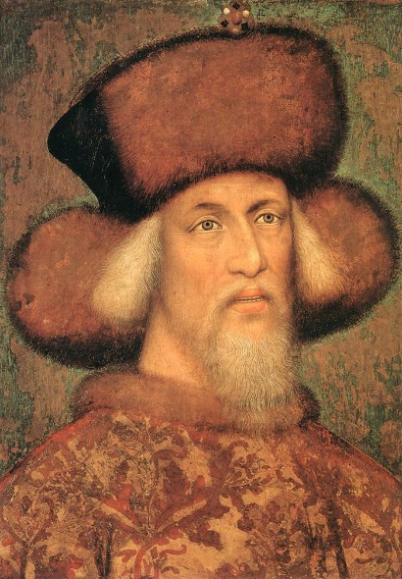
The Rise and Expansion of the Ottoman Empire
Ottoman invasions of Europe first occurred in the mid-14th century; in 1453 Sultan Mehmed II conquered Constantinople (Constantine XI was the last Byzantine emperor), Ottoman origin in settlements in Central Anatolia, adopted Islam as well as certain elements of Byzantine culture
At the end of the 14th century, the Ottoman Empire gradually took control of most of the Balkan Peninsula, 1389 Battle of Kosovo and defeat of Serbia
In 1396, the Hungarian King Sigismund of Luxembourg confronted the Turks at Nicopolis and his army was crushed.

Slide 8
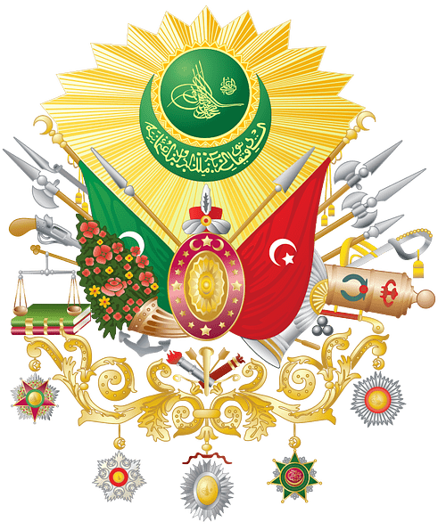
The Rise and Expansion of the Ottoman Empire
The expansion of the Ottoman Empire continued around the Mediterranean, the Black Sea (Crimea), Middle East (Syria, Jordan, Iraq, Iran, Palestine…) and North Africa
At the beginning of the 16th century, the Turks began to directly threaten Central Europe – the Battle of Mohács in 1526 and the defeat of Louis II Jagiellon, 1529 siege of Vienna (Golden Apple)
Conflict with the Ottoman Empire was continual – it occurred throughout the 16th and 17th centuries, especially in Central Europe (Hungary) and in the Mediterranean (Battle of Lepanto 1571, 1683 another siege of Vienna)
During the 18th century, the Ottoman Empire was gradually pushed out of Europe

Slide 9
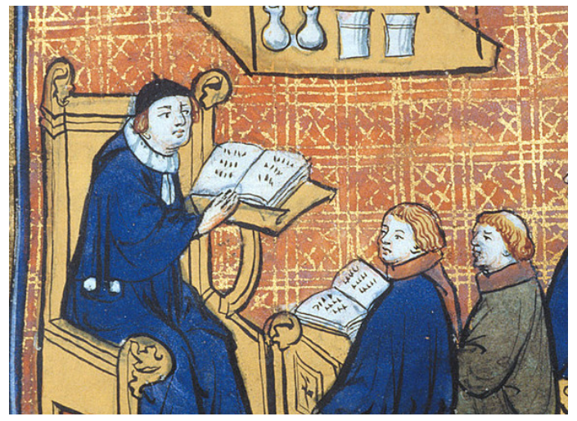
Education in the Middle Ages
Gradual emergence of a network of schools; however, education is initially fully under the direction of the church – parish, chapter, cathedral and monastic schools

Slide 10
Education in the Middle Ages
The Church also acts as the bearer of education – creation of books (transcription – scriptoria); the irreplaceable role of Latin as a unifying language (not only in liturgy)
During the 12th century, in connection with urban colonisation, municipal schools gradually start to appear. This is mainly in Western Europe – in Central and Eastern Europe, the trend begins to manifest from the end of the 13th century
City (Latin) schools disrupt the church's monopoly over education – teaching the so-called trivium (reading, writing and counting – use of vernacular), use of Latin at higher levels
Private education – intended for aristocratic society (nobility, royal courts)

Slide 11
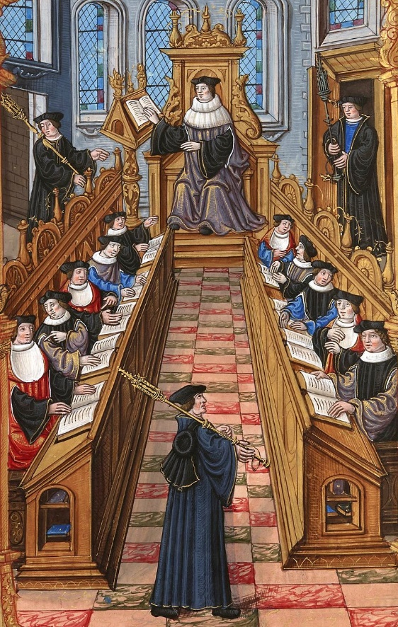
Education in the Middle Ages
City (Latin) schools disrupt the church's monopoly over education – teaching the so-called trivium (reading, writing and counting – use of vernacular), use of Latin at higher levels
Private education – intended for aristocratic society (nobility, royal courts)

Slide 12
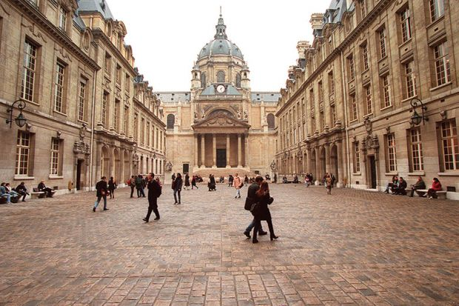
University Education
The oldest universities were established in the Early Middle Ages (Salerno, Bologna, Sorbonne…)

Slide 13
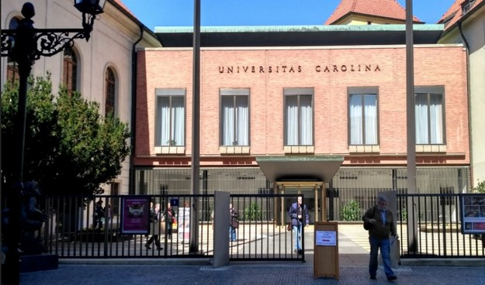
University Education
In the Czech lands – Prague university, established 7 April 1348 at the behest of Charles IV, the oldest "transalpine" university
Universities are self-governing and comprised of their academic community
The academic community elects the rector and deans
Prague university
had what were called
university nations:
Czech,
Saxon,
Bavarian,
Polish.

Slide 14
University Education
Universities in the Middle Ages and the Early Modern Period usually consisted of four faculties, which was also the case for the University of Prague:
Deans were the heads of faculties.
Faculty of THEOLOGY
Faculty of MEDICINE
Faculty of LAW
Faculty of ARTS
The university had the right to award academic degrees:
Bachelor
Master
Doctor

Slide 15
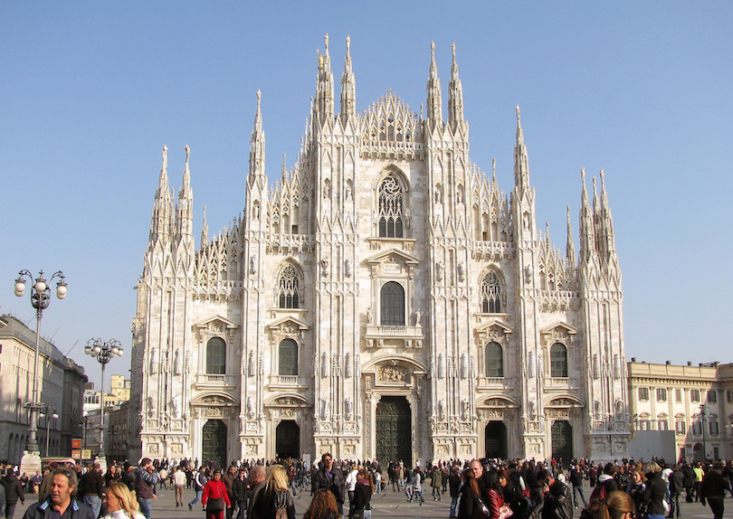
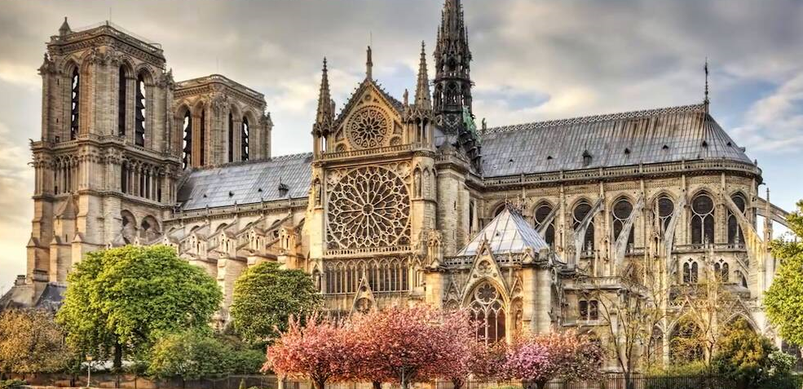
Gothic Culture and Gothic Style
Originated in France during the 12th century (Kings Louis VI and Louis VII, Abbot Suger) as a distinctive artistic style, the only one that did not emerge from the environment of the Italian Peninsula.
It was seen across all areas of art – mainly in architecture (especially churches), in the abbey of Saint-Denis, near Paris.

Slide 16
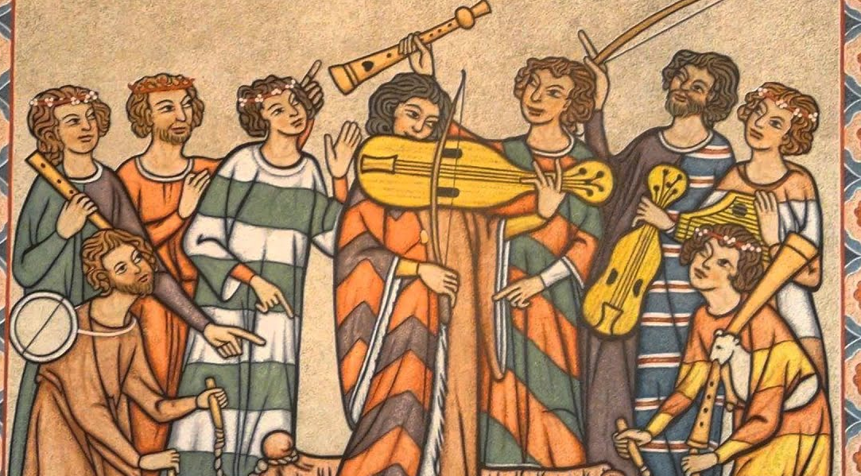
Gothic Culture and Gothic Style
Typical features: verticality, use of buttresses, pointed arch, rib vault, tall windows and spires, use of stained glass (glass mosaic). The height was supposed to suggest the path up towards God
The Gothic style could also be seen in sculpture (Madonnas, attempts to capture the personality of the figures and their expression, emotion), painting (panel paintings, frescoes), secular buildings – town houses (stone), walls, castles
Early, High and Late Gothic France, Germany, Czech lands
Chivalric culture, troubadours (Minnesängers), love poetry, respectful and attentive behaviour towards women

Slide 17
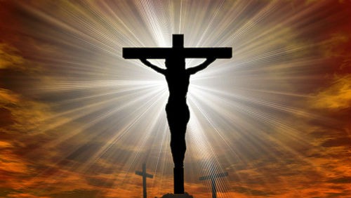
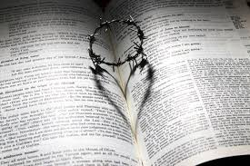
Church and the Middle Ages
Figure of Jesus Christ (Son of God), the symbol of the cross, The Bible – Old and New Testament

Slide 18
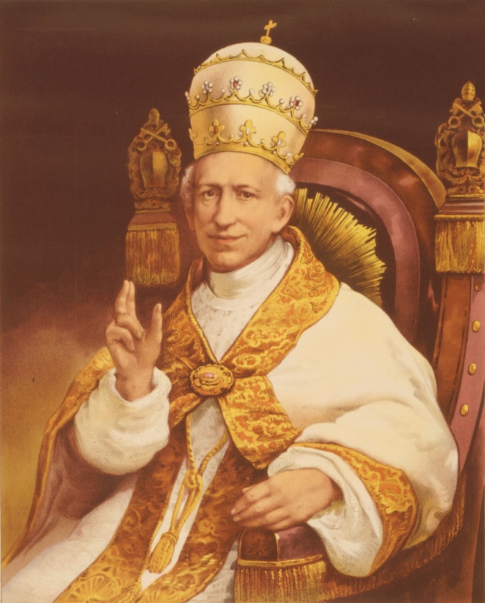
Church and the Middle Ages
Edict of Milan – year 313, Roman emperor Constantine, tolerance of Christians, Christianity subsequently the official religion of the Roman Empire
Rome becomes centre of Christianity, the Pope (Bishop of Rome) as head of Christians – St Peter (42-67 CE), one of the 12 apostles and a disciple of Jesus Christ

Slide 19
Church and the Middle Ages
1054 – schism between the western and eastern branches of Christianity (Cardinal Humbert of Silva Candida excommunicated the Patriarch of Constantinople, Keroularios); dispute over the idea of triunity of God (Holy Trinity)
Organisation of Church: Parish, Diocese, Archdiocese
The important role of monasteries and religious orders (both of men and women)
Investiture Controversy – Pope Gregory VII and Emperor Henry IV (pilgrimage to Canossa), ended by the Worm Concordat in 1122
Ecclesiastical state at peak power during the pontificate of Innocent III (1198–1216)

