Slide 1
History of Europe – forming a European identity 2

Slide 2
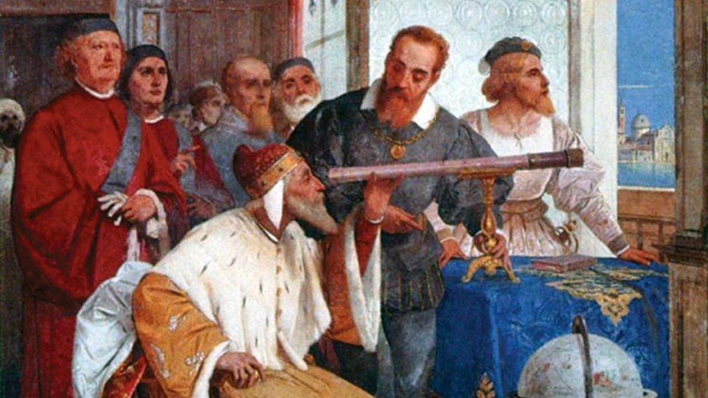
Early Modern Period and Humanism
Renaissance – artistic movement that originated in Italy during the 14th century, generally embraces the legacy of antiquity (rebirth)
Humanism – human at the centre, human existence, emphasis on the values of worldly life
Broadening the horizons of knowledge – astronomy (Copernicus, Galilei, Bruno), printing press (Gutenberg)

Slide 3
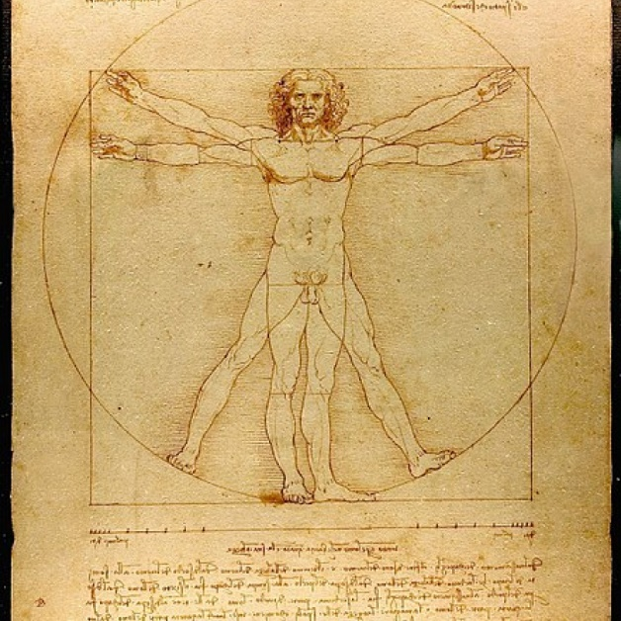
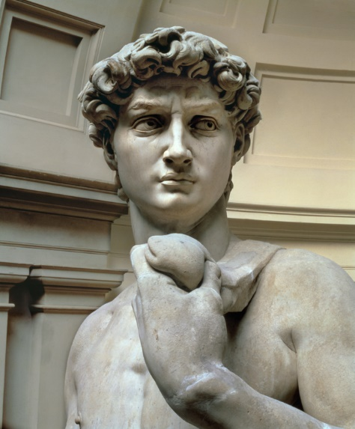
Early Modern Period and Humanism
Art – emphasis on reality, beauty of the human body, use of perspective, proportionality (Leonardo da Vinci, Michaelangelo, Raphael, Dürer, Bosch, Donatello...), literature – Dante, Petrarch, Boccaccio, Shakespeare

Slide 4
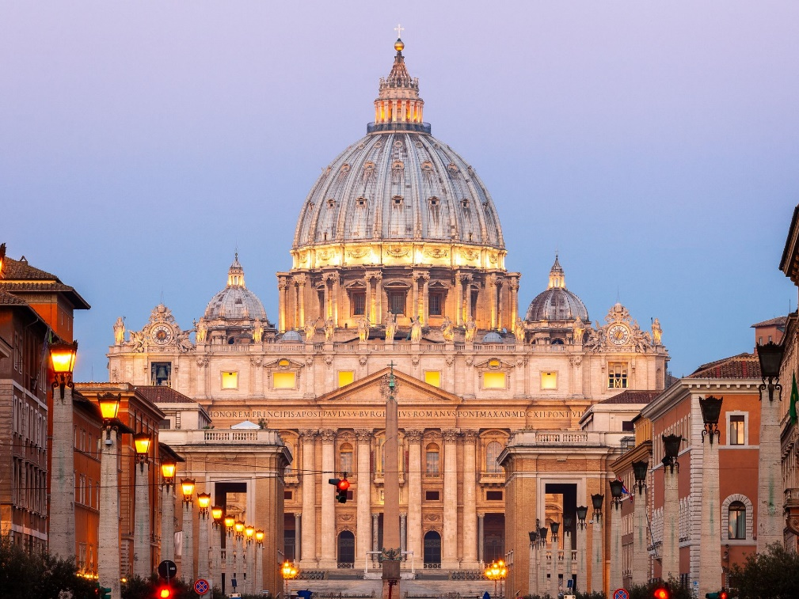
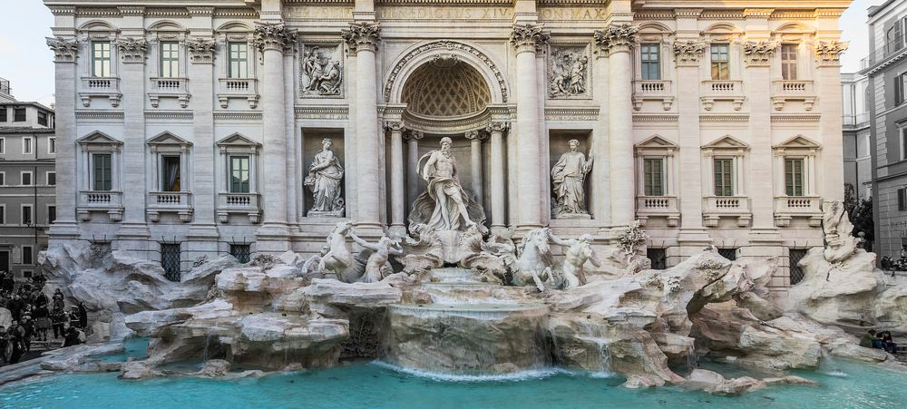
Early Modern Period and Humanism
Architecture – airiness, straight lines, arcades, rectangular windows, circular arch, connection to nature; emphasis on secular buildings – chateaux, houses of burghers
Florence, Rome, Venice, France, Spain

Slide 5
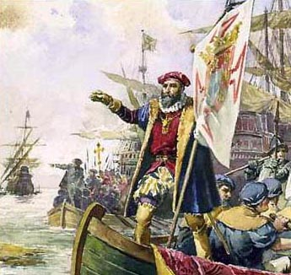
Maritime Discoveries and Colonisation
Arrival of the Renaissance, new discoveries in the field of astronomy, geography (compass, maps), improvements in ship design; at the same time, desire for precious metals, new resources and new "trade" routes
15th century – Portugal: Bartolomeu Dias – Cape of Good Hope, Vasco de Gama – India (opening up a new trade route)

Slide 6
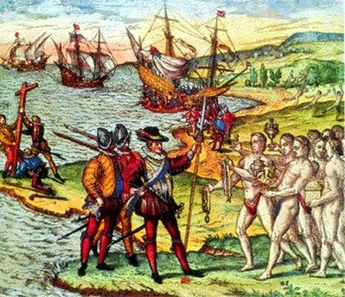
Maritime Discoveries and Colonisation
1492 – Christopher Columbus (12 October 1492 – San Salvador, present-day Bahamas), discovery of a new continent, inhabitants labelled as "Indians"; Amerigo Vespucci; new crops, slaves

Slide 7
Maritime Discoveries and Colonisation
During the 16th century, the Spanish ruled much of contemporary Latin America – H. Cortés (Aztec Empire, Tenochtitlan), F. Pizarro (Inca Empire), Viceroyalty of New Spain, stream of gold and other resources to continental Spain
Treaty of Tordesillas – 1494, signed at the urging of Pope Alexander VI, dividing line between the colonial claims of Spain and Portugal about 500 km west of Cape Verde
North America colonised during 16th century: France (Canada), England and the Netherlands (East Coast of today's USA)

Slide 8
Maritime Discoveries and Colonisation
During the 16th and 17th centuries, stabilisation of colonial dominion of England and France in North America – New England and New France – René-Robert Cavelier's journey down the Mississippi River to its mouth (Louisiana).
Conflict between France and Great Britain during the Seven Years' War and the defeat of France (Battle of Quebec – Battle of the Plains of Abraham – 1759)
Russia's expansion to Alaska and its colonisation – 18th century (area around today’s Anchorage)
Abel Tasman's journeys of discovery in the Pacific (17th Century); subsequently the British explorer James Cook – Australia, New Zealand, numerous islands in the Pacific
Gradual colonisation of India from the late 18th century, culminating in the following century – Great Britain (East India Company) as the main colonial power.
From the 17th century, the Netherlands also becomes a colonial power – Dutch East India Company, colonisation of today's Indonesia (Batavia)
In the second half of the 19th century, the interior of the African continent became the subject of intensive colonisation – Great Britain, France, Belgium, Germany, Portugal, Italy

Slide 9
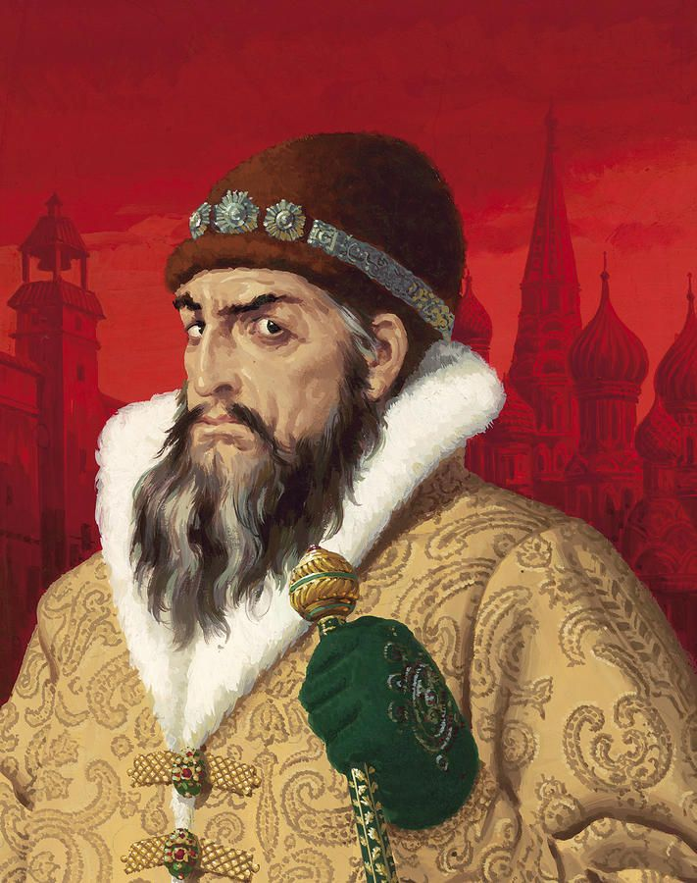
Unification of Russia
During the 13th century, establishment of Muscovy with its centre in Moscow
1380 – defeat of the Tatars by Prince Dmitry Donskoy in the Battle of Kulikovo; definitive defeat of the Tatars during the reign of Ivan III. At the end of the 15th century, Ivan III also got most of the princes to recognise his power and started using the title of Tsar
Ivan (IV) the Terrible (1533–1584) –
many reforms, centralisation of the country,
attempts to eliminate the power of nobles (boyars),
ruthless rule; the Kremlin and Saint Basil's Cathedral

Slide 10
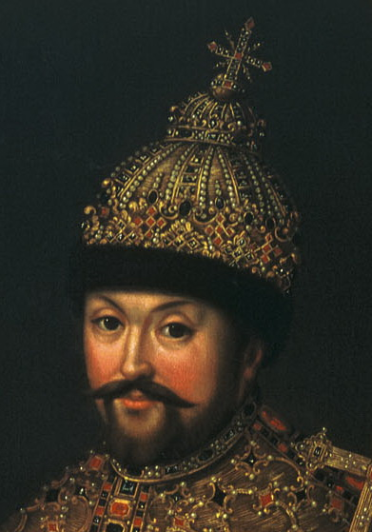
Unification of Russia
After the death of Ivan IV comes a period of instability and chaos – smuta (time of troubles); self-proclaimed "farmer" tsars – False Dmitrys; involvement of foreign powers – Poland and Sweden
In 1613, Tsar Michael I (1613–1645) of the Romanov dynasty ascends the throne, end of the smuta period and gradual stabilisation of the Russian state, expansion into Siberia and its colonisation

Slide 11
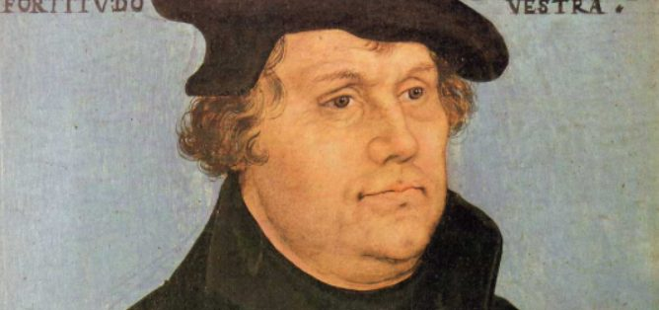
Reformation
The first manifestations of the Reformation in the 14th and 15th centuries in England (John Wycliffe) and the Czech lands (Hussites)
Early 16th century – dissatisfaction with the state of the Catholic Church in the northern regions of Germany (sale of indulgences); speech by Martin Luther, professor at University of Wittenberg – reform theses nailed to the door of the local church

Slide 12
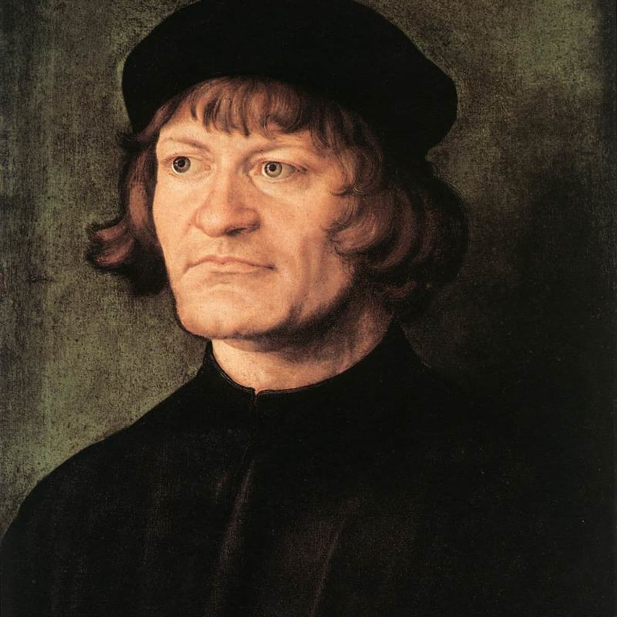
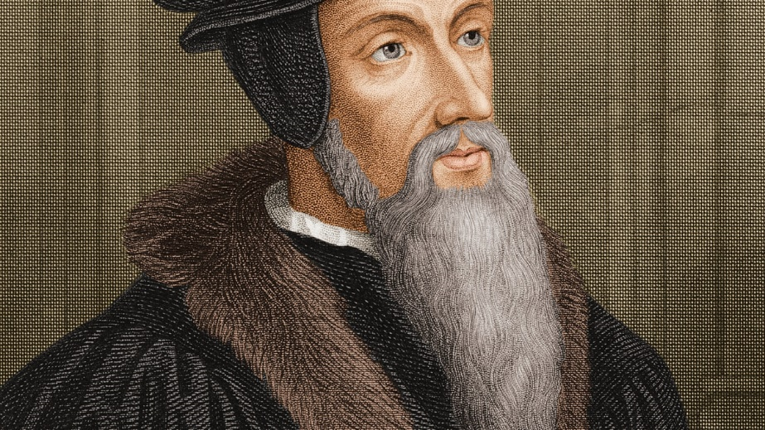
Reformation
The Bible as the only source of faith (translated into German), communion under both kinds (sub utraque specie)
Supporters of Luther labelled as PROTESTANTS (Lutherans), Luther's theses gained support throughout contemporary society (peasants, burghers, nobility)
In the area of today's Switzerland – John Calvin (Geneva, Geneva Catechism, temperance, austerity, order) and the theologian Huldrych Zwingli (Zurich, motto "Thou shalt not make unto thee any graven image") – Calvinists and Zwinglians

Slide 13
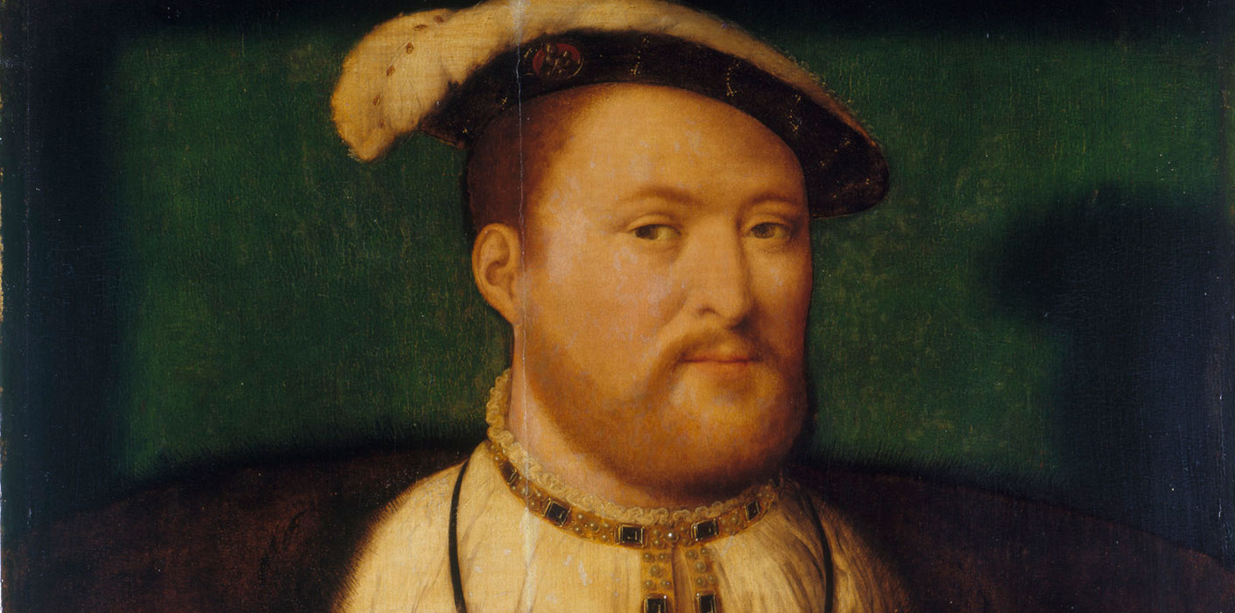
Reformation
The Anabaptist Movement – a person only accepts christening in adulthood
England – Henry VIII (1509–1547) and the Church of England: monarch as head of church
Religious Peace of Augsburg 1555 – Cuius regio, eis religio

Slide 14
16th-Century England and the Tudors
The Hundred Years' War was followed in England by the so-called War of the Roses (1455–1487) between the House of Lancaster and and House of York, which internally exhausted and broke up the country. It ended with the Battle of Bosworth in August 1485, in which Richard III fell, and with Henry VII Tudor taking over as ruler
Henry VII stabilised England and increased royal power. This trend continued under his successor Henry VIII (1509–1547)

Slide 15
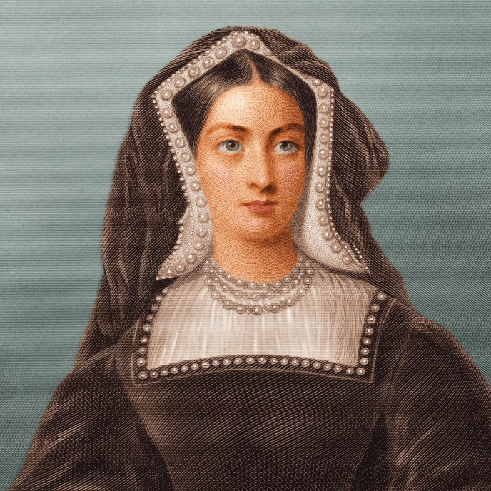
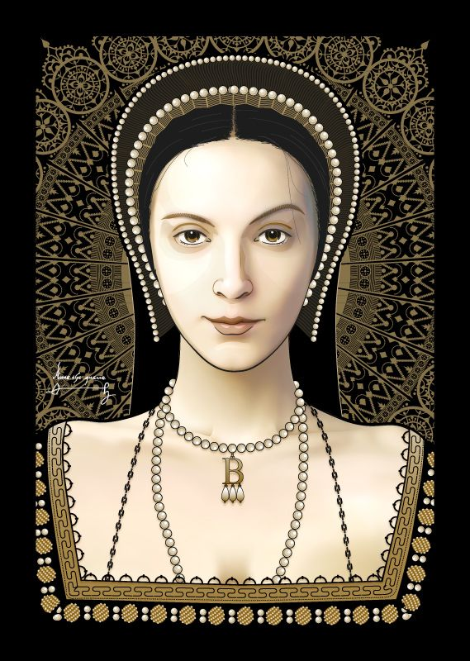
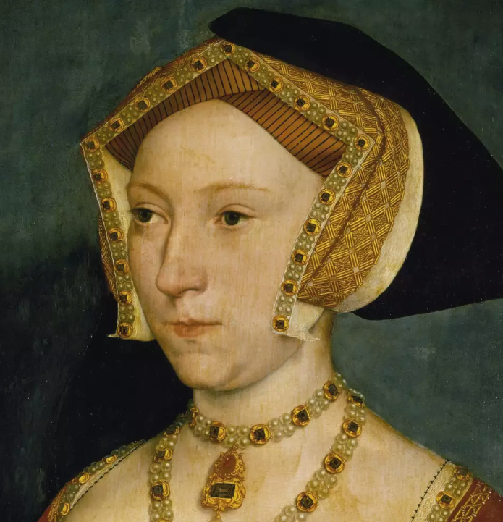
16th-Century England and the Tudors
In 1533, the Pope refused to accept his divorce from Catherine of Aragon – the result was a split with Rome and the establishment of the Church of England, headed by the King of England and the highest ecclesiastical figure, the Archbishop of Canterbury (the six wives of Henry VIII – Catherine of Aragon, Anne Boleyn, Jane Seymour, Anne of Cleves, Catherine Howard and Catherine Parr)

Slide 16
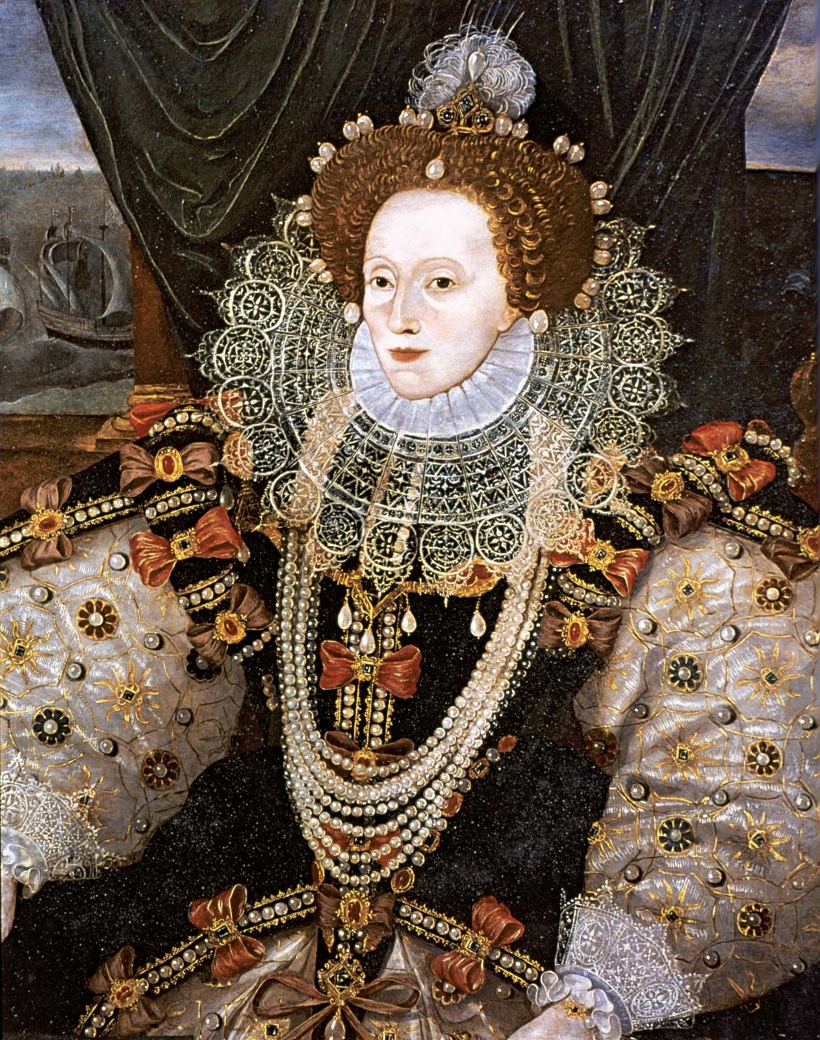
16th-Century England and the Tudors
England rose in power during the reign of Queen Elizabeth I (1558–1603)

Slide 17
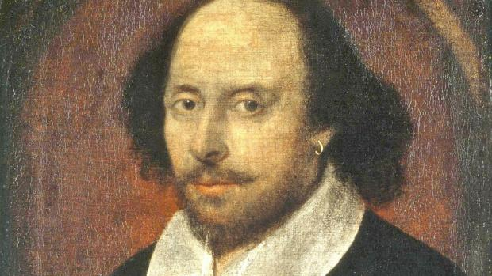
16th-Century England and the Tudors
Colonial expansion and conflict with Spain under Philip II – 1588 battle in the English Channel and the defeat of the Spanish Armada
Vice admiral of the English fleet – Francis Drake and his role in maritime discoveries, East India Company
16th Century England – Development of Culture and Society – e.g., William Shakespeare

Slide 18
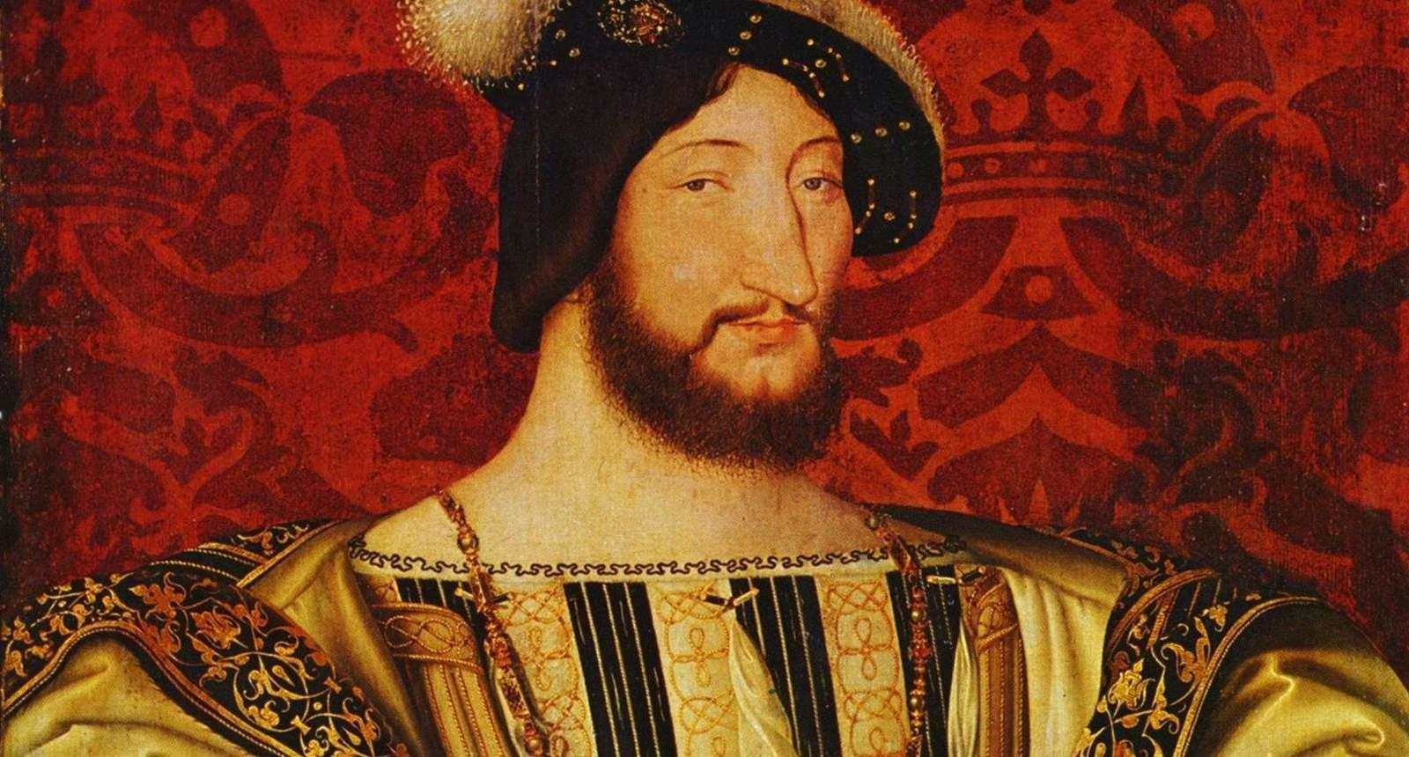
The Habsburgs and the Establishment of the Netherlands
Early 16th century – rise of the Habsburg dynasty. In 1516 the Habsburg Charles I (second-born son of Philip the Fair and Joanna of Castile) became King of Spain and later the Holy Roman Emperor (Charles V). 1492 – conquest of Granada – reconquista.
In 1526, Ferdinand I, brother of Charles I, became King of Bohemia and Hungary.
The growing power of the Habsburgs was met with disapproval from France – King Francis I – and clashes on the territory of the Italian Peninsula

Slide 19
The Habsburgs and the Establishment of the Netherlands
Moreover, the conflict with the Ottoman Empire broke out in earnest – the Battle of Lepanto (1571) and, in the area of Germany, the Reformation was pushing against the Catholicism of the Habsburgs
The 16th century was a period of growing economy and power of Spain as a result of an influx of gold from across the ocean. Charles I and His Conflict with Cities
Charles I (V) was succeeded by his son Philip II (1556–1598) – a "fanatical" Catholic. At the beginning of his reign, an uprising broke out in the Netherlands (1566) – part of the Habsburg dynastic dominions
The uprising was to be suppressed by the Governor, the Grand Duke of Alba (so-called reign of terror). William of Orange led the fight against the Spanish, the United Provinces of the Netherlands (Calvinism) were proclaimed in 1581

Slide 20
The Thirty Years' War
Causes – the European Reformation in the 16th century and the formation of two religious-political blocs within the territory of the Holy Roman Empire: the Catholic League and the Protestant Union – increasing tensions at the turn of the 16th and 17th century
The Bohemian Revolt, which broke out in May 1618, became the trigger for the conflict
Bohemian War (1618–1620) – ended with the Battle of White Mountain (November 1620)
This was followed by the Palatinate War (1620–1623) , during which the Catholic League gained a clear advantage – conquest of Palatinate and the dissolution of the Protestant Union.

Slide 21
The Thirty Years' War
Denmark (King Christian IV) entered the war of 1625, becoming the leader of the new anti-Habsburg coalition – Danish War (1625–1629). This phase of the war ended with the defeat of Denmark (Battle of Dessau Bridge, Battle of Lutter) which was a moment of fame for Albrecht von Wallenstein
The success of the Habsburgs and the Catholic League caused the displeasure of the Protestant princes in the HRE and of France (Cardinal Richelieu) – formation of another anti-Habsburg coalition led by Sweden (King Gustav Adolf II). Swedish War (1630–1648) – the longest phase of the Thirty Years' War, the conflict transformed from a religious into a political conflict
The Battle of Lützen 1632 and the death of Gustav Adolf II Attempts from both sides to reach a compromise – peace negotiations in the Westphalian cities of Osnabrück and Münster – Peace of Westphalia 1648

Slide 22
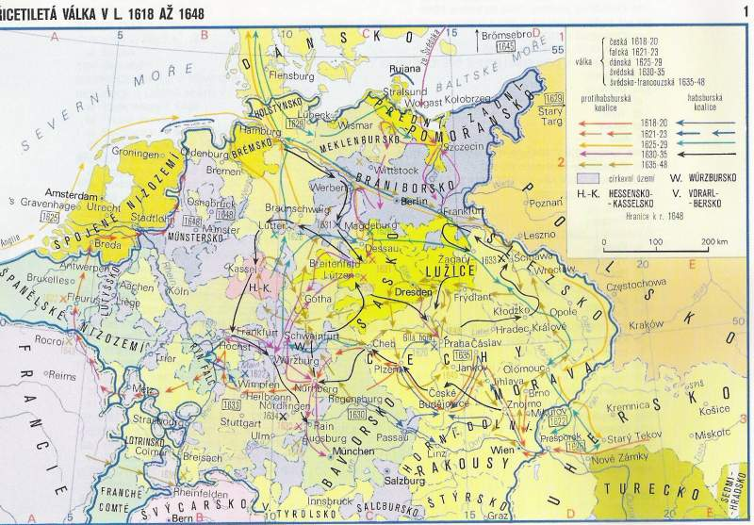
The Thirty Years' War

Slide 23
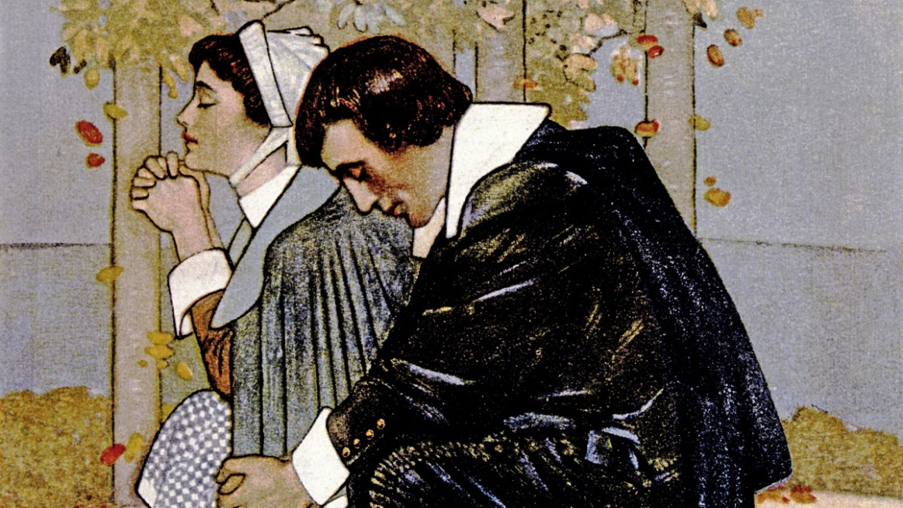
The English Revolution (1642–1660)
At the beginning of the 17th century, England became one of Europe's main powers
In 1603, the childless Elizabeth I died, succeeded by James VI and I (son of Mary, Queen of Scots) and then by his son Charles I in 1625, seeking to further strengthen absolutist rule – conflict with parliament
Privileging the Church of England and persecuting Puritans (English followers of Calvinism)

Slide 24
The English Revolution (1642–1660)
Opposition to the king was gradually forming and, in 1642, a war broke out between the king and parliament. Afterwards, Oliver Cromwell became the head of the Parliamentarist army, defeating the Royalist army in 1645 in the Battle of Naseby. King Charles I was captured and executed in 1649
England declared a Commonwealth, in 1653 Cromwell dissolved the Rump Parliament a proclaimed himself Lord Protector – he retained this position up until his death in 1658
During the English Revolution there was a conflict with the Netherlands (dispute over position in maritime trade)
In 1660, the English monarchy was restored – the Stuarts returned to the throne with Charles II (son of Charles I) – the power of kings is severely limited by parliament

