Slide 1
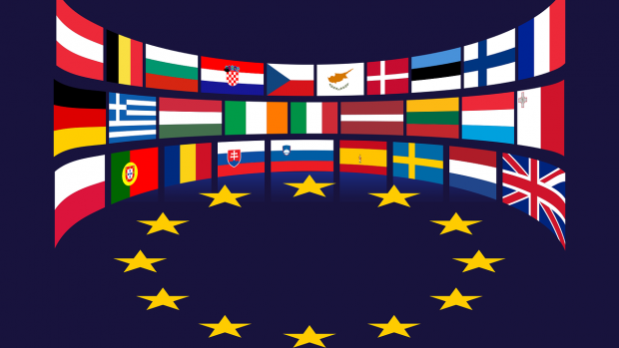
History of Europe – forming a European identity 5

Slide 2
Unification of Italy – Italian Peninsula in the Early 19th Century
After the Congress of Vienna, the territory of modern Italy essentially reverted into its state prior to the Napoleonic Wars – i.e., fragmentation into smaller state units – Kingdom of Sardinia, Kingdom of the Two Sicilies (Naples), Piedmont and others. Most of the north was brought back into the Habsburg monarchy
However, Italy could no longer fully return to its original "feudal" conditions – formation of citizen elites, promotion of liberal ideas along with the idea of a unified Italian nation
In 1820, a revolution occurred in Naples which reverberated through most of Italy, but was eventually suppressed by Austrian troops .
Gradually, groups were formed with the goal of a unified Italy, among which the Carbonari – a secret political group originally operating in the south of Italy – occupied the most prominent position.

Slide 3
The Young Italy Movement
New impetus on the path to the creation of a unified Italy was the July Revolution in France in 1830 (overthrow of the absolutist rule of Charles X and establishment of a constitutional monarchy headed by king Louis Philippe), which received great support in Italy
The internally disjointed network of the secret Carbonari associations was replaced in 1831 by Young Italy, led by Giuseppe Mazzini (1805-1872)
The aim of the Young Italy organisation was to fight – even violently – for the creation of a unified Italian state – attempts to organise a wide-scale uprising against the conservative governments of the individual Italian states and expel Austria from the north of Italy (compensation by gaining territory in the Balkans)
However, their calls for a wide-scale uprising were unanswered (partly due to the internal disunity of Young Italy) and the isolated actions of the rebels were easily suppressed
An important factor for the future unification of Italy was the internal development in the Kingdom of Sardinia (Piedmont), where the liberal-minded King Charles Albert ascended the throne in 1831
Industrialisation also occurred on the Italian Peninsula during the 1820s-1840s, construction of transport networks – factors which aided the process of creating a unified Italian state

Slide 4
The First Italian War of Independence
In 1847, Pope Pius IX (pontificate since 1846) allowed liberal reforms to be implemented in Central Italy
This reformist effort was followed by many other Italian states, attempts were made at creating a customs union on the Italian Peninsula, and riots began in the Austrian-ruled Lombardy.
In January 1848, a revolutionary uprising broke out in Naples
The revolution spread across the Italian Peninsula and one of its primary goals was the creation of a unified Italian state
In addition to the internally fragmented Young Italy movement, the Kingdom of Sardinia – King Charles Albert – leads the struggle for the unification of Italy
However, Charles Albert primarily pursues his own dynastic interests, and the attempt to lay the foundations of a united Italy is thwarted by the defeat of the Kingdom of Sardinia by Austrian troops in the battles of Custoza (1848) and Novara (1849).
Charles Albert subsequently abdicated in favour of his son Victor Emmanuel II (1849)
As a result of the military failures of Charles Albert, an uprising broke out in Rome, the end of papal reign was declared along with the Roman Republic, which was to become the basis of the future united Italy and in which Giuseppe Mazzini became the leading figure. In response to these events, France deployed troops to Rome – under the pretext of mediating peace between the Pope and the "insurgents" – these eventually gained control of the city in August 1849, finally ending the First Italian War of Independence

Slide 5
The Second Italian War of Independence
In the 1850s, Mazzini tried unsuccessfully to initiate a wide-scale uprising aimed at creating a unified Italy
In the latter half of the 1850s, this goal was adopted by the Kingdom of Sardinia, led by Victor Emmanuel II and Prime Minister Camillo Cavour
The Kingdom of Sardinia was a constitutional monarchy and carried out numerous liberal reforms, developing industry and infrastructure. Over time, it became the most important state on the Italian Peninsula
Cavour tried to establish closer relations with the France of Napoleon III, which led to the Plombières Agreement, according to which France was to support the aspirations of the Kingdom of Sardinia leading to the establishment of a unified Italy in exchange for territorial gains in Savoy and the area around Nice
In 1859, a conflict was started with Austria, which ended in its defeat in the bloody Battles of Magenta and Solferino – the Habsburg monarchy had to relinquish its influence and territory in Northern Italy
This initiative was also taken up in 1859 by democratic (radical) revolutionaries led by Giuseppe Garibaldi, who successfully started an uprising in Sicily (Expedition of the Thousand) against the ruling House of Bourbon. Subsequently, Southern Italy became part of the Kingdom of Sardinia. On 4 March 1861, the Sardinian parliament passed a resolution to create a unified Italy

Slide 6
Unification of Italy 1861–1870
Although we may speak of a unified Italy from 1861, it still lacked the territory around Rome in Central Italy, known as Lazio, which was still under papal control
Italy also did not include Veneto, as even after 1859, it was still part of the Austrian monarchy
In 1866, after the outbreak of the Austro-Prussian War, Italy entered the conflict as an ally of Prussia and, despite the failures of the Battle of Custoza and the naval Battle of Lissa, acquired Veneto thanks to the victory of Prussia in the war.

Slide 7
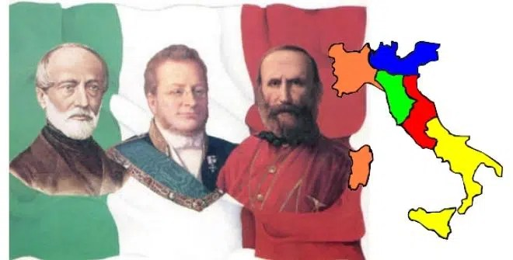
Unification of Italy 1861–1870
Through Giuseppe Garibaldi, Italy also tried to gain control of Lazio, which had been under the "protection" of France since 1848 and was ruled by a conservative-Catholic regime, but this proved fruitless
The situation changed after the defeat of Napoleon III's France by Prussian armies at the Battle of Sedan in 1870, which Italy exploited by occupying Rome in August of that year
Lazio was subsequently annexed into Italy and the Italian capital was transferred from Florence to Rome. The annexation of Lazio in 1870 finalised the more than half-century-long process of the unification of Italy, which had been a monarchy since 1861, led by King Victor Emmanuel II (referred to as Pater Patriae) of the House of Savoy

Slide 8
The Unification of Germany – German Lands at the Turn of 18th and 19th Centuries
During the Middle Ages and the Early Modern Period, a number of political entities (approximately 300) were established on the territory of present-day Germany, among which Bavaria, Saxony and Prussia occupied the dominant positions.
All these states belonged into the wider framework of the Holy Roman Empire, whose emperors had been recruited from House of Habsburg since the 15th century.
During the Napoleonic Wars, a fundamental shift occurred – in 1806, after the defeat of Austria and Prussia (Wars of the Third and Fourth Coalitions), the Holy Roman Empire ceased to exist and was replaced by the Confederation of the Rhine under French control.
Emperor Francis II abdicated and subsequently accepted the title of Austrian emperor as Francis I

Slide 9
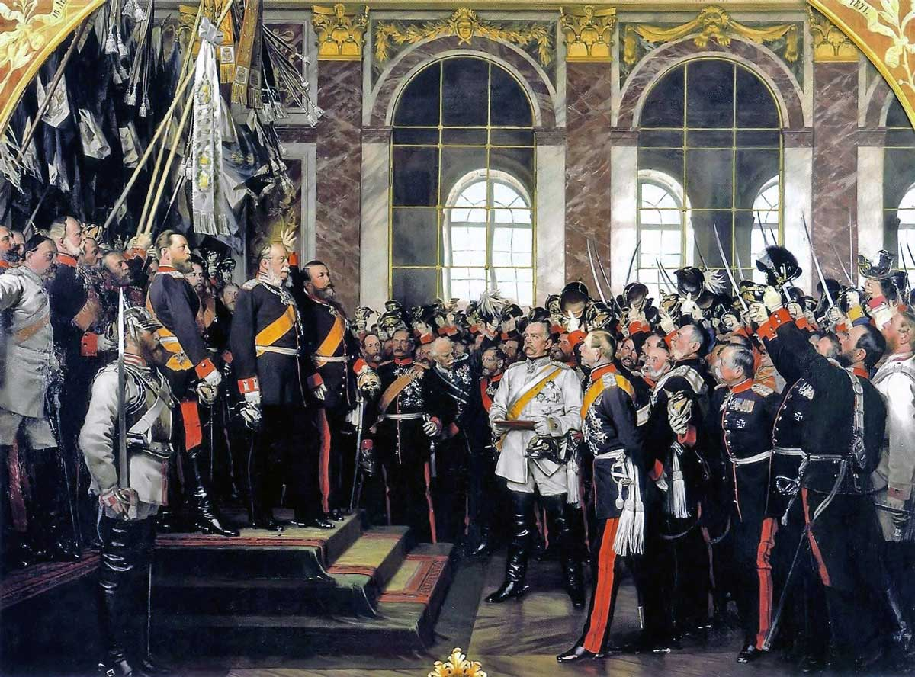
Germany after the Congress of Vienna
The Congress of Vienna decided to reorganise Germany – the outdated Holy Roman Empire was not restored, the Confederacy of the Rhine was abolished and the German Confederation (a political association of German states) was established instead, with its centre in Frankfurt am Main (German Diet) and with the Austrian monarchy holding a dominant position (permanent presidency of the Austrian emperor), despite complaints of Prussia

Slide 10
Germany after the Congress of Vienna
After the Napoleonic Wars, an intensive process of a formation of a German national identity and shared national consciousness took place on German territory, regardless of the individual (existing) political entities within the German Confederation. The main bearers of this trend were students and their assemblies – 1817 at Wartburg Castle, 1832 national demonstrations in the Bavarian town of Hambach – during which calls for German unity were made – i.e., the creation of a modern German state
Austria (Chancellor K. W. von Matternich) strongly opposed these trends towards unification and liberalism
The German territory also saw a rapid development of the economy and transportation between the 1820s and 1840s – factors that aided the process that would lead to the creation of a unified German state

Slide 11
1848 and 1849 and the Attempt to Unify Germany from "Bottom Up"
The revolutionary years of 1848–1849 provided a new impetus for the process of forming a united German state
Within the German Confederation, this was closely linked to the efforts to adopt an all-German liberal constitution
To this end, the so-called "Committee of Fifty" was convened in Frankfurt am Main to prepare a new constitution and elections into an all-German parliament. These elections took place in April and May 1848 – the elected parliament went into session on 31 May 1848
Two basic ideas of German unification emerged
– Greater Germany: the unification of all German countries, including Austria (and by extension the Czech lands) – i.e., effectively the territory of the German Confederation
– Little Germany : unification of Germany without Austrian (and Czech) lands
In the end, the concept of Little German prevailed and the parliament adopted an all-German constitution that defined Germany as a constitutional monarchy, privileges of the nobility were abolished, freedom of the press, personal liberty and more were guaranteed.
The German crown was offered to the Prussian King Frederick William IV, who rejected it because he did not want to become reliant on the all-German parliament.
This event marked a turning point for the Frankfurt Parliament, as individual deputies started resigning, it was then moved to Stuttgart where it was later dissolved in June 1849.

Slide 12
The Road to German Unity (1850–1871)
After 1849, Prussia – the largest, politically and economically strongest state within the lesser German Confederation (excluding Austria and the Czech lands) – began to assert itself as the main actor in Germany's future unification
These ambitions of Prussia could be seen in the intervention in Hesse in 1850, which encountered resistance from the Austrian monarchy as the most important entity within the German Confederation. The threat of conflict between Prussia and Austria was averted by Russia in November 1850 with the so-called Peace of Olomouc, on the basis of which Prussia recognised Austrian hegemony in the German Confederation
However, this proved to be merely temporary and the dispute between Austria, which intended to keep the German Confederation as a free federation of states under its sole influence, and Prussia, which, on the contrary, openly sought to create a united German state under its own rule, resumed ten years later

Slide 13
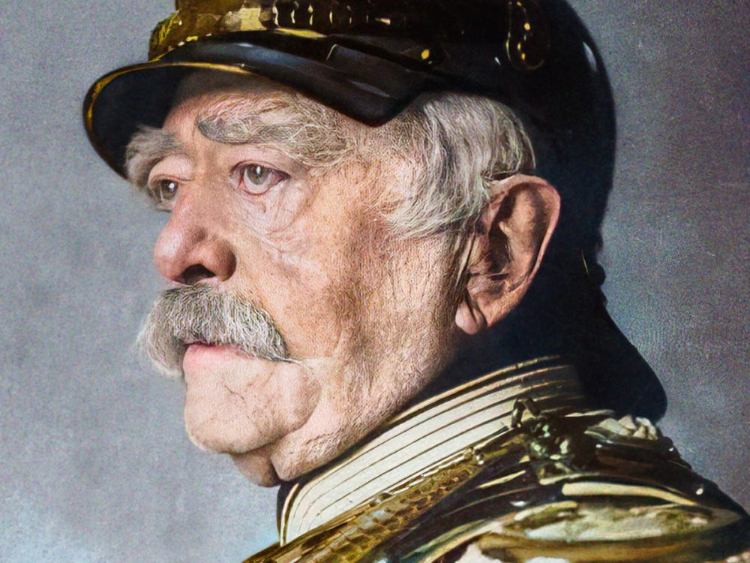
The Road to German Unity (1850–1871)
In 1862, the skilful politician Otto von Bismarck became Prussia's Minister-President, promoting the concept of unifying Germany with "blood and iron"
In 1864, the Second Schleswig War broke out, with Austria and Prussia on one side and Denmark on the other, over the disputed territory of Schleswig and Holstein, which Denmark had annexed shortly before (1863) despite the opposition of the German Confederation
Denmark was defeated and the territory of Schleswig came under the administration of Prussia, while the territory of Holstein was run by Austria

Slide 14
Austro-Prussian War – 1866
Prussia sought to occupy Holstein as well, which Austria eventually evacuated without a fight. Tensions between the two countries began to rise rapidly.
Prussia took advantage of the favourable international situation and began to further pressure Austria (e.g., accusations of stoking anti-Prussian sentiments in Holstein)
In April 1866, Prussia entered into an alliance with Italy, which sought to annex Veneto, an area under Austrian rule.
The situation escalated in June 1866 with Prussia declaring war against Austria
The war was swift, with Prussia gaining a clear advantage (the Battles of Königgrätz and Tovačov) and its armies advanced on Vienna
A truce was agreed between the two armies in Mikulov in South Moravia, and the Peace of Prague was signed in August 1866
As part of this peace agreement, Austria left the German Confederation and gave up its claims to Holstein. Prussia then established the North German Confederation under its hegemonic rule, replacing the German Confederation

Slide 15
The Franco-Prussian War and Unification of Germany
Its victory against Austria strengthened Prussia's position and opened up a path for it to unite Germany
Prussia's rising influence on the international scene and especially in the German territories displeased the France of Napoleon III
It began to try and isolate Prussia through attempts to establish alliances with Austria and Italy
A direct conflict between France and Prussia flared up over the issue of filling the open Spanish throne in 1868 (forced resignation of Queen Isabella II)
France supported the candidacy of Prince Ferdinand of Portugal, while Prussia – Otto von Bismarck – secretly backed the candidacy of Prince Leopold, Prince of Hohenzollern
However, information about Prince Leopold's secret candidacy reached the public and caused tensions between France and Prussia. France demanded that the Hohenzollerns make a public commitment never to run for the Spanish throne again
This request was passed on to King William I of Prussia by the French ambassador during his stay in the spa town of Bad Ems
William I informed Chancellor Bismarck of this meeting via the so-called Ems Dispatch, which Bismarck altered before publishing it so that it would come off as offensive towards France, with the clear intention of sparking a military conflict

Slide 16
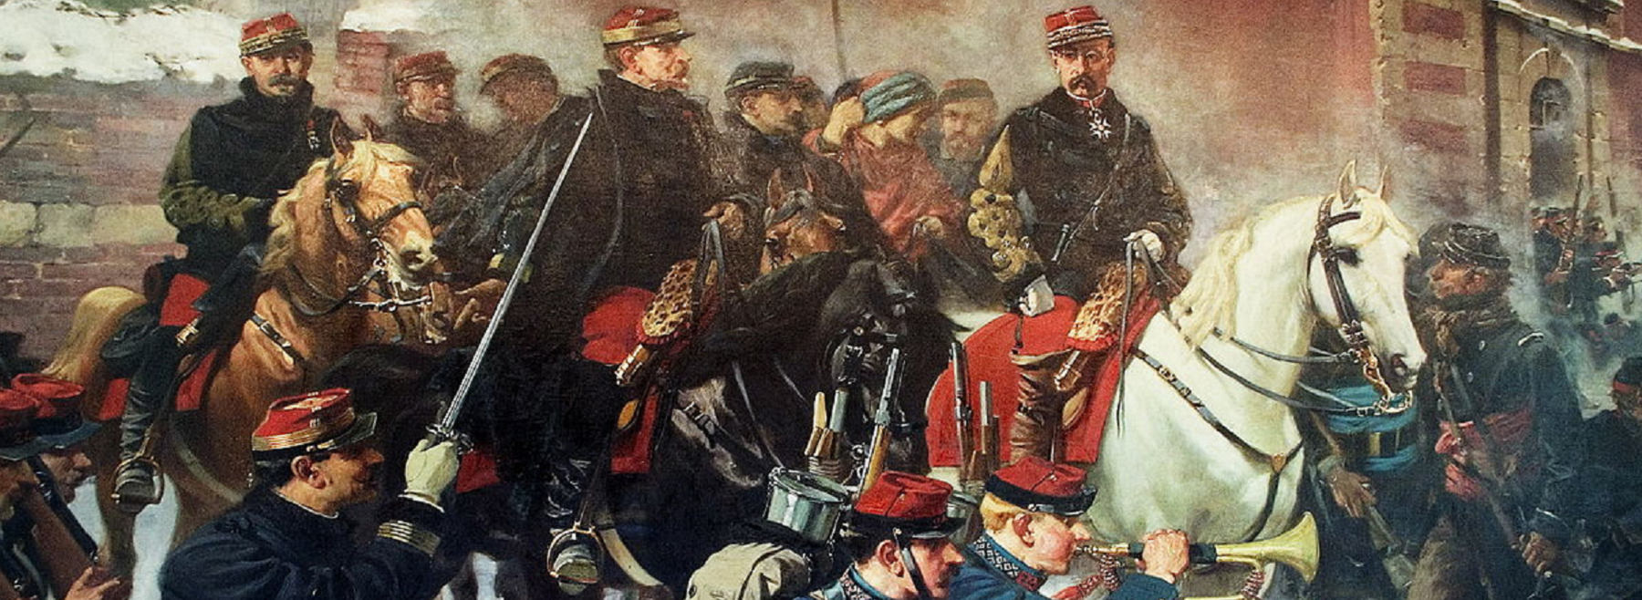
The Franco-Prussian War and Unification of Germany
Conflict between Prussia and France broke out in August 1870
Prussia had guaranteed support through a number of alliance treaties with individual German states (Bavaria, Saxony, Baden and others), significantly bolstering the size of its army.
The French army was insufficiently prepared for war – numerically, logistically and in style of command

Slide 17
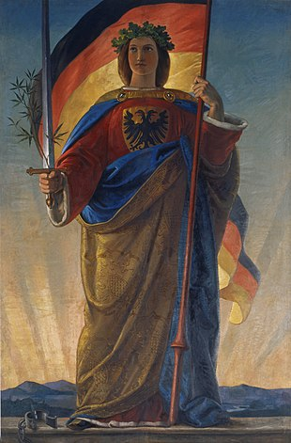
The Franco-Prussian War and Unification of Germany
The decisive battle took place on 1 September 1870 at Sedan, where the French were defeated and Napoleon III was captured
The Prussian armies later occupied Paris, where an uprising had recently broken out
On 18 January 1871 (still during the siege of Paris) in the Hall of Mirrors of the Chateau de Versailles, a united Germany was grandly proclaimed – it was headed by Emperor William I with Otto von Bismarck as the Imperial Chancellor.
Subsequently, the imperial constitution was adopted – Germany became a constitutional monarchy
In the following decades, Germany experienced rapid economic growth and became one of the most important powers in Europe

