Slide 1


national stereotypes
Notes:
NAETINEM: Reflection of National and European Identity in the New Millennium (NAETINEM)
reg. č. 2019-1-CZ01-KA203-061227

Slide 2
content
1. What is a Stereotype?
2. National Stereotypes
3. National Stereotypes about Czechs
4. Sources
  4.1 Online Sources

Slide 3
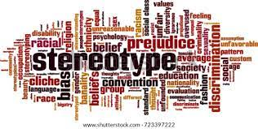
what is a stereotype?
A stereotype is a settled, usually simplified attitude or opinion about a certain group of people. This opinion is then transferred to a specific individual.
Stereotypes presented by the media are referred to as media stereotypes.

Slide 4
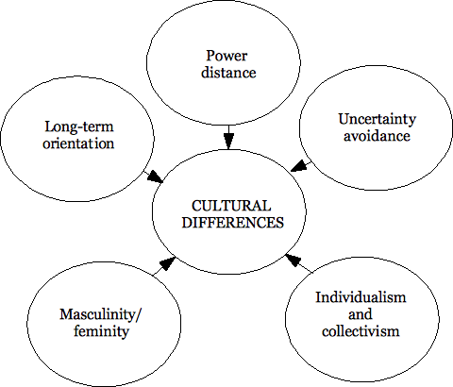
what is a stereotype?
G. Hofstede & G. J. Hofstede has defined five national culture dimensions:
  power distance,
  uncertainty avoidance,
  masculinity versus femininity,
  individualism versus collectivism,
  long versus short term orientation.
Notes:
Sources:
Hofstede G. & Hofstede G. J. Cultures and Organizations: Software for the Mind, New York, NY: McGraw-Hill Professional, 2004.

Slide 5
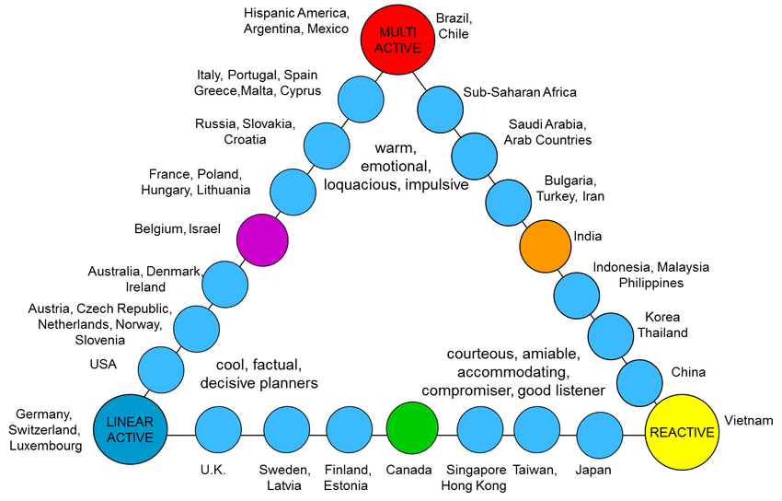
what is a stereotype?
Richard D. Lewis model of cultural types:
  The Lewis Model is designed to indicate with which particular cultural group an individual would have empathy with.
  Lewis named his three typologies Linear-active, Multi-active and Reactive.
Notes:
Sources:
Richard. D. Lewis. Cross Cultural Communication: A Visual Approach. UNKNO, 1999.

Slide 6
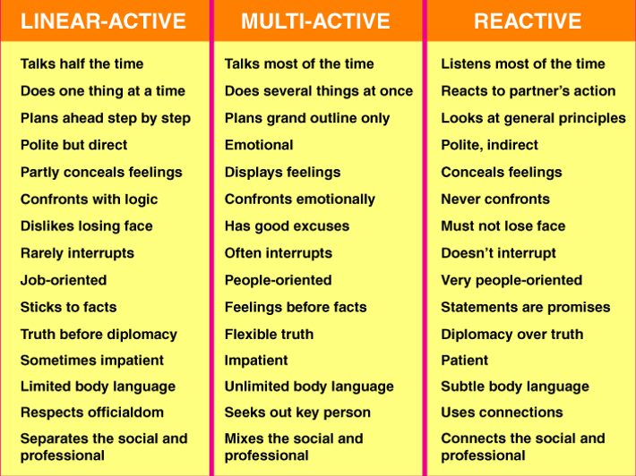
what is a stereotype?
A schematic overview of the characteristics:
Notes:
Sources:
https://unitedbycultureblog.wordpress.com/the-lewis-model/the-lewis-model-explanation/

Slide 7

National stereotypes
According to the Czech Population and Housing Census* from the year 2011, the Czech Republic is characterized by national homogeneity with a dominant representation of Czech nationality.
Notes:
Sources:
Veronika Kolaříková. Czech National Identity and the Elements Through Which is Constructed. Czech-Polish Historical and Pedagogical Journal, 12/2, 2020, s. 66–96.
* Český statistický úřad. (2014). Národnostní struktura obyvatel. Český statistický úřad. p. 2. [cit. 15. 12. 2018]. Available from: https://www.czso.cz/documents/10180/20551765/170223- 14.pdf/d0d27736-ef15-4f4f-bf26-e7cb3770e187?version=1.0

Slide 8
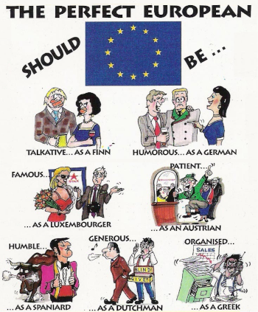
National stereotypes
National identity is one of many identities of (post) modern man and as such, it can be mutually combined with other identities (regional, ethnic, class, gender, etc.).
National identity tells us and our surroundings who we are.

Slide 9
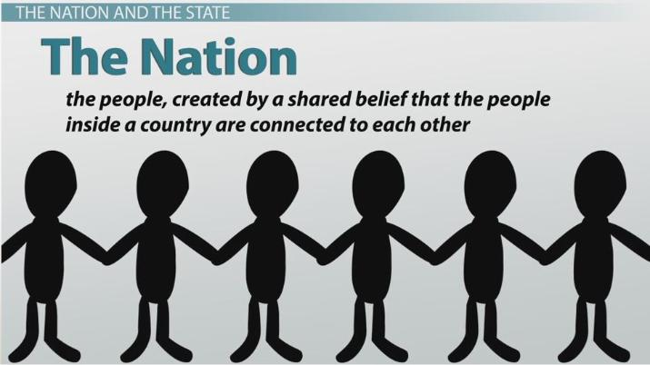
National stereotypes
There are several perspectives through which we can look at national identity.
Currently in scientific discourse dominates the modernist conception of the nation. This concept understands nation as an unintended consequence of modern (European) society, in which at the turn of the 18th and 19th century the on-going structural changes caused the rise of nationalism.

Slide 10
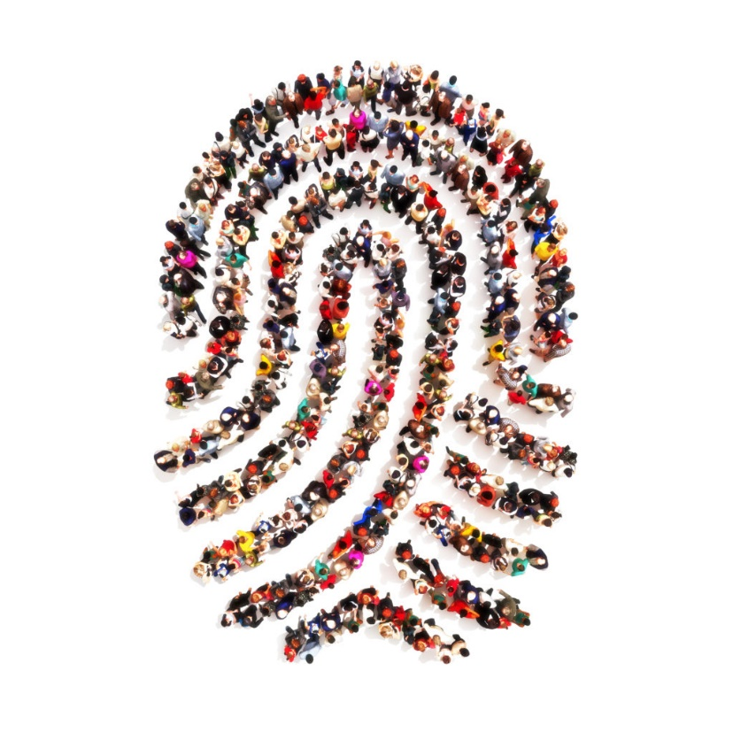
National stereotypes
There are a number of elements through which national identity is constructed.
These elements, respectively their categories often overlap and relate to each other.
Still, it is useful to include them in these categories for clarity and other analytical work.

Slide 11
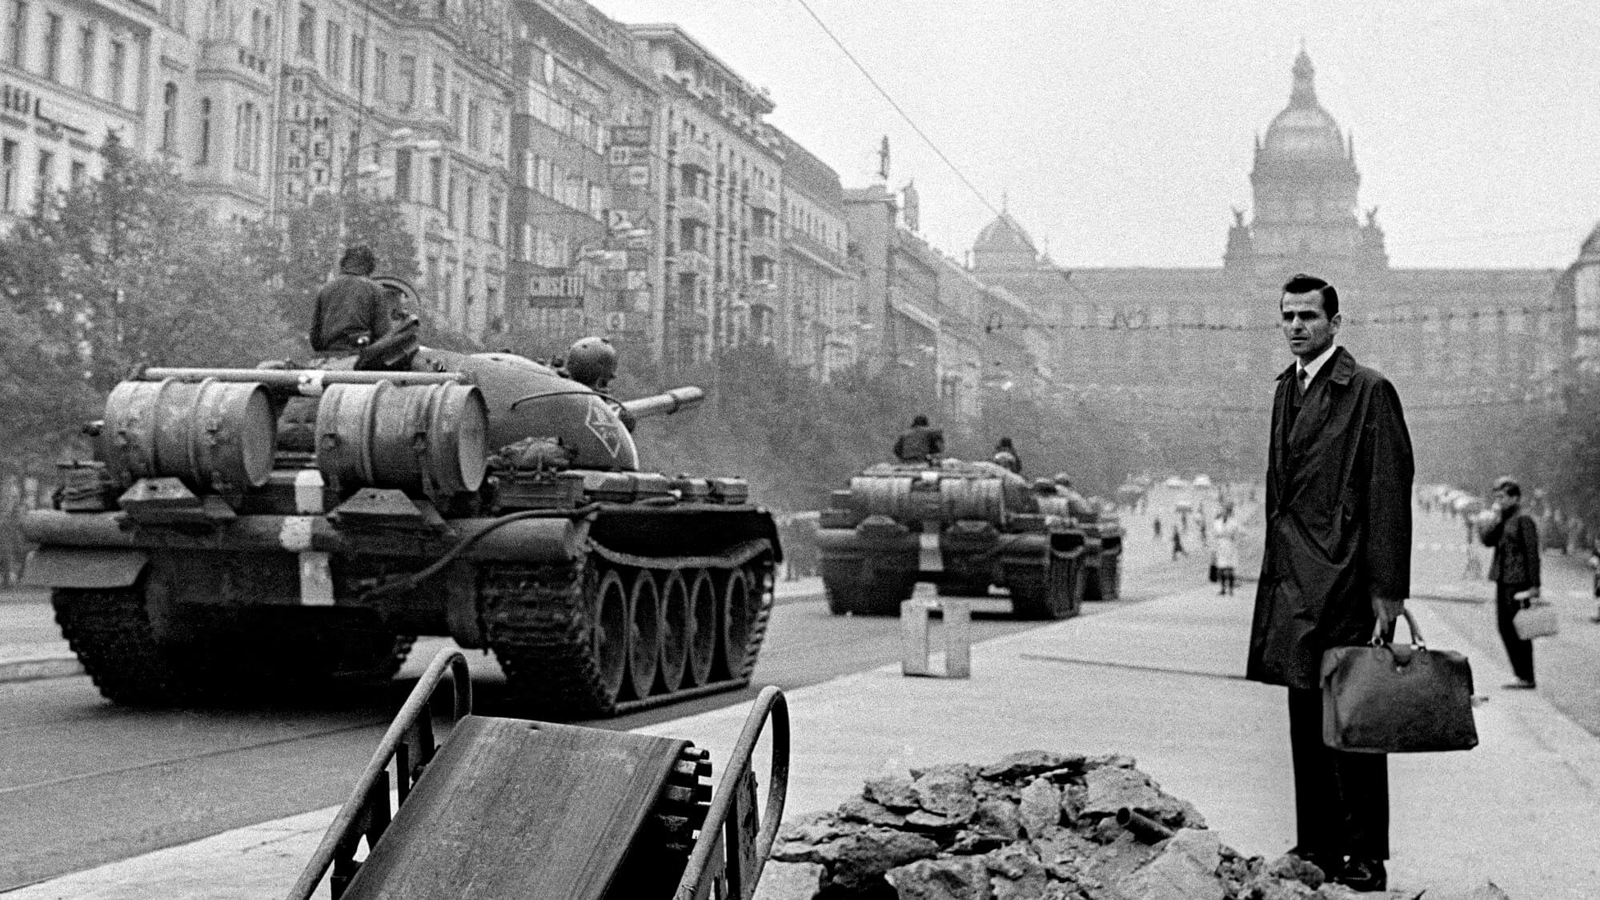
National stereotypes
The first category consists of (1) historical memory:
  An important role in shaping national identity always had national history and national myths. They gave the community a feeling of continuity, thus not only describing its existence, but also legitimizing it.

Slide 12
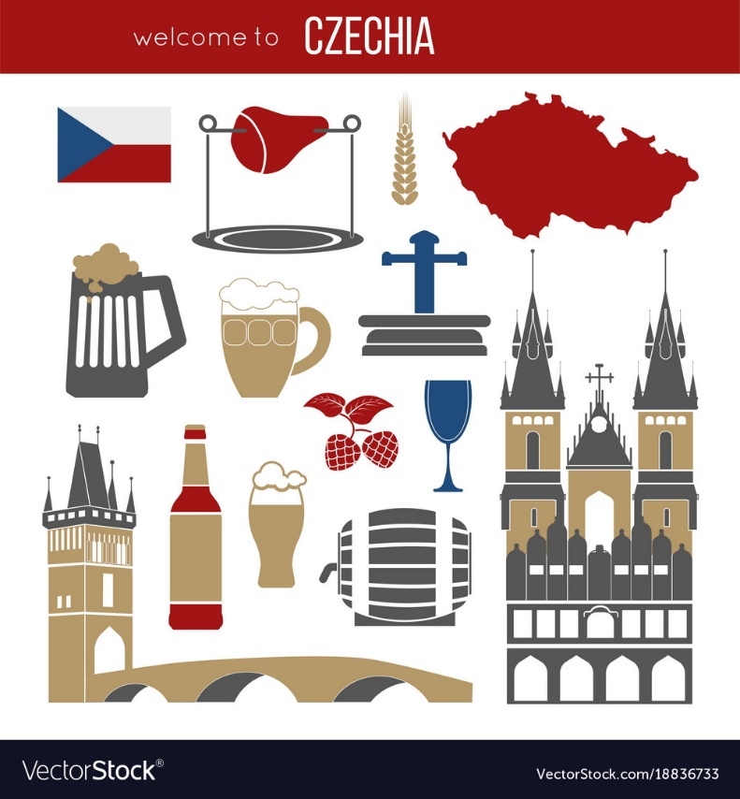
National stereotypes
In addition to historical memory, the collective (national) identity is further shaped by (2) characteristic cultural features of groups.
  These are group-specific values – sacrament values, heroism, honour, justice, democracy, etc., norms, canonical texts, symbols and sacred objects, food, dressing, emblems, etc.
  Important role have also shared traditions, festive feasts, rituals, and other specific activities (e.g. religious practices) that shape and strengthen the collective identity of the group, sense of reciprocity and unity.

Slide 13
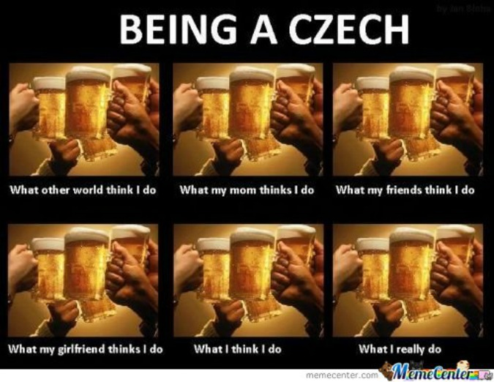
National stereotypes
Another category of elements involved in the process of forming the national identity consists of (3) national stereotypes through which members of a nation create categorization of themselves and the outside world.
  These stereotypes are based on autostereotypes (ideas about ourselves) and heterostereotypes (ideas of others).
  Autostereotypes and heterostereotypes are involved in differentiation and exclusion processes, which are involved in shaping the boundaries between communities.

Slide 14
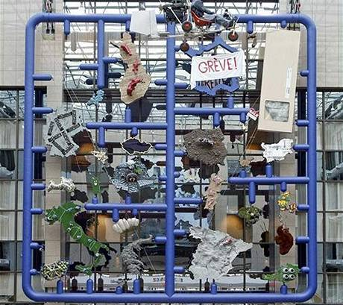
national stereotypes about Czechs
Socks with Sandals ≠ Fashion.
Today's Mood, not Necessarily Unhappy.
They're Awful Service Providers.
Czechs Lack Vision.
Indifference Is Part of the Cultural Identity.
Everyone Is an Atheist…
… But Nothing Is More Sacred than Beer.
Tightfistedness Is a National Trait.
Notes:
Sources:
David Černý: Entropa (2009)

Slide 15
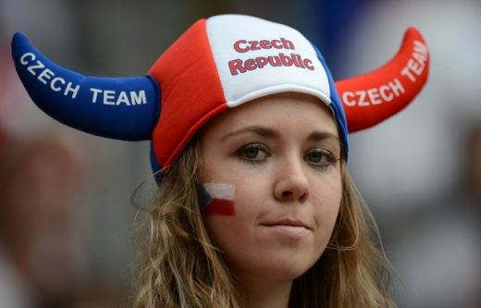
national stereotypes about Czechs
What are Czech traits?
  They are a bit egoistic, prudent, sometimes bad, never in a good mood.
  However, they also have a sense of humor, like jokes, and are never serious.
  They often go outside, like to have fun. Czechs do sports very actively, almost every Czech can ski.

Slide 16
sources
Hofstede G. & Hofstede G. J. Cultures and Organizations: Software for the Mind, New York, NY: McGraw-Hill Professional, 2004.
Kolaříková Veronika. Czech National Identity and the Elements Through Which is Constructed. Czech-Polish Historical and Pedagogical Journal, 12/2, 2020, s. 66–96.
Lewis Richard. D.. Cross Cultural Communication: A Visual Approach. UNKNO, 1999.

Slide 17
Online sources
Český statistický úřad. (2014). Národnostní struktura obyvatel. Český statistický úřad. p. 2. [cit. 15. 12. 2018]. Available from:https://www.czso.cz/documents/10180/20551765/170223- 14.pdf/d0d27736-ef15-4f4f-bf26-e7cb3770e187?version=1.0
https://unitedbycultureblog.wordpress.com/the-lewis-model/the-lewis-model-explanation/

