Slide 1
Film aDAPTATION as a device of creating the „Czech world“
Notes:
NAETINEM: Reflection of National and European Identity in the New Millennium (NAETINEM)„
reg. č. 2019-1-CZ01-KA203-061227

Slide 2
content
1. Czech World
2. Film Adaptation as a Device of Creating the „Czech World“
3. Case Studies
3.1 Case Study 1 - A Hunting Logbook
3.2 Case Study 2 – Cosy Dens
3.3 Case Study 3 – Romance for the Bugle
4. Sources

Slide 3
Czech world
The birth of modern Czech culture:
For a long time, Czech culture was not as self-evident as it is today
During 19th century, the concept of „Czech culture“ even seemed to be a contradiction in terms – contradictio in adiecto
The Czech world was rather a non-culture, something extra-cultural, or pre-cultural, an instinctive world of original values ​​associated with childhood, nature and folklore
Notes:
Sources:
Macura, Vl. Znamení zrodu a české sny. Praha: Academia 2015.

Slide 4
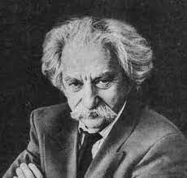
Czech world
No idea of ​​a special semiosphere* tied to the Czech language that could fully surround the individual and satisfy all his social and cultural needs was conceivable:
Lotman coined the term semiosphere in analogy to and in extension of Vernadsky’s (1926) concept of the biosphere. While the biosphere comprises ‘the totality of and the ,organic whole of living matter and also the condition for the continuation of life’ (Lotman, 1990: 125), the semiosphere is ‘the semiotic space necessary for the existence and functioning of languages’. It is a space which has ‘prior existence and is in constant interaction with languages’ (1990: 123).
Notes:
Sources:
Lotman, J. Staťji po tipologiji kultury. Tartu: Tartuskij gosudarstvennyj universitet 1973.
Nöth, W. „The topography of Yuri Lotman's semiosphere“. In: International Journal of Cultural Studies 18(1) 2014.
Lotman YM. Universe of the Mind: A Semiotic Theory of Culture, trans. Shukman A. Bloomington, IN: Indiana University Press 1990.
Vernadsky V. (1926) Biosfera. Leningrad. (Trans. Langmuir DB, The Biosphere. New York: Copernicus Springer, 1998.)

Slide 5
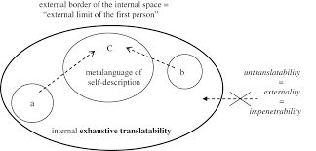
Czech world
The terms ‘semiosphere’, ‘semiotic space’ and ‘culture’ are not sharply delimited in relation to each other. On the one hand, cultures, semiotic spaces and semiospheres have the same topological characteristics, such as centres, peripheries, insides and outsides, and boundaries. On the other hand, ‘the semiosphere is the result and the condition for the development of culture’ (Lotman, 1990: 125).

Slide 6
Czech world
Czech culture was much more a result of creation than an environment; the reality of the Czech world was stored in cultural creations, in texts:
Representatives of Czech culture focused on those areas of culture that are generally capable of creating the illusion of a developed society with strong and defining national characteristics
→ the sacralization of language and a reverent relationship to it

Slide 7
Czech world
Lotman was not yet writing about the new media, but his semiotic theory of culture has since become a source of inspiration for researchers in cyberspace and web culture, which shows that it offers useful tools for the understanding of the new media of the 21st century.
The cyberspace, with its characteristics of connectivity, mobility and ubiquity (Santaella, 2010), is certainly a semiosphere.
Does it have all of the characteristics that Lotman attributes to the semiospheres in his studies of literary and cultural texts?
Does it have a centre, a periphery, and boundaries? Is it a space of essential asymmetries?
Notes:
Sources:
Santaella, L. A ecologia pluralista da comunicacao: conectividade, mobilidade, ubiquidade. Sao Paulo: Paulus 2010.

Slide 8
Czech world
Translation and adaptation became the primary means of creating the Czech world; texts were the cornerstone of realizing one's own identity as belonging to a certain nation, which primarily took the form of a certain language (text).
T → ∞ I ≈ T → ∞ A
I ↔ A
The adaptation as ongoing intertextual process

Slide 9
Film aDAPTATION as a device of creating the „Czech world“
Film form ------------------- reality
representation
A certain attitude towards realism: art techniques somehow directly relate to real-world events and objects that the artist has chosen to portray in his written text, painting or screen → film: taking a special position between literature and photography: a combination of an image and reality (photo) with narrative forms of fiction (literature; in addition, common devices: camera as point of view, editing as time manipulation, etc.).
- Realism as a complex system of conventions and illusions (R. Barthes)

Slide 10
Film aDAPTATION as a device of creating the „Czech world“
(1) The film is more prone to explicitity in the proces of "reading“.
(2) Film as a realistic form par excellence.
(3) Realism as what the reader / viewer usually brings to the text.
(4) Realism as a "pastiche": through the secondary mimesis it copies what is already a copy!
(The dexterity of literature and film lies in the illumination of the world that is meaningful).

Slide 11
Film aDAPTATION as a device of creating the „Czech world“
(5) The basic rule of realism: the dependence of one type of codification on another → the realistic description depends on the codified painting standard (each literary description is a "view", to describe rather means to put a "framework" on reality (writer's easel) rather than deciding on how the continuum of objects could be described).
(6) But the film is not a "copy of a copy" like literature, but rather a process in which the "framing" code, inherited from painting, coexist with the operation of image production.

Slide 12
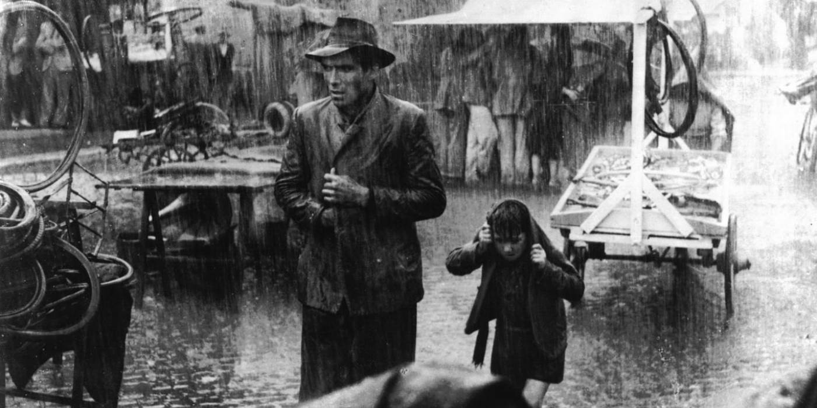
Film aDAPTATION as a device of creating the „Czech world“
(7) That "real" (in realistic text) is just a code of representation (signification), it is never a code of execution: the fictional reality or the reality of a fiction (novel) is not feasible.
(system of meaning → order of feasibility).

Slide 13
Film aDAPTATION as a device of creating the „Czech world“
What's going on between a book and a movie? (Text 1 & Text 2)
3 basic concepts:
(1) „Psychological" concept of adaptation
book model ------ → movie: "spirit of the text"

Slide 14
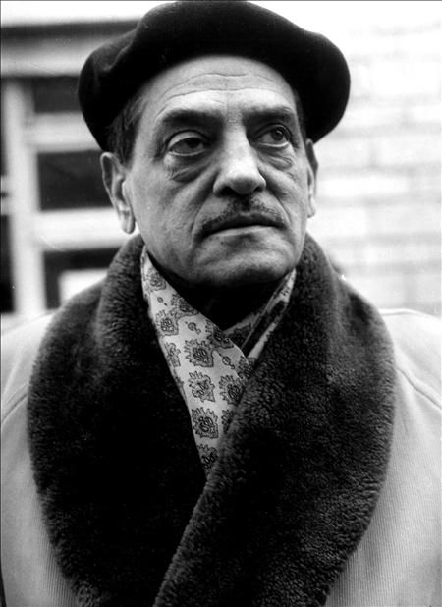
Film aDAPTATION as a device of creating the „Czech world“
Christopher Orr: "A good adaptation must be true to the spirit of the original literary model".
Luis Bunuel: "[...] I want to remain true to the spirit of the original".

Slide 15
Film aDAPTATION as a device of creating the „Czech world“
Assumption 1: a certain psychological connection in which the "spirit of the text" passes from the novel to the reader (in the case of film adaptation the reader is the filmmaker) and from the film to the a viewer.
Assumption 2: the form may change, the spirit / meaning remains. The task of adaptation is to capture the "spirit" of the artwork to preserve it despite changes of a form and/or a medium.
The novel’s spirit → (the novel’s form) → (filmmaker response) → (film) → viewer response

Slide 16
Film aDAPTATION as a device of creating the „Czech world“
(2) „Ventriloquist" Concept of Adaptation
- what goes from book to film is not "spirit of the text" but "dead body", e.g. that adaptation, like a ventriloquist, supports the dead work and inhales its voice.

Slide 17
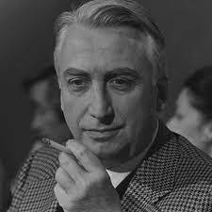
Film aDAPTATION as a device of creating the „Czech world“
this concept is related to the concept of connotation according to Roland Barthes:
1 The novel’s signs – the novel signifieds = the novel’s signifiers
2 The novel’s signifiers + the films signifieds = the adaptation signs
adaptation = novel + film

Slide 18
Film aDAPTATION as a device of creating the „Czech world“
(3) Genetic Concept of Adaptation
- well established in narratologically oriented theories
- what is the subject of transformation between book and film is a certain depth narrative structure similar to genetic structure.

Slide 19
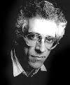
Film aDAPTATION as a device of creating the „Czech world“
Seymour Chatman: "manifesting substance" like genetic material expects a clear substance in cells and body tissue.
Brian McFarlane: The "depth structure" that passes from novel to film is the so-called cardinal function (form of expression). What is the subject of transformation (form of content) requires specific mechanisms ("adaptation proper") → e.g. different plot-building strategies (e.g. sequence of events: sequencing).

Slide 20
Film aDAPTATION as a device of creating the „Czech world“
Expression Content
Substance
Form
Media insofar as they can communicate stories.(Some media are semiotic systems in their own right.) | Representations of objects & actions in real & imagined worlds that can be imitated in a narrative medium, as filtered through the codes of the author’s society.
Narrative discourse (the structure of narrative transmission) consisting of elements shared by narratives in any medium whatsoever. | Narrative story components: events, existents, and their connections.
Notes:
Sources:
Chatman, S. Story and Discourse. Narrative Structure in Fiction and Film. Cornell University Press 1980.

Slide 21
Film aDAPTATION as a device of creating the „Czech world“

Slide 22
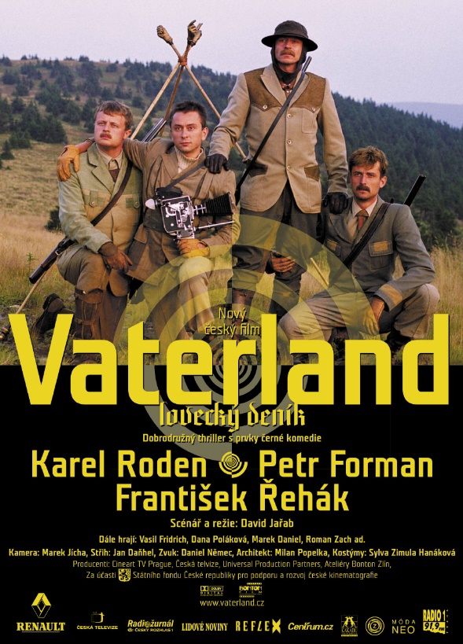
Case study - Vaterland
Vaterland / Vaterland (A Hunting Logbook, 2004)
- dir. David Jařab
Descendants of the noble Czadsky family return to their homeland years after being expelled by the former totalitarian regime. Brothers Richard and Vilém, their wives, and their cousins Max and Leo find the devoted major-domo Willmer still at their dilapidated family residence. He has been taking care of their ancestors’ memories and keepsakes and, especially, of their grandfather’s treasured diary. It contains instructions for hunting the mysterious beings inhabiting the local hills.
Notes:
https://www.youtube.com/watch?v=dLbLCv4YMA4
Source: Youtube.com

Slide 23
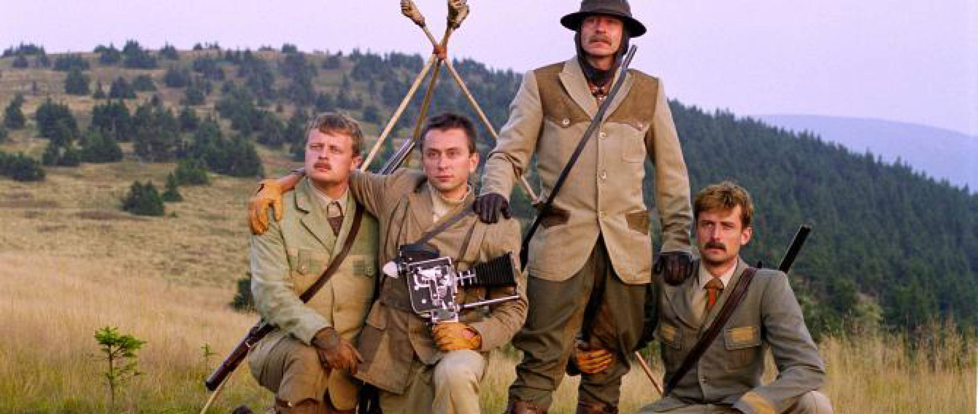
Case study - Vaterland
The specifically Czech environment is depicted as a surreal place where tradition meets modernity.
Belonging to a given environment (historically and based on family relationship) is a matter of collective memory.

Slide 24
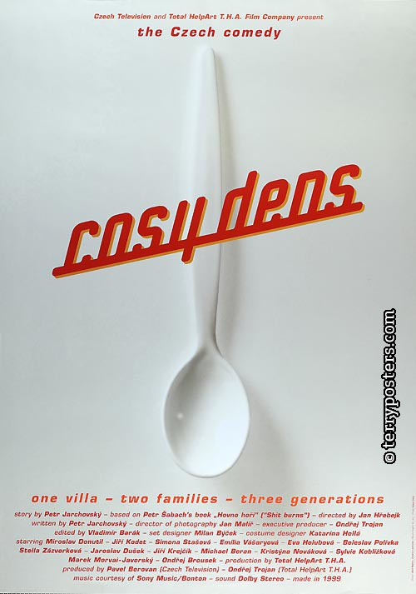
Case study – Cosy Dens
Pelíšky (Cosy dens, 1999)
- dir. Jan Hřebejk
Two families, Sebkovi and Krausovi, are celebrating christmas, but not everyone is in a good mood. Teenage kids think their fathers are totaly stupid, fathers are sure their children are nothing more than rebels, hating anything they say.
Notes:
https://youtu.be/jlFr5Y7TvdE
Source: Youtube.com

Slide 25
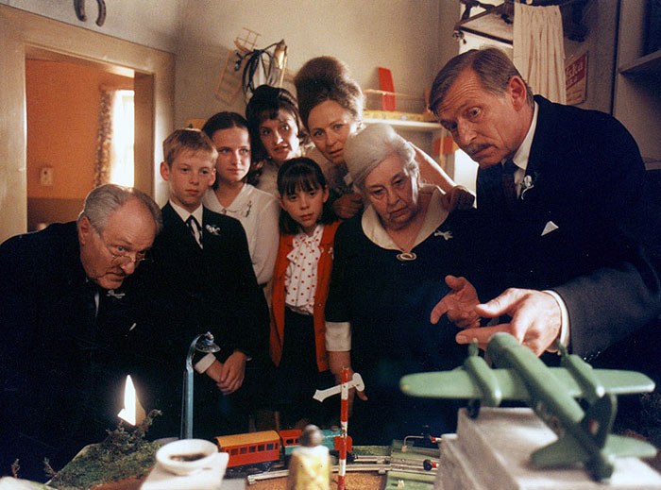
Case study – Cosy Dens
A traditional example of how Czech film relates to the history of Czech society.
A bitterly funny look at the 1960s from the perspective of two families from different backgrounds.
History in the film takes the form of more or less humorous episodes, while Czech identity is viewed as a linear path from happiness to disappointment (or vice versa).

Slide 26
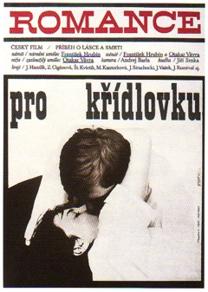
Case study – Romance for the Bugle
Romance pro křídlovku (Romance for the Bugle, 1966)
- dir. by Otakar Vávra
- based on the epic poem (1962) of the same name written by František Hrubín
The wistful call of the bugle rises above this lyrical story of first love, which takes hold over the course of a summer and ends with the death of the hero’s grandfather. A sense of anguish marks the boy's coming of age, a formative experience that viewers share as they are swept along by the force of Vávra’s poetic style.
Notes:
https://youtu.be/26QqV9jBHpU
Source: Youtube.com

Slide 27
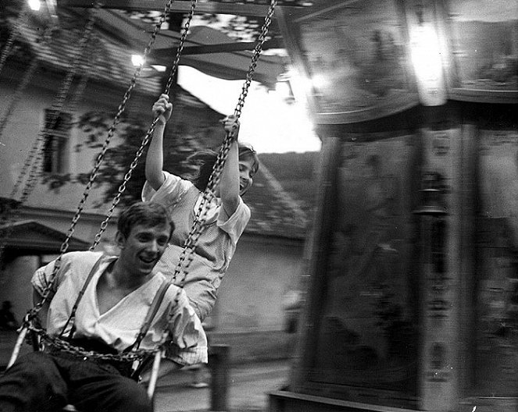
Case study – Romance for Bugle
With reference to the literary artwork, the Czech world is presented as primarily connected with nature.
The Czech world is a language and a text in a language, the homeland is a linguistic homeland, and patriotism is primarily a philological, literary activity.
The tradition that contributes to the continuity of the Czech world is inevitably a sound of nature (the sound of the bugle).

Slide 28
sources
Chatman, S. Story and Discourse. Narrative Structure in Fiction and Film. Cornell University Press 1980.
Macura, Vl. Znamení zrodu a české sny. Praha: Academia 2015.
Lotman, J. Staťji po tipologiji kultury. Tartu: Tartuskij gosudarstvennyj universitet 1973.
Lotman YM. Universe of the Mind: A Semiotic Theory of Culture, trans. Shukman A. Bloomington, IN: Indiana University Press 1990.
Nöth, W. „The topography of Yuri Lotman's semiosphere“. In: International Journal of Cultural Studies 18(1) 2014.
Santaella, L. A ecologia pluralista da comunicacao: conectividade, mobilidade, ubiquidade. Sao Paulo: Paulus 2010.
Vernadsky V. (1926) Biosfera. Leningrad. (Trans. Langmuir DB, The Biosphere. New York: Copernicus Springer, 1998.)

