Slide 1




The situation in the 20th century and the shift in people's mindset

Slide 2
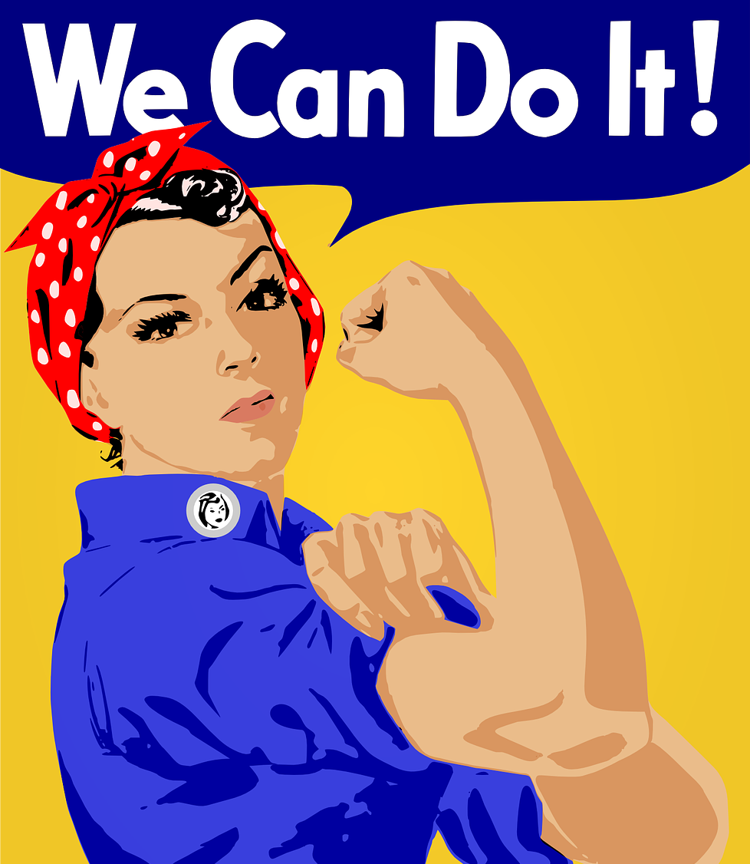
In this modul you will get acquainted with:
definition of the term feminism
conditions of equality asserted and requested by the suffragettes
the main causes of the second wave of feminism
classification and characteristics of types of feminism

Slide 3
Feminism, emancipation and change in the first half of the 20th century
Emancipation was originally understood as the acquisition of certain freedom or equality of a certain group of people through the use of force (in the Middle Ages it was sought by burghers or people who belonged to non-Roman Catholic religions, in the Modern Age by villeins, slaves in the USA, etc.). In later stages, emancipation is primarily related to efforts to equalize and gain women's independence from men.
Feminism was a specific form of female emancipation. Especially in its early stages, it was often associated with more militant expressions of women striving for equality in society. This "struggle" of women for their own rights ceased to be violent in the 1960s.

Slide 4
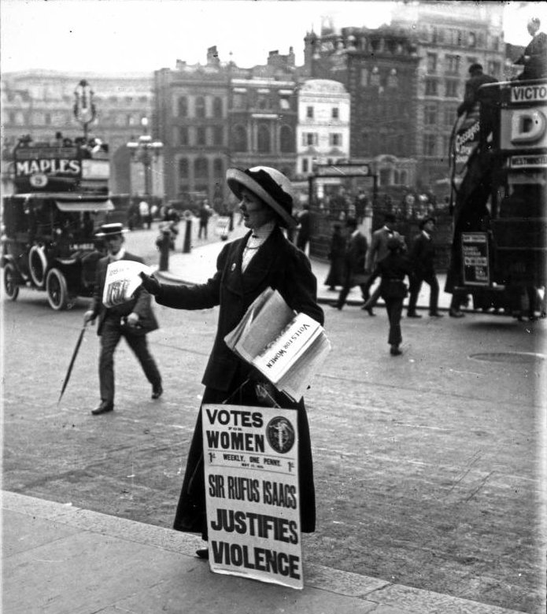
Suffragettes
The first wave of feminism was marked by women's efforts to achieve equal political rights with men and it is very often referred to as the suffragette era.
The activities of suffragettes is getting more intensive at the beginning of the 20th century and is gaining global support and popularity.
On the other hand, the period of the 1920s is considered a period of decline of suffragettes. Partly because many states accepted their demands (after the first end of World War II), partly because suffragettes became too militant.

Slide 5
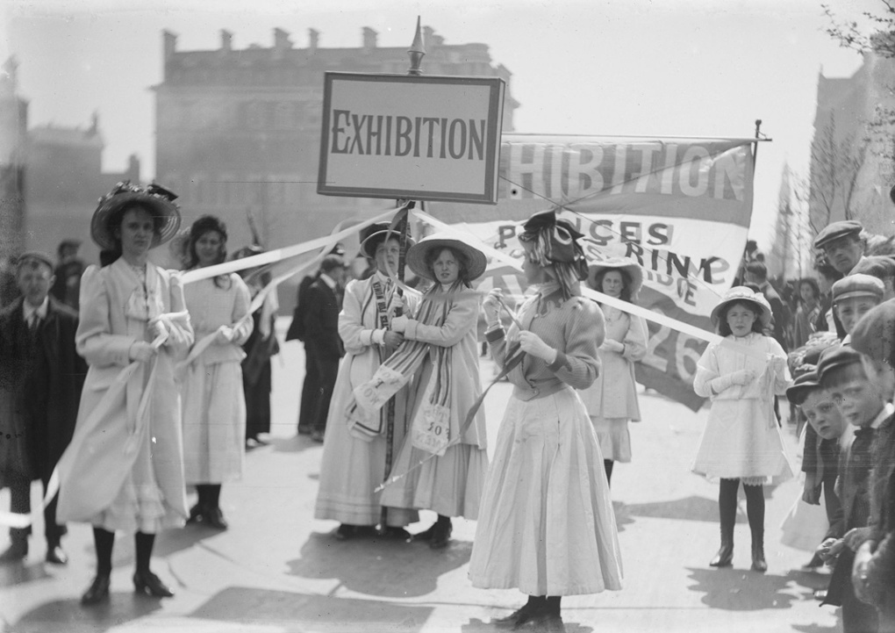
In addition to achieving political equality, women also wanted to eliminate conventions in their lifestyle, occupations, or the opportunity to travel and discover the world.
The change in women's economic behavior is also crucial, to which the advertising agencies reacted immediately. Women have fully entered the market and the industries have specialized in covering their demands by products exclusively for them.
The end of the 1930s is marked by political events in the world (the rise of totalitarian ideologies), which limited the feminist movements, organizations and women's demands for stronger equality.

Slide 6

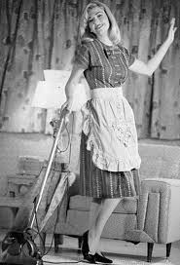
The second wave of feminism
The stage of feminism, which dates back to the 1960s.
It is characterized by a qualitative change in the content of women's activities that took place during the process of women's emancipation.
The essence of womanhood, its social status and role in society was to be addressed.
The causes of the changes lay mainly in the position of women during the World War II, but were also affected by e. g. the rise of the Hippies movement.
The members of the so-called second wave pointed out, among other things, topics such as greater control over one's own body, including removing taboos on women's intimate behaviours, changes in legislation (e. g. the law on family, divorce, social support, etc.), the question of reason and origin for social gender inequality, efforts to break down social stereotypes and clichés, removal of economic barriers between the sexes, recognition for their domestic work, greater involvement in political life.

Slide 7
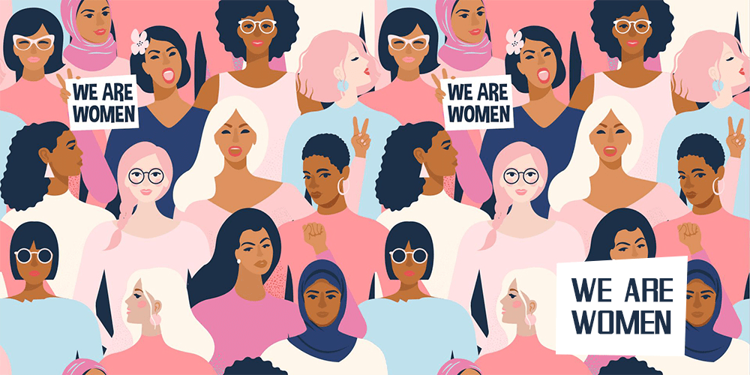
Types of feminism
In order to find answers to many new questions related to gender aspects and also due to the development of gender studies in Western Europe and the USA, feminism was differentiated during the 20th century according to the area to which it primarily related. Some of the areas have its roots in previous centuries. The most well-known approaches include:
Liberal Feminism
Socialist Feminism
Radical Feminism
Eco-Feminism
Cultural Feminism

Slide 8
Literature
ABRAMS, Lynn. Zrození moderní ženy: Evropa 1789-1918. 1. vyd. Brno: Centrum pro studium demokracie a kultury, 2005. 367 s. ISBN 80-7325-060-8.
BARŠA, Pavel, ed. Politika rodu a sexuální identity. Vyd. 1. Brno: Masarykova univerzita, 2002. 219 s. Sborník prací Fakulty sociálních studií brněnské univerzity. 7. ISBN 80-210-2834-3.
BOCK, Gisela. Ženy v evropských dějinách: od středověku do současnosti. Vyd. 1. Praha: NLN, Nakladatelství Lidové noviny, 2007. 381 s. Utváření Evropy; sv. 11. ISBN 978-80-7106-494-7.
EISLER, Riane Tennenhaus. Číše a meč, agrese a láska aneb Žena a muž v průběhu staletí. Praha: Lidové noviny, 1995. 329 s. ISBN 80-7106-095-X.
CHVOSTKOVÁ, Klára. Sociální hnutí zvané feminismus. Olomouc: Univerzita Palackého. Bakalářská práce. 2012. 46 s. [online]. [cit. 15. 8. 2017]. Dostupné z: http://theses.cz/id/jexnjw/BP.pdf
LINHART, Jiří, ed. Velký sociologický slovník. Sv. 1, A-O. Vyd. 1. Praha: Karolinum, 1996. 747 s. ISBN 80-7184-164-1.
OAKLEY, Ann. Pohlaví, gender a společnost. Vyd. 1. Praha: Portál, 2000. 176 s. ISBN 80-7178-403-6.
PTÁČKOVÁ, Kateřina, ed., LENDEROVÁ, Milena, ed. a STRÁNÍKOVÁ, Jana, ed. Dějiny žen, aneb, Evropská žena od středověku do poloviny 20. století v zajetí historiografie: (sborník příspěvků z IV. pardubického bienále 27.-28. dubna 2006). Vyd. 1. Pardubice: Univerzita Pardubice, 2006. 601 s. ISBN 80-7194-920-5
SLABÁKOVÁ, Radmila et al. Konstrukce maskulinní identity v minulosti a současnosti: koncepty, metody, perspektivy. Vyd. 1. Praha: NLN, Nakladatelství Lidové noviny, 2012. 542 s. ISBN 978-80- 7422-218-4.
SMETÁČKOVÁ, Irena, ed. a JARKOVSKÁ, Lucie. Gender ve škole: příručka pro budoucí i současné učitelky a učitele. Vyd. 1. Praha: Otevřená společnost, 2006. 67 s. ISBN 80-903331-5-X.
SMETÁČKOVÁ, Irena, ed. a VLKOVÁ, Klára, ed. Gender ve škole: příručka pro vyučující předmětů občanská výchova, občanská nauka a základy společenských věd na základních a středních školách. Vyd. 1. Praha: Otevřená společnost, 2005. 191 s. ISBN 80-903331-2-5.
ZVĚŘINA, Jaroslav. Feminismus a jeho současné podoby. Revuepolitika [online]. 2004. [cit. 15. 8. 2017]. Dostupné z: https://old.cdk.cz/rp/clanky/174/feminismus-a-jeho-soucasne-podoby/

Slide 9
Pictures
http://www.nezoufalemanzelky.cz/2016/07/20/1407/
https://cs.wikipedia.org/wiki/Sufra%C5%BEetka#/media/Soubor:British_suffragette_clipped.jpg
https://upload.wikimedia.org/wikipedia/commons/9/92/Younger_suffragettes_promoting_the_Women%E2%80%99s_exhibition%2C_May_1909.jpg
https://www.google.com/search?q=druh%C3%A1+vlna+feminismu&tbm=isch&ved=2ahUKEwjapK-dyL3xAhWU_IUKHdLDDhwQ2-cCegQIABAA&oq=druh%C3%A1+vlna+feminismu&gs_lcp=CgNpbWcQAzIECAAQGDoECCMQJzoCCAA6BAgAEB46BwgjEOoCECc6BQgAELEDOgYIABAIEB5Qge0XWLCfGGDeoxhoAXAAeAGAAVmIAdcPkgECMjmYAQCgAQGqAQtnd3Mtd2l6LWltZ7ABCsABAQ&sclient=img&ei=v3LbYJrJI5T5lwTSh7vgAQ&bih=609&biw=1263&rlz=1C1SQJL_csCZ836CZ836&hl=cs#imgrc=XPlqmuVOIAryJM
https://www.attelier.sk/medzinarodny-den-zien-feminizmus-v-hudbe/

Slide 10
Thank you for your attention.

