Slide 1
Characteristics of the contemporary civilization. Selected gender topics of the 21st century

Slide 2
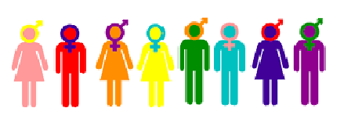
In this chapter you will get acquainted with:
the general view of today’s society on women
the reflections of gender issues in contemporary education
the general opinion of the society on the position of women in politics

Slide 3
Gender and education in the 21st century
At present, the area of education is the subject of many studies and research, including gender issues of education.
Even today, however, it is possible to identify at least three areas in which we can very easily reveal the influence of stereotypes and socially formed constructions of proper education of a boy or girl, namely, expectations from the child (resulting from the already mentioned parental attitudes and educational ideals), specific interpretation of child behaviour and ideas about the child's future life in relation to his or her gender.
It is similar in further education, especially in school, where most subjects belong to the group of humanity or technical subjects. From a gender point of view, humanity subjects are usually associated mainly with girls, while technical subjects are usually associated with boys.

Slide 5
Gender and politics in the 21st century
In today's society, there are only a few states in which equality between men and women is not enacted by law.
Despite these strengthening legal measures, the representation of women in politics is low.
The primary barriers that obstruct women to enter the political scene can be divided into three types: institutional, individual and social.
There are various strategies for increasing the representation of women in politics, e. g. legislative measures, intra-party measures, educational activities for politic etc.

Slide 6
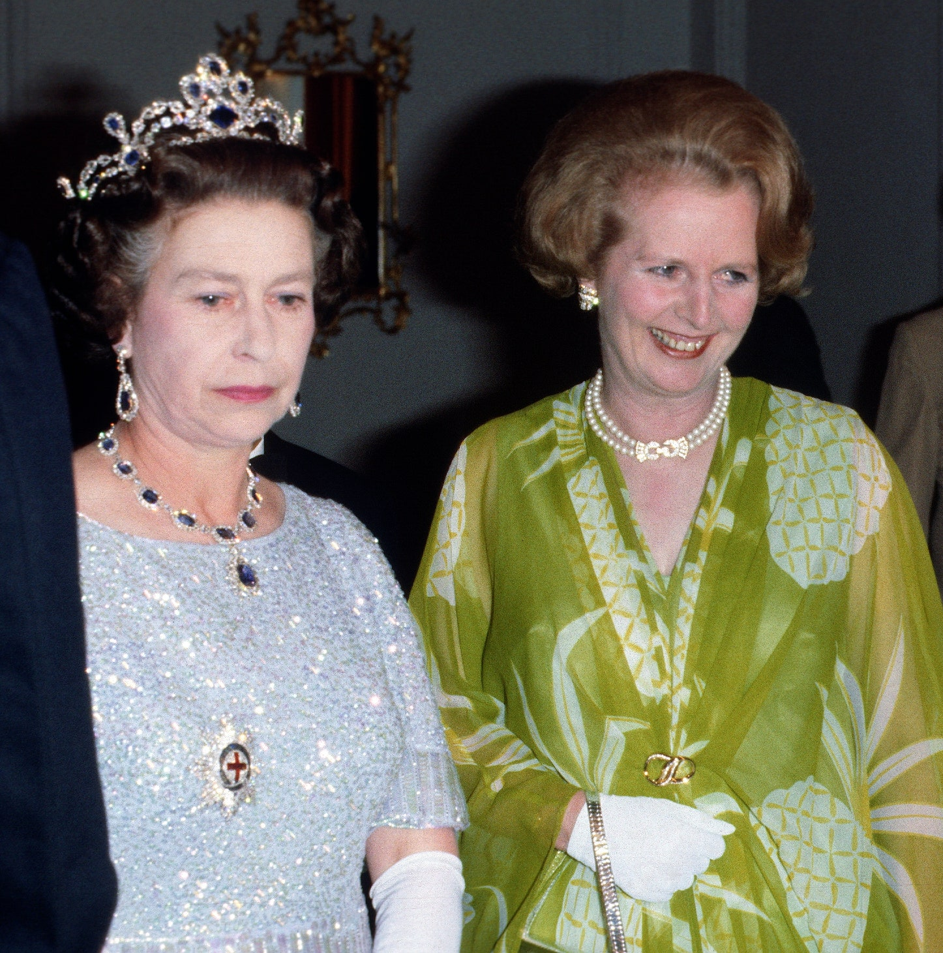
It is possible to apply different types of the so-called gender equality strategy, namely: rhetorical strategies, equal opportunities, positive action.
The primary goal of introducing gender quotas into a country's political system is to secure a certain percentage of women within the list of candidates, parliament, parliamentary commission or government.
Quota systems aim to create at least a critical limit of 30% of women to promote the interests.

Slide 7
Gender and media
The media are an integral part of human society, participating in its formation and creation. They play a significant role in shaping the outlook on life, reflecting different principles, values or priorities of society.
Due to the influence of the media on individuals, we can discuss socio-psychological primary effects, the so-called direct influence of behaviour or attitudes through media or advertising messages.
Due to impacts of media on the value attitudes of the whole society, there are discussions about their socio - psychological secondary effects.
From their beginnings, the media have played a key role in distributing specific definitions of gender roles and gender relations, often in the form of stereotypes.

Slide 8
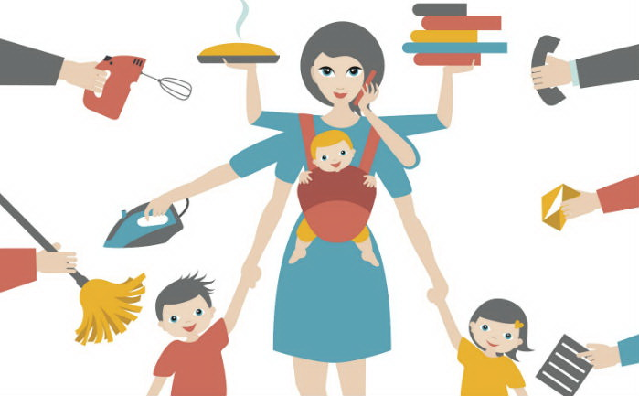

Slide 9
Media reports present very specific ideas about what women and men look like, how they behave and what the relationships are between them.
When looking at the media through the prism of gender, it is possible to analyse many factors that determine the messages media present to the public or how the message is received and consumed.
However, it is undeniable that the media, as one of the most important information channels, are involved in creating attitudes and mechanisms of behaviour that in many ways disadvantage women.

Slide 10
Literature
ATKINSON, Rita L. et al. Psychologie. 1. vyd. Praha: Victoria Publishing, 1995. 863 s. ISBN 80-85605- 35-x.
BENARD, Cheryl. Matky dělají muže: jak dospívají synové. Praha: Pragma, 1997. 233 s. ISBN 80-7205- 435-X.
CZECH, Lumír. Společenské důsledky medializace skutečnosti. 2010. [online]. [cit. 26. 7. 2017]. Dostupné z: http://www.inflow.cz/spolecenske-dusledky-medializace-skutecnosti
FIALOVÁ, Eva, SPOUSTOVÁ, Ivana a HAVELKOVÁ, Barbara. Diskriminace a právo: [diskriminace na základě pohlaví a rovné příležitosti žen a mužů na trhu práce z pohledu práva. [Praha]: Gender Studies, 2007. 46 s. ISBN 978-80-86520-20-9.
FAFEJTA, Martin. Úvod do sociologie pohlaví a sexuality. Ve Věrovanech: Jan Piszkiewicz, 2004. 159 s. ISBN 80-86768-06-6.
FINKIELKRAUT, Alain. Destrukce myšlení. 2. vyd. Brno: Atlantis, 1993. 112 s. ISBN 80- 7108-063-2.
OAKLEY, Ann. Pohlaví, gender a společnost. Vyd. 1. Praha: Portál, 2000. 176 s. ISBN 80-7178-403-6.
OSVALDOVÁ, Barbora. Česká média a feminismus. 1. vyd. Praha: Libri, 2004. 158 s. Gender sondy; sv. 1. ISBN 80-7277-263-5.
RAKUŠANOVÁ, Petra. Česká politika: Ženy v labyrintu mužů? [online]. [cit. 12. 7. 2017]. Dostupné z: http://padesatprocent.cz/docs/zeny-labyrint-muzu.pdf
RENZETTI, Claire M. a CURRAN, Daniel J. Ženy, muži a společnost. Vyd. 1. Praha: Karolinum, 2003. 642 s. ISBN 80-246-0525-2.

Slide 11
SHEU, Ursula. Nenarodíme sa ako dievčatá, urobia nás nimi. [online]. [cit. 25. 5. 2017]. Dostupné z: http://www.aspekt.sk/content/knizna-edicia/aspekt-12000-nerodime-sa-ako-zeny-stavame-sa-nimi
SMETÁČKOVÁ, Irena, ed. a JARKOVSKÁ, Lucie. Gender ve škole: příručka pro budoucí i současné učitelky a učitele. Vyd. 1. Praha: Otevřená společnost, 2006. 67 s. ISBN 80-903331-5-X.
SMETÁČKOVÁ, Irena, ed. a VLKOVÁ, Klára, ed. Gender ve škole: příručka pro vyučující předmětů občanská výchova, občanská nauka a základy společenských věd na základních a středních školách. Vyd. 1. Praha: Otevřená společnost, 2005. 191 s. ISBN 80-903331-2-5.
SVOBODOVÁ, Lucie. Novozélandské školačky vyhrály boj proti genderovému stereotypu, mohou si vybrat uniformu se sukní nebo kalhotami. 2007. [online]. [cit. 4. 7. 2017]. Dostupné z: https://www.seznam.cz/zpravy/clanek/novozelandske-skolacky-vyhraly-boj-proti-genderovemustereotypu-mohou-si-vybrat-uniformu-se-sukni-nebo-kalhotami-29238
SUCHÝ, Adam. Mediální zlo - mýty a realita: souvislost mezi sledováním televize a agresivitou u dětí. Vyd. 1. Praha: Triton, 2007. 168 s. Psyché; sv. č. 49. ISBN 978-80-7254-926-9.
VÁGNEROVÁ, Marie. Vývojová psychologie I.: dětství a dospívání. Vyd. 1. Praha: Karolinum, 2005. 467 s. ISBN 80-246-0956-8.
VRÁBLIKOVÁ, Kateřina. Vliv volebních systémů na politickou reprezentaci žen v postkomunistických zemích. 2007. [online]. [cit. 2. 8. 2017]. Dostupné z: http://ispo.fss.muni.cz/uploads/EVS/004/EVS_02_02_2.pdf
WOLF, Naomi. Mýtus krásy. Vyd. 1. Bratislava: Aspekt, 2000. 352 s. 8085549158
ZORMANOVÁ, Lucie. Vytváří raná výchova rozdíly mezi dívkami a chlapci? [online]. [cit. 4. 6. 2017]. Dostupné z: https://www.rovne-prilezitosti.cz/clanky/clanek-15.html

Slide 12
Pictures
https://a2larm.cz/wp-content/uploads/2017/09/gender.jpg
https://www.vanityfair.com/hollywood/2020/11/margaret-thatcher-queen-elizabeth-the-crown
https://nespechej.cz/proc-se-nestydet-za-to-ze-mam-pani-na-uklid/
https://www.kfilmu.net/film/blondynka1/nazory/
https://www.femina.cz/zena-za-volantem-2/
https://www.trendprezeny.sk/blog-trend-pre-zeny/tajomstvo-zdravia/muzi-nas-stresuju-viac-ako-deti-vedeli-ste-to

Slide 13
Thank you for your attention.

