Slide 1


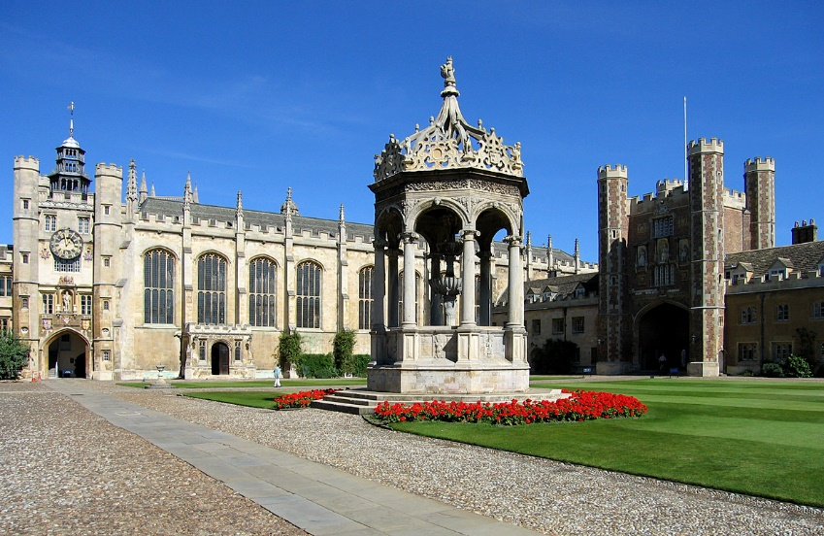
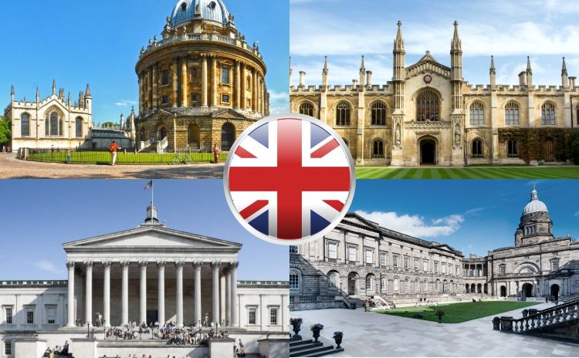
Diversity, Identity and Success in Higher Education: British and European Perspective
British Situation

Slide 2
Types of universities
Ancient Universities
  Founded before the end of the 16th century
  The University of Oxford, the University of Cambridge, the University of St Andrews, the University of Glasgow, the University of Aberdeen, the University of Edinburgh (+Ireland: The University of Dublin)
Red Brick Universities
  Established in the late 19th and early 20th century
  The University of Liverpool, the University of Manchester, the University of Sheffield, the University of Reading
New Universities (Plate Glass Universities)
  “New” – former Colleges of Advanced Technology were promoted to universities in 1963
  The University of Warwick, the University of Sussex, the University of Lancaster
Polytechnics
  Higher education institutions linked with industry and business
  Polytechnics allowed to award their own degrees and be renamed to universities
  The University of Brighton (formerly Brighton Polytechnic), Liverpool John Moores University, the University of Portsmouth
The Open University
  Established in 1969
  Combining “learning while earning” – part-time distance learning
  Open admissions policy
Admissions and Enrolment
Admission requirements depend on which university you are applying to as each of them sets their own rules
A-Levels are crucial in the admission process
  Universities typically require A-Levels in 3 subjects
Admission tests are not common with the exception of Oxford and Cambridge Universities; when it comes to the Oxford and Cambridge Universities admission process, an interview is usually conducted as well
Applications are submitted online through the UCAS website (Universities and Colleges Admissions Service)

Slide 3
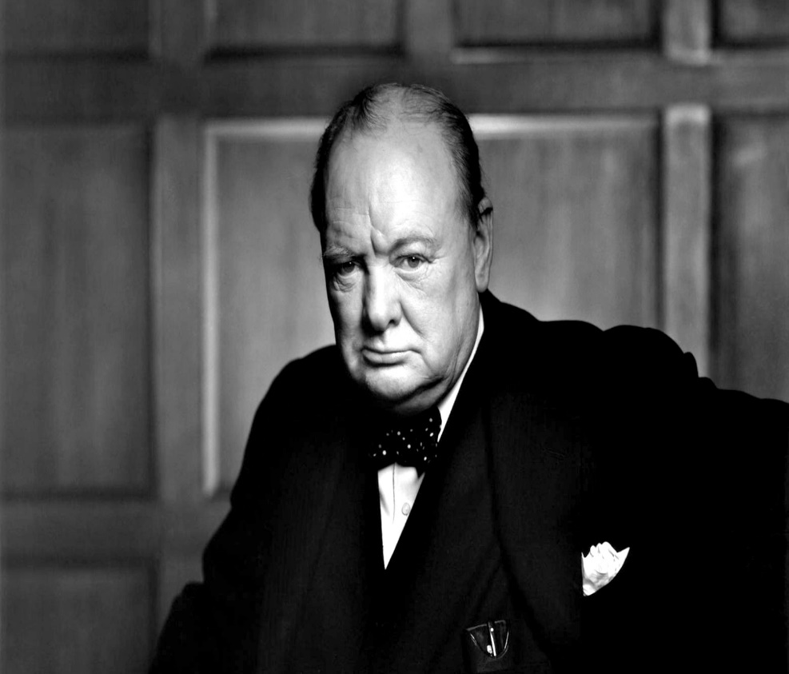
WINSTON CHURCHILL
"Keep England White" was a good slogan" ... (1955)
"I think (i.e. to keep Britain white) it is the most important subject facing this country, but I cannot get any of my ministers to take any notice".

Slide 4
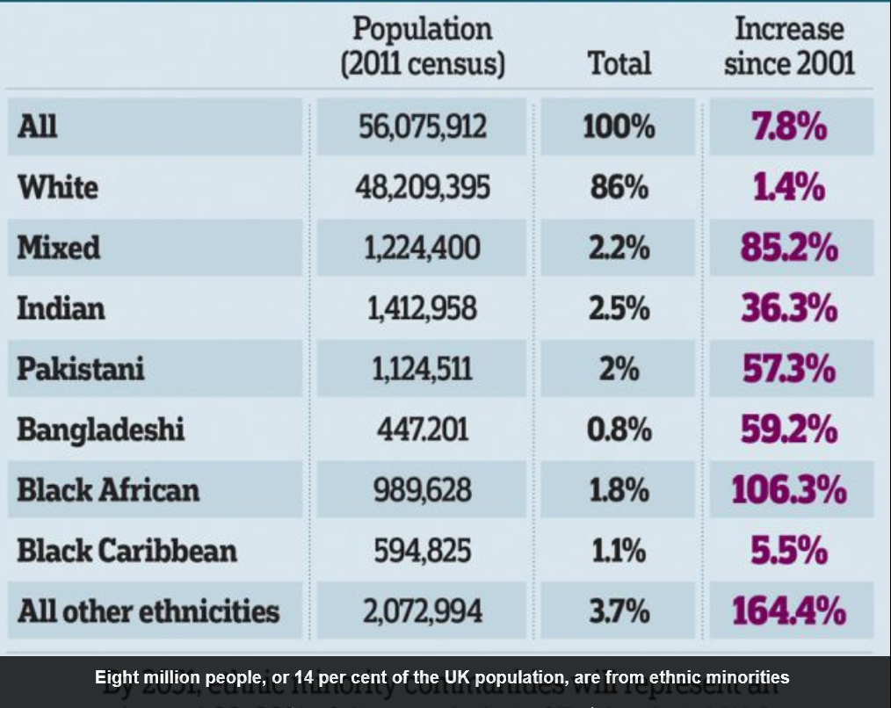
ETHNIC STRUCTURE OF UK POPULATION

Slide 5
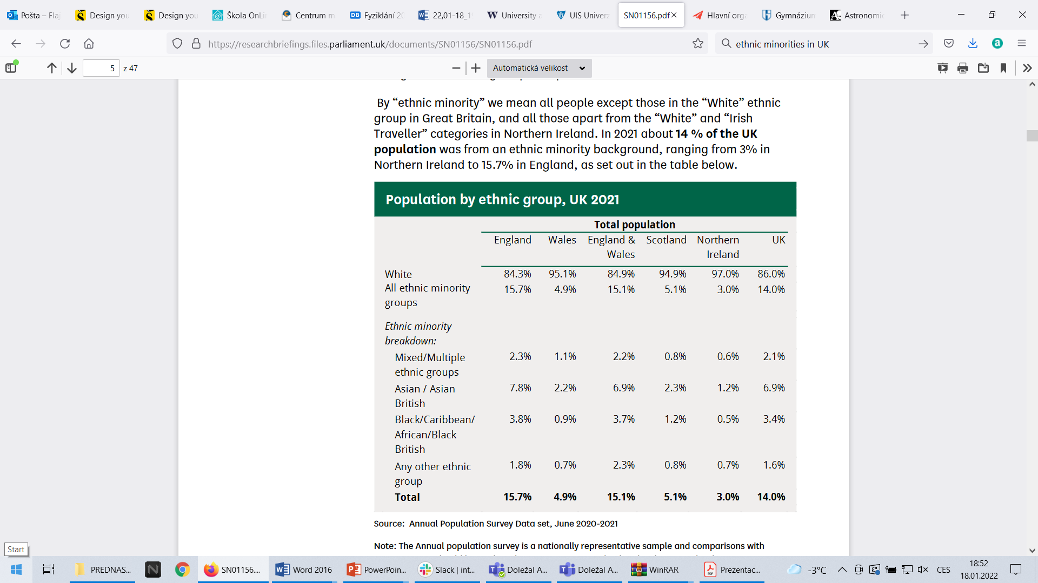

Slide 6
CENSUS
– PEOPLE WITH CARIBBEAN ROOTS
1891 | 8,689
1901 | 8,680
1911 | 9,189
1921 | 9,054
1931 | 8,585 ( 1941 NO CENSUS)
1951 | 15,301
1961 | 171,800

Slide 7

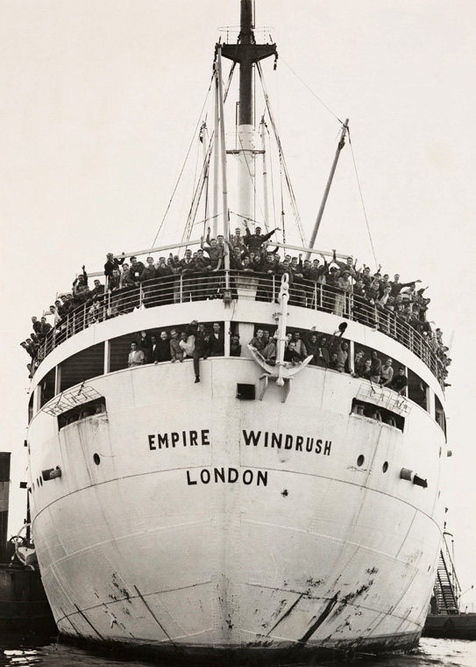
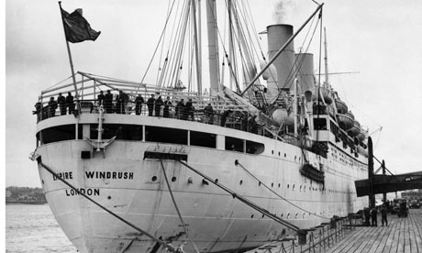
WINDRUSH
22 JULY 1948, TILBURY
Advertisement for passage on Empire Windrush from Kingston, Jamaica to the UK, The Daily Gleaner, 15 April 1948

Slide 8
CENSUS – PEOPLE WITH CARIBBEAN ROOTS
1891 | 8,689
1901 | 8,680
1911 | 9,189
1921 | 9,054
1931 | 8,585 ( 1941 no census)
1951 | 15,301
1961 | 171,800
1971 | 446200 West Indians in England, out of which 223300 were born in UK, approx. 188100 were Jamaicans
1981 | 598627 West Indians in England
2011 | 1021540 West Indians in UK

Slide 9
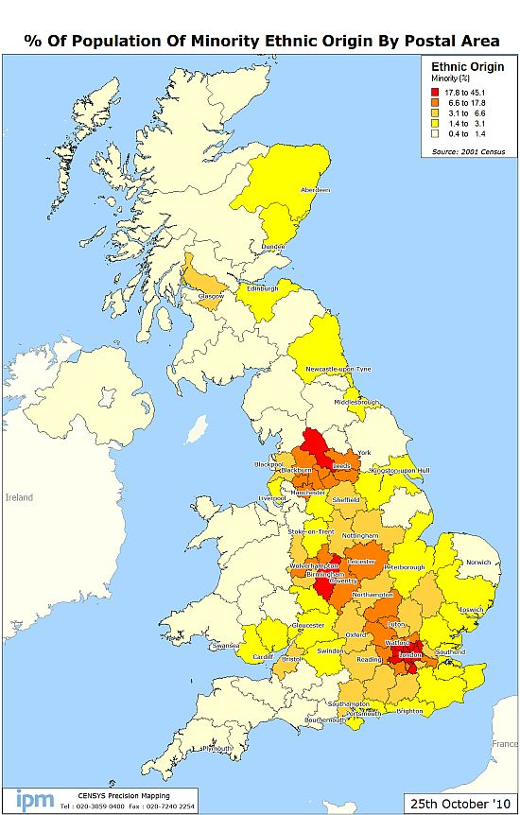
GEOGRAPHICAL DISTRIBUTION
OF ETHNIC MINORITIES

Slide 10
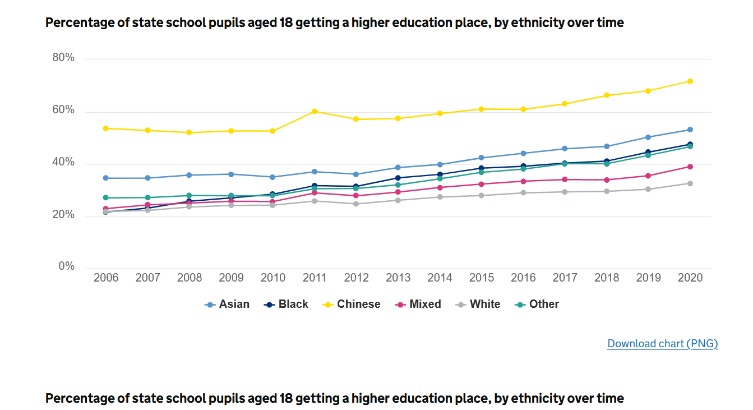
ENTRY RATE
pupils from the Chinese ethnic group had the highest entry rate into higher education from 2006 to 2020
in every year from 2007 to 2020, White pupils had the lowest entry rate into higher education
– the percentage of state school pupils aged 18 accepted into college or university
UCAS End Of Cycle Report 2020

Slide 11
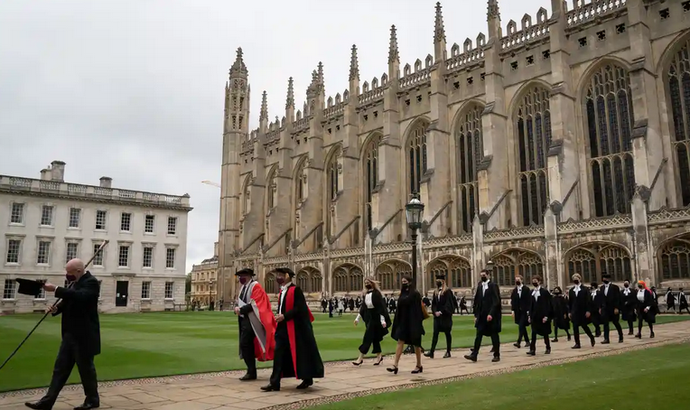
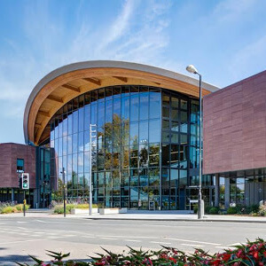
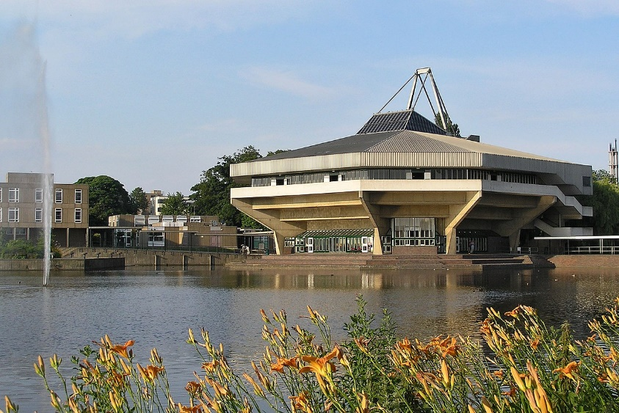
TRANSFORMATION OF UK HIGHER EDUCATION
The expansion of the UK higher education that began in the mid-1980s is considered to have transformed an elite system into a mass one.
Student numbers tripled between 1980 and 2010 and opportunities for advanced study were extended to an increasing proportion of the population.
However, the expansion was not fully funded by the state and both students and staff have, in different ways, covered the shortfall.
Inclusion of women: admission – 1870s, degrees – Oxford 1920, Cambridge – 1948
Co-education – mostly introduced in 1980´s at the ancient universities

Slide 12
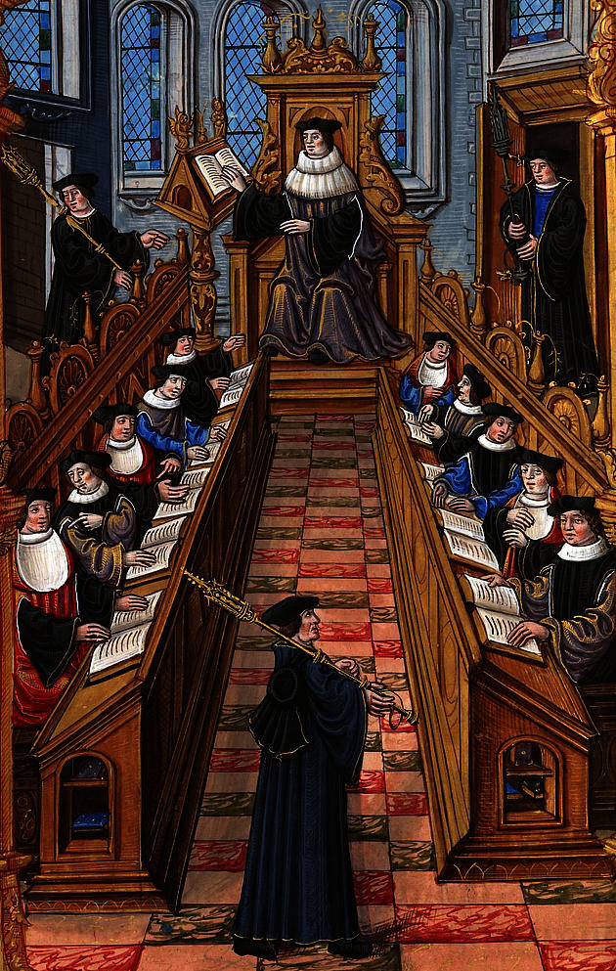
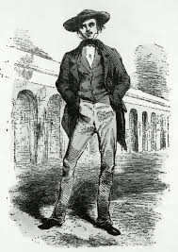
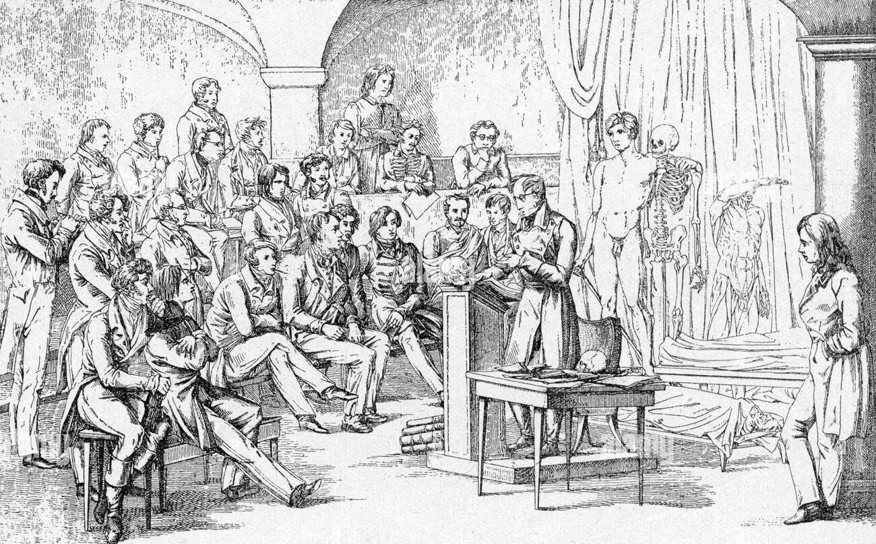
STUDENT MOBILITY
Student mobility for higher education is not a recent phenomenon.
one in ten of the students at medieval universities came from other countries
during the nineteenth century and the majority of the twentieth century, as a result of the dominance of the nation state, travelling outside of one’s country of origin to pursue a higher education was relatively rare, extending to only two to three per cent of the entire student population
recent years have, however, seen a reversal of this trend, as increasing numbers of tertiary students have chosen to study abroad.
The OECD (2007) notes that, in 2005, over 2.7 million of students were enrolled outside of their country of citizenship

Slide 13
INTERNATIONAL CLIMATE
AT UK UNIVERSITIES
1. University of Westminster (170 nationalities, 8582 international students)
2. Kingston University (164 nationalities, 7256 international students)
3. City, University of London (163 nationalities, 10006 international students)10. Brunel University (153 nationalities, 6146 international students)
4. Middlesex University (163 nationalities, 8758 international students)
5. UCL (University College London) (163 nationalities, 17543 international students)
6. Open University (159 nationalities, 8263 international students)
7. University of Greenwich (159 nationalities, 7259 international students)
8. King's College London (158 nationalities, 11341 international students
9. Manchester Metropolitan University (155 nationalities, 4645 international students)
10. Brunel University (153 nationalities, 6146 international students)

Slide 14

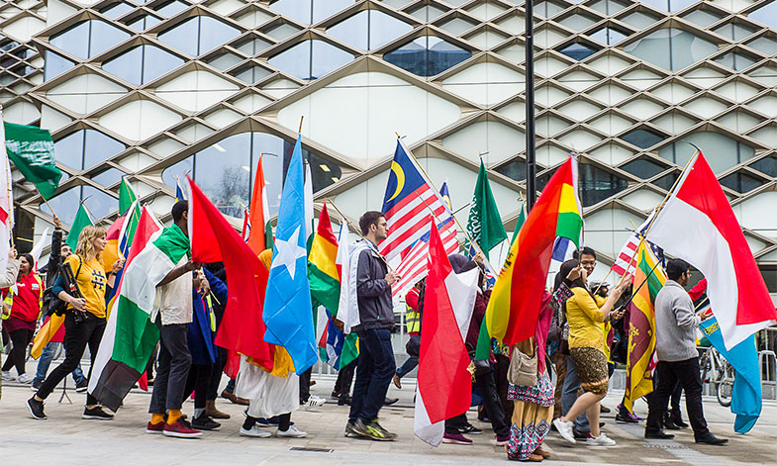
Internationalization of UK universities
The UK was the second most popular destination in the world for international students in 2016.
There were 458,490 international students studying in UK higher education institutions in 2017-2018, accounting for 19.6 percent of the UK’s total student population. A total of 14 percent of all undergraduates and 35.8 percent of all postgraduates were international.
In 2017-2018, the top five sending countries for international students were China, India, the US, Hong Kong and Malaysia. Researchers note that Chinese students at UK higher education institutions made up 23.2 percent of all international students, while the top sending countries within the EU were Italy, France and Germany.

Slide 15
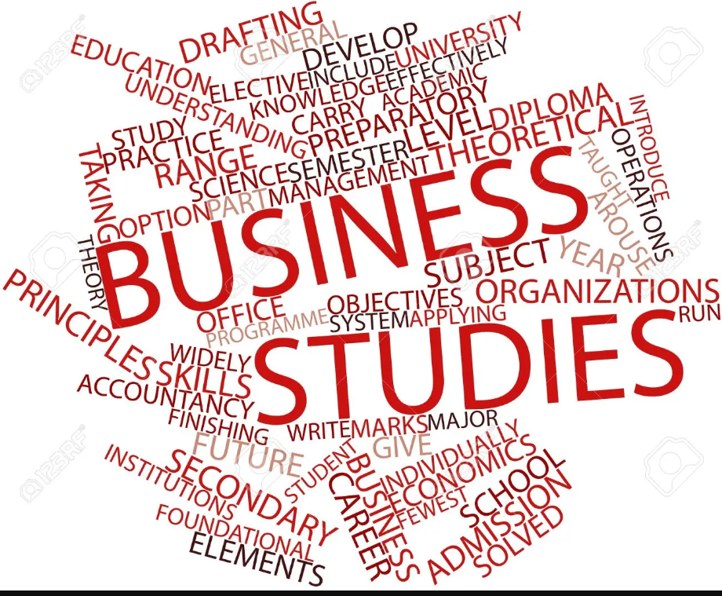
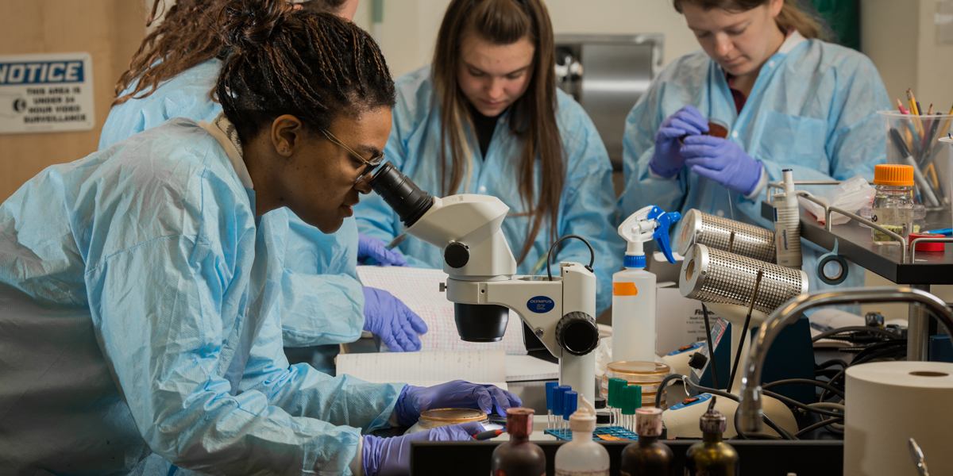
Top 5 popular areas of study
(both undergraduate and postgraduate) in 2017-2018:
Business and administrative studies
Engineering and technology
Social studies
Creative arts and design
Biological sciences

Slide 16
QS World University Rankings 2021 – Top 10 Universities in the UK
UK Rank | Global Rank | Institution
1 | 5 | University of Oxford
2 | 7 | University of Cambridge
3 | 8 | Imperial College London
4 | 10 | UCL (University College London)
5 | 20 | University of Edinburgh
6 | 27= | The University of Manchester
7 | 31= | King’s College London (KCL)
8 | 49 | London School of Economics and Political Science (LSE)
9 | 58 | University of Bristol
10 | 62 | The University of Warwick
Criteria:
1/ Entry standards
2/ Student satisfaction
3/ Research quality
4/ Graduate prospects
5/ Academic services spend
6/ Facility spend
7/ Degree completion
8/ Student staff ration

Slide 17
Conditions for success in education
1/ support already at primary and secondary level of education
2/ offer of various university study programmes reflecting diversity
„Not seeing yourself reflected in what you learn can have an impact on aspirations and outcomes. Many of our children don´t have parents that work in skilled work, that have studies to a higher lever or achieved success in the arts for example, so it is essential children see role models being successful in all areas of the curriculum.“
„If a student cannot relate new information to his own experiences, or connect the new materiál to a familiar concept, he may perceive the new information as frustrating, difficult or dismiss it completely, believing it to be in conflict with his already tenuous understanding of the world. Teachers have the responsibility to seek out cultural building blocks students already possess, in order to help build a Framework for understanding.“
„If you are learning about people like you then you have positive role models in and this can be a driving force in growing aspiration.“
Source: Pearson Research
3/ Feeling well/ fitting in into the climate of the university – support schemes

Slide 18
Support of various initiatives and research groups in all levels of education
Black Lives Matter – protests over the summer of 2020 has caused a new reevaluation of the situation in British curricula, especially in regards to:
1/ ethnicity and minority background
2/ gender
3/ special needs
4/ representation of teaching staff – who teaches
5/ language background – English as a mother tongue vs. English as an additional language
6/ appropriate text books or learning materials reflecting diversity

Slide 19
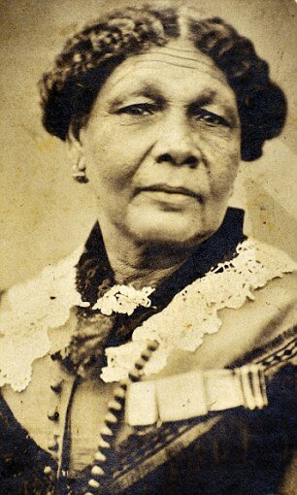
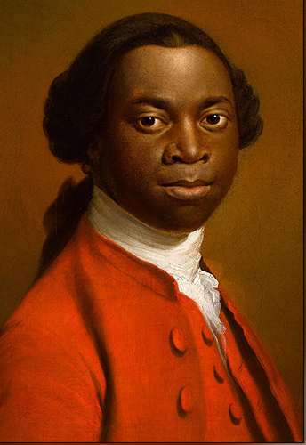
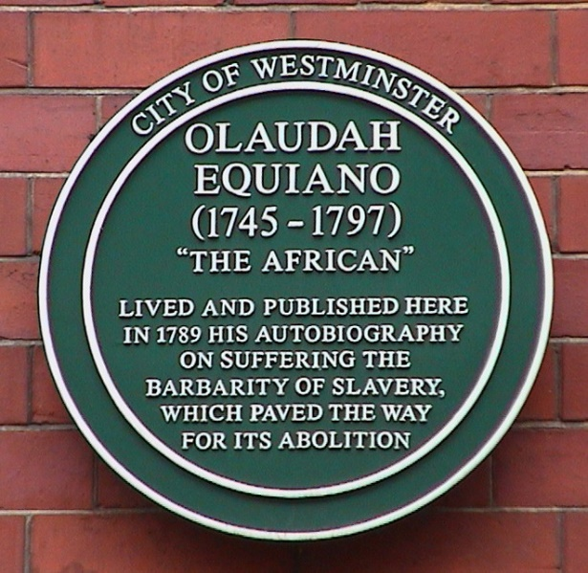
Diversity in History
No inclusion of pioneering historical figures in the National Curriculum
Big histories of nations vs. little histories of individuals, families and communities
Monolithic and misleading big history vs. history courses showing diversity and multiculturalism
Examples:
Mary Seecole
Olaudah Equiano – African Abolitionist

Slide 20
While our academic colleagues are busy trying to decolonise curriculums everywhere, I would like to show my appreciation for allies in higher education administration, too. There are several key stakeholders in the #BLM administrators’ mission within higher education that I would like to say a massive thank you to.
Next, thank you to the planning teams, for preparing the data on non-academic staff ethnicity characteristics so that we can see the scale of mountain we need to collectively climb (I am in the “mixed” category, so not many reflected at senior level). It’s a shame that according to HESA, from 2019-20 it became optional for providers in England and Northern Ireland to report data about staff on non-academic contracts (with the exception of any non-academic contracts held by vice-chancellors/heads of institutions or governors). Note to self: find out how I can monitor equality and diversity progress in this area.

Slide 21
Pearson survey
A teacher respondent:
„The Black Lives Matter movement has really made me realise how black history is not taught. For example, in my own teaching of inventors I did not realise that out of all the inventors we study, not one was black and that this should not be the case.“
Source: Diversity and Inclusion in Schools

Slide 22
Diversity in Literature
GCSE – English – no writers with ethnic background until the new millenium
Then : Grace Nichols, Monica Ali, Andrea Levy, Bernardine Evaristo
Almost no courses not to speak about study programmes in ethnic literature
Pioneering work:
American University (USA, Washington D.C.) – 2000 – first konference on Black British Studies
University of Warwick - Yesu Persaud Centre for Caribbean Studies
Goldsmiths University (London) – Black Literature and Black Studies
Brunnel University – Bernardine Evaristo

Slide 23
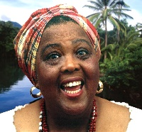
Louise Bennett
„Colonization in Reverse“
Wat a joyful news, Miss Mattie
I feel like me heart gwine burs'
Jamaica people colonizin
Englan in reverse.
By de hundred, by de t'ousan
From country and from town,
By de ship load, by de plane-load
Jamaica is Englan boun.
Dem a-pour out o'Jamaica,
Everybody future plan
Is fe get a big-time job
An settle in de mother lan.
What a islan! What a people!
Man an woman, old and young
Jusa pack dem bag an baggage
An tun history upside dung!
Some people don't like travel,
But fe show dem loyalty
Dem all a-open up cheap-fare-
To-England agency.
An week by week dem shipping off
Dem countryman like fire,
Fe immigrate an populate
De seat o' de Empire.
http://www.youtube.com/watch?v=Hmi-UXZ_tN8 (4:43)

Slide 24
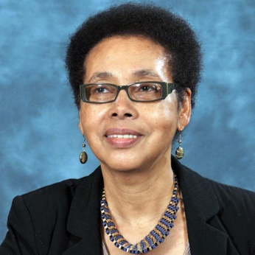
GRACE NICHOLS „Island Man“
Morning
And the Island man wakes up
To the sound of blue surf
The steady breaking and wombing
Wild seabirds
And fisherman pulling out to sea
The sun surfacing defiantly
From the east
Of his small emerald island
He always comes back groggily grogilly
Comes back to sands
Of a grey metallic soar
The surge of wheels
To dull North Circular roar
Muffling muffling
His crumpled pillow waves
Island man heaves himself
Another London day
https://www.youtube.com/watch?v=1bACVeAclpU

Slide 25
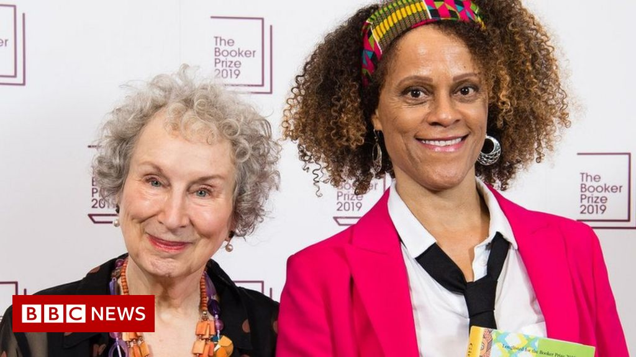


BERNARDINE EVARISTO

Slide 26

JOHN AGARD „ Alternative Anthem“
Put the kettle on
Put the kettle on
It is the British answer
to Armageddon.
Never mind taxes rise
Never mind trains are late
One thing you can be sure of
and that’s the kettle, mate.
It’s not whether you lose
It’s not whether you win
It’s whether or not
you’ve plugged the kettle in.
May the kettle ever hiss
May the kettle ever steam
It is the engine
that drives our nation’s dream.
Long live the kettle
that rules over us
May it be limescale free
and may it never rust.
Sing it on the beaches
Sing it from the housetops
The sun may set on empire
but the kettle never stops.”
http://www.youtube.com/watch?v=xMF-d8CQYUQ

Slide 27
Sources:
Claire, Alexander. „Influencing the cultural diversity of the UK history curriculum.“https://www.lse.ac.uk/Research/research-impact-case-studies/influencing-cultural-diversity-uk-history-curriculum
Diversity and Inclusion in Schools

