Slide 1



Immigrants in the British school system
Mar

Slide 2
Statistics
Huge rise of immigration
700 000 school-aged children do not have
at least one parent from UK
(one in every 15 pupils)
The number has doubled since 2007 (and is growing)
The majority is from Poland and India
followed by Pakistan and Lithuania

Slide 3
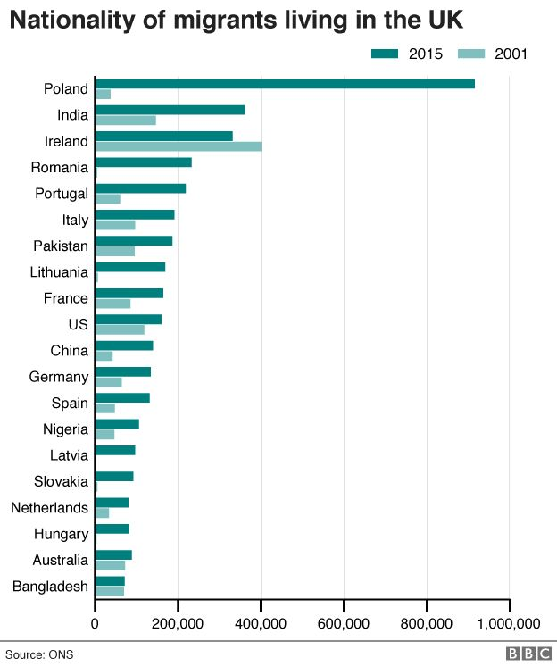

Slide 4

Consequences
Overcrowded and international classes
(mostly in London)
Harder to find a school place
big pressure
The need of 1600 schools
in the next 9 years

Slide 5
Social consequence
Immigrant communities create social subcultures
  They mix neither with other immigrants nor with locals
➔ Social connections suffer

Slide 6
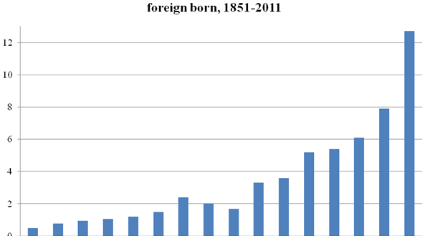

Slide 7
The situation is getting worse
Migrants tend to have more children than Britons
Drastic growth of population
  10 millions in the next 10 or 20 years
British people are concerned about the levels of immigration and want to see them reduced

Slide 8

Why the UK?
More used to receiving migrants
More hospitable and willing to integrate them
Easier to get the job

Slide 9
Possible solutions
Introducing some version of the primary purpose rule
  Originally imposed in 1993
  The proof of someone following their spouse into Britain that the marriage was not entered into primarily to obtain admission to the UK
  Abolished in 1997
Increasing the number of failed asylum seekers that are deported
Increasing the controls on the borders

Slide 10
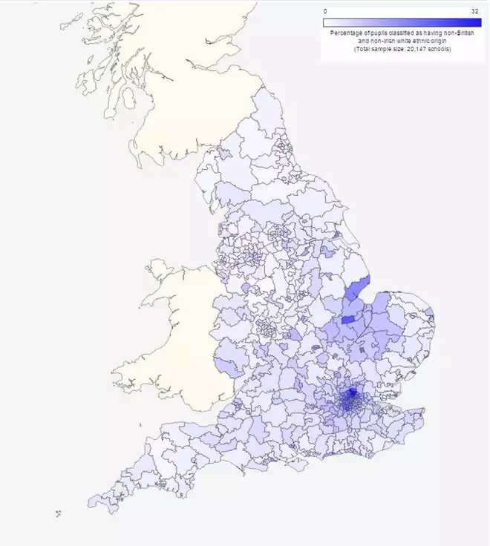

Slide 11
Comparison between
British and non-British children
Non-British children from Europe perform better
Immigrant families value education more
English as an additional language seems to be an indicator of educational outcome
The most of the thriving classes are around London

Slide 12
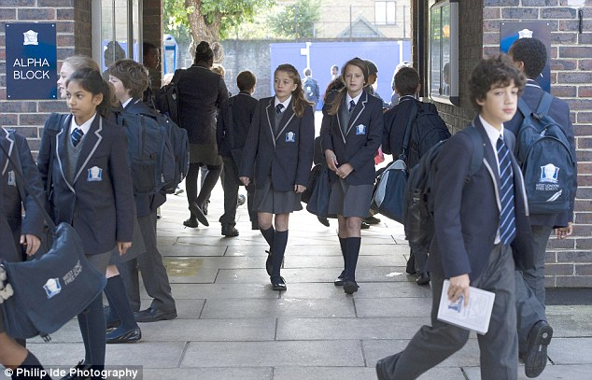
Thank you for your attention.

Slide 13
Sources
https://www.independent.co.uk/news/education/education-news/uk-schools-with-large-numbers-of-eu-migrant-pupils-perform-better-a7060106.html
https://www.bbc.com/news/education-39285039
https://www.theguardian.com/education/2012/sep/11/children-immigrant-families-uk-schools
https://www.independent.co.uk/news/education/education-news/uk-schools-with-large-numbers-of-eu-migrant-pupils-perform-better-a7060106.html
https://www.express.co.uk/comment/expresscomment/608118/Mass-migration-threat-our-children-education
https://www.migrationwatchuk.org/briefing-paper/365
https://www.telegraph.co.uk/news/uknews/5028913/All-you-need-to-know-about-immigration-in-Britain-today.html

