Slide 1
Globalization and International Cooperation

Slide 2
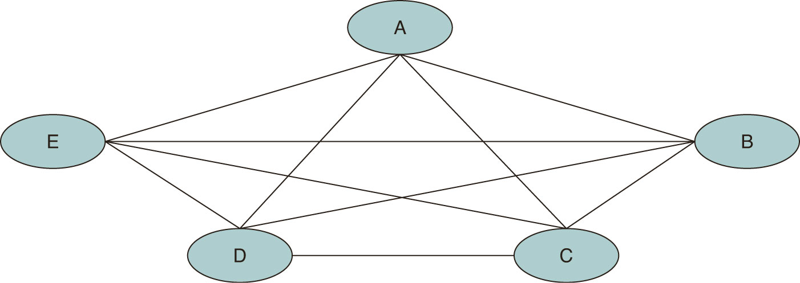
The state and its role in the International System

Slide 3
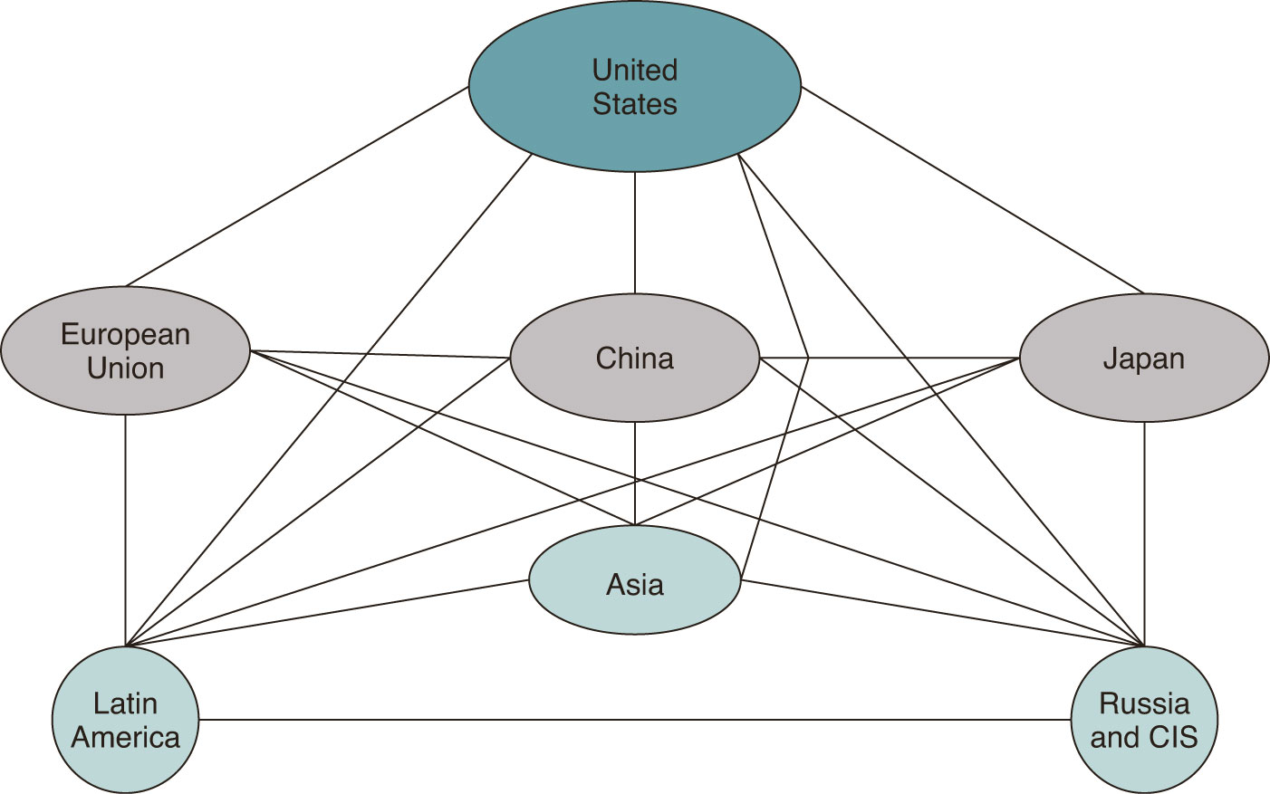
Unipolar system on the global level and multipolar system on the na regional level

Slide 4
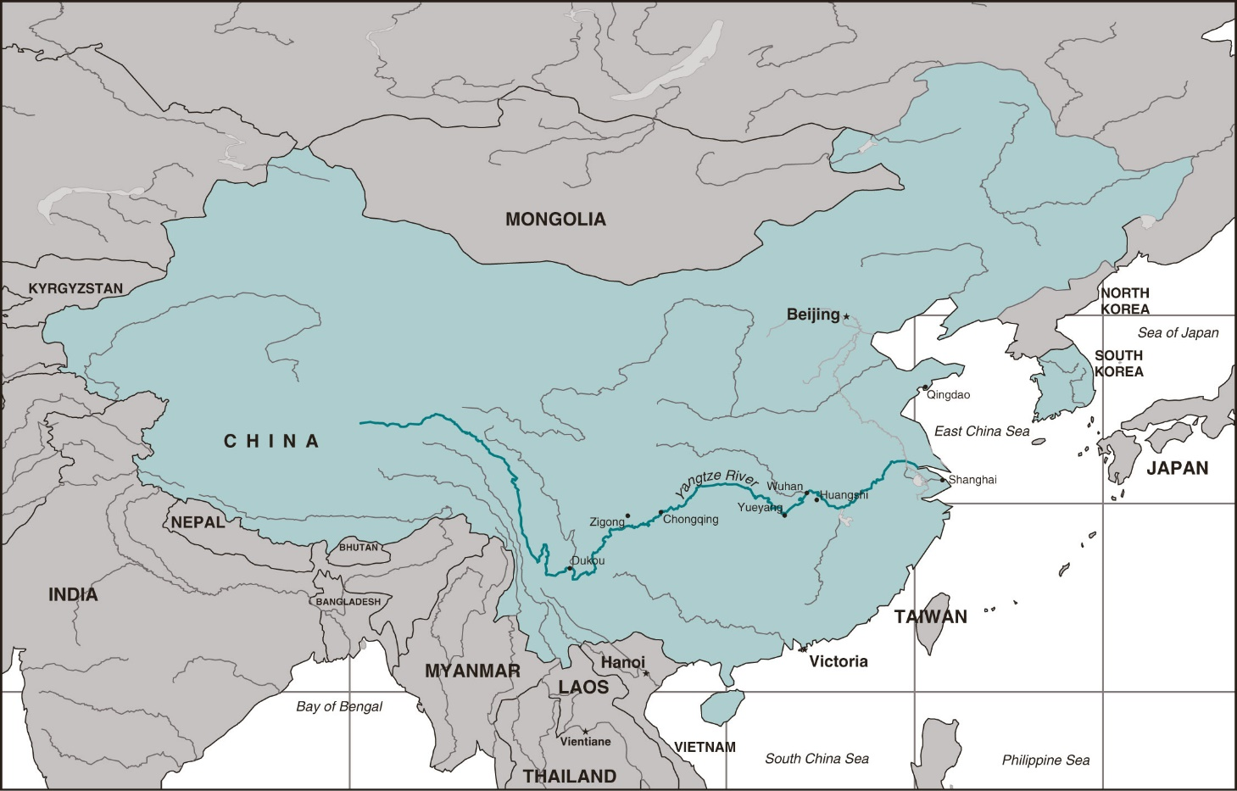
The power in the International System

Slide 5
International System
Interaction between states define the long-term „rules of the game“, which determines, what is the state and how this states treat each other
This rules set up the international system
Anarchy
Sovereignty
Balance of power
Global Powers and Middle Powers

Slide 6
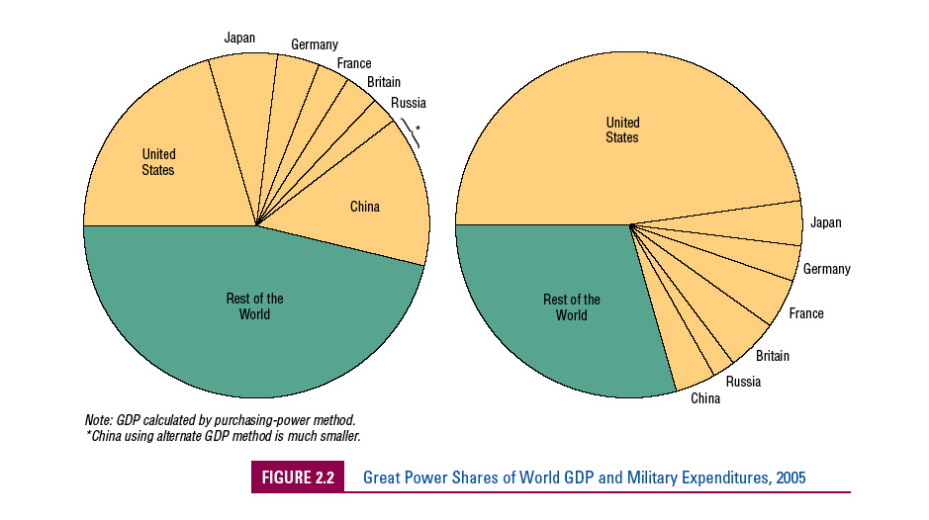

Slide 7
Hegemon
Internationalism versus isolationism
Unilateralism versus multilateralism

Slide 8
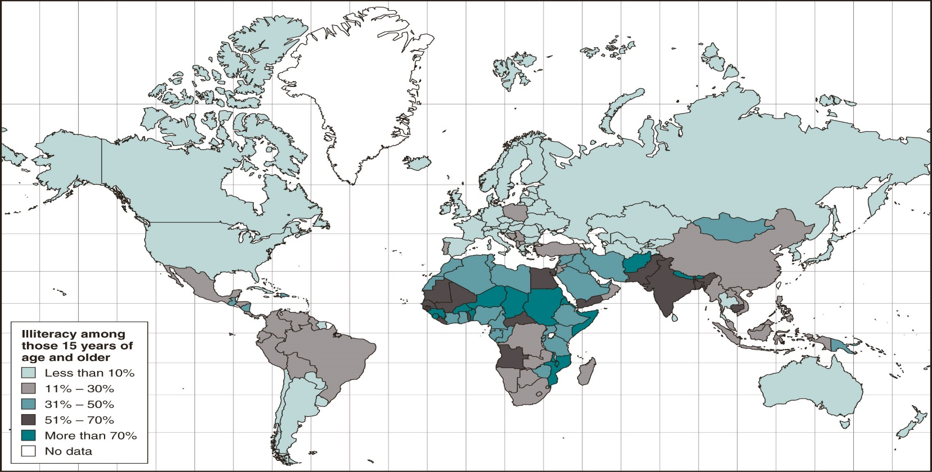
Rates of illiteracy in the world

Slide 9
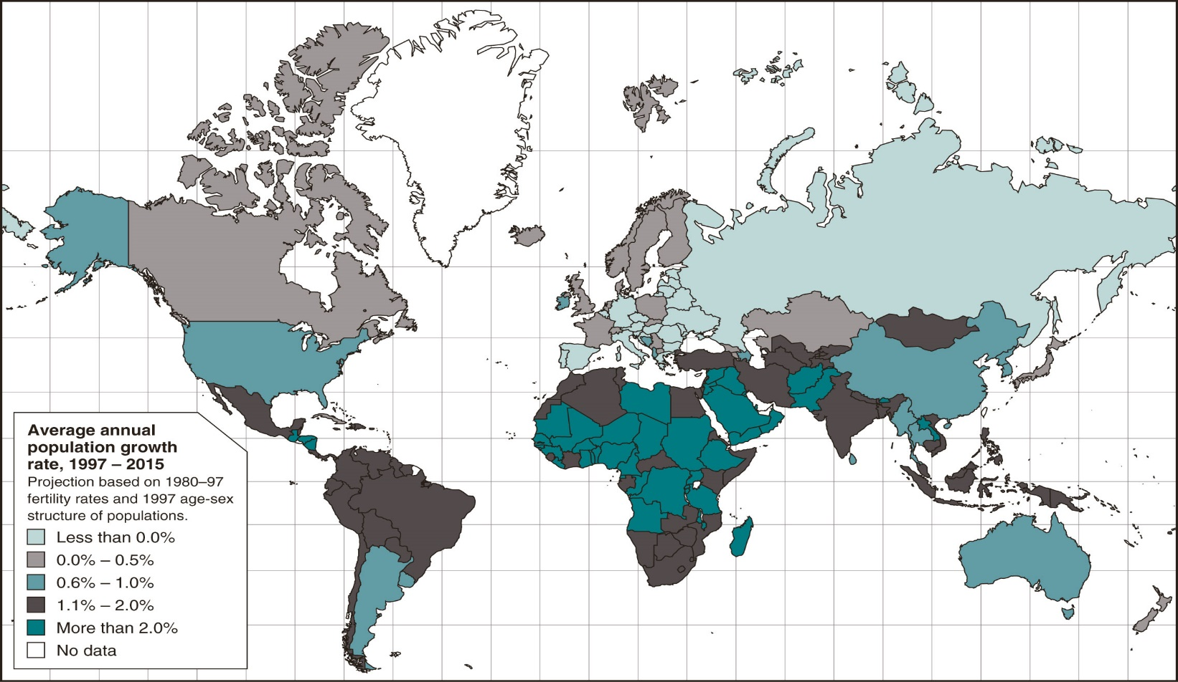
Population growth

Slide 10
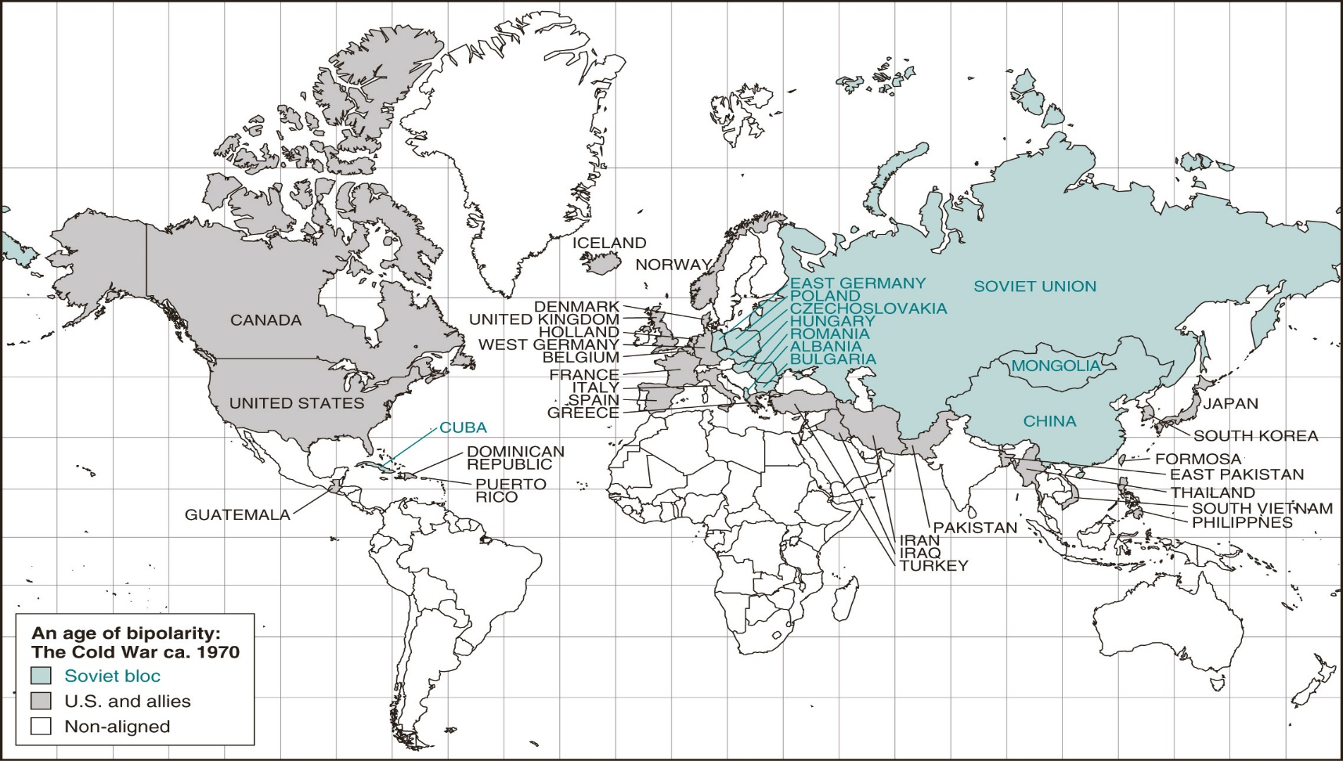
The Bipolar World

Slide 11
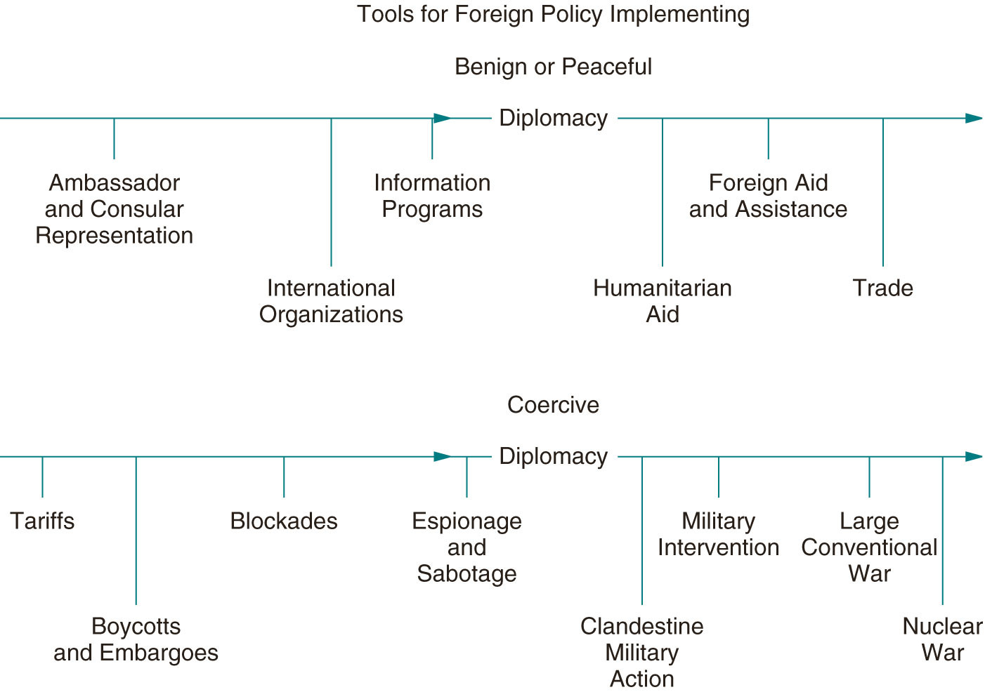
Formulating the State's Foreign Policy
autor prezentace, datum prezentace, univerzitní oddělení, fakulta, adresa

Slide 12
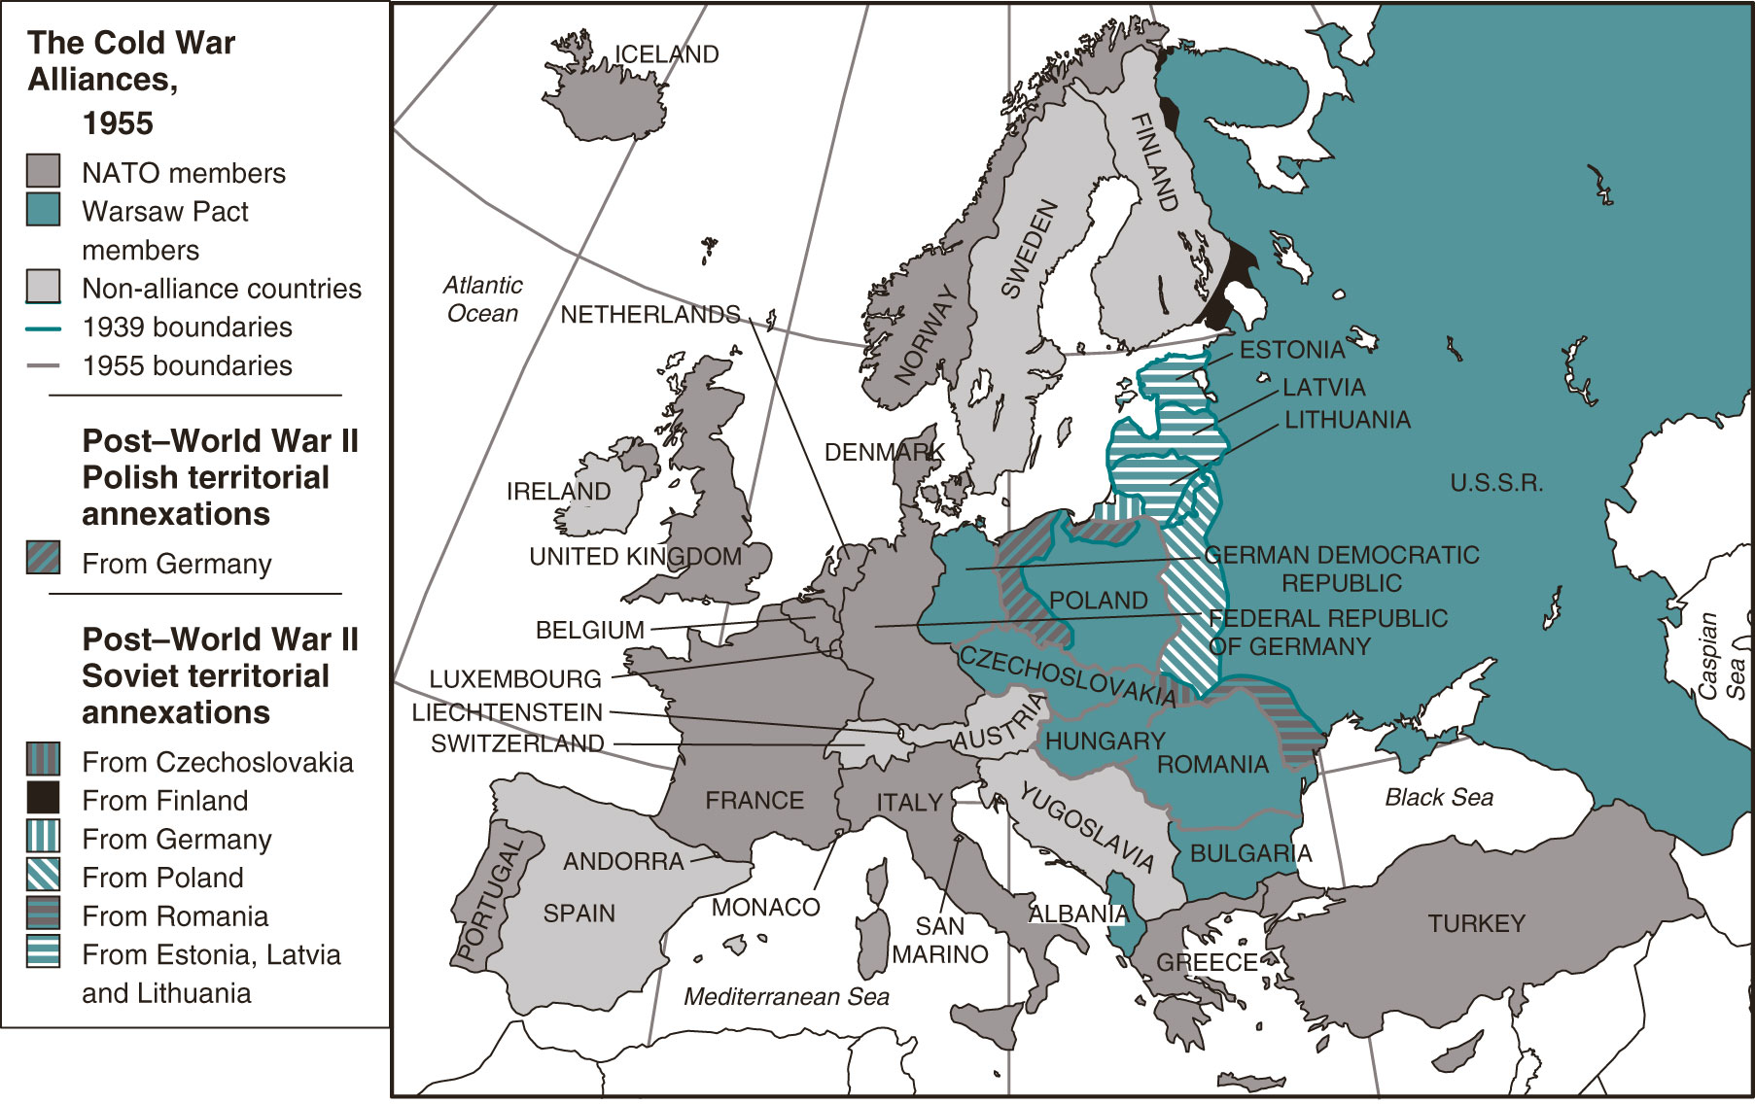
Cold War Alliance Map

Slide 13
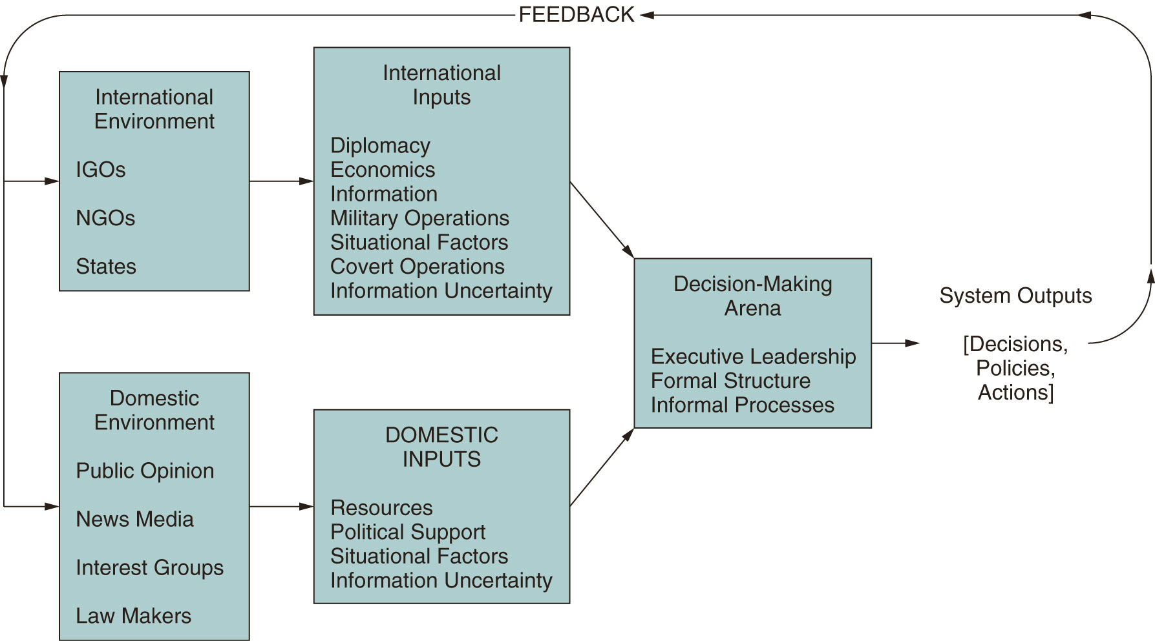
Foreign policy formulation and implementation

Slide 14
Foreign policy formulation and implementation
State A acts on State B to make X
The state is a unitary player who makes rational decisions based on interests and expected outcomes

Slide 15
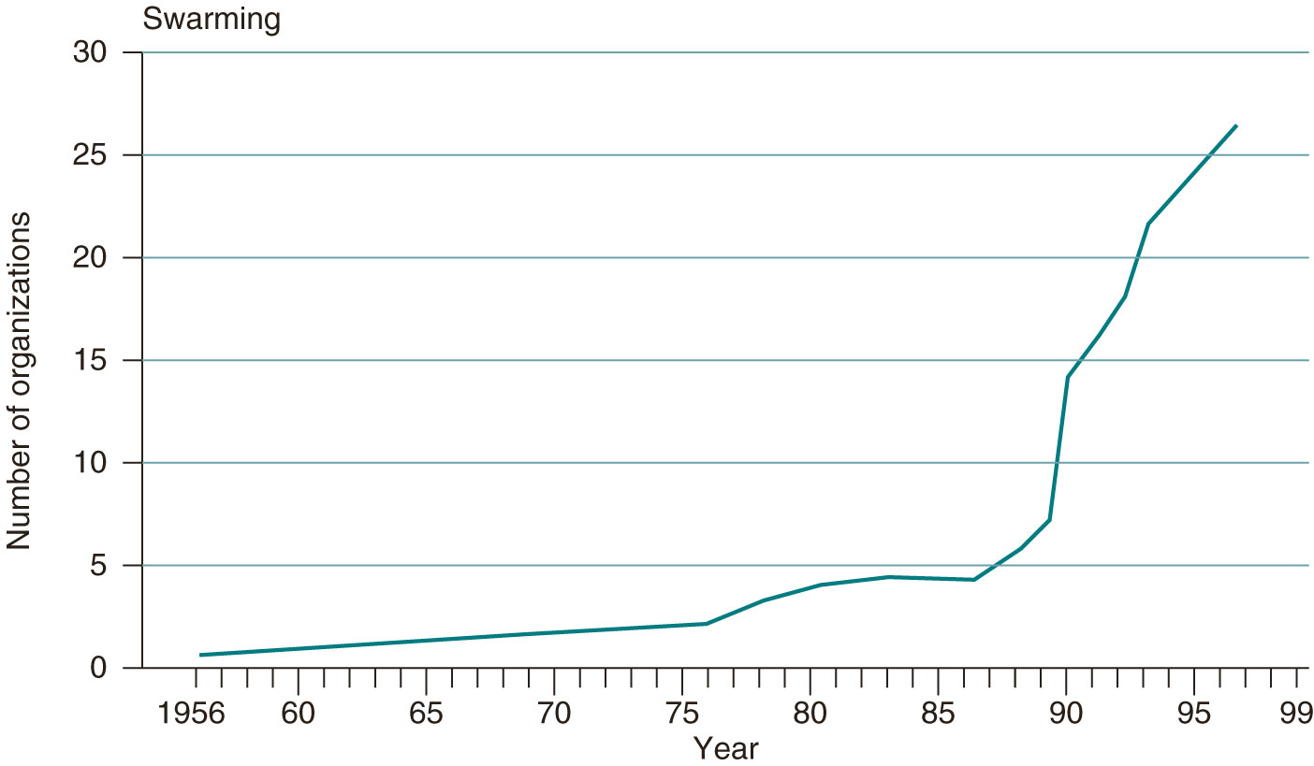
Corporate and non-governmental organizations (growth of non-state organisations 1956-1999)

Slide 16
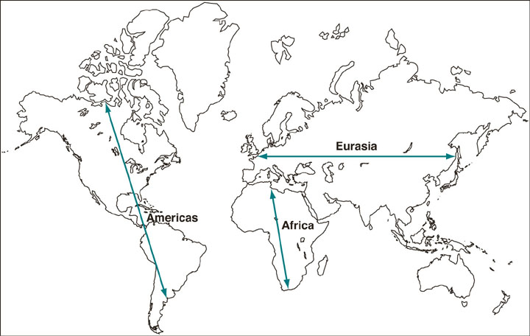
Political Geography

Slide 17
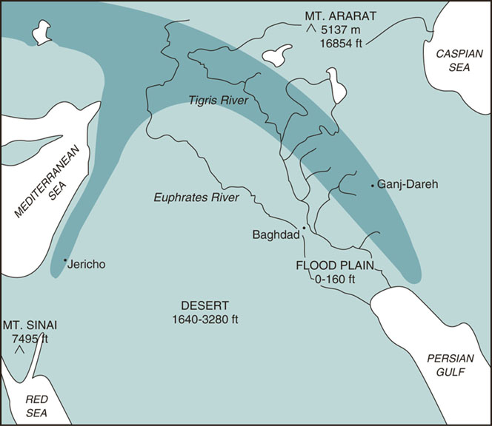
The Fertile Crescent

Slide 18
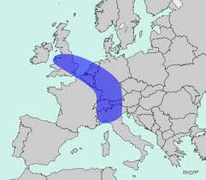

Slide 19
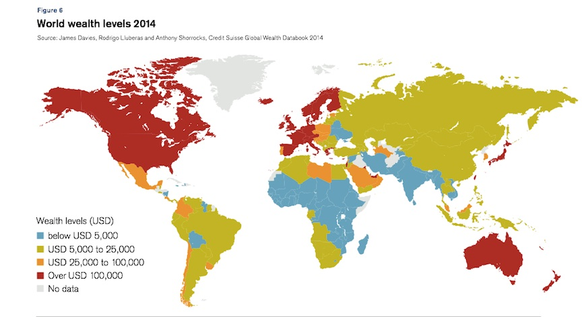

Slide 21
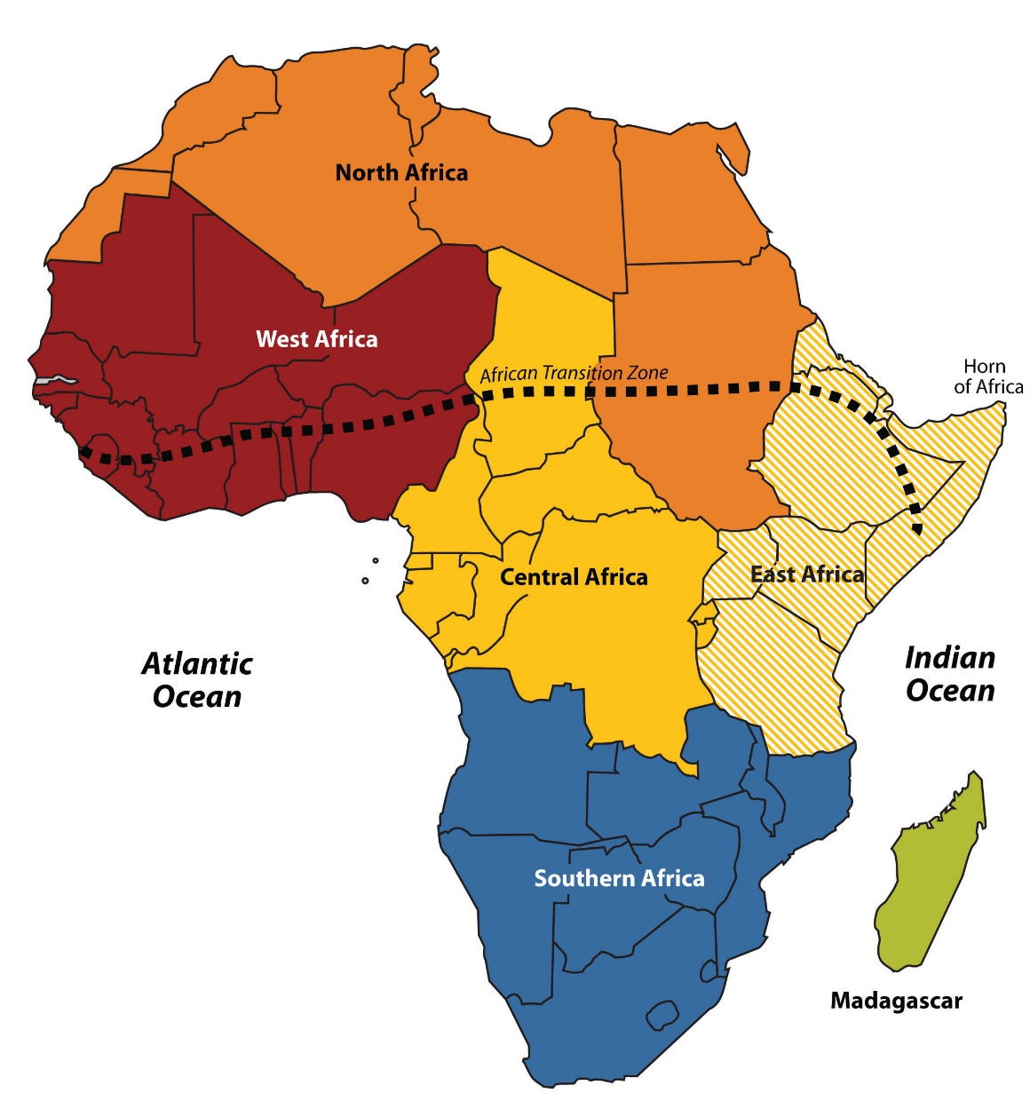

Slide 22
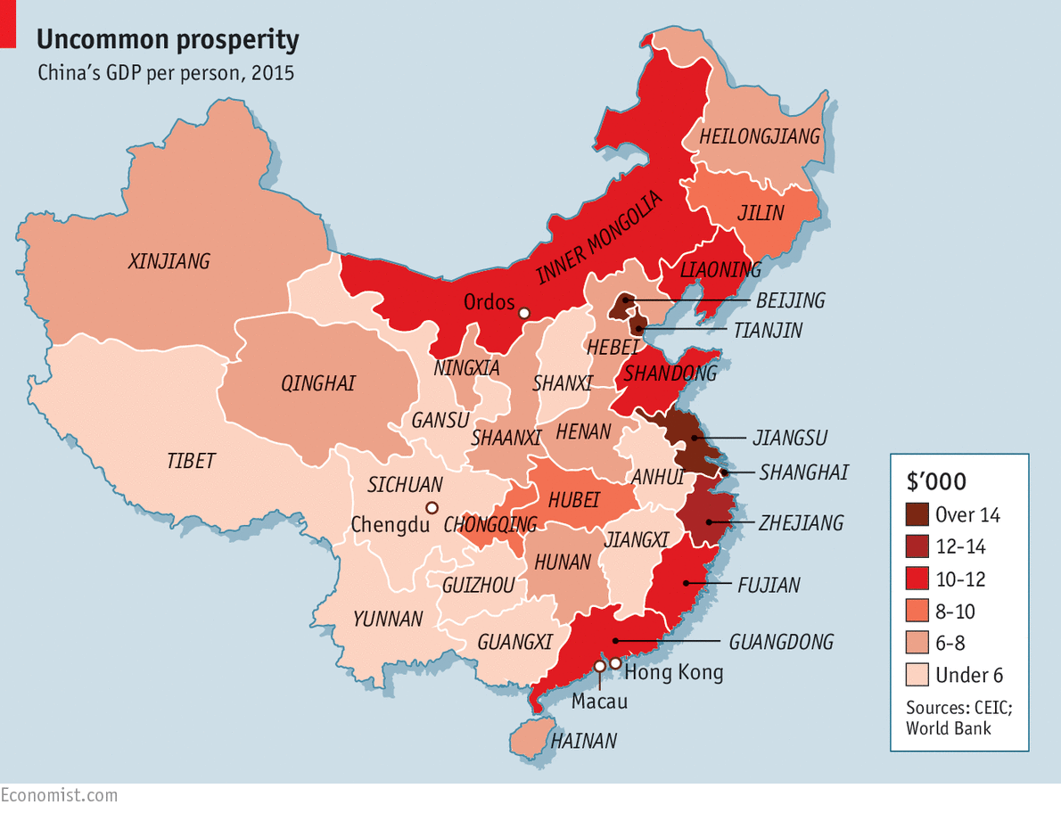

Slide 23
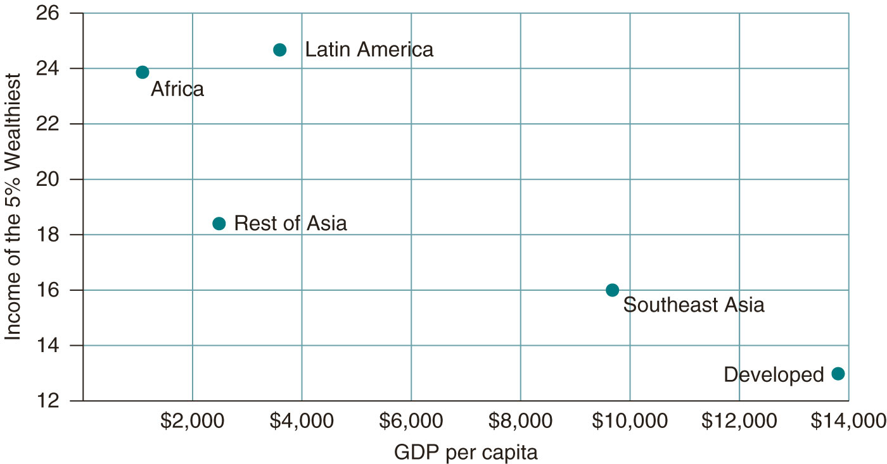
Income of the richest 5% of the country's population as % of total income
autor prezentace, datum prezentace, univerzitní oddělení, fakulta, adresa

Slide 24
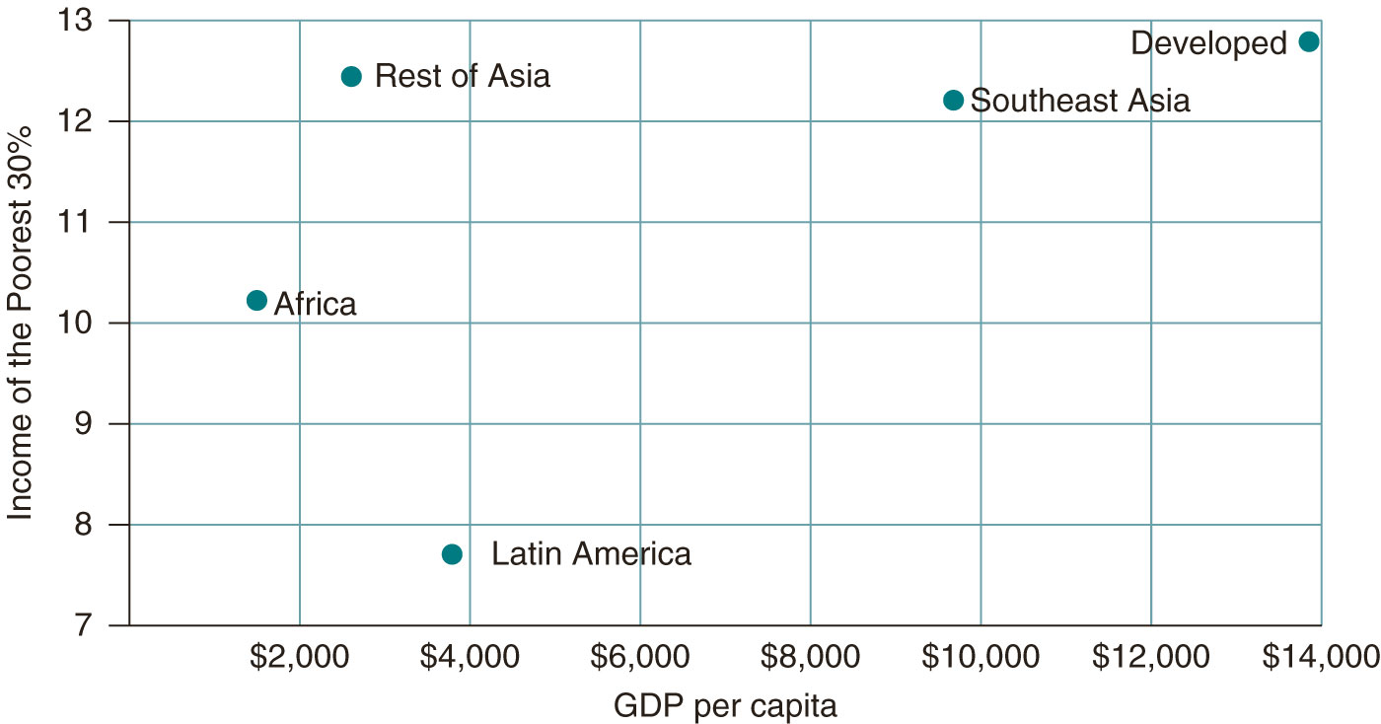
Income of the poorest 30% of the country's population as % of total income

Slide 25
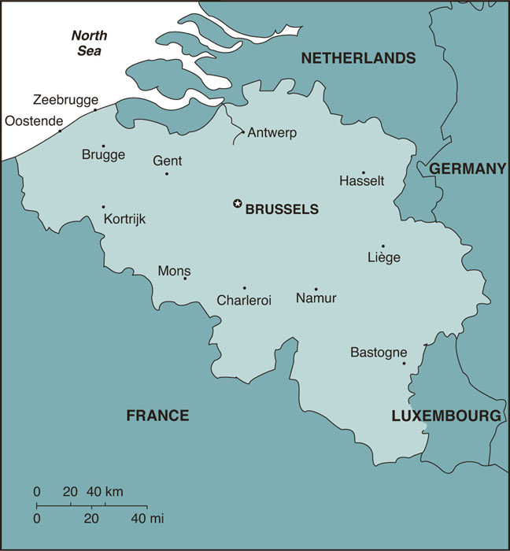
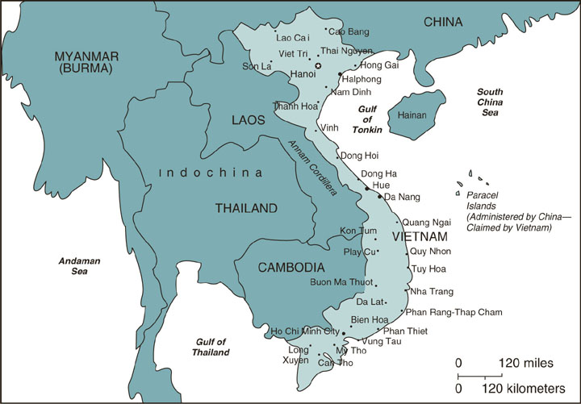
Country Shape

Slide 26
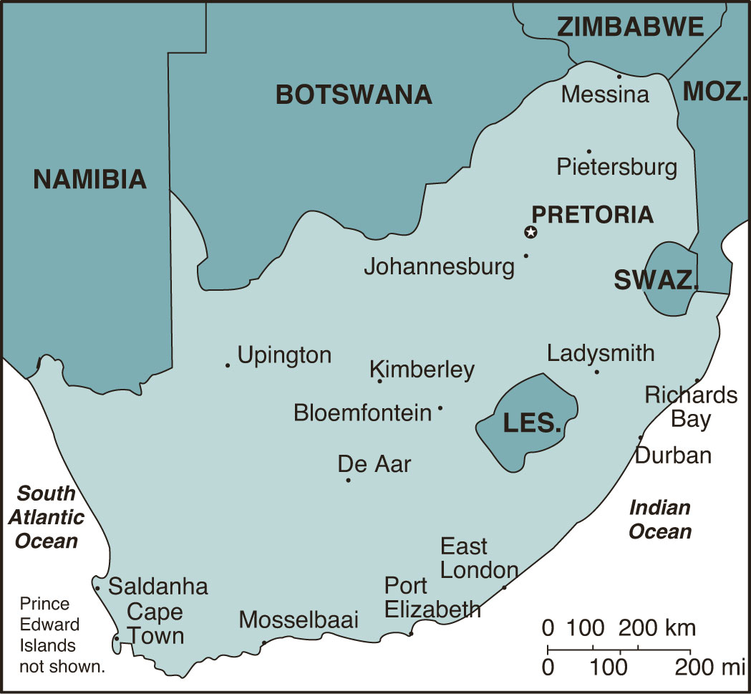
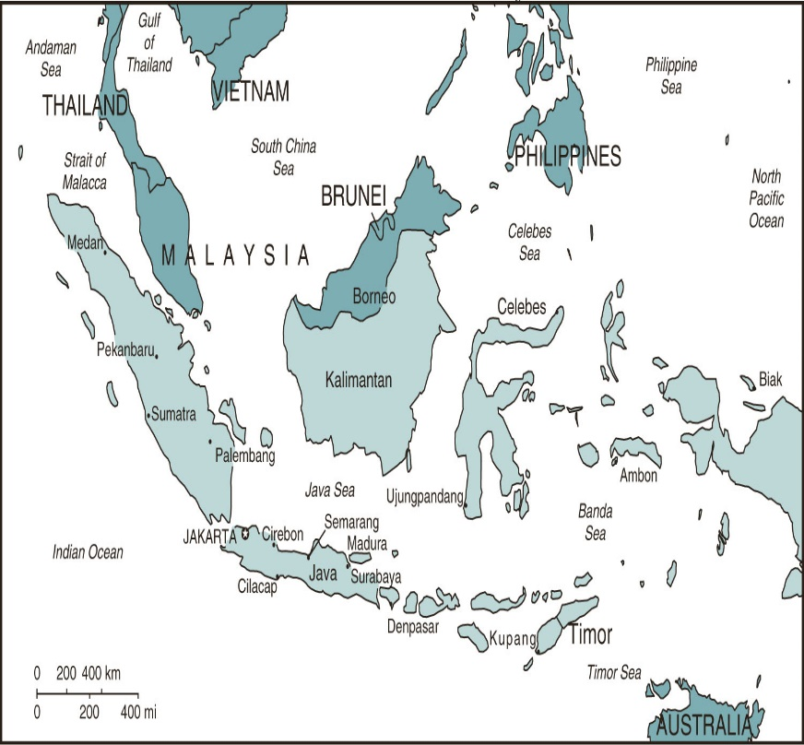
Political Geography

Slide 27
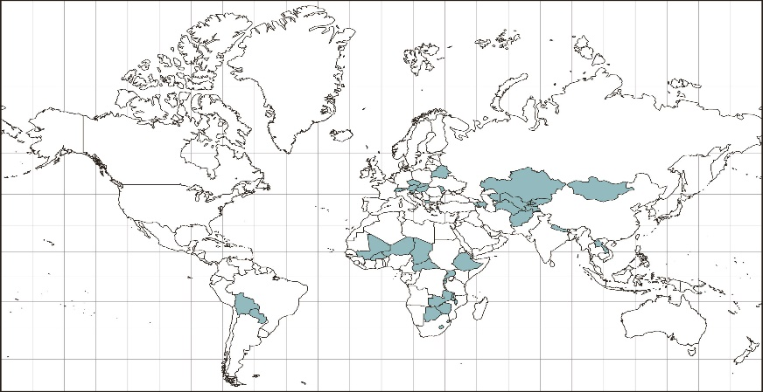
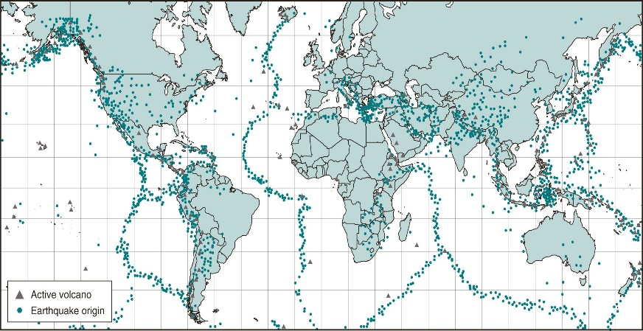
Political Geography

Slide 28
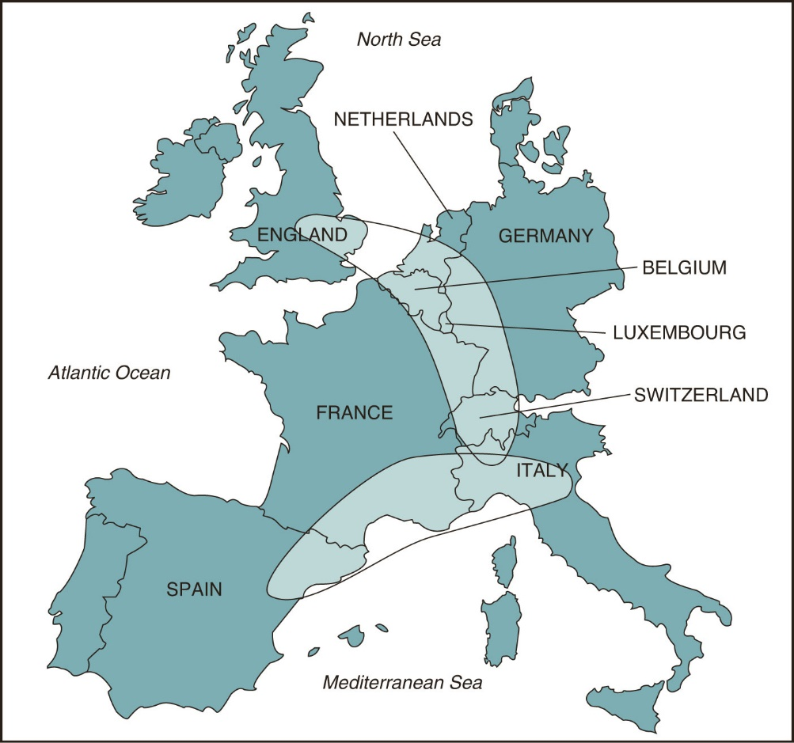
Nationalism and Regionalism

Slide 29
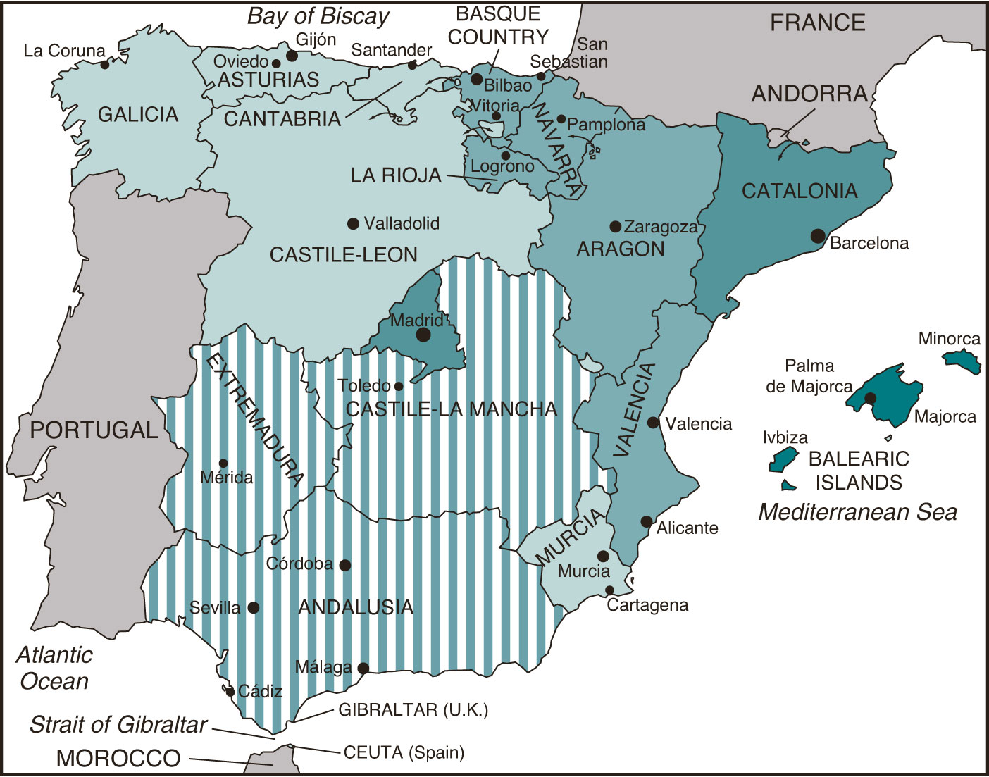

Slide 30
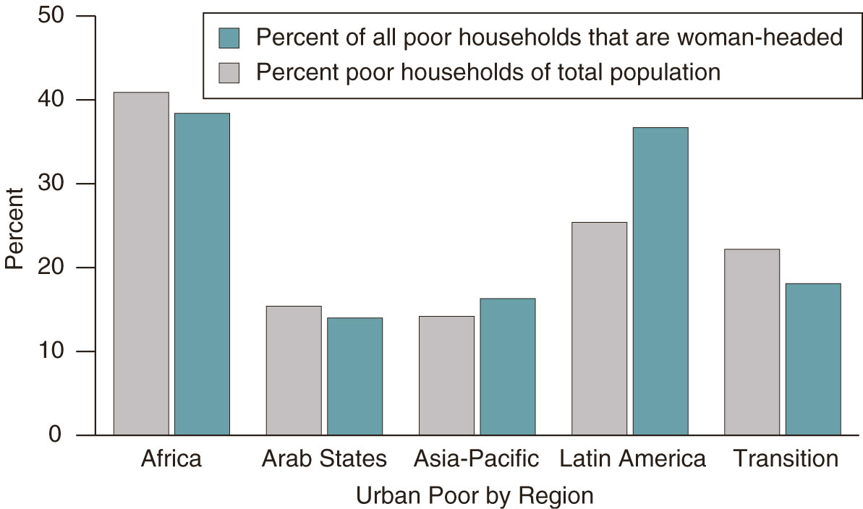
Global Justice

Slide 31
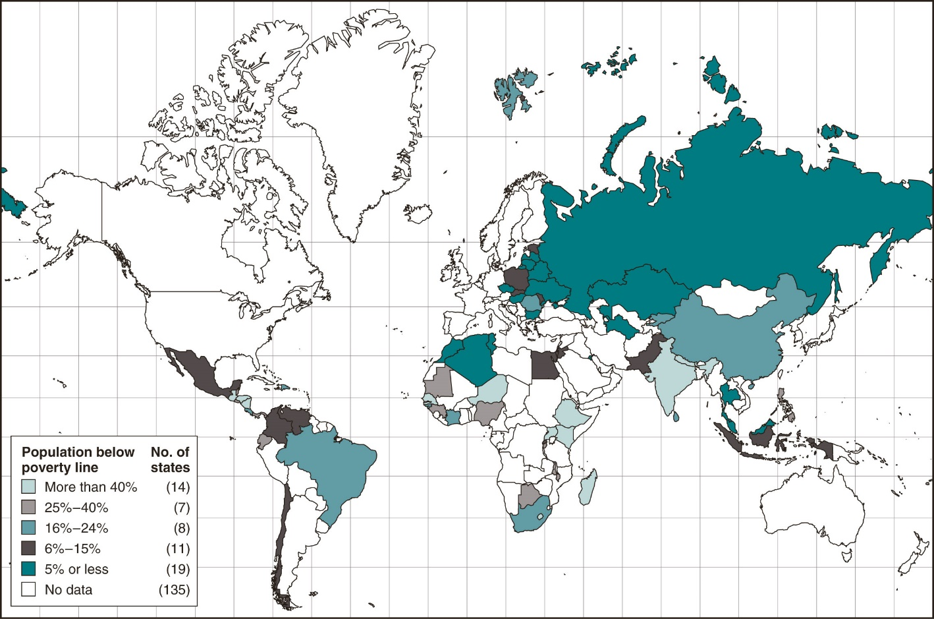
The incidence of extreme poverty – less than USD 1 per day

Slide 32
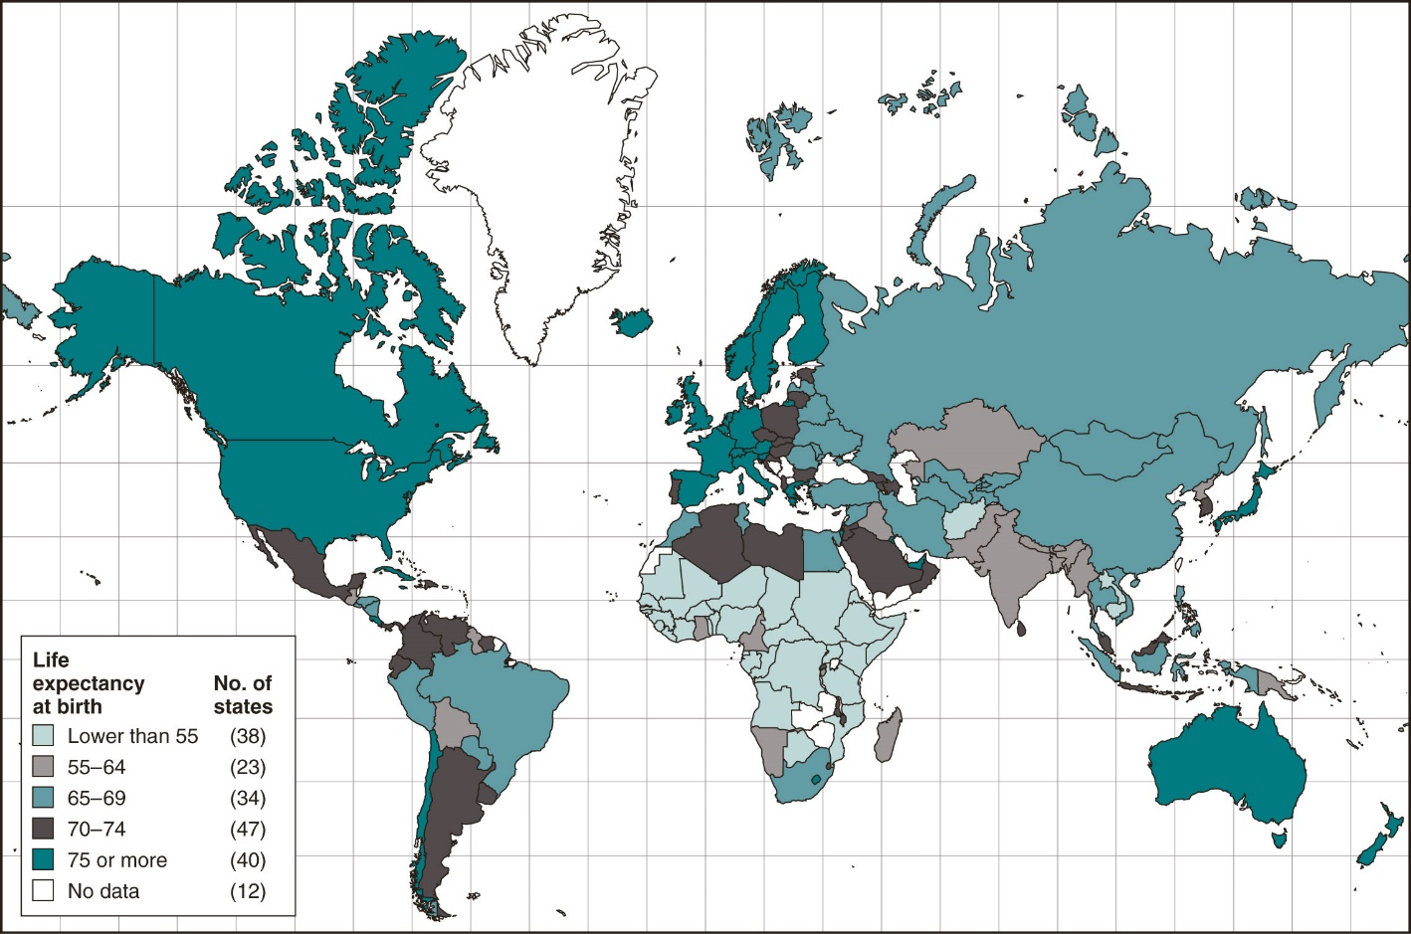
Average age

Slide 33
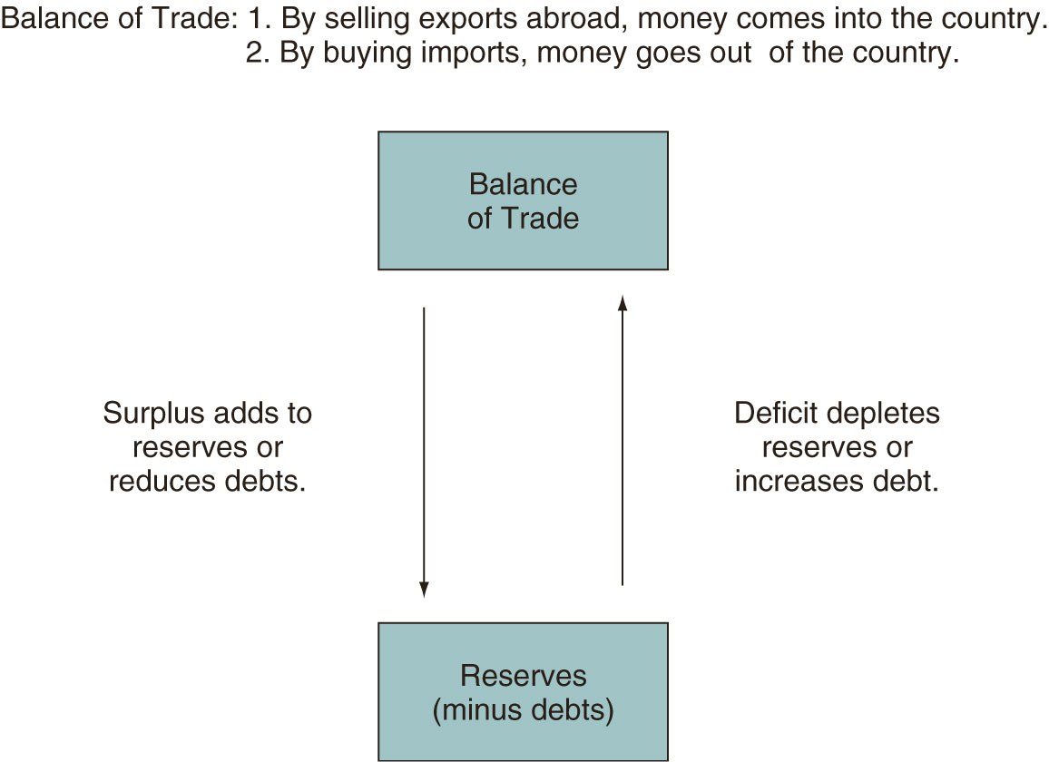
Political Economy

Slide 34
Linking questions
Trade and capital flow
Defence expenditure
Terrorism and political violence
Diseases
Global warming
Reliance on raw materials
Work and trade
Foreign investment and financial markets

Slide 35
Realism versus Liberalism
Realism: stresses the importance of the state and its promotion of national interests, emphasis on power, pragmatism, self-help, balance of power, peace is achieved by force
Liberalism: a more cooperative, global approach, the important role of international institutions and regional organizations, norms, power is destructive, peace is achieved through cooperation
Postmodernism: political reality determines how we understand, define and communicate concepts such as technological progress, political values are mental constructs, peace can be achieved by creating and promoting political identity
Constructivism: the exchange of ideas leads to new connections, creates global structures, the system and actors are not immutable, national political identities also change and adapt, the influence of culture, morality and ideology

