Slide 1



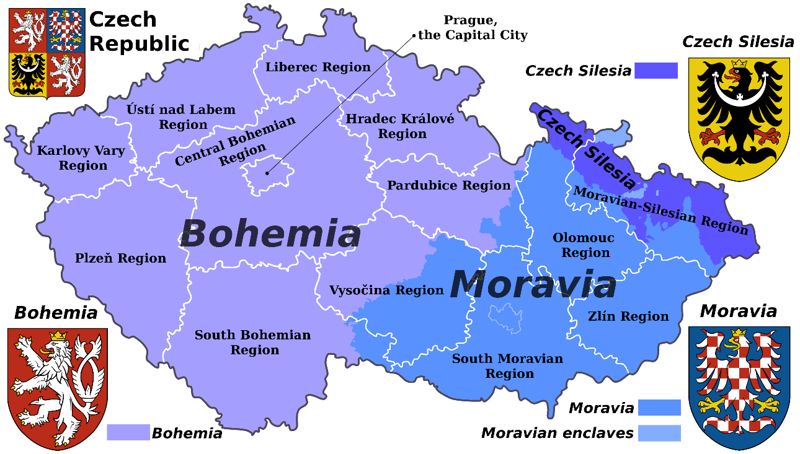
Czech Footprint in the World
Notes:
Links:

Slide 2

Story of
Notes:
Links:

Slide 3
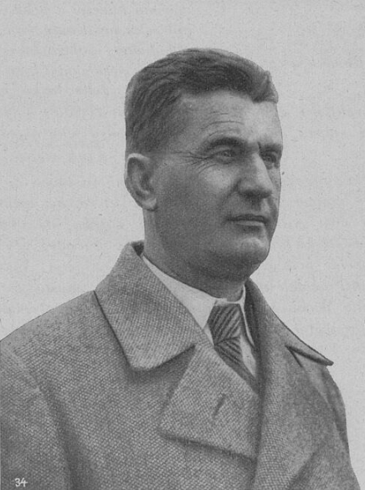
Baťa Towns in the World
Bat'a, also Bat'a's factories, is the name of a large Czech (originally Czechoslovak) shoe company founded by the siblings Anna, Antonín and Tomáš Bat'a in Zlín in September 1894.
From 1932, after the tragic death of Tomáš Bat'a, one of the founders of the company, Jan Antonín Bat'a took over all the company's assets on the basis of the Inheritance Agreement.
In 1939, as a result of the political situation, the Slovak factories were separated under "Bat'a, Slovenská účastinná spoločnosť" with its headquarters in Šimonovany. At the time of its nationalisation, the Czechoslovak Bata concern was involved in forty manufacturing industries. On 1 January 1949, the Bata plants in Zlín were renamed Svit.
Several companies were formed from the Slovak company Bata, and the production of footwear was merged with Zavody 29. augusta (ZDA) in Partizánské.
Notes:
Links:

Slide 4
Baťa Towns in the World
After WW2, Bata's factories in the socialist countries were nationalised without compensation. Branches in capitalist countries remained in family ownership and were managed both from South America – Jan Antonin Bata, and North America – Canada, by the family of Jr. Tomas Bata jr.
The current European headquarters of the company is in Lausanne, Switzerland. The headquarters for the Czech Republic is again in Zlín.
In 2004, the Guinness Book of World Records named Bata the "Largest Shoe Seller and Manufacturer" of all time, as they say the company has sold over 14 billion pairs of shoes in its existence.
Notes:
Links:

Slide 5
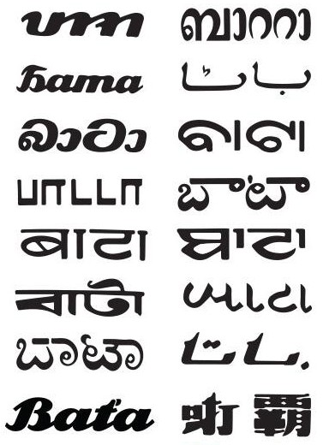
Baťa Towns in the World
Aafter the establishment of the Protectorate, Jan Antonín Bata, left the country and from 1941 he began to build new workplaces, production and new cities in South America, in Brazil. In the Czechoslovakia in 1938, he published the book Building a State for 40,000,000 People, in which he presented his extensive economic plans to the public. In 1939, he went into exile in the USA and settled in Brazil, where a new centre for the management of foreign Bata companies was established.
From 1938, his nephew Tomáš Jan Baťa also built a plant in Canada. The management of the company in Zlín was thus made up of Dominik Čipera, Hugo Vavrečka, František Malota and Josef Hlavnička.
After the WW2, the development of the company was divided. Canada became the new center of Bata's company (nephew Tomáš J. Baťa).
Notes:
Links:

Slide 6
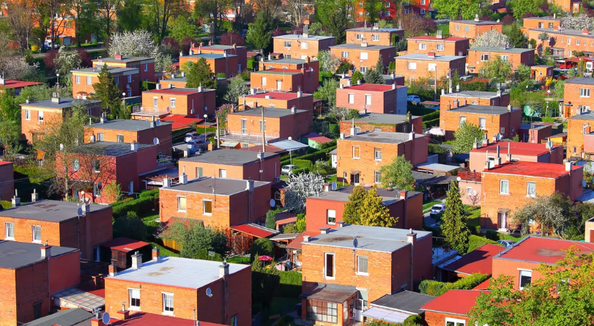
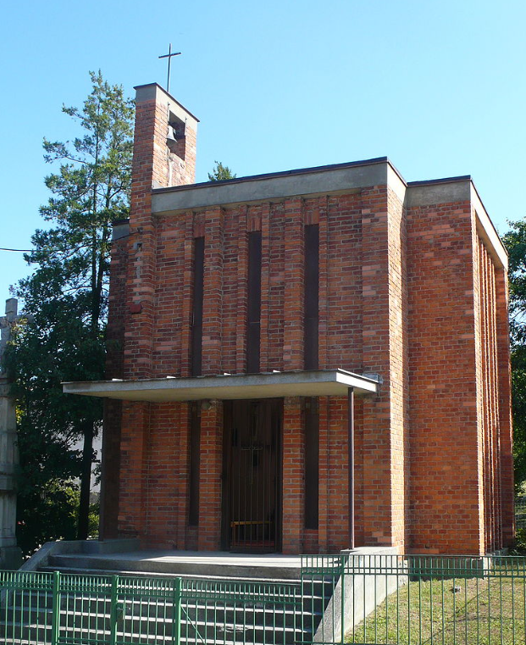
Baťa Towns in the World
Bata built not only the factory, but also all the facilities for it and its employees.
He produced the raw materials himself and sold them without intermediaries, thus saving on costs.
In today's Otrokovice, he built his own tannery, in Zlín he built a company producing machinery and owned fields and forests.
He built Bata houses (luxury housing at the time) and dormitories for his employees, which, together with the high wages at the factory, were the main reason for the influx of labour and the expansion of Zlín.
There were also schools for future employees, kindergartens, and other services.
Notes:
Links:

Slide 7
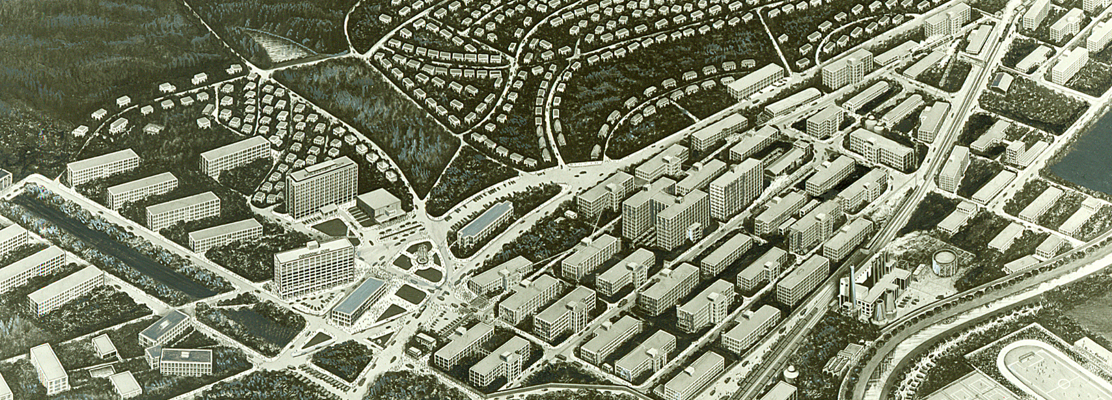
Baťa Towns in the World
The whole of Zlín was built according to a unified functionalist plan by the architect František Lydia Gahura called the Garden City. The development of Zlín continued even after the death of Tomáš Bata. During the time of Jan Antonín Bata, for example, the administrative building No. 21 was built, a department store and a hotel were completed, and the Institutes of Studies were established.
Notes:
Links:

Slide 8
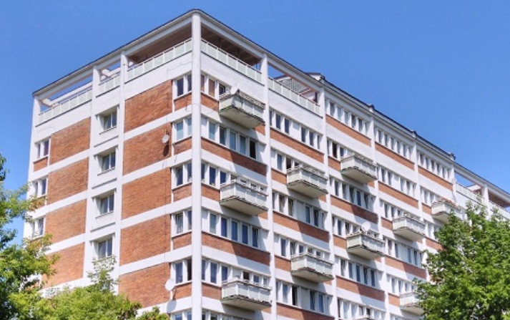
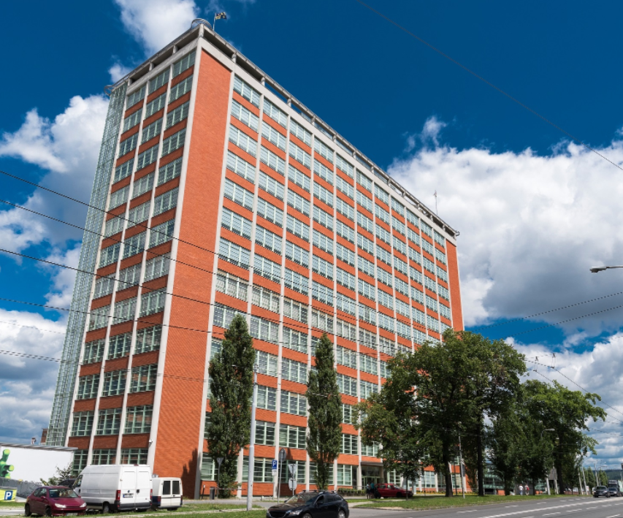
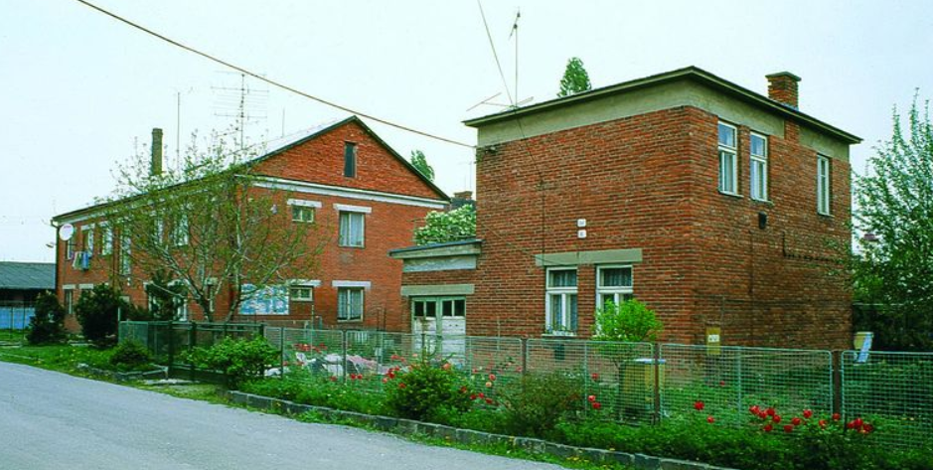
Baťa architecture
Notes:
Links:

Slide 9
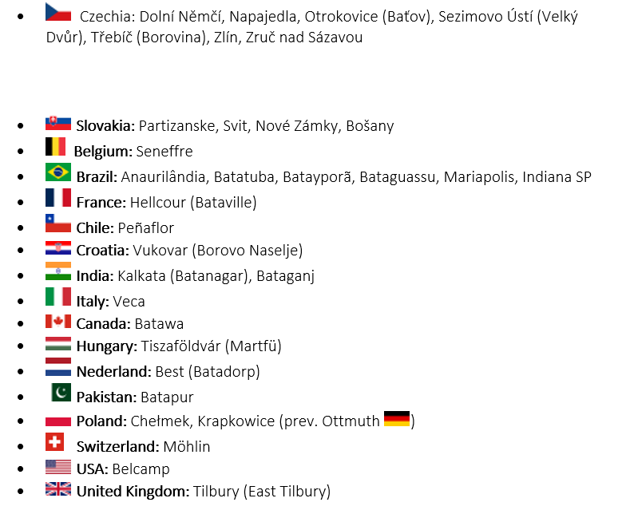
Baťa Towns
in the World
Notes:
Links:

Slide 10
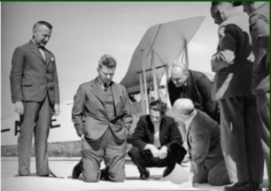
Baťa Towns in Brazil
Jan Antonin Bata did the impossible in Brazil, after creating one of the largest companies in the world in just seven years (by 1939 he had already been expelled by the Nazis) as CEO of Bata in 1932-1942, the years of the deepest world crisis:
120 companies
5810 shops
105 700 employees
Notes:
Links:

Slide 11
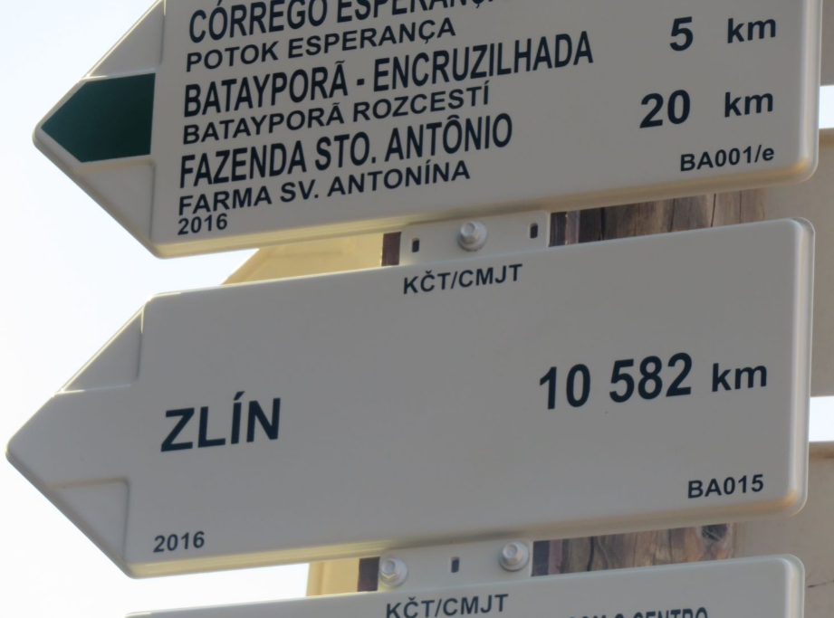
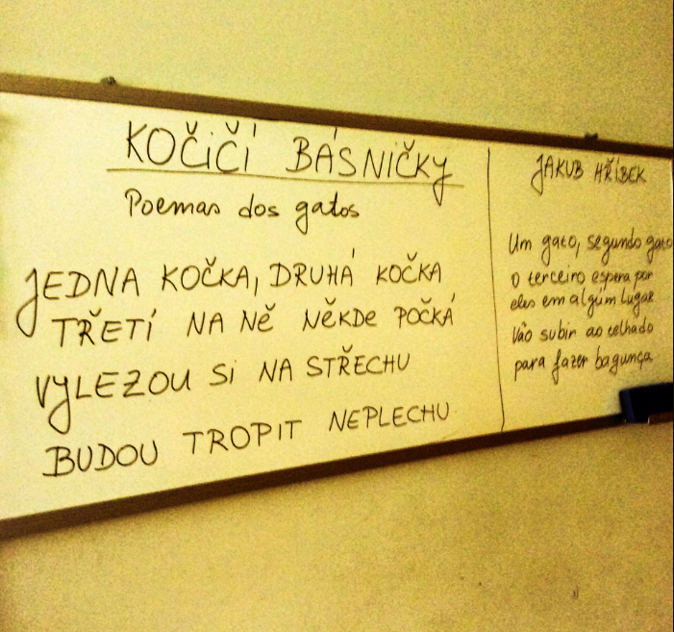
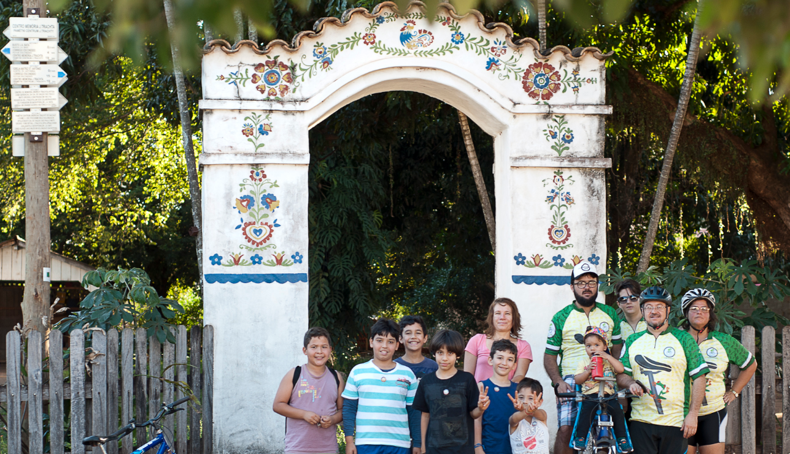
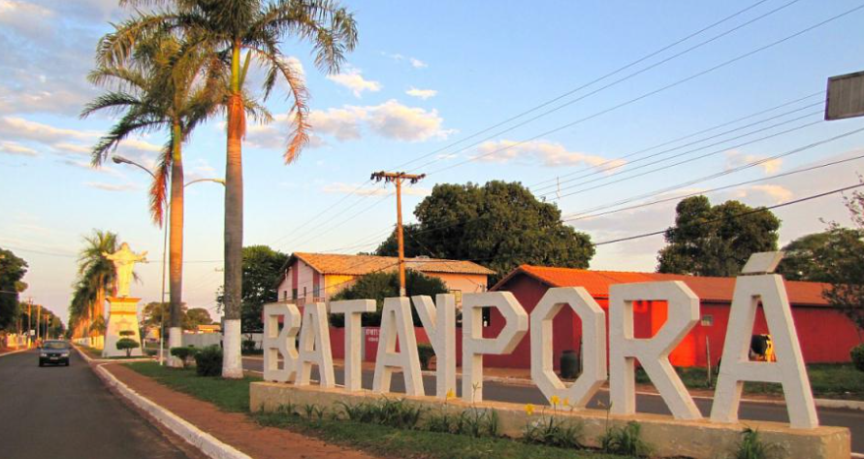
Baťa Towns in Brazil
The city of Batayporã is located in the territory of the state of Mato Grosso do Sul (MS), one of the twenty-seven Brazilian federated states, located in the mid-west of Brazil.
Batayporã (in the Guaraní Indian language, "Bata's Good Water") was founded in the 1950s.
Notes:
Links:

Slide 12
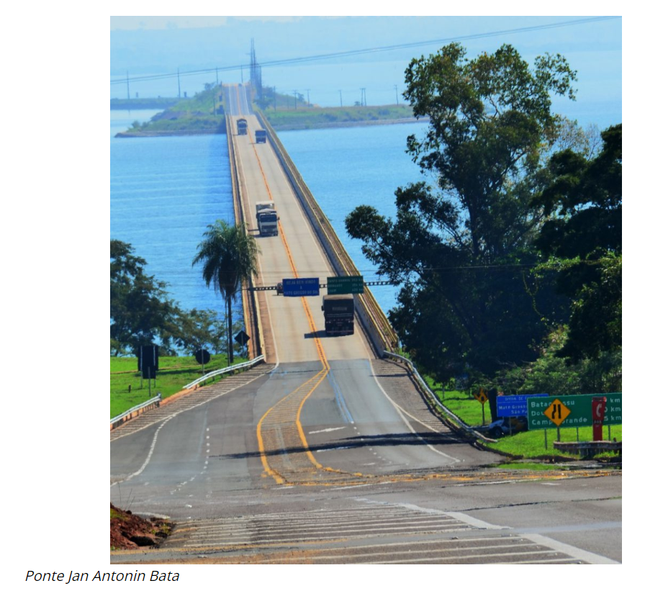

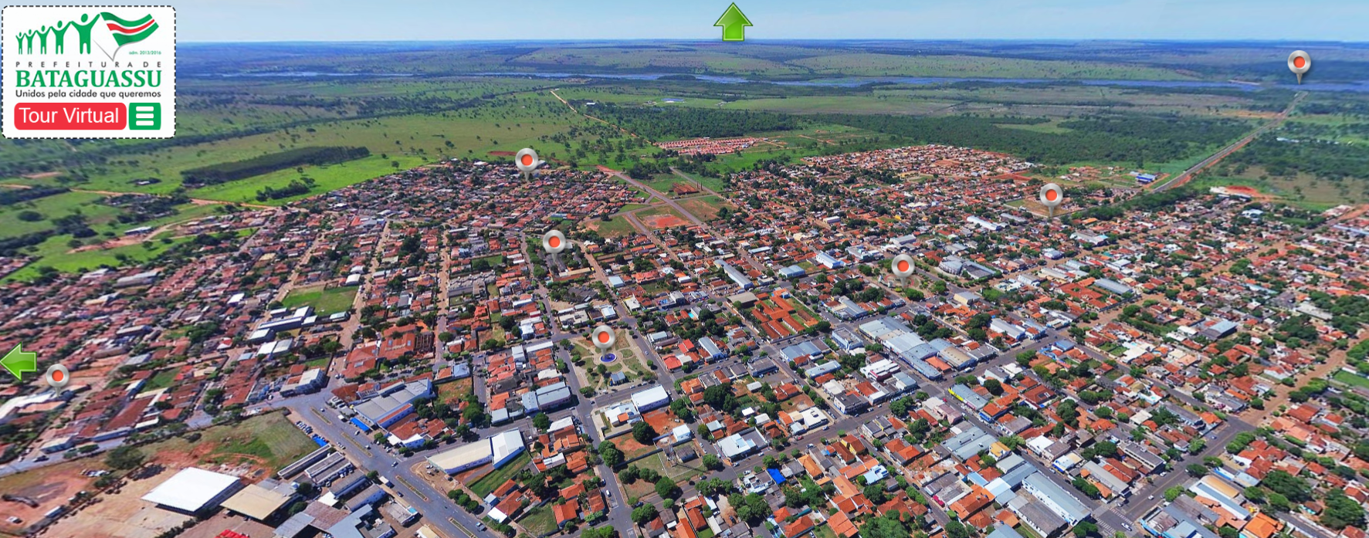

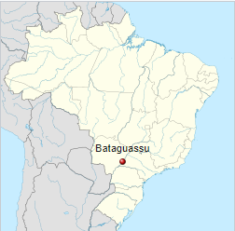
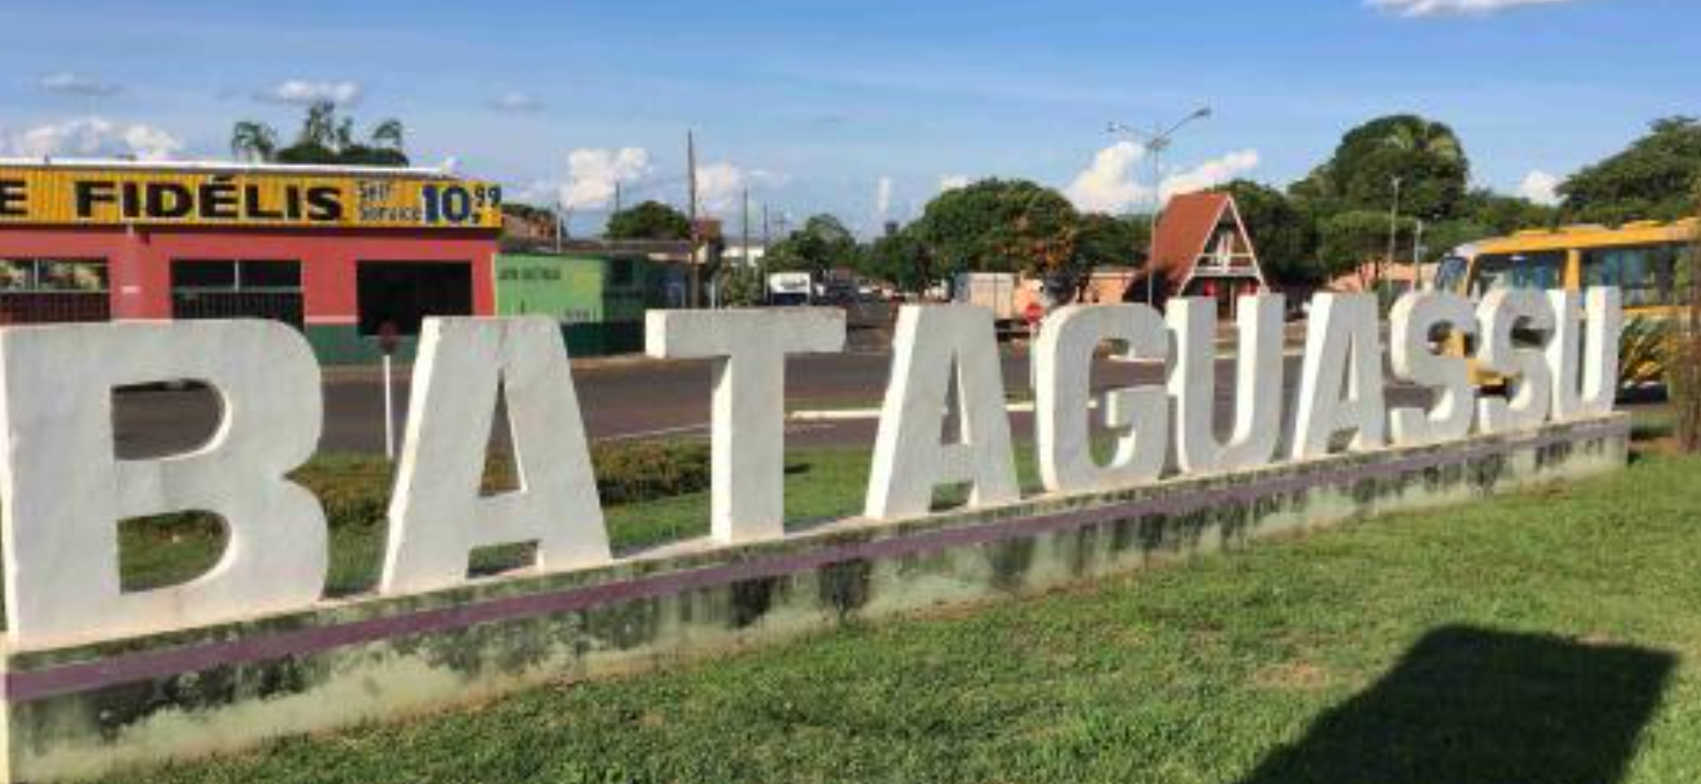
Baťa Towns in Brazil
Notes:
Links:

Slide 13
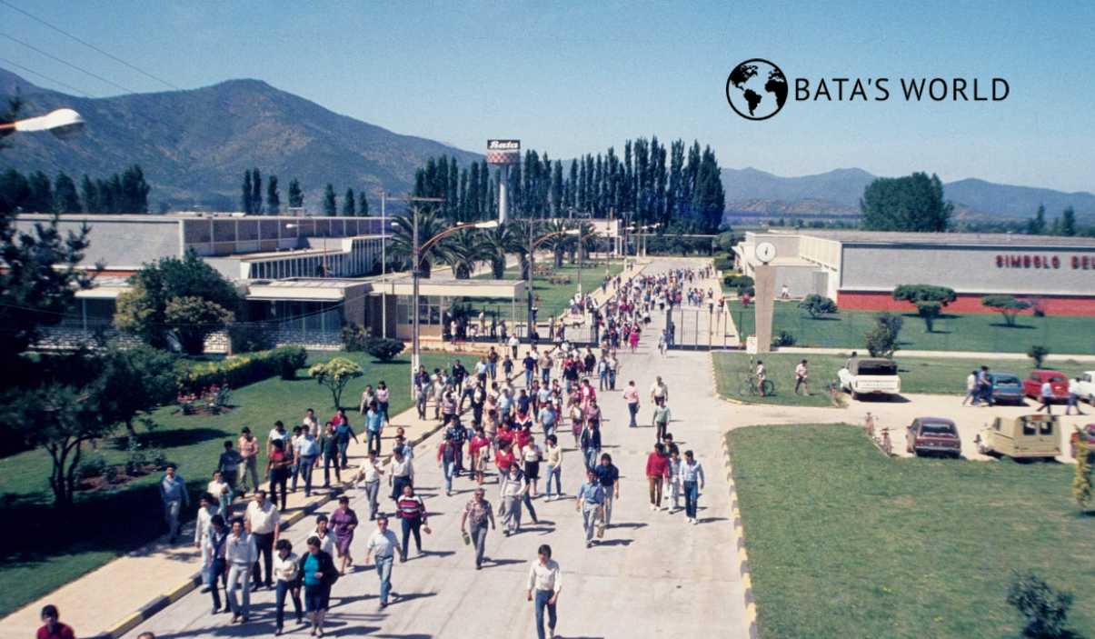
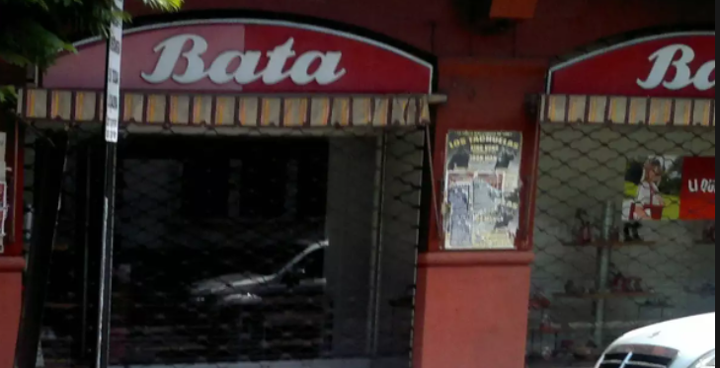
Melipille - Chile
Notes:
Links:

Slide 14
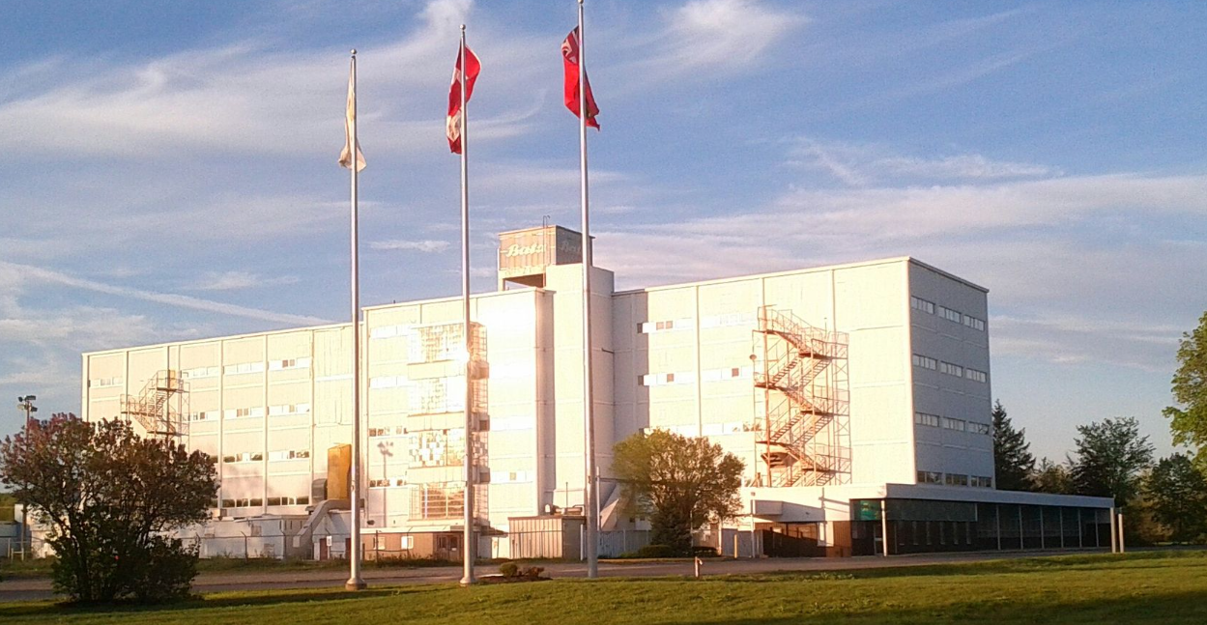
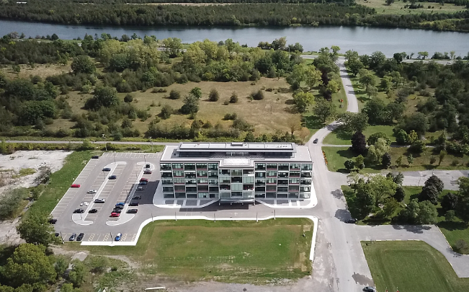
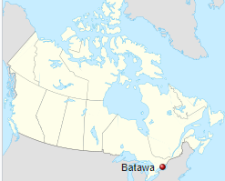
Batawa – Canada
Notes:
Links:

Slide 15
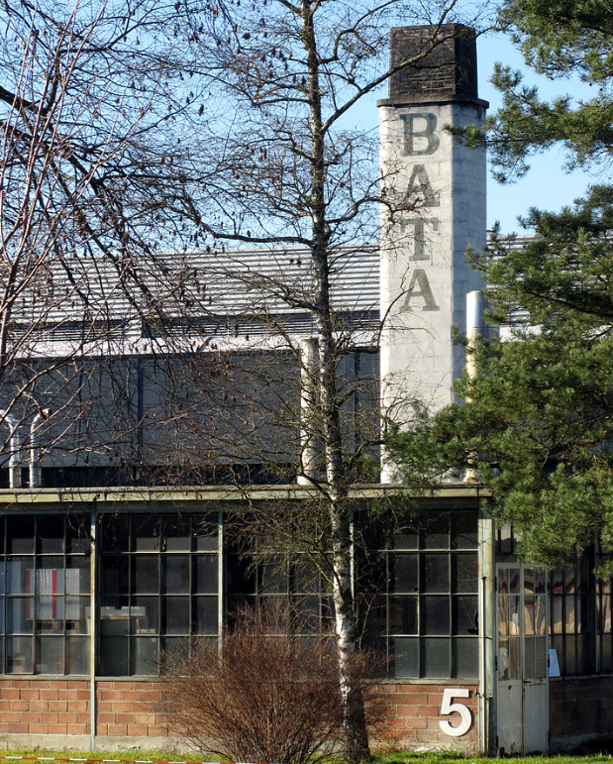
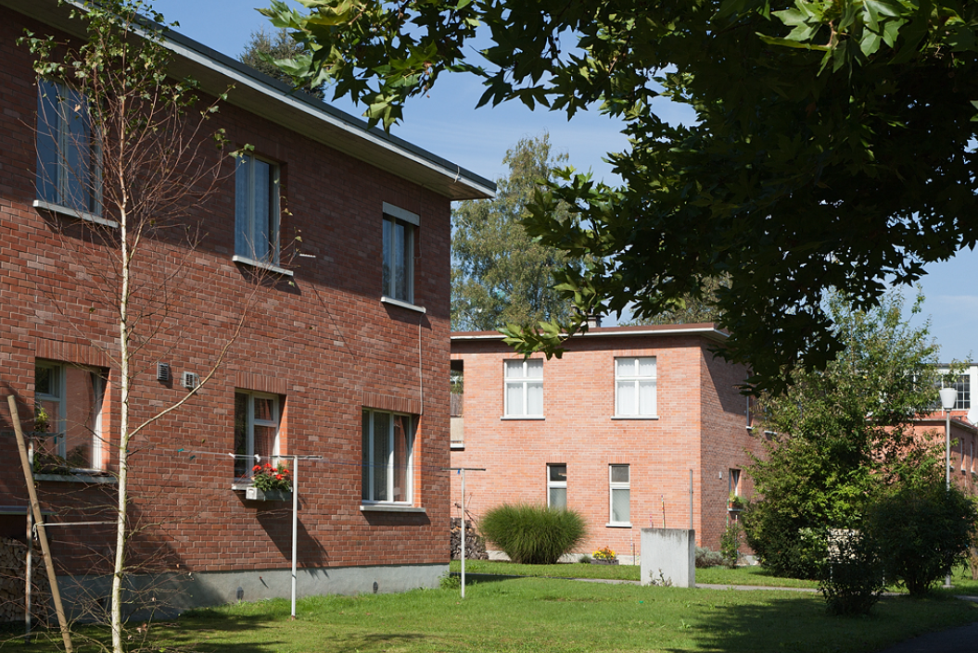
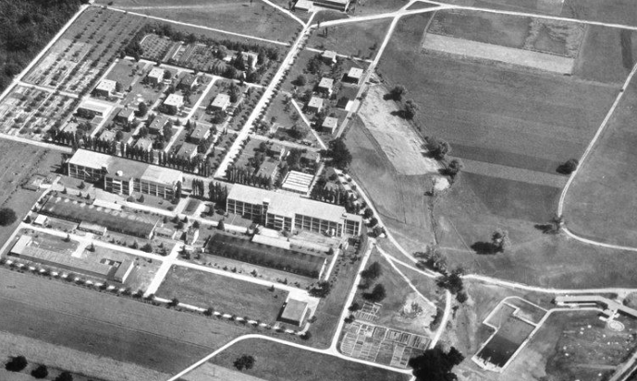
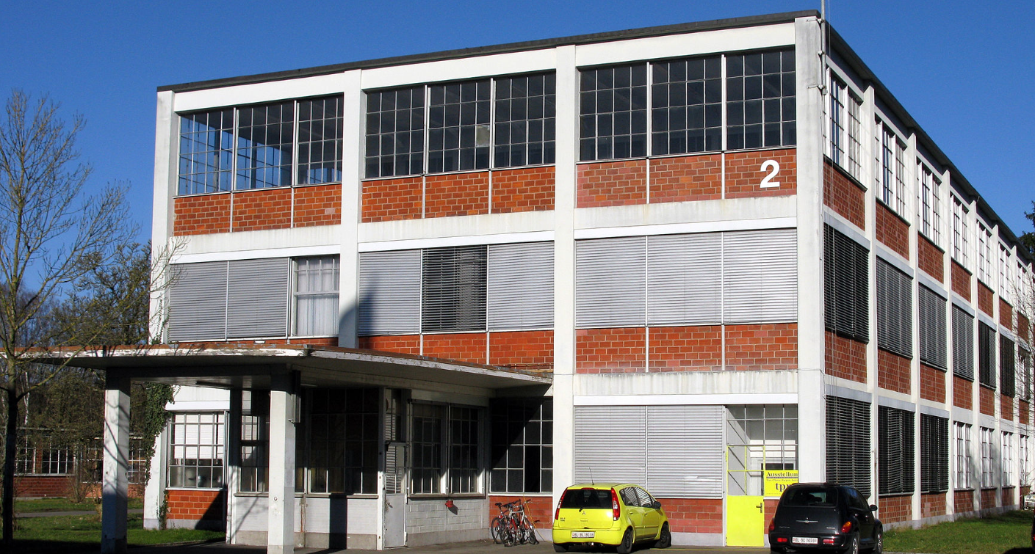
Möhlin – Switzerland
Notes:
Links:

Slide 16
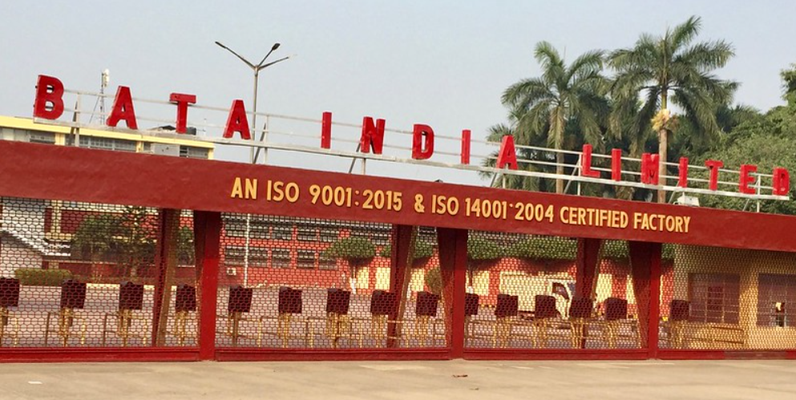
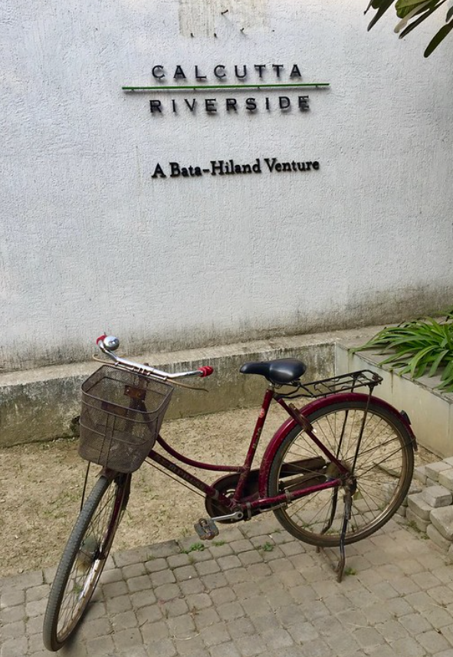
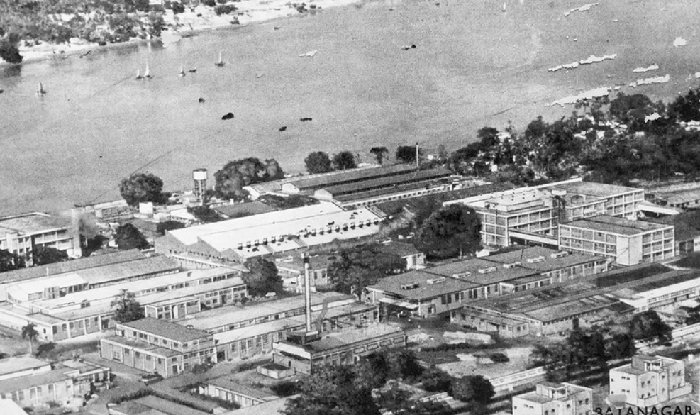
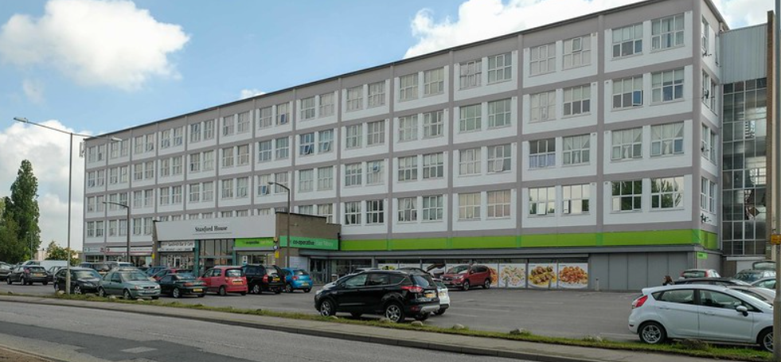
Batanagar – India
Notes:
Links:

Slide 17
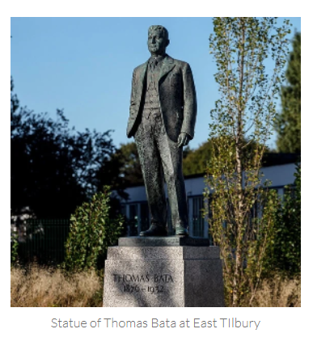
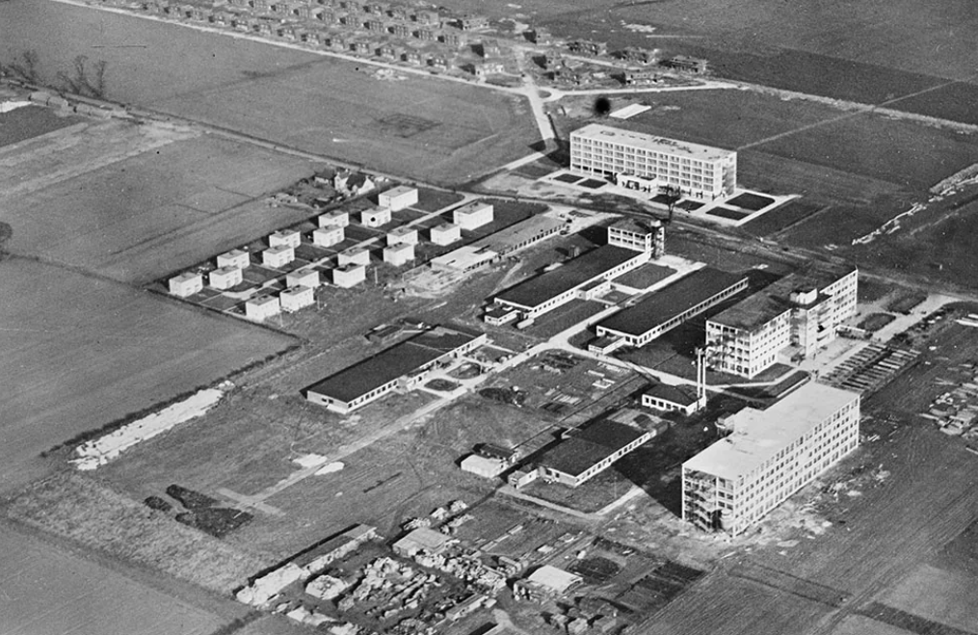
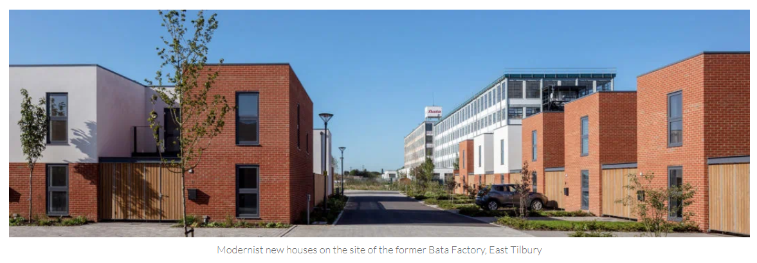
Tilbury – United Kingdom
Notes:
Links:

