Slide 1


The Theory and Transformation of Citizenship Education

Slide 2
The Definition of the theory of Education
a fundamental branch of paedagogy
it systematizes and categorizes education sciences (tracking, for example, their goals, methods, forms, prerequisites)
the focus is on both theories and educational ideologies and ideals, directions and theoretical discourses, as well as ways of thinking

Slide 3
The Definition of the Theory of Education
the theory of education refers to a concept which clarifies the functioning of institutions (school) or processes (teaching)
these concepts need to be general and abstract enough to apply to the maximum number of situations possible

Slide 4
Approaches to the theories of education
there are two approaches:
theory of Education as a Philosophical Discipline
(for example paedagogical idealism, realism, conservatism)
theory of Education as an Empirical Discipline
(for example “school effectiveness theory”)
there are exceptions, which may be referred to as "mixed", falling under both categories (e.g. neo-essentialism in education)

Slide 5
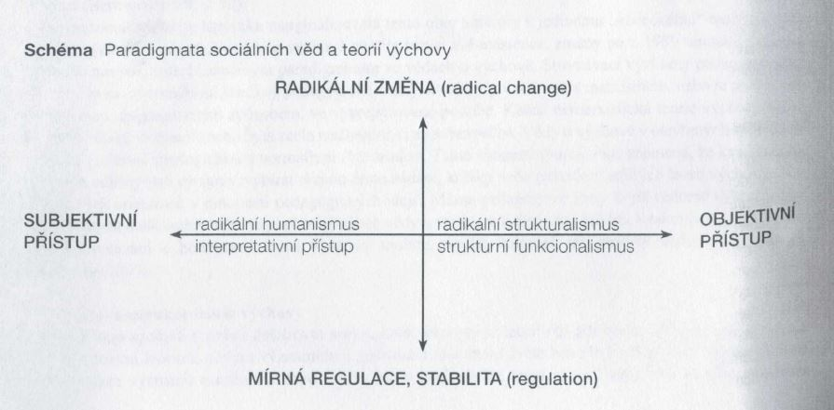
The paradigms of social sciences and theories of education
Source: Prokop in Průcha, Pedagogická encyklopedie.

Slide 6
The paradigms of the theories of education
Pedocentrism
a) Humanistic pedocentrism
b) Interpretative pedocentrism
2) Traditionalism
a) Structuralist traditionalism
b) Functionalist traditionalism

Slide 7
The paradigms of the theories of education
Pedocentrism – emphasis on the child’s unrestricted development; attention to an individual/personality; support and development of the student's potential; the teacher is responsible for generating the optimal environment
a) Humanistic pedocentrism – a radicalizing trend (operating with unschooling); the aim is to remove barriers, discrimination, inequality…
- theories: emancipatory pedagogy, interculturality, postmodernism, anti-pedagogy…

Slide 8
The paradigms of the theories of education
Pedocentrism – emphasis on the child’s unrestricted development; attention to an individual/personality; support and development of the student's potential; the teacher is responsible for generating the optimal environment
b) Interpretative pedocentrism – the teacher helps to overcome barriers, not remove them
- theories: personalistic paedagogy, phenomenological paedagogy, religious paedagogy...

Slide 9
The paradigms of the theories of education
2) Traditionalism – society should participate in developing educational practice. Students are taught values upheld by the previous generation.
a) Structuralist traditionalism – education follows on historical experience, is well-planned, and designed to drive the student to deliver. The teacher teaches binding patterns of behaviour and thinking that are socially acceptable.
- theories: Herbartism, positivism, Frankfurt school critical theory...

Slide 10
The paradigms of the theories of education
2) Traditionalism – society should participate in developing educational practice. Students are taught values upheld by the previous generation.
b) Functionalist traditionalism – efforts to connect education to society's goals; the student adopts the status quo, which can be gradually altered
- theories: functionalism, neopositivism, rationalism…

Slide 11
Methods used to study the theories of education
Reconstruction of the theory of education – it needs to be objective, unbiased, and unprejudiced. We reconstruct all the premises and categories of the theory, and identify with the main principles and goals. The goal of the method is to interpret a given theory.
Hermeneutic criticism – the meaning of the theory is interpreted and gradually specified, and own approach is applied. The goal is to identify all the meanings (including those previously hidden).

Slide 12
Methods used to study the theories of education
3) Comparison – theories in different environments (countries) or concepts (schools of thought). The comparison has allowed the development of a map of education paradigms (see diagram ).

Slide 13

Food for thought
Is there anything new to be studied in today’s paedagogy?
Does postmodernism have anything to offer to paedagogical theory?
Is the theory of education but dreaming of the impossible?

Slide 14
Sample modern theories of education
Essentialism
- the aim is to instill in students the basics of culture through the curriculum selected in advance (by the state).
- the student is to be guided to work diligently and participate in civic life
- rejection of changes driven by popular trends

Slide 15
Sample modern theories of education
Perennialism
- based on universality, it aims to interpret the world, which is a given (relationships, systems, links, laws, etc. are clearly defined)
- the goals of the educational process are timeless; emphasis is on rationality and the "classical" concept of study

Slide 16
Sample modern theories of education
Progressivism
efforts to reform the traditional concept, and tendency toward alternatives (rejection of memorization, subject-based system, etc.)
preference for action- and experience-based learning, project-based learning…
emphasis on the child's personality (not the content) and active involvement of students, relativism, and critical thinking

Slide 17
Sample modern theories of education
Social reconstructivism
- the school is a key institution for changing society and a way out of the crisis (the teacher has a decisive role)
the education process is a manifestation of a specific culture

Slide 18
Sample modern theories of education
Critical theory
- one of the latest theories
reflection on other attributes of the educational process (e.g. conflict theory, hidden curriculum, social control)
the school transcends its boundaries and mission (interacting with politics, economy, society, and affecting their transformation)

Slide 19
The roots of dualism in the theories of education
Dualism is the encounter of two opposing theories.
Dewey claims that people tend to think in extreme opposites, i.e. dualistically.
Examples?

Slide 20
The roots of dualism in the theories of education
Concept: (according to Strouhal)
Natural education – developed in the modern age; a person is viewed as a source of potentialities that should be self-realized. The concept involves cultivation of natural inclinations "from within" - for example subjectivism.
"Classical/Traditional education" - it builds on the traditions of education (since Antiquity), and guides a person in a certain direction (even against their will). Education is a formative activity, which surpasses a person’s natural inclinations and replaces them with new ones.

Slide 21


The roots of dualism in the theories of education
Natural education
developed in detail by Rousseau
nature is conceived as a source of "mysterious powers, mysticism"
humans should live in harmony with nature
Rousseau’s idea: adults live in a moral crisis, therefore the child needs to be raised in freedom and its natural dispositions developed. The child is cultivated, but not by society – Locke’s idea

Slide 22



The roots of dualism in the theories of education
Education dilemma

Slide 23




The roots of dualism in the educational theories
and Rousseau’s method:

Slide 24
The roots of dualism in the educational theories
Classical / Traditional education
education is understood as the conversion of a person
inspired by Socrates, Plato, Aristotle
without a goal, pedagogy is pointless
(we define both what we want to achieve and what we want to suppress)

Slide 25
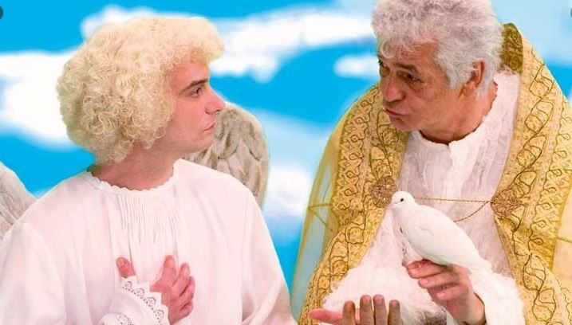
The roots of dualism in the educational theories
Classical / Traditional education
Medieval modification:
the need to reinforce theory with the Christian dimension of education
“We all have one master [...] in heaven” (Augustine of Hippo)

Slide 26
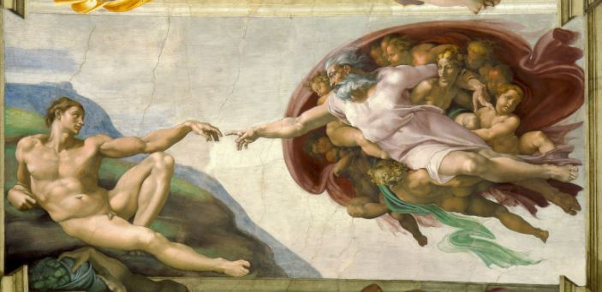
The roots of dualism in the educational theories
Classical / Traditional education
modern modification:
Humanism human nature is a sum of subjective potentials

Slide 27
Conclusion ?
Émile Durkheim:
"Education theory (like all pedagogy, after all) cannot be a purely abstract and generalizing discipline about the
"constants" of educational reality, about the prerequisites of "good" or "effective" education. It has to build on the historical context in which it is placed, to react to it, while bearing in mind that the criterion according to which pedagogy formulates its goals and which needs to be considered at all times, is from the sphere of what is not (but should be), and not from the sphere of what merely is. This criterion has been a universality of European thought for thousands of years.”

Slide 28
References:
Monographs:
DEMJANČUKOVÁ, D., STARK, S. Proměny paradigmatu výchovy. Prague: Epocha, 2017. 373 p. ISBN 978-80-7557-100-7.
HUBÁLEK, T. et al. Vývoj občanského vzdělávání a etické výchovy v českých zemích. First edition. Prague: Epocha, 2017. 104 p. Erudica; Vol. 32. ISBN 978-80-7557-110-6.
LORENZOVÁ, J. Kontexty vzdělávání v postmoderní situaci. 1st ed. Prague: Faculty of Arts, Charles University in Prague, 2016. 335 p. Humanitas; Vol. 9. ISBN 978-80-7308-650-3.
PELCOVÁ, N. Vzorce lidství: filosofické základy pedagogické antropologie. 2nd revised ed., V Portálu 1. Prague: Portál, 2010. 261 p. ISBN 978-80-7367-756-5.
PELCOVÁ, N., SEMRÁDOVÁ, I. Fenomén výchovy a etika učitelského povolání. 1st ed. Prague: Karolinum, 2014. 220 p. ISBN 978-80-246-2636-9.
PINC, Z. Fragmenty k filosofii výchovy: eseje a promluvy z let 1992-1998. 1st ed. Prague: Oikoymenh, 1999. 149 p. Oikúmené. ISBN 80-7298-004-1.
PRŮCHA, Jan, ed. Pedagogická encyklopedie. 1st ed. Prague: Portál, 2009. 935 p. ISBN 978-80-7367-546-2.
ROUSSEAU, J. J., Emil čili o vychování. 1926, Olomouc.
STANĚK, A. Výchovné paradoxy v kontextu didaktiky společenských věd a jejich reflexe učiteli vybraných společenskovědních předmětů na úrovni sekundárního vzdělávání. Habilitation thesis, Faculty of Education, Palacký University, 2012.
STANĚK, A. Výchovné paradoxy v kontextu didaktiky společenských věd. Prague: Epocha, 2018. 178 p. ISBN 978-80-7557-111-3
STROUHAL, M. Teorie výchovy: k vybraným problémům a perspektivám jedné pedagogické disciplíny. Prague: Grada, 2013. 192 p. ISBN 978-80-247-4212-0.
STROUHAL, M., ed. Učit se být učitelem: k vybraným problémům učitelského vzdělávání. Prague: Charles University, Karolinum, 2016. 170 p. ISBN 978-80-246-3465-4
STROUHAL, M., ŠTECH, S. ed. Vzdělání a dnešek: pedagogické, filosofické, historické a sociální perspektivy. Prague: Charles University, Karolinum, 2016. 225 p. ISBN 978-80-246-3558-3.

Slide 29
References:
Electronic Reference Sources:
STROUHAL, M. Teorie výchovy: Pedagogika jako snění o ideálech. Available at: https://clanky.rvp.cz/clanek/k/z/18097/TEORIE-VYCHOVY-PEDAGOGIKA-JAKO-SNENI-O-IDEALECH.html/

