Slide 1
Ethics of Social Relations

Slide 2
Ethics – an attempt at the definition
An emancipated and constituted science, the subject matter of which is the study of socially approved norms of behaviour. It deals with human conduct from both the theoretical and practical aspect.
A philosophical discipline – so-called practical philosophy. It investigates how people should behave, responsibility for one’s actions, and whether behaviour is governed by generally binding rules.
An interdisciplinary science – so-called Philosophical Ethics. It deals with the fundamental nature of the dimensions of our lives which we consider moral. Doubt concerning good and evil, duty and responsibility, what is desirable and what is not.

Slide 3
Ethics – categorization
I) Metaethics - moral language
Fundamental ethics - basic issues
Normative ethics - behaviour evaluation
Descriptive ethics - phenomenon description
Applied ethics - practical application
II) Individual ethics - I (good x evil)
Social ethics - we (justice x injustice)

Slide 4
Introduction – the concept of social ethics
social ethics deals with “social reality" (interactions between people).
it can be a science if social reality meets selected parameters (constancy, regularity). It is not concerned with interactions which are stochastic, short-term, isolated, or too subjective.

Slide 5
Introduction - the concept of social ethics
it studies social institutions: a) the family
b) knowledge
c) economy
d) politics and law
e) culture and religion

Slide 6
Social ethics premises
a person decides about their actions based on rational reasoning (not only impulses, feelings, instinct...)
decision-making is (intentionally and unintentionally) influenced by interaction with other people
decision-making needs to have selected parameters (freedom, responsibility)
people try to typify and classify various life situations they create their own ethical and moral rules to help them make decisions and assess the actions of others

Slide 7
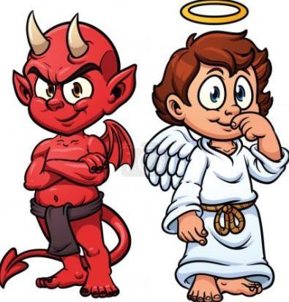
Social ethics premises
when defining and internalizing ethical and moral standards, a person uses specific criteria based on their cognitive skills ("IQ and EQ", experience, relationship to values, relationship to good and evil...)
the idea of the "ideal" is considered in decision-making

Slide 8
Individual ethics
focus on practice, which is primarily related to the individual and their personal responsibility
assumption that we are able to rationally evaluate the motives behind our behaviour or justify our behaviour

Slide 9
Social ethics
critical reflection on social structures, institutions, interactions
responsibility for social facts cannot be attributed to an individual within social ethics

Slide 10
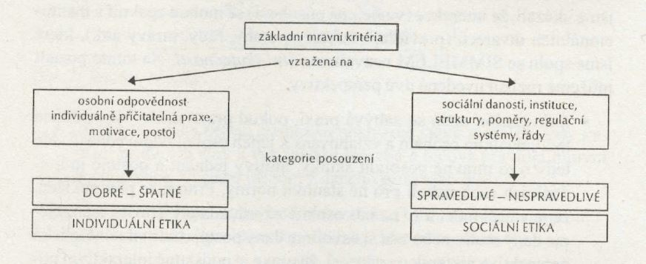
Social ethics x Individual ethics
Source: Anzenbacher, A.: Křesťanská sociální etika. p. 12.

Slide 11
Social ethics and the clash between individualism and universalism
Individualism - human beings prioritize their own interests
- an individual is "above" the society’s interests
freedom is viewed as a capacity to promote one’s interests
- the opposite is collectivism, which claims the contrary - society is superior to the interests of the individual

Slide 12
Social ethics and the clash between individualism and universalism
Universalism - a concept focused on the whole, society
the validity of norms, values, patterns of behaviour etc. is generalized
the importance of singularity is challenged (preference for generalization)

Slide 13
Possible consequences of individualism and universalism
Individualism may foster two extreme aspects:
A) egoism = an individual considers themselves the goal of their own action
B) altruism = the individual seeks the object of action in other persons

Slide 14
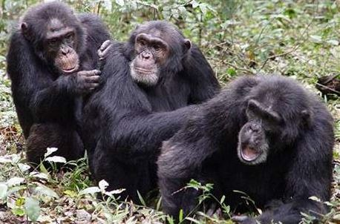

Slide 15
Possible consequences of individualism and universalism
Universalism may stimulate the following extreme aspects:
- the object of ethical behaviour is always a "higher whole” (family, nation, humanity)
- it can be divided into many types, based on associations (political, social, environmental...), which may be contradictory

Slide 16
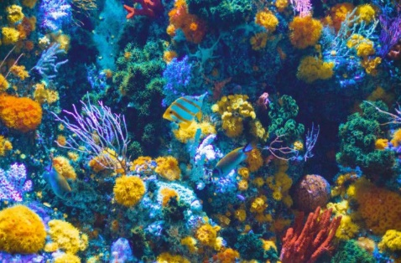
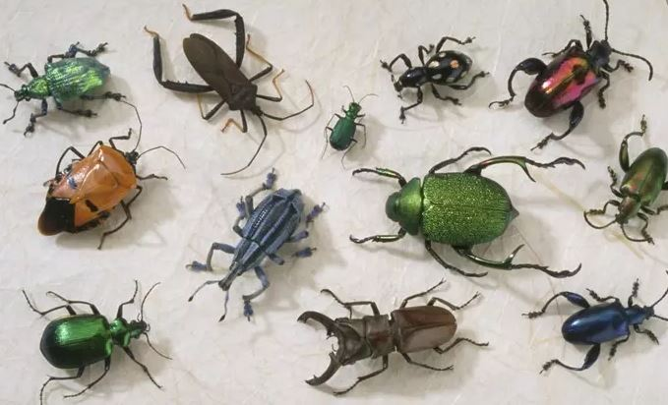
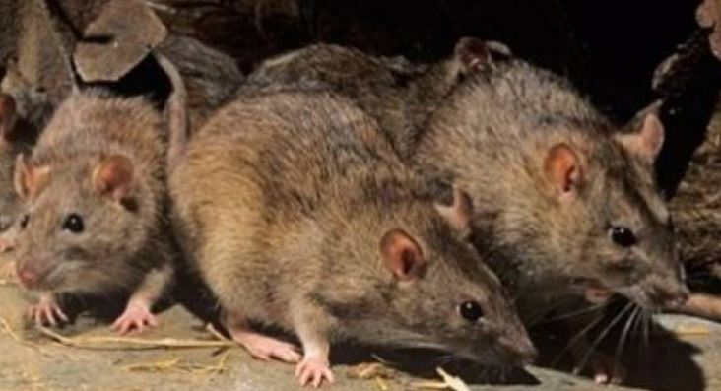
B
A
D
C
E
G
F
H
I

Slide 17
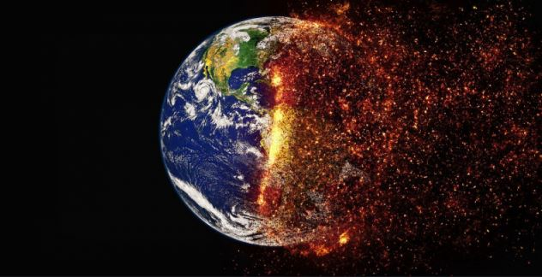
Reductionist fallacies
Social ethics reduced to individual ethics
the importance of social reality is challenged
failure to understand the quality of social reality
behaviour is viewed as a sum of individual interactions

Slide 18
Reductionist fallacies
2) Individual ethics reduced to social ethics
the role of individual responsibility for behaviour is challenged
practice is a reflection of social reality (without considering the degree of individual responsibility for creating social reality)
the individual does not act on their own behalf but as a "product" of society

Slide 19
Axiology
the study of values
it analyzes the place and nature of values in society and in the value structure
it examines their formation, functioning, and transformation
it aims to define the essence of the values

Slide 20
Value significance triad
Values have no meaning on their own.
They become important based on how they affect one’s life.
A person needs to be aware of the significance of the values.

Slide 21
Value awareness
3) A person needs to be aware of the significance of the values
- possible if a person appreciates the values of truth, social cohesion, and responsibility
- otherwise, one’s value system could be upset (a shift to "non" important values, recklessness, selfishness...)

Slide 22
The concept of values
Value = a property of an object, phenomenon, idea, relationship or behaviour, consisting in the satisfaction of one of the needs of a person.
A value may be perceived as a:
a) specific quality (=property) of something
b) one’s relationship to something or someone
c) universal standard of conduct

Slide 23
The sequence of perception of the world and recognition of values
ATTRIBUTE IMPORTANCE INTERPRETATION
VALUE INTEREST ATTITUDE
BEHAVIOR

Slide 24
Value-related myths
Ideas equating values with "things"
The concept of values as a special reality
True values are spiritual values

Slide 25
Value principles
They demonstrate the direction of one’s values
They serve as "practical principles" in relation to behaviour, in the form of value stereotypes (for example decency pays off).

Slide 26
Values and emotions
EMOTIONS
expression of the state of a person and their relationship to something or someone
a response to an outside stimulus
associated with physiological changes (pleasant and unpleasant feelings)
categorized into affects, moods and passions (joy, trust, surprise, fear, rage...)
related to more permanent feelings (these are biologically purposeful, stronger, and less controllable, compared to cognitive processes)

Slide 27
Values and emotions
values are often influenced by our emotions
Is this a good thing?

Slide 28
Basic ethical categories (not only in relation to social ethics)
Good x Evil
Freedom
Responsibility
Conscience
Justice

Slide 29
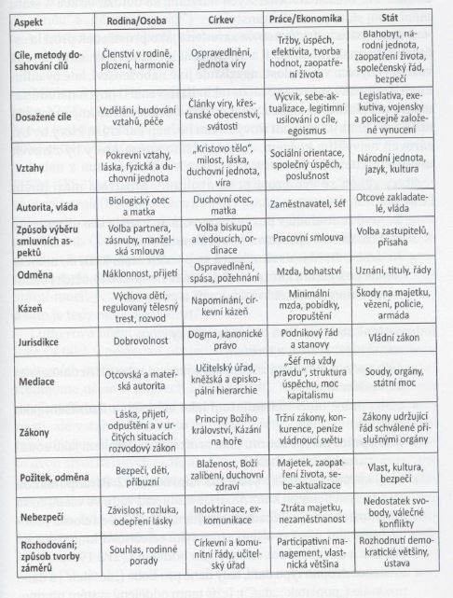
Value relativity
Source: Schirrmacher, T.: Morální odpovědnost. p. 77.

Slide 30
Negative forms of individual and social ethics and morality
Moral nihilism – indifference
Moral void – helplessness
Moral stagnation – environmental effects
Vulgarization
Selfishness
Absence of any decorum
Absence of respect and self-respect

Slide 31
Virtues determining moral integrity
Self-respect and dignity
Respect for others
Good and happiness
Sense of fairness
Love (eros, philia, agape)

Slide 32
References:
ANZENBACHER, A. Úvod do etiky. 3rd ed. Prague: Academia, 2001. 292 p. ISBN 80-200-0953-1. Anzenbacher, A. Křesťanská sociální etika: úvod a principy. 2nd edition. Brno: CDK, Centrum pro studium demokracie a kultury, 2015. 271 p. ISBN 978-80-7325-371-4. BRÁZDA, R. Ethicum. 1st ed. Zlín: VeRBuM, 2010. 188 p. ISBN 978-80-904273-9-6 HUBER, W., Etika. Základní otázky života. Prague: Vyšehrad, 2016. 256 p. ISBN 978-80-7429-642-0. SCHIRRMACHER, T. Morální odpovědnost. Prague: Návrat domů, 2016. 131 p. ISBN 978-80-7255-353-2. STÖRIG, H. J. Malé dějiny filosofie. 8th ed., Kostelní Vydří: Karmelitánské nakladatelství, 2007. 653 p. ISBN 978-80-7195-206-0. VOLF, J. Filozofie 1. Ebook. Hradec Králové: Lukáš Vik, 2018. 205 p. ISBN 999-00-017-8201-6
WEISCHEDEL, W. Skeptická etika. 1st ed. Prague: Oikoymenh, 1999. 165 p. Oikúmené. ISBN 80-86005-84-4.

